Slide 1

HEALTH CARE
CHARGES
What is associated with the bill, and how we would price the next customer
Presented By :
Aaron Powell
Thuan-Andy Bui

Slide 2

The big picture
Smoking dominates the bill; prediction and explanation are different jobs
Explain with the equation.
Price with the random forest.
3.8×
$22.8k
Average bill: smokers vs non-smokers
$32,050 vs $8,441
Adjusted smoker gap at BMI 30
$4,624
$4,366
Random-forest repeated-check miss
Random-forest held-out miss
The regression gives readable dollar effects. The forest bends with the observed charge pattern and is the better scorer.

Slide 3
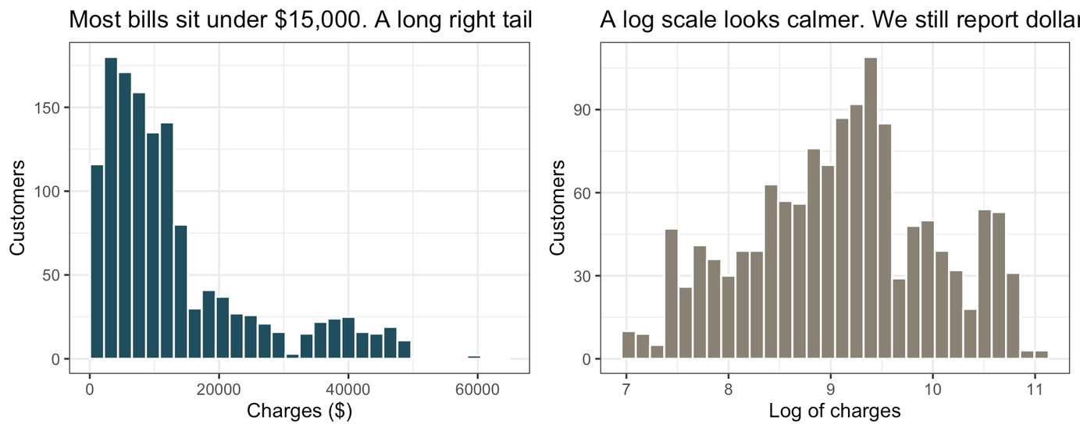
Data Analysis
  Data is not a random sample of the country
  This not a causal effect of smoking, weight, or region, and is not a guarantee for one future person
  Charges range from $1,122 to $63,770.
1,337
20.5%
distinct customers
smokers in the file
$13,279
$9,386
average bill
median bill

Slide 4
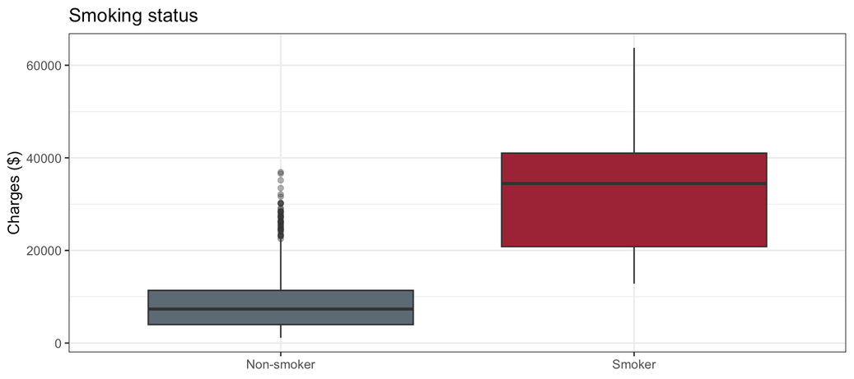
$32,050
average smoker bill
$8,441
average non-smoker bill
Median bills
$34,456 smoker
$7,346 non-smoker
Smoking Stats
Smoker VS Non-Smoker
3.8× average bill

Slide 5
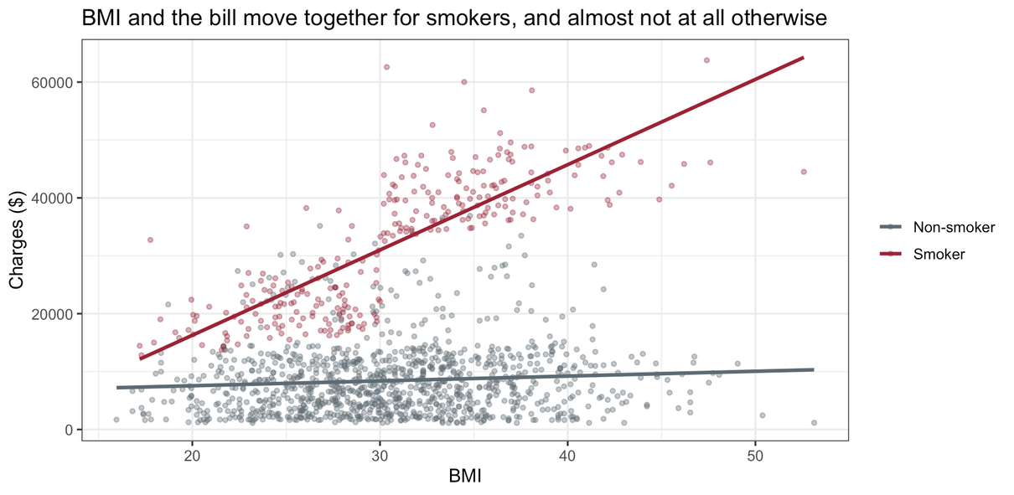
BMI vs Smoking
ADJUSTED INTERPRETATION
+$1,461
per BMI point among smokers
Smoker gap
BMI 25 → $15,643
BMI 30 → $22,833
BMI 35 → $30,024
+$23
per BMI point among non-smokers
(range includes zero)

Slide 6
The Equation
Quote the smoker effect at an observed BMI. The smoker coefficient alone is the gap at BMI 0, which is not practical.
charges = β₀ + β₁(age) + β₂(children) + β₃(BMI) + β₄(smoker) + β₅(BMI × smoker) + region + ε
Age
Children
Region
Sex
+$264 per year
~2.0% of the average bill
+$512 per additional child
SE −$1,207; SW −$1,228
vs Northeast
Not clearly associated after adjustment
(p = 0.062)
0.839
$4,853
Important
Quote the smoker effect at an observed BMI. The smoker coefficient alone is the gap at BMI 0, which is not practical.
Adjusted R²
Residual standard deviation

Slide 7
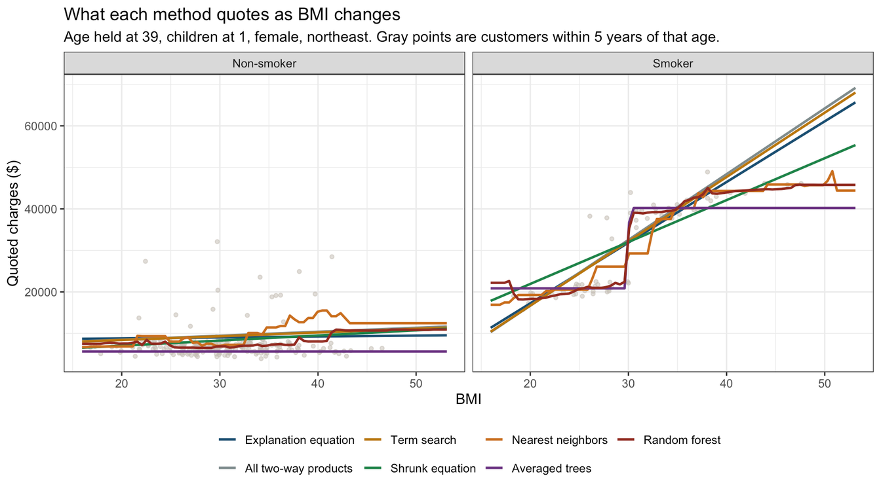
Pricing the next customer
Explaining an average difference and pricing one new customer are different jobs
The forest bends with the smoker cloud instead of forcing one straight line.
At high BMI, straight-line smoker predictions keep climbing while the observed smoker cloud levels off.

Slide 8
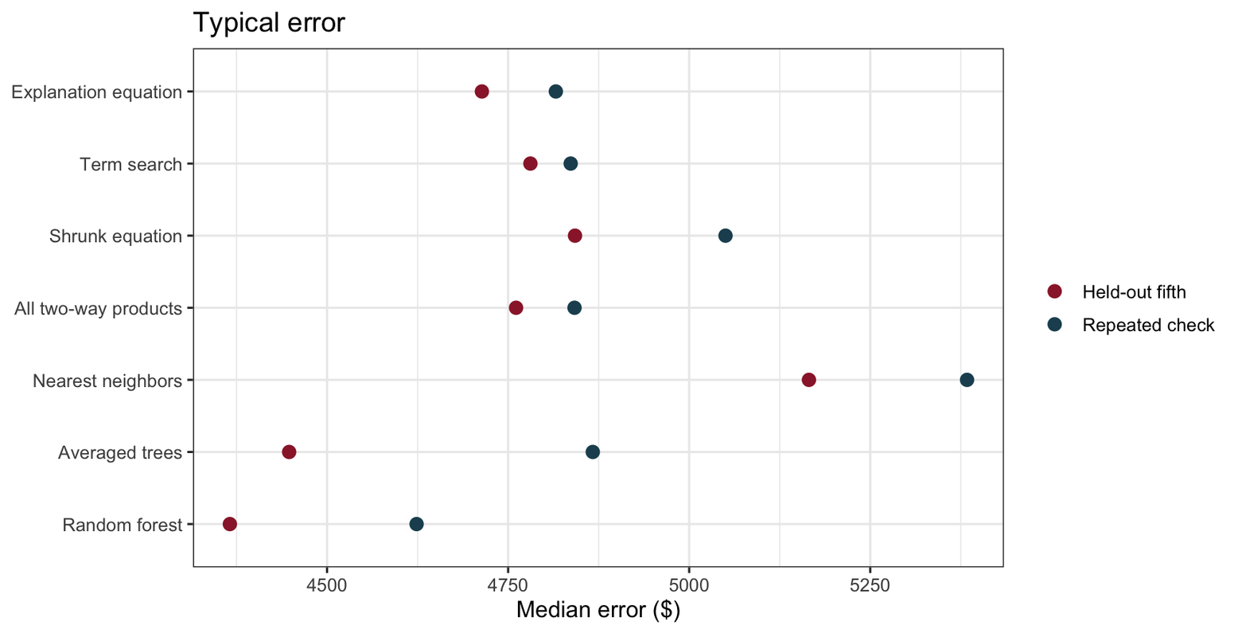
Random Forest Ranks as most Optimal
Lower is better. The repeated 10-fold check is the primary comparison when one 80/20 split moves.

Slide 9
What we would use
PRODUCTION PRICING
Use one model to score; keep the other to explain.
Random forest
PRODUCTION PRICING
• Lowest error on both validation checks
• Follows the observed smoker shape at high BMI
• Does not require one common residual spread
Short regression equation
EXPLANATION
• Readable dollar effects for age, children, BMI × smoking, and region
• Paired resampling gives ranges for the effects we quote
• Better for the “why did the bill move?” conversation
$4,624 repeated • $4,366 held-out
Adjusted R² = 0.839
Both models still struggle with high-charge non-smokers. Flexibility does not replace missing information.

Slide 10
Scope:
What the file can and cannot support
WHAT WE CANNOT SAY
• No causal effect: smoking, BMI, and region were not assigned.
• No national rate: this is not a random sample of the country.
• Independence is assumed, not verified.
WHAT WE CAN SAY
• Smoking, BMI, age, children, and region are associated with charges in these customers.
• The smoker gap depends strongly on BMI.
• The forest is the best scorer among the methods compared here.

Slide 11
Scope:
What the file can and cannot support
WHAT WE WOULD COLLECT NEXT
Diagnosis / pre-existing conditions
Plan design and deductible
Why it matters
Hospital / provider context
The forest’s repeated check edge is only about $192. A future cohort should confirm that edge before production.
Time horizon / year identifier
A later book of customers
Why it matters

Slide 12
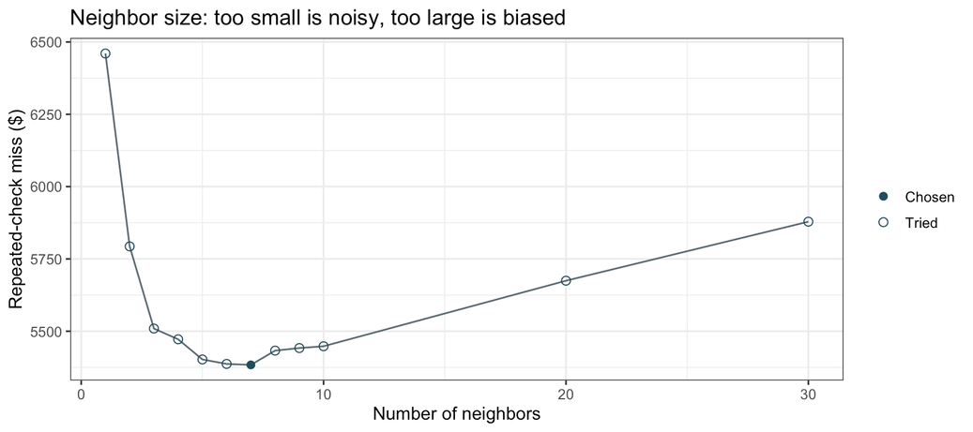
Appendix
Modeling choices
Smoker residual SD ≈ $5,717
Non-smoker residual SD ≈ $4,588
ALTERNATIVE MODELS
RESIDUAL SPREAD
Stepwise / term search
Penalized regression
Residual variance is not constant. Paired resampling was used for coefficient uncertainty because it keeps each customer’s predictors and outcome together.
15 terms; repeated-check miss $4,836. AIC improved, new-customer error did not.
14 of 33 terms kept; repeated-check miss $5,050.
k-nearest neighbors
Best neighborhood k = 7; repeated-check miss $5,384.
TRANSFORMATION CHECK
Log charges reduced skew, but the common age slope failed badly (< 0.001). The dollar scale was retained for interpretation and prediction.
Why it matters

