Slide 1

Locating the Source of Oscillation With Two-Tier Dynamic Mode Decomposition Integrating Early-Stage Energy
Presented by –Pratik Bheda(2022EEB1205),Nishant(2022EEB1194),Rohit Agarwal(2022EEB1209)

Slide 2
Objective of our paper
To Locate the Source of Oscillation With Two-Tier Dynamic Mode Decomposition

Slide 3
Dynamic Mode Decomposition (DMD)
Dynamic Mode Decomposition (DMD) is a powerful data-driven technique used for analyzing complex dynamical systems.
It helps extract spatio-temporal coherent structures (modes) from high-dimensional time-series data, making it a popular tool in fluid dynamics, control systems, power systems, and many other engineering applications.
Given sequential snapshots of data collected over time, DMD decomposes this dataset into a set of modes, each associated with a specific growth/decay rate and oscillation frequency.
This allows us to predict future system behavior, identify dominant patterns, and locate the source of instabilities or oscillations.

Slide 4
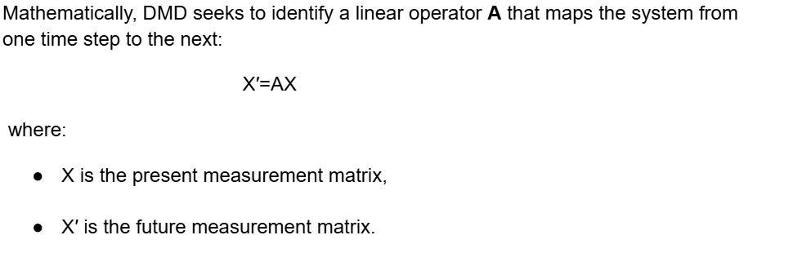

Slide 5
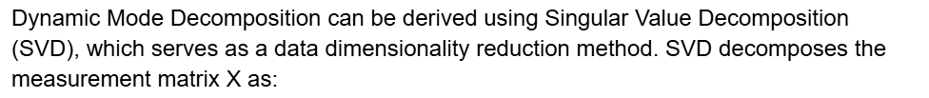
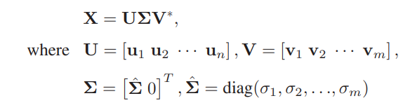
DMD through Singular Value Decomposition (SVD)
U and V are unitary matrices containing the left and right singular vectors,
Σ is a diagonal matrix with singular values,* denotes the conjugate transpose.

Slide 6
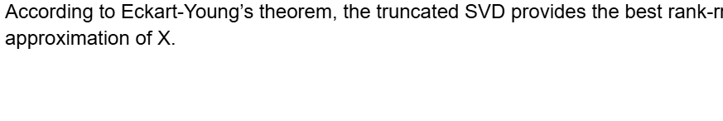



Truncated SVD: Further reduces dimensionality by keeping only the most significant r modes.

Slide 7





Computing the DMD Operator
If we let the eigenvalues and eigenvectors of as Λ and W, i.e., W = WΛ
Here,
Λ contains the DMD eigenvalues (growth/decay rates and oscillation frequencies) and
denotes spatio-temporal coherency and denotes the temporal distribution of the mode amplitudes.

Slide 8

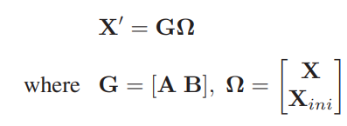
Improved Dynamic Mode Decomposition (DMD)
Inspired by DMD with control (DMDc), which separates external control impacts from inherent system dynamics by incorporating control input
The improved DMD introduces the initial measurement state Xini as an input. This enhancement allows the model to focus solely on the oscillatory dynamics while decoupling the stationary base state.

Slide 9

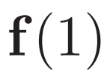

For any discrete time k, the system evolves as:
Here, f(k) represents the oscillation dynamics evolving over time. At k=1, the relationship becomes:
Substituting back, we get the modified state relationship:

Slide 10


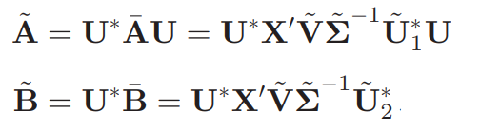
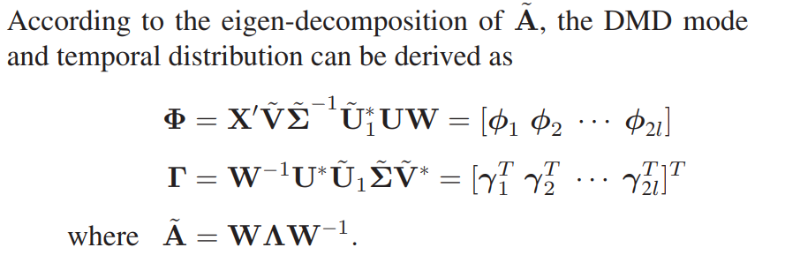
SVD-Based Decomposition
Apply Singular Value Decomposition (SVD) to the input matrix:
The least-squares solution for G is computed as:
The final approximations of the system dynamics matrices are:

Slide 11
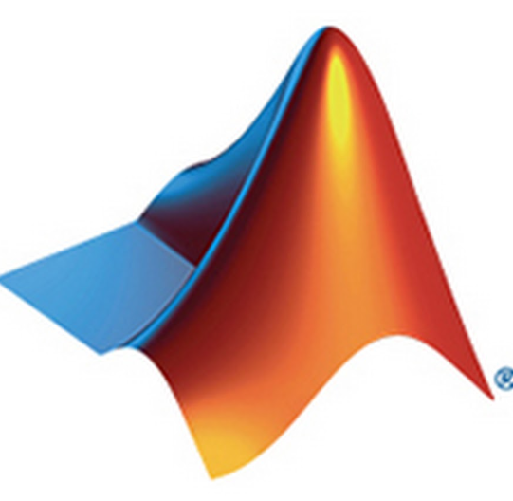
Implementation
Oscillation location is simulated on MATLAB R2024a environment, implemented on a computer system with Intel Core i7-10700 2.90 GHz CPU and 32 GB RAM.
The proposed algorithm is applied on the simulation data in WECC 179 and 240 bus systems.
Also, on a real case in ISO-NE validate the effectiveness of the proposed method.

Slide 12
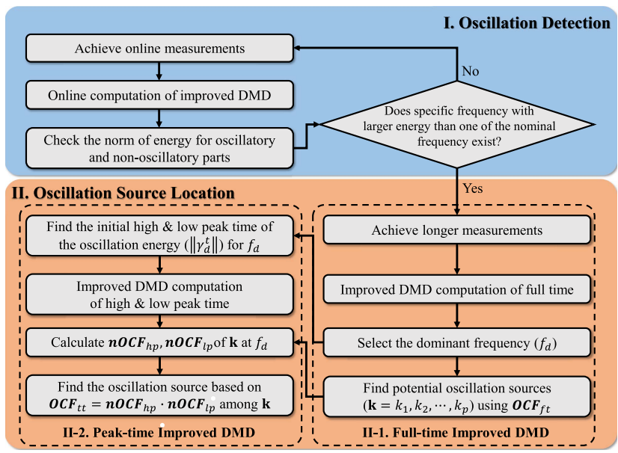
Proposed oscillation source location framework

Slide 13
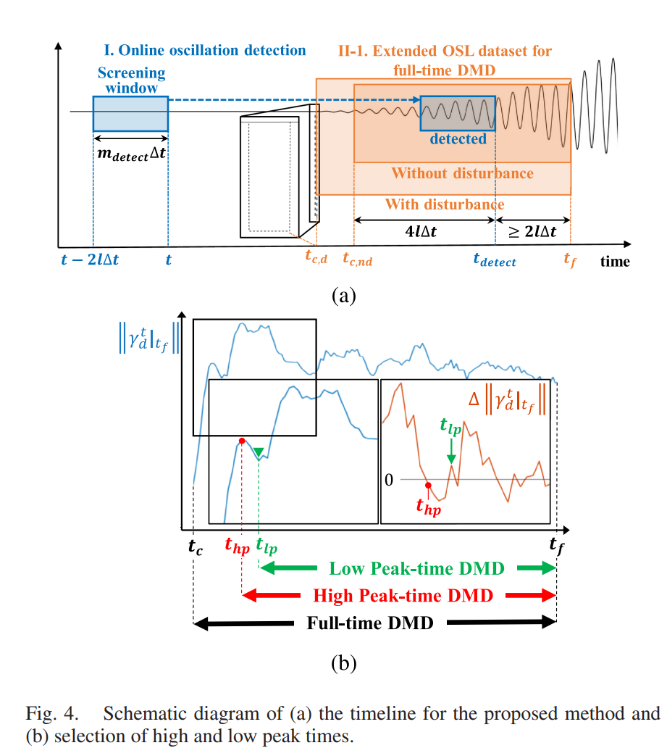

Slide 14
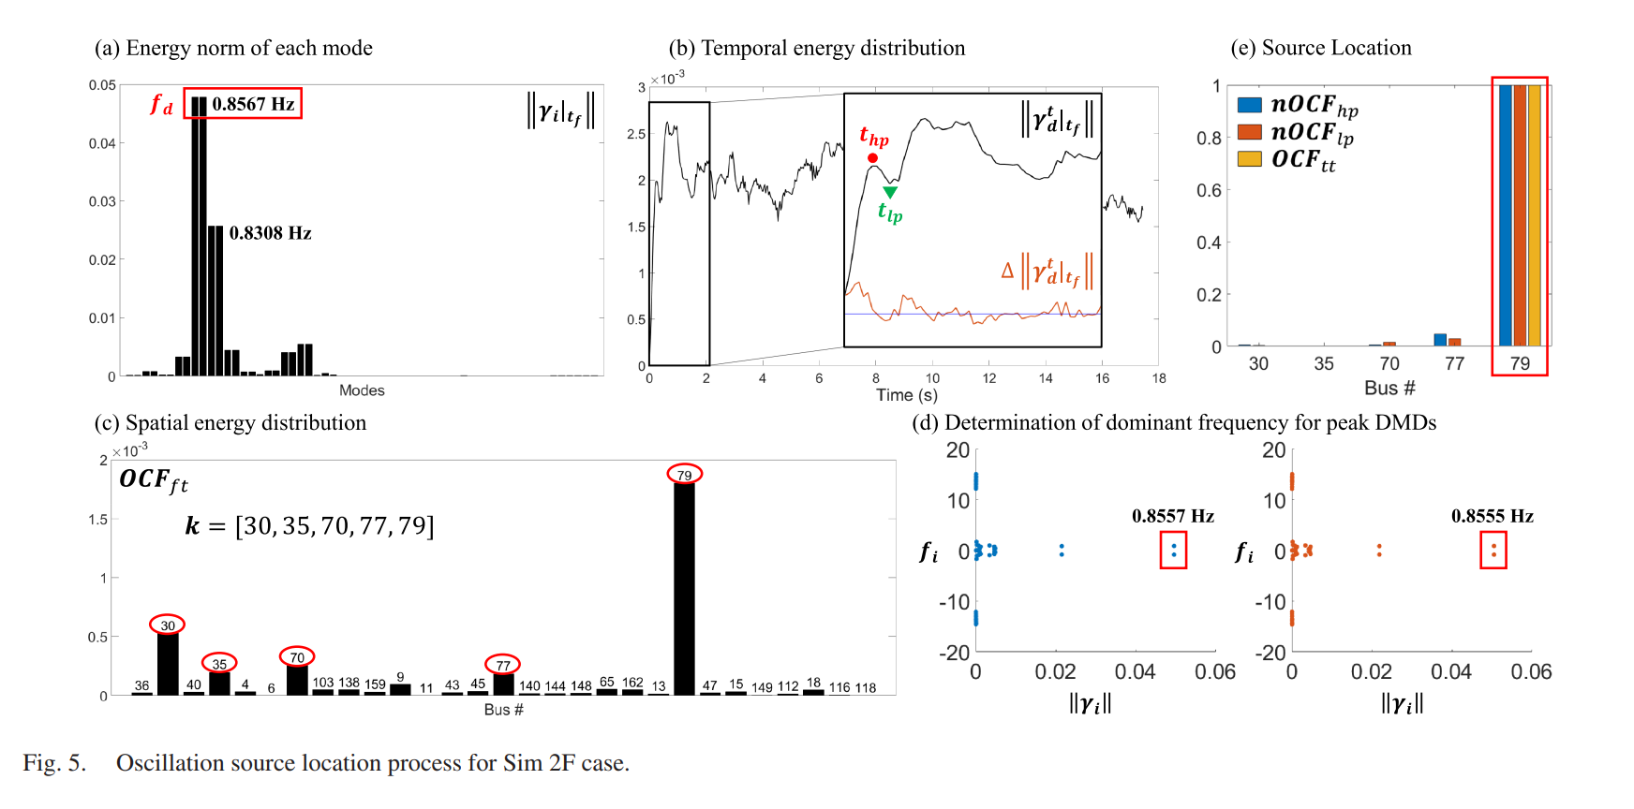

Example

Slide 15
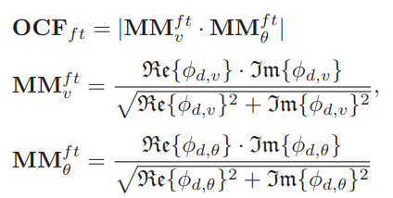


Computation of full time Oscillation Contribution factor(OCF)
Where the subscript ft means the full-time, and the mode magnitudes are separated into and

Slide 16
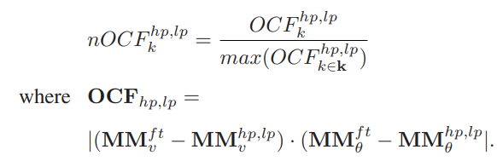

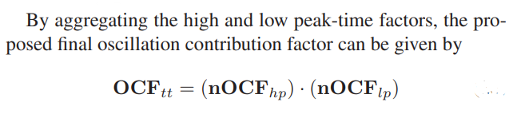
Normalisation
The bus with the largest ${OCF}_{tt}$ is considered the oscillation source of the dominant frequency.

Slide 17
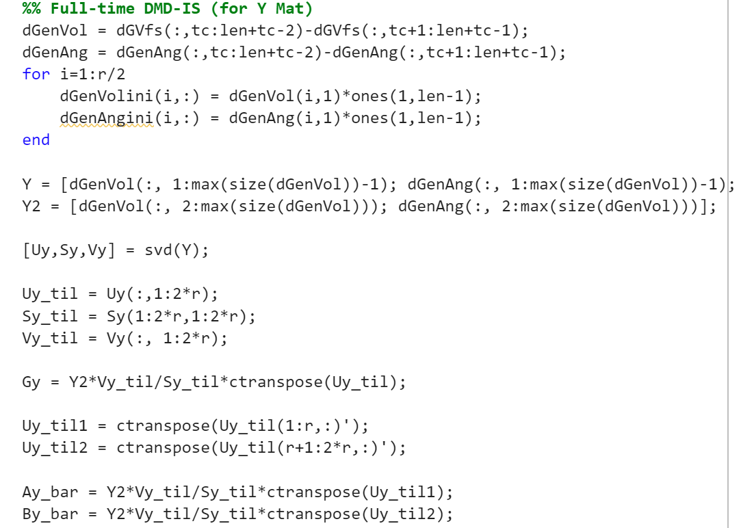
Code to compute the DMD parameters

Slide 18
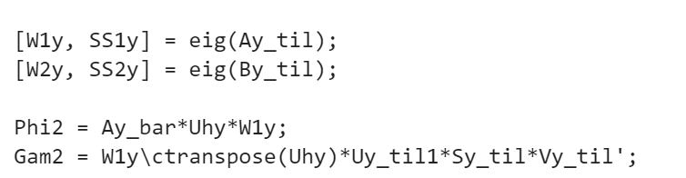
MATLAB Function to get Eigen value and Eigen vector

Slide 19
Conclusion
An improved DMD-based approach to locate the oscillation source beyond the conventional usage of DMD to identify the oscillation modes.
Motivated by the structural limitation of the original DMD in locating the forced oscillations with unusual patterns, we have reformulated the DMD with control (DMDc) by replacing the control input with the initial state of the measurements.
The two-tier structure and corresponding normalized contribution factor help to enhance the accuracy and robustness by analyzing the spatial distribution of the energy in the initial stage of the oscillation.

