Slide 1
Getting Started with the Fabric User APIs
Ted Pattison
Principal Program Manager
Fabric CAT Team

Slide 2
Agenda
Fabric User API Fundamentals
Understanding Authentication and Authorization
Creating Workspaces and Configuring Access
Creating Semantic Models and Reports
Creating Lakehouses and Notebooks
OneLake Interop with the ADLS Gen2 APIs

Slide 3

Fabric User API Design and Architecture
Fabric User API used to create and manage workspaces and workspace items
Fabric User API designed to be accessible to any developer on any development platform
Built using principles of REST and open security standards (OAuth2 and Open ID Connect)
Fabric User API designed to allow caller to be either a [user] or a [service principal]*
Public cloud endpoint accessible through base URL of https://api.fabric.microsoft.com/v1
Caller must first acquire access token for Fabric User API from Azure AD
Caller must transmit access token in all API calls using Authorization header
CAVEAT – There is no .NET SDK for the Fabric REST APIs yet – that will come sometime in 2024
Your Application
Fabric User APIs
access token
JSON Result
HTTP Response: 200 OK

Slide 4
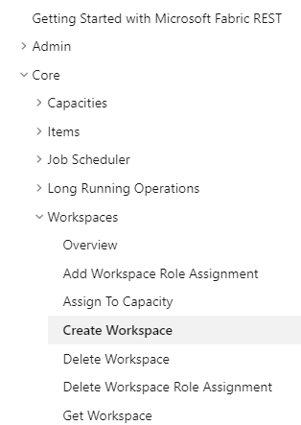
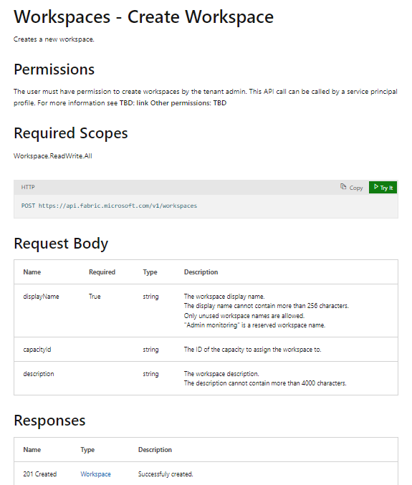
RTFM! = Read The Fabric Documentation
Fabric REST APIs documentation available online is essential developer resource
https://learn.microsoft.com/rest/api/fabric

Slide 5





Developing Multi-tenant Applications in Fabric
Multi-tenant application is responsible for creating and managing customer tenants
Customer tenant created using one or more Fabric workspaces
Developer uses Fabric User APIs to create and configure workspace items
Workspace items include lakehouses, notebooks, semantic models and reports
Fabric Multi-tenant Environment
Azure AD Tenant Owned by ISV
Customer 01 Tenant Workspace
Customer 01
17 users
lakehouse
notebook
model
report
Custom ISV Application
Customer 02 Tenant Workspace
lakehouse
notebook
model
report
Customer 02
85 users
Customer N Tenant
lakehouse
notebook
model
report
Customer N
450 users

Slide 6
Understanding the Abstraction of a Workspace Item
Fabric introduces unified Item abstraction for creatable workspace item types
Item types are categorized by Fabric Workload/Experience
Item type Dataset has been renamed to SemanticModel
Developers use unified Create Item API together with item definition to create Fabric item
Fabric Item Types by Fabric Workload/Experience
Power BI
Data Engineering
Data Science
Data Warehouse
Real-time Analytics
SemanticModel
Lakehouse
MLExperiment
Warehouse
KQLDatabase
Report
Notebook
MLModel
MirroredWarehouse
KQLDataConnection
PaginatedReport
SparkJobDefinition
DataPipeline
KQLQueryset
Environment
Eventstream

Slide 7
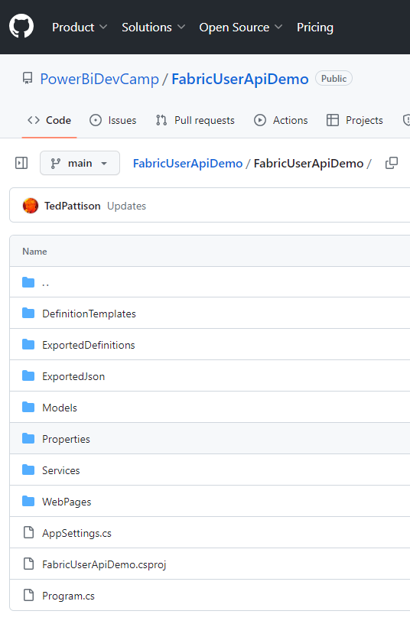
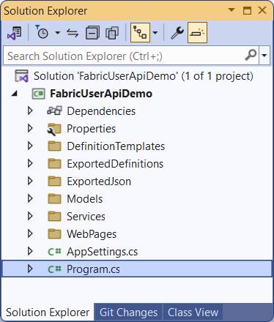
Download Fabric User API Demo Project from GitHub
GitHub repository at https://github.com/PowerBiDevCamp/FabricUserApiDemo
Download FabricUserApiDemo project source code from GitHub to local PC for testing
Open FabricUserApiDemo.csproj using any edition of Visual Studio 2022 with latest updates applied

Slide 8
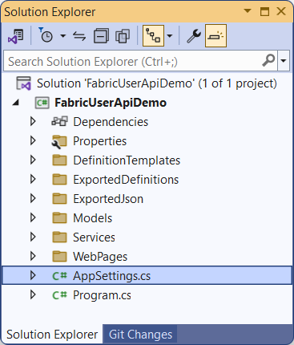
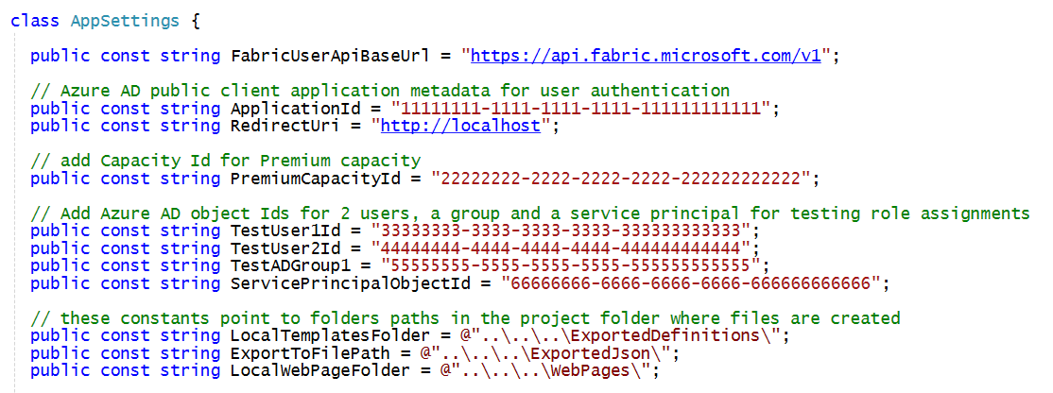
Fabric User API Demo Project
FabricUserApiDemo is developer sample which demonstrates calling Fabric User APIs
Created as simple console application created using C# and .NET 7
Can be opened and run using any version of Visual Studio 2022
You must update configuration data in AppSettings.cs before running project in Visual Studio debugger

Slide 9
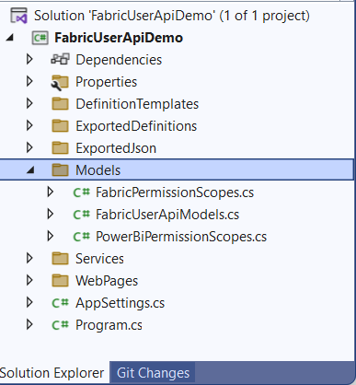
Important C# Classes in Models Folder
FabricUserApiModels.cs - serialization classes to convert between JSON and .NET objects
FabricPermissionScopes - delegated permission scopes for Fabric User API
PowerBiPermissionScopes - delegated permissions for Power BI REST API

Slide 10
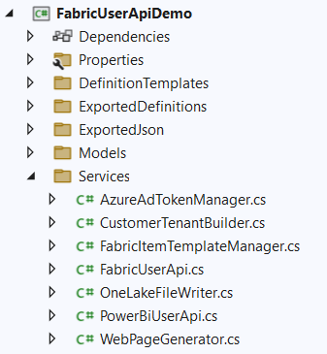
Important C# Classes in Services Folder
AzureAdTokenManager - used to acquire access tokens from Azure AD
FabricUserApi - used to execute HTTP requests to Fabric User API
FabricItemTemplateManager - used to assembly item definitions for Create Item API
CustomerTenantBuilder - contains high-level logic and execution flow for provisioning customer tenants
OneLakeFileWriter- used to write files to OneLake using ADLS Gen2 APIs
PowerBiUserAPi - used to execute HTTP requests to Power BI REST API
WebPageGenerator - used to generate HTML pages to demonstrate Power BI embedding

Slide 11
Agenda
Fabric User API Fundamentals
Understanding Authentication and Authorization
Creating Workspaces and Configuring Access
Creating Semantic Models and Reports
Creating Lakehouses and Notebooks
OneLake Interop with the ADLS Gen2 APIs

Slide 12
Acquiring Access Tokens using MSAL
Leverage Microsoft Authorization Libraries (MSAL)
Used for authentication and access token acquisition
MSAL libraries provide developer productivity while supporting security best practices
MSAL libraries provide support for caching access tokens and refresh tokens behind the scenes
More info at https://learn.microsoft.com/en-us/entra/identity-platform/msal-overview
MSAL libraries on other platforms
MSAL.NET
MSAL for Android
MSAL Angular
MSAL for iOS and macOS
MSAL Java
MSAL.js
MSAL Node
MSAL Python
MSAL React
MSAL libraries provide support for…
Web applications
Web APIs
Single-page apps (JavaScript)
Mobile and native applications
Daemons and server-side applications

Slide 13
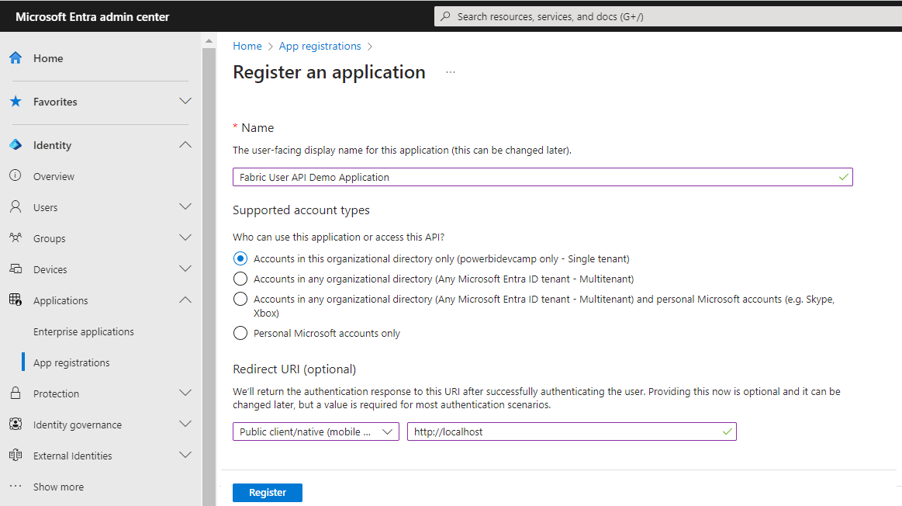
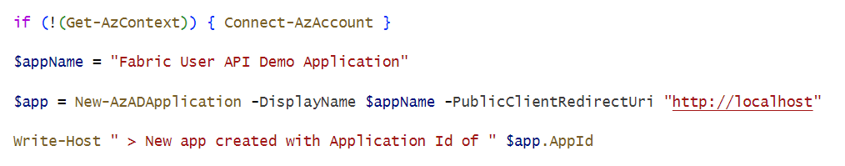
Creating New Entra Id Application
You need Entra ID application
Microsoft recently renamed Azure Active Directory to Microsoft Entra ID
Creating new application in the Entra ID portal at https://entra.microsoft.com/
Creating new Entra ID application using PowerShell

Slide 14
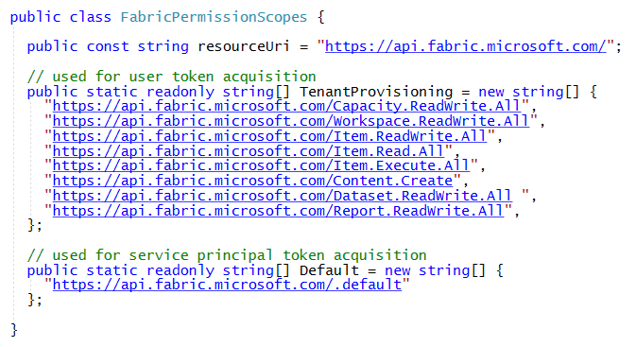
Authentication and Access Token Acquisition
Authenticating as user requires adding delegated permission scopes to access token
Required permission scopes should be passed in request to acquire access token from Azure AD
Delegated permission scopes for Fabric APIs have resource URI of https://api.fabric.microsoft.com/
Delegated permission scopes managed in FabricPermissionScopes class
Service Principal do not require delegated permission scopes
CAVEAT: There is not full support for service principal access in initial public preview release

Slide 15
Generic Item Scopes versus Specific Item Scopes
Generic permission scopes used to grant permissions to Fabric items of all types
Item.Read.All
Item.ReadWrite.All
Item.Execute.All
Item.Reshare.All
Specific permission scopes used to grant permissions to specific types of Fabric items
Lakehouse.ReadWrite.All
Notebook.ReadWrite.All
Notebook.Execute.All
SemanticModel.ReadWrite.All
SemanticModel.Reshare.All
Report.ReadWrite.All

Slide 16
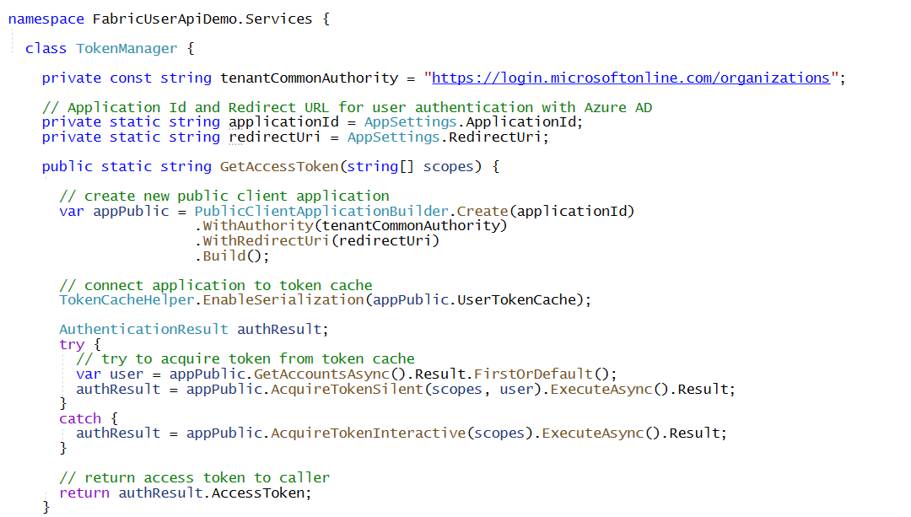
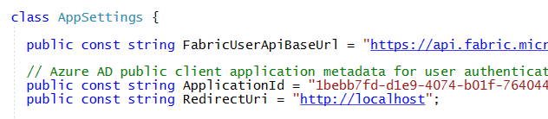
Acquiring Access Token for User using MSAL.NET
AzureAdTokenManager class provides code to authenticate user
Uses MSAL.NET (Microsoft.Identity.Client) to implement Azure AD authentication flow
Desktop and console applications can use redirect URI of http://localhost
Demo app leverages MSAL.NET support for caching access tokens and refresh tokens
Requires creating Azure AD application as public client with redirect URI of http://localhost
GetAccessToken first attempts to get token from cache before prompting user for login

Slide 17
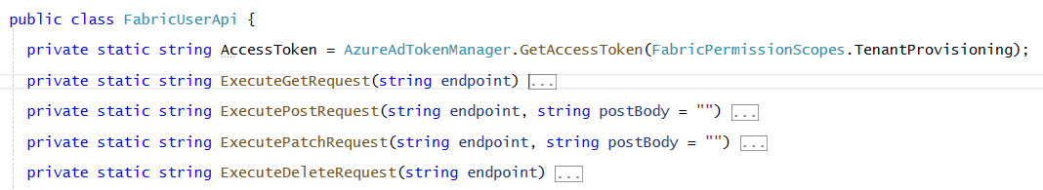
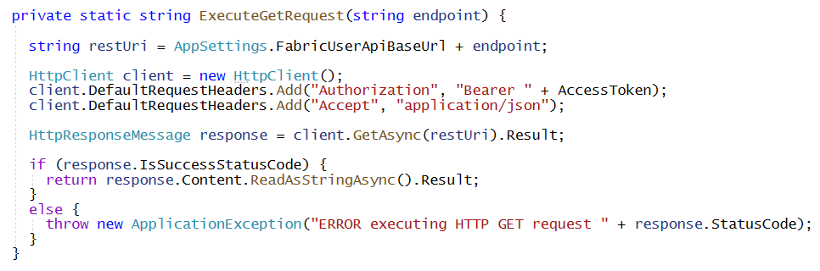
Transmitting Access Token in Fabric User API Calls
FabricUserApi class acquires access token at startup
No need to login interactively if application can retrieve access token or refresh token from cache
Methods which execute HTTP requests using HttpClient must add access token
Here's an example of ExecuteGetRequest adding Authorization header with access token

Slide 18
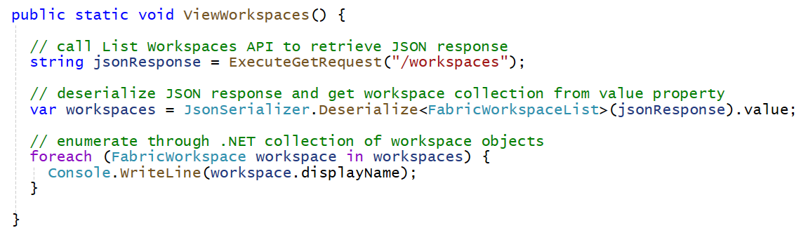
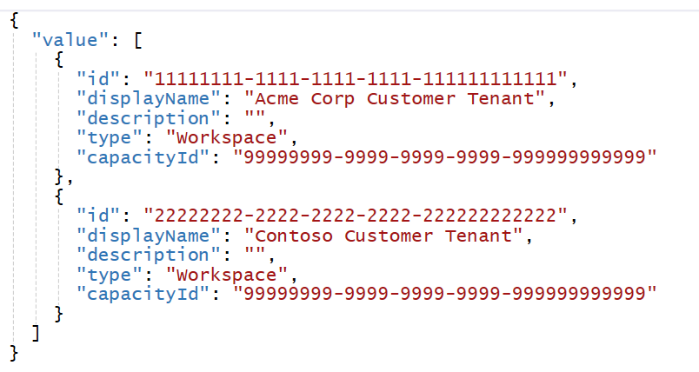
Executing Fabric API Calls with ExecuteGetRequest
Call ExecuteGetRequest by passing relative base URL to endpoint
This examples calls List Workspaces API by passing /workspaces in call to ExecuteGetRequest
Calls to ExecuteGetRequest will automatically transmit access token in Authorization header
Fabric API returns response to GET request with JSON in response body
Your Application
Fabric User APIs
access token
JSON in Response Body
200 OK

Slide 19
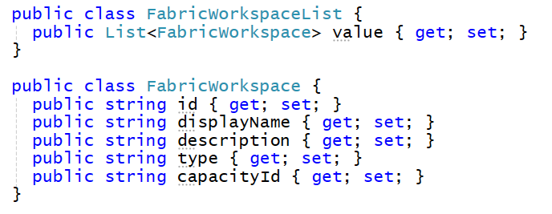
Deserializing JSON from the HTTP Response
C# serialization classes are used to convert between JSON and .NET object
Example serialization classes used to deserialize response from List Workspaces API
Use JsonSerializer and Fabric serialization classes to deserialize JSON from response body
Creating .NET classes that map to structured JSON

Slide 20
Agenda
Fabric User API Fundamentals
Understanding Authentication and Authorization
Creating Workspaces and Configuring Access
Creating Semantic Models and Reports
Creating Lakehouses and Notebooks
OneLake Interop with the ADLS Gen2 APIs

Slide 21
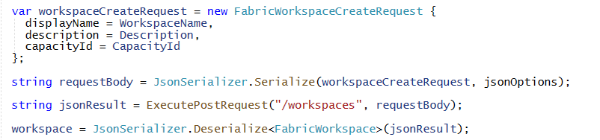


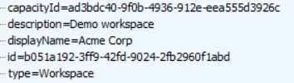
Create Workspace
Workspace created using POST operation with JSON body payload
Use JsonSerializer and Fabric serialization class to prepare JSON for request body
Successful call returns 201 CREATED and JSON response body contains Id of new workspace
Your Application
HTTP Request
Fabric User APIs
POST https://api.fabric.microsoft.com/v1/workspaces
HTTP Response
201 CREATED

Slide 22
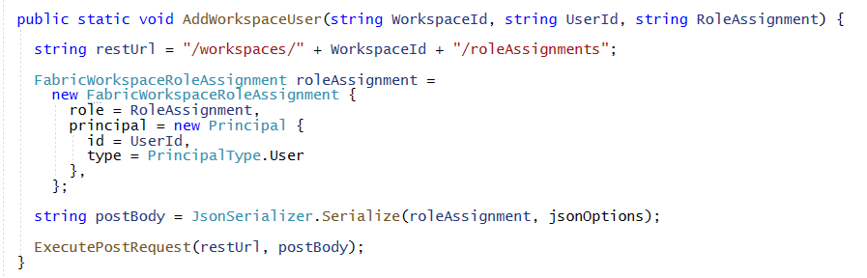

Add Workspace Role Assignment for User
Workspace role assignment added using POST operation with JSON body payload
User must be added using object Id of Azure AD user account (adding user by email not allowed)
Successful assignment of workspace role returns 200 OK
Your Application
HTTP Request
Fabric User APIs
POST https://api.fabric.microsoft.com/v1/workspaces/{WORKSPACE_ID}/roleAssignments
HTTP Response
200 OK

Slide 23
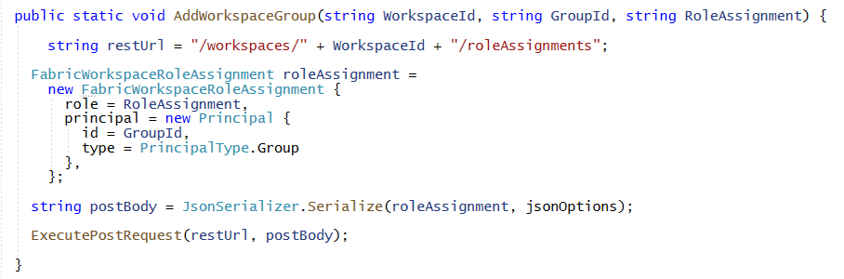

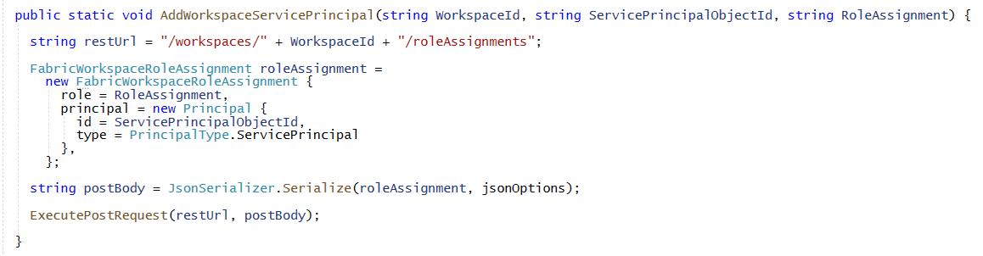

Assigning Roles to Azure AD Groups and Service Principals
Assigning workspace role to Azure AD group using object Id
Assigning workspace role to service principal using object Id
JSON in request body
JSON in request body

Slide 24
Agenda
Fabric User API Fundamentals
Understanding Authentication and Authorization
Creating Workspaces and Configuring Access
Creating Semantic Models and Reports
Creating Lakehouses and Notebooks
OneLake Interop with the ADLS Gen2 APIs

Slide 25
Getting Away from Deployment and ALM using PBIX Files
Managing definitions for datasets and reports in Power BI has been difficult
Common to package dataset and report definitions in PBIX files created with Power BI Desktop
To developers, PBIX file is a black box that provides no ability to read or write what's inside
Developer uses Imports API to publish PBIX files which creates datasets and reports
ALM and CI/CD become problematic when managing datasets and reports using PBIX files
Fabric User API introduces much better way to create items and to manage ALM
Provides developer with full control when creating, reading or updating item definitions
Fabric User API allows developers to move past limitations of working with PBIX files
New APIs include Create Item, Get Item Definition and Update Item Definition

Slide 26
Understanding the Abstraction of a Workspace Item
Fabric platform introduces unified Item abstraction for workspace artifact types
Item types are categorized by Fabric Workload
Item type Dataset has been renamed to SemanticModel
Developers use unified Create Item API together with item definition to create Fabric item
Fabric Item Types by Fabric Workload/Experience
Power BI
Data Engineering
Data Science
Data Warehouse
Real-time Analytics
SemanticModel
Lakehouse
MLExperiment
Warehouse
KQLDatabase
Report
Notebook
MLModel
MirroredWarehouse
KQLDataConnection
PaginatedReport
SparkJobDefinition
DataPipeline
KQLQueryset
Environment
Eventstream

Slide 27
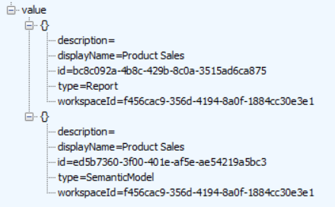
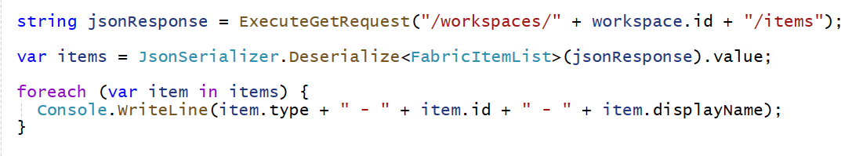
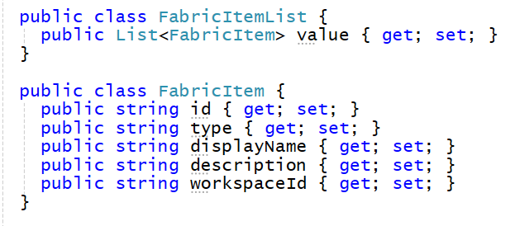
Discover Items in Workspace using List Items API
List Items API returns items for a specific workspace
Construct List Items API URL using target workspace Id and /items
List Workspace Items API supports type query string parameter to filer on item type
Your Application
Fabric User APIs
GET https://api.fabric.microsoft.com/v1/workspaces/{WORKSPACE_ID}/items
200 OK

Slide 28
Programming with Fabric Item Definitions
Fabric items are created and updated using item definitions
You need to create and pass item definition when calling Create Item API
You can retrieve item definition for existing Fabric item by calling Get Item Definition
Modifying existing item Fabric by calling Update Item Definition and pass item definition
Your Application
Fabric User APIs
Item
Definition
POST - Create Item
Item
Definition
GET - Get Item Definition
Item
Definition
POST - Update Item Definition

Slide 29
Fabric Item Definition Structure
To call Create Item API, you must pass displayName, type and definition
Item definition includes array of parts where each part is item-specific file
Content for parts converted to/from inline base64 format when transmitted across network
Each type of item requires unique set of parts when calling Create Item API
Creating semantic model definition requires parts for definition.pbidataset and model.bim
Create report definition requires parts for definition.pbir, report.json and optionally a theme file
displayName:
Product Sales
displayName:
Sales by Product
type:
SemanticModel
type:
Report
definition:
definition:
parts: {
}
parts: {
}
definition.pbidataset
definition.pbir
model.bim
report.json
report-theme.json

Slide 30
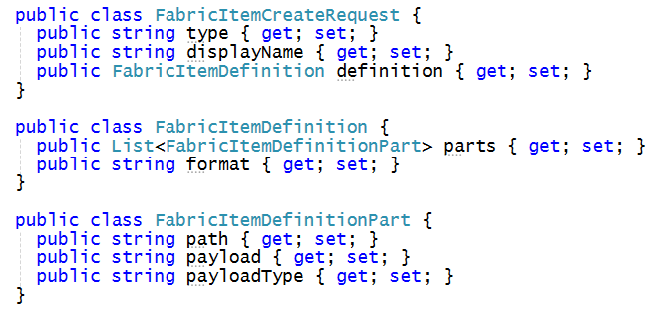
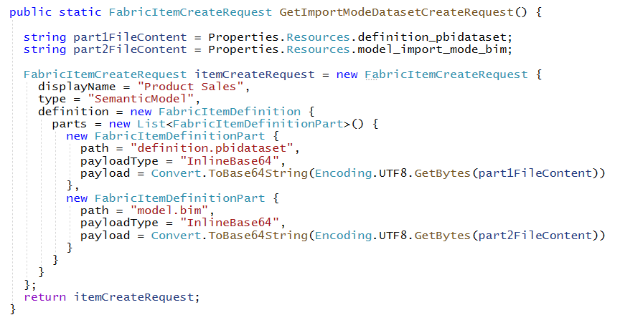
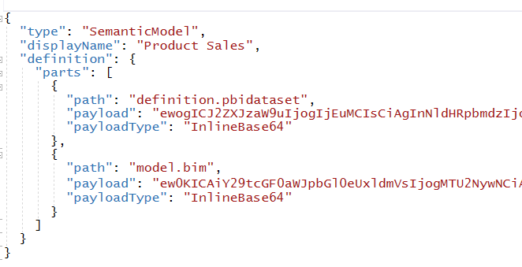
Assembling Item Definitions for Calls to CreateItem API
FabricUserApiModels.cs contains FabricItemCreateRequest serialization class
Use FabricItemCreateRequest to assemble item definition for create request

Slide 31
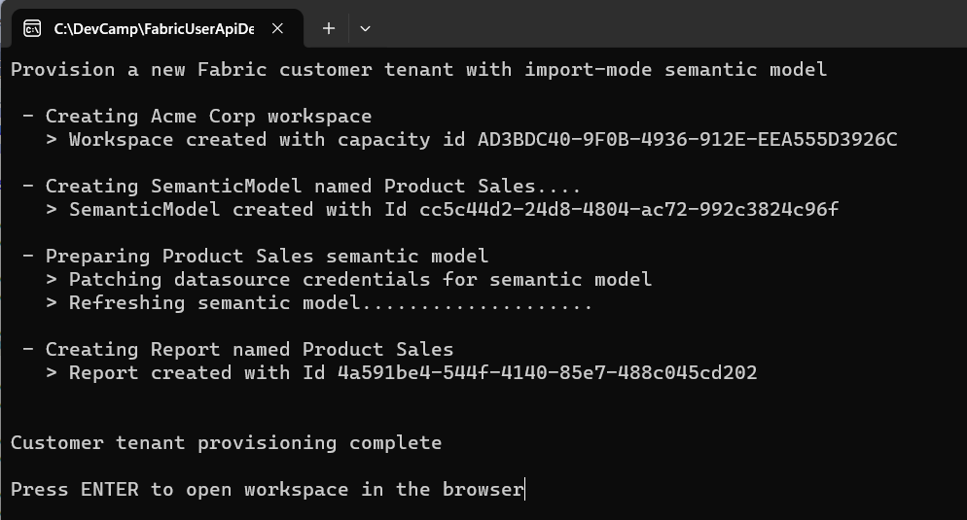
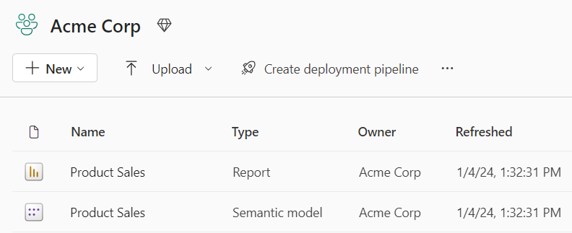
Customer Tenant Provisioning Example #1
Flow to create import-mode semantic model and report
Create workspace and assign workspace members
Create import-mode semantic model (aka dataset) using CreateItem API
Set semantic model credentials and run refresh operation using Power BI REST API
Create new report which is bound to import-mode semantic model using CreateItem API

Slide 32
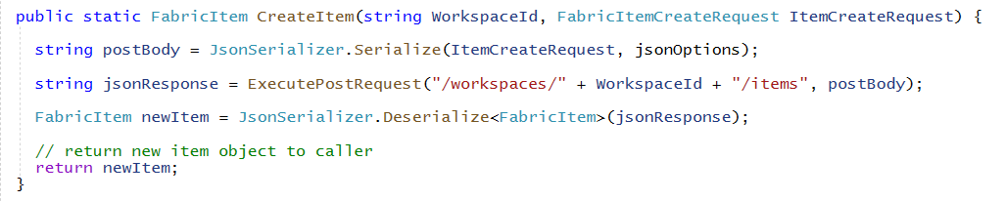
Creating Semantic Model using CreateItem
Call FabricUserApi.CreateItem passing FabricItemCreateRequest instance
CreateItem calls ExecutePostRequest to send request across network to Fabric User API
CreateItem might return either 201 Created or 202 Accepted on successful call
CreateItem returns 201 Created when it successfully created the item in a synchronous operation
CreateItem returns 202 Accepted when it successfully starts async operation to create the item
ExecutePostRequest must be implemented to handle both 201 response and 202 responses

Slide 33
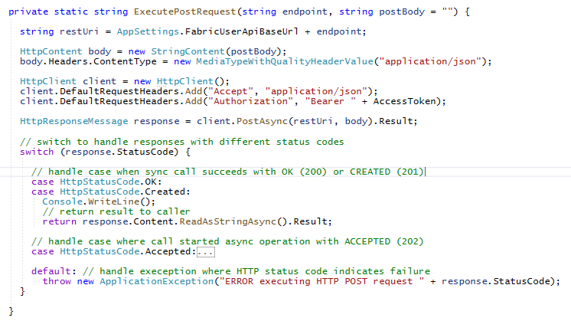
Long Running Operations – Part 1
Calls to CreateItem might return 201 Created or 202 Accepted
Calls that return 201 Created are synchronous
Calls that return 202 Accepted are asynchronous and considered to be long running operations
synchronous operation
long-running operation

Slide 34
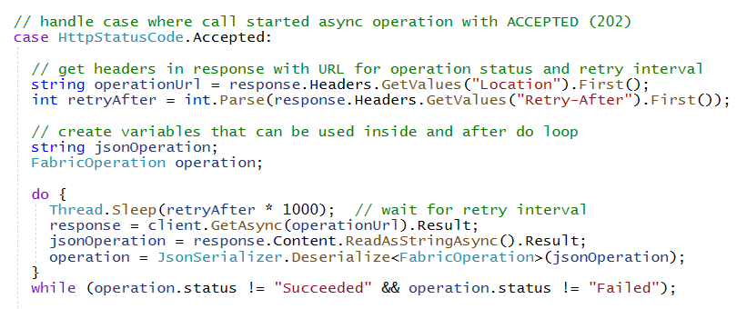
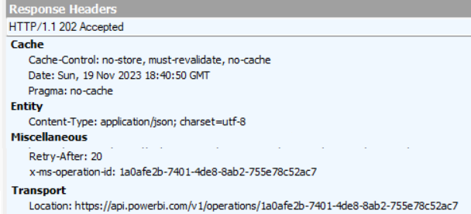
Long Running Operations – Part 2
Asynchronous calls which return 202 Accepted include two important response headers
Location response header provides URL to call Get Operation State API to get operation status
Retry-After response header returns number of seconds to wait before calling Get Operation State
Fabric User API enforces throttling to prevent caller from checking operation status too frequently
Calling too frequently for specific time window results in status code of 429 Too Many Requests
Developer should poll until response operation.status equals either Succeeded or Failed

Slide 35
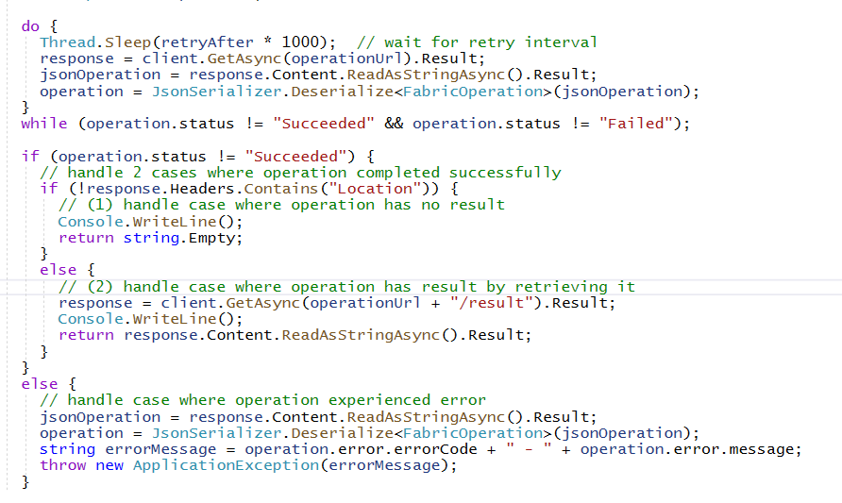
Long Running Operations – Part 3
In calls to Get Operation Status which return operation.status == "Succeeded"
If response does not include Location header, that means there is no result to return to caller
If response includes Location header, then you should call Get Operation Result to fetch result
Add /result to end of URL in Location header to call Get Operation Result
Location header absent
Location header exists
Call to Get Operation Result

Slide 36
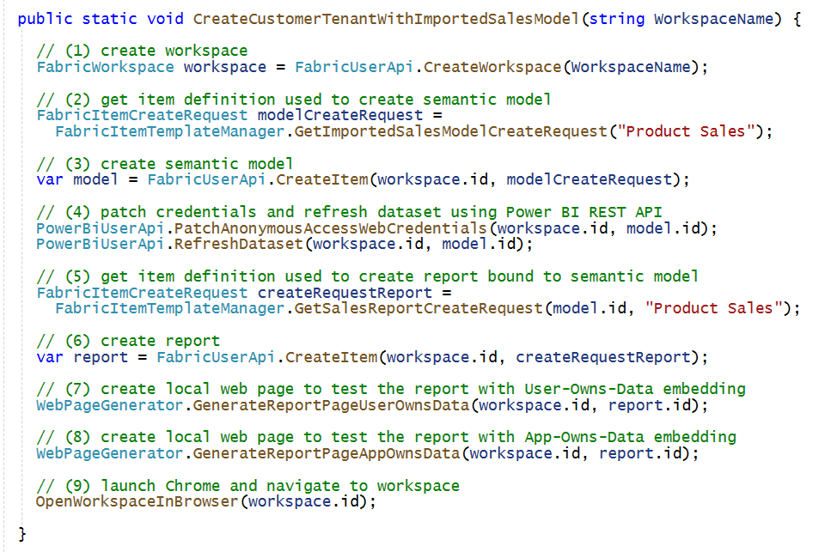
Provisioning Flow to Bind Report to Semantic Model
When you create a new report, you need to bind it to a target semantic model
When you create a new semantic model, you need to capture item Id returned from Create Item
When creating the item definition for the report, you use item Id for semantic model for binding

Slide 37
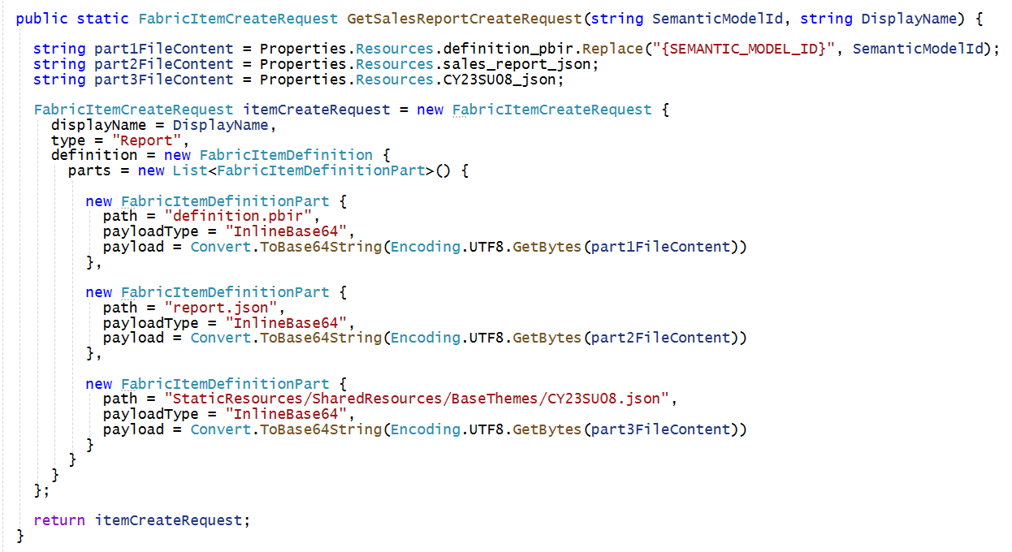
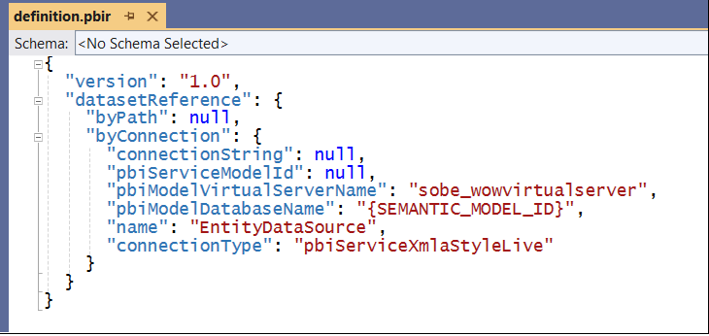
Creating Report using CreateItem API
Creating Report involves definition with the following parts
definition.pbir - this contains Id of target semantic model
report.json – this contains report layout definition for pages and visuals
custom-theme.json (optional) – a Power BI Desktop report theme

Slide 38
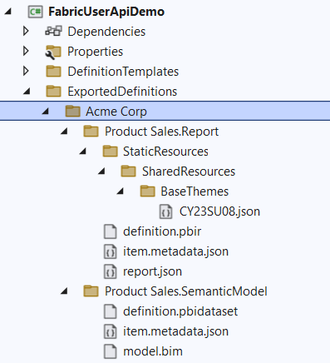
Exporting Existing Items using Get Item Definition
Get Item Definition API allows you retrieve item definition for existing items
Call Get Items to discover set of item Ids in workspace then call Get Item Definition once for each item Id
Make it possible to create a folder on local file system with set of files for each item definition part
Exported items definitions used to reverse engineering item definition parts needed for calling Create Item
Your Application
Fabric User APIs
Item Definition
for Report
GET - Get Item Definition
Item Definition
for Semantic Model
GET - Get Item Definition

Slide 39
Agenda
Fabric User API Fundamentals
Understanding Authentication and Authorization
Creating Workspaces and Configuring Access
Creating Semantic Models and Reports
Creating Lakehouses and Notebooks
OneLake Interop with the ADLS Gen2 APIs

Slide 40


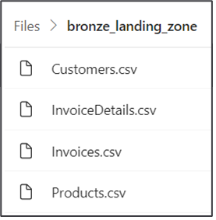
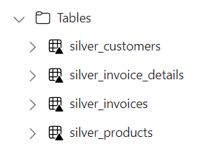
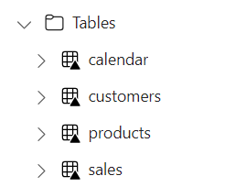

Using Spark Jobs to Create Lakehouse Tables
You can leverage Fabric support for Spark to create and populate lakehouse tables
Create lakehouse (or multiple lakehouses for greater isolation)
Create Spark Environment as workspace item for running Spark jobs
Create Notebook (or Spark Job Definition) containing ETL logic ingest data files and create tables
Execute code in notebook by running it as on-demand Spark job
Customer Tenant Workspace
Environment
Lakehouse
bronze layer
silver layer
gold layer
Custom ISV Application
notebook
Spark job
Spark job
Spark job

Slide 41
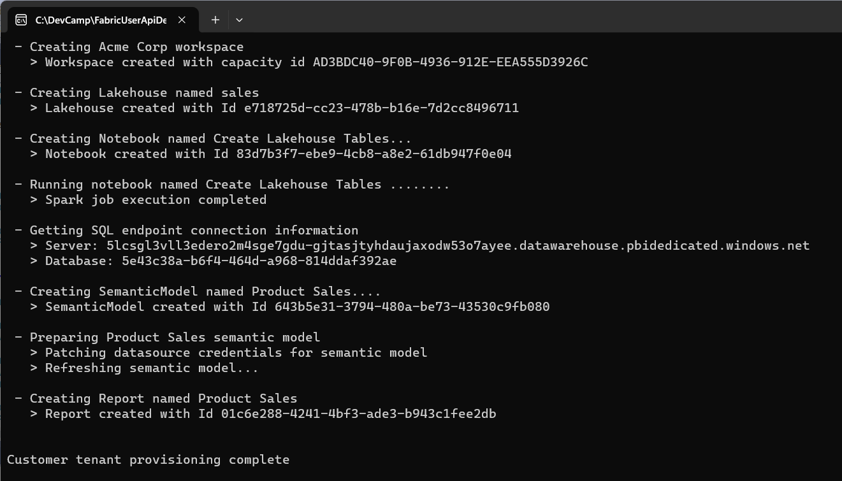
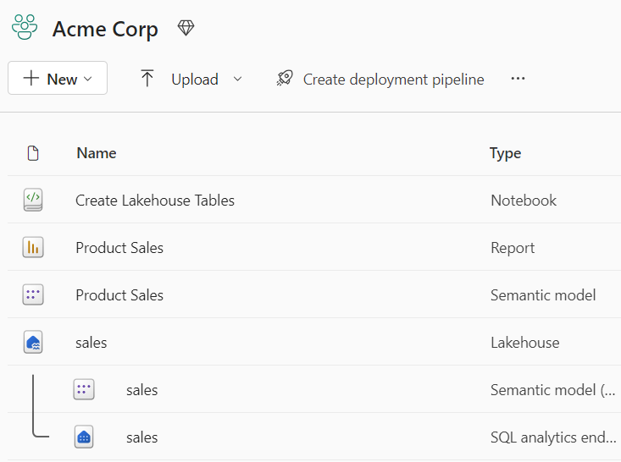
Customer Tenant Provisioning Example #2
Flow to create lakehouse tables, DirectLake semantic model and report
Create workspace and assign workspace members
Create lakehouse and then use lakehouse ID to create notebook which is bound to lakehouse
Run notebook with python code to ingest data from CSV files and generate lakehouse tables
Create DirectLake semantic model connected to lakehouse SQL endpoint
Set semantic model credentials and run refresh operation using Power BI REST API
Create new report which is bound to import-mode semantic model using CreateItem API

Slide 42
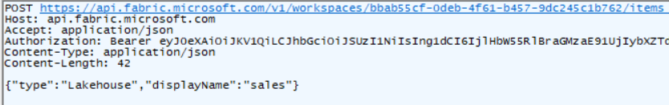
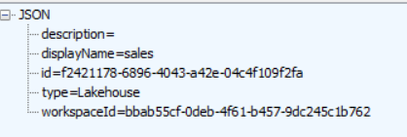
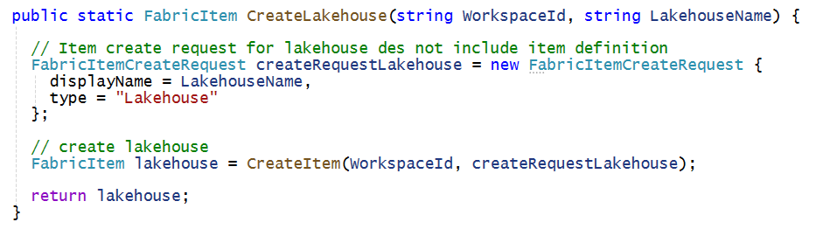
Creating Lakehouse using Create Item
Lakehouse created without item definition – you only pass displayName and type
Response from Create Item includes lakehouse id which is require to create notebooks
Code used in developer sample application to create lakehouse

Slide 43
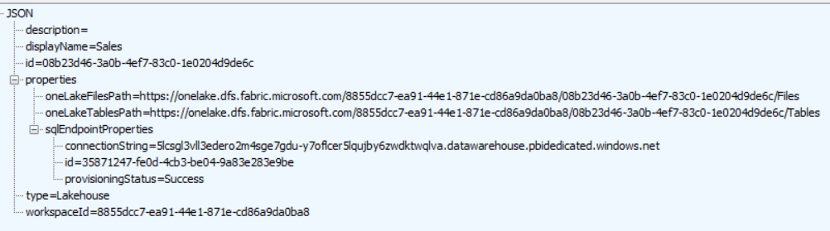
Lakehouse Properties
Retrieve lakehouse properties by executing GET request through /lakehouses endpoint
GET request with target URL of /workspaces/{WORKSPACE_ID}/lakehouses/{LAKEHOUSE_ID}
JSON response provides sqlEndpointProperties data required to create semantic model
Response also contains OneLake path properties used to access lakehouse storage
These paths can be used together with ADLS Gen2 APIs to read and write files to and from lakehouse
oneLakeFilesPath property contains path to unmanaged Files section of lakehouse file system
oneLakeTablesPath property contains path to managed Table section of lakehouse file system

Slide 44
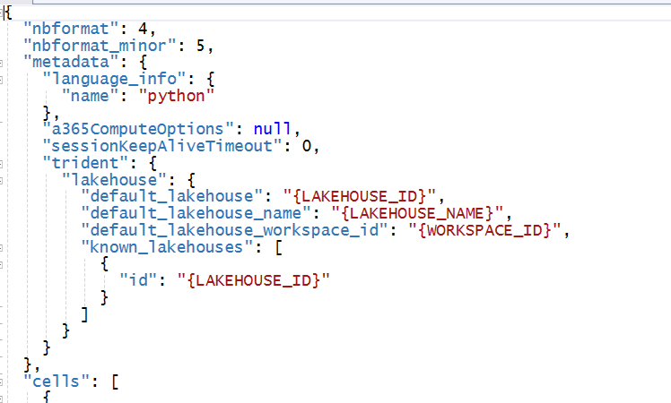

Create Item Definition Part for Notebook
Notebook item template is .ipynb file containing placeholders
Placeholders used to substitute Ids for workspace and lakehouse
This is technique used to bind new notebook to existing lakehouse
Notebook Part Template with Placeholders
Notebook Part Instance passed to Create Item API

Slide 45


Binding Notebook to Lakehouse
Notebook item template contains placeholders
When creating item definition with for notebook set item definition format to ipynb

Slide 46

Running Notebooks using the Job Scheduler API
Fabric User API provides Job Scheduler
Call Run On Demand Item Job API passing jobType query string parameter with value of RunNotebook
/workspaces/{WORKSPACE_ID}/items/{NOTEBOOK_ID}/jobs/instances?jobType=RunNotebook
Job Scheduler is async API similar to long-running operations (LRO)
Successful call returns 202 Accepted and response header values for Location and Retry-After
You can use ExecutePostRequest to poll and wait for RunNotebook job to complete

Slide 47


Starting On-demand Spark Job to Run Notebook
Use POST command to Job Scheduler - Run On Demand Item Job API
/workspaces/{WORKSPACE_ID}/items/{NOTEBOOK_ID}/jobs/instances?jobType=RunNotebook
Response returns Location and Retry-After headers similar to long running operation
Checking on a job status by executing GET request on URL in Location header response
Allows you to see if job has completed or still in progress
Currently uses InProgress and Completed
Should be updated to Running and Succeeded instead for consistency with long running ops

Slide 48
Exposing Data to Consumers through the SQL Endpoint
Data in lakehouse tables accessible through SQL endpoint
SQL endpoint automatically created when you add tables to lakehouse
SQL endpoint of Lakehouse provides read-only access for executing queries
SQL endpoint provides data access to wide range of SQL-based applications
ISV AAD Tenant
Customer Tenant Workspace
SQL-based
Reporting Tools
Lakehouse
SQL Endpoint
SQL-based
Export Utilities
Ad Hoc
SQL Query Tools

Slide 49

Creating Semantic Models on Lakehouse Tables
Creating semantic model on lakehouse tables uses DirectLake mode
Creating model allow you to define relationships, measures, hierarchies, etc.
Model created by passing model.bim to Create Item API
Customer Tenant Workspace
Lakehouse
Semantic Model (aka Dataset)
SQL Endpoint

Slide 50
Creating and Exposing Power BI Reports
Reports can be built on top of DirectLake models
Power BI reports can provide rich interactive experience for users
Report can be made accessible to licensed users through Power BI service
Report can be made accessible to licensed users through User-Owns-Data embedding
Report cannot yet be made accessible to external users through Apps-Owns-Data embedding
Customer Tenant Workspace
Lakehouse
Semantic Model (aka Dataset)
report
Consumers
SQL Endpoint
report
Consumers
report
Consumers

Slide 51
Agenda
Fabric User API Fundamentals
Understanding Authentication and Authorization
Creating Workspaces and Configuring Access
Creating Semantic Models and Reports
Creating Lakehouses and Notebooks
OneLake Interop with the ADLS Gen2 APIs

Slide 52
Pushing Data Files into OneLake using ADLS GEN2 APIs
ADLS Gen2 APIs is essential for Fabric ISVs and developers
Fabric Lakehouse exposes Azure storage containers for read-write access
ADLS Gen2 API is primary API to upload, download and transfer files to/from OneLake storage
Caveat: API documentation does not include specific guidance for OneLake access
Customer Tenant Workspace
Lakehouse
Files section
Custom ISV Application
ADLS Gen2 API

Slide 53
ADLS Gen2 API Resources for Fabric Developers
ADLS Gen2 APIs are essential for Fabric developers
This is the primary API to upload, download and transfer files to/from OneLake storage
Resources for learning programming with ADLS Gen2 APIs
Azure Data Lake Storage Gen2 REST APIs Documentation
ADLS GET2 API .NET SDK adds valuable productivity layer when using C#
CAVEAT: None of this documentation includes specific guidance using ADLS Gen2 APIs with OneLake
Microsoft Documentation for OneLake-specific guidance on ADLS Gen2 APIs is limited
Article on accessing OneLake content using ADLS Gen2 APIs Connecting to Microsoft OneLake
Low-level details for developers calling this API to access OneLake OneLake and Azure Data Lake Storage (ADLS) Gen2 API parity

Slide 54

Developer Sample – OneLake Integration Demo
You can download this C# console application from this GitHub repository
https://github.com/PowerBiDevCamp/OneLakeIntegrationDemo

Slide 55


Understanding the OneLakeIntegrationDemo Project
Project references in OneLakeIntegrationDemo
Important classes which demonstrate programming ADLS Gen2 APIs

Slide 56

Review of OneLakeTokenCredentials Class

Slide 57

Review of OneLakeFileWriter Class

Slide 58

Customer Tenant Provisioning with ADLS Gen2 APIs

Slide 59

Uploading Data Files and Loading as Delta Tables

Slide 60
Summary
Fabric User API Fundamentals
Understanding Authentication and Authorization
Creating Workspaces and Configuring Access
Creating Semantic Models and Reports
Creating Lakehouses and Notebooks
OneLake Interop with the ADLS Gen2 APIs

