Slide 1
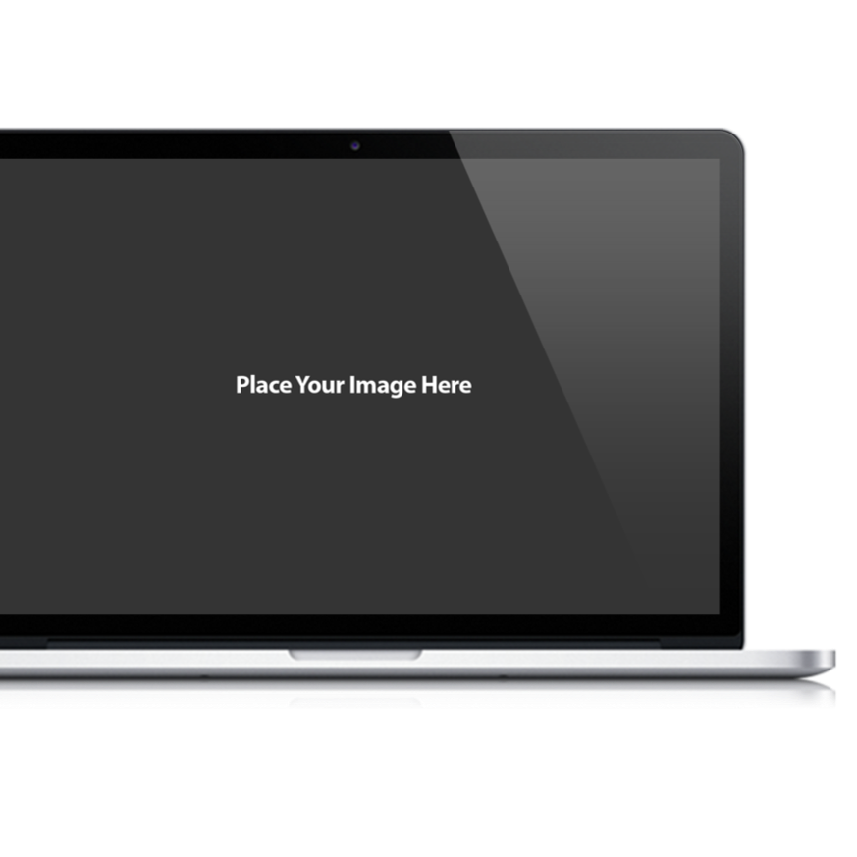
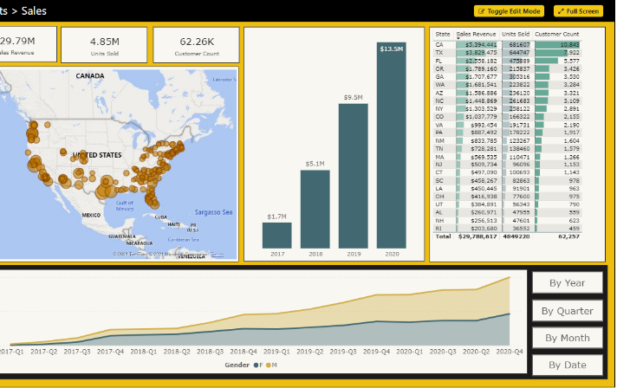
Microsoft Power BI
PBICAT
Tenant Management
Developer Sample
Ted Pattison Power BI Customer Advisory Team (PBICAT)

Slide 2

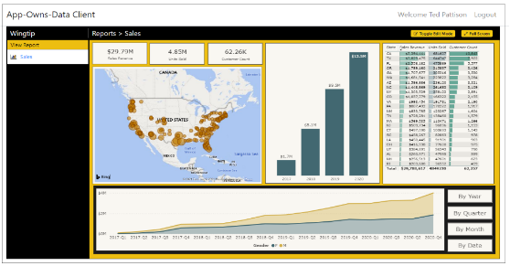
Customer Tenants in App-Owns-Data Embedding
Tenant represents a customer with one or more users
You must create a separate tenant footprint in Power BI for each customer
Power BI environment
Customer 01
17 users
Customer 01 Tenant
Sales
Power BI Workspace
Power BI Dataset
Datasource credentials
Power BI Report

Slide 3
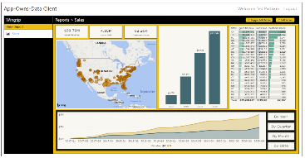
Designing a Multi-tenant Environment
Power BI Multi-tenant Environment
Customer 01
17 users
Customer 01 Tenant
Sales
Power BI Workspace
Power BI Dataset
Datasource credentials
Power BI Report
Customer 02
243 users
Customer 02 Tenant
Sales
Power BI Workspace
Power BI Dataset
Datasource credentials
Power BI Report
Customer N
74 users
Customer N Tenant
Sales
Power BI Workspace
Power BI Dataset
Datasource credentials
Power BI Report

Slide 4
Tenant Management Developer Sample
The Power BI Service limitation
Power BI Service limitation restricts users/service principals to 1000 workspaces
App-owns-data embedding with 1 service principal only support 1000 workspaces
Strategies for scaling beyond the 1000 workspace limit
Create new service principal for each customer tenant
Designing service principals pooling scheme with up to 1000 tenants for each

Slide 5
App-Owns-Data Starter Kit - Value Proposition
Provides guidance for the following tasks and procedures
Onboarding new customer tenants
Managing user permissions
Implementing customer-facing client as Single Page Application (SPA)
Creating custom telemetry layer to log user activity
Monitoring user actions such as viewing, editing, and creating reports
Monitoring report performance across all customer tenants

