Slide 1


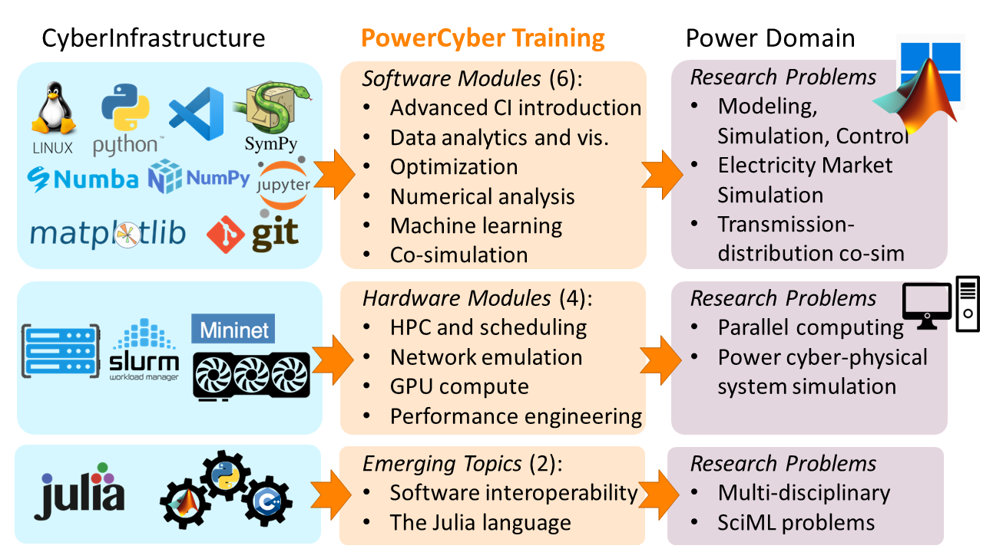
Collaborative Research: CyberTraining: Pilot: PowerCyber: Computational Training for Power Engineering Researchers
Award No.: 2319895, 2319896, PIs: Hantao Cui, Xin Fang, 2024-2025
Objectives
Team
Develop textbook-quality, interactive training modules in Jupyter Book to cover advanced CI in software, hardware, and emerging techniques that have the potential to transform power engineering research.
Offer a virtual “PowerCyber Training” workshop each summer of the budget period.
Incorporate the training materials into the curricula of undergraduate and graduate students to foster research interest.
Outcomes
A pilot training workshop that initiates researchers with advanced CI capabilities for solving power-domain problems
Overview of the PowerCyber Training
Project Activities
PowerCyber Training Webinar series and hands-on active training
Asynchronous workshops in 2025
Power engineering researchers
Industry trainers
Self-paced online learning
Online archive for training materials
Contact
Homepage: powercybertraining.github.io
PIs: Dr. Hantao Cui hcui9@ncsu.edu
Dr. Xin Fang xfang@ece.msstate.edu

