Slide 1
客户端数据库简介
20190602孙勇亮

Slide 2
工具
Database4.exe（qq群文件）
数据文件，客户端安装目录
FoowwCE.sdf FoowwCELarge.sdf
密码：FangxunSrc-DesktopReleaseBranch\FangxunSoft\DataModel\ConnectionStringHelper.cs

Slide 3
公司
ApplicationLogs 操作日志
Changes 变化同步
ClientChanges
UsersAlias
Users
Deparment

Slide 4
管理
AbsenceApplications 缺席
AchievementCommissionRatioSettings
AchievementCommissionSettings
Achievements 业绩
AchievementShareRatioRecords
AchievementShareRatioSettings
AttendanceLocations 出席地点
AttendancePlan
AttendanceRecord
AttendanceRules 出席规则，考勤
AttendanceSettingUsers 设置出席用户
AttendanceSpecialDays
AttendanceTimes 次数
AttendanceUsers 出席用户

Slide 5
业务
AppointmentVisitComments
Attachments
BlackList 中介黑名单
BlackListDicts
Blocks 板块
BrokerageRecords 佣金记录
BrokerageShares 分配
BuildingTypeFacility
BuildingTypes 建筑类型，多层住宅，公寓
Cites 城市
Communities 小区
Companies 公司
CompanyBlocks 公司板块
CompanyCommunities
CompanyCommunityBuildings
CompanyDistricts
CompanyDeparments
CompanyDemandNew
CompanyDemandRent
CompanyDemandSecond

Slide 6
业务
companyGroups
companyGroupUsers
companyMachines
CompanyRegionDepartments 区域部门
CompanyRegions 区域
CompanySettingOverdue
CompanyUsers
ContractProcedureSettings 流程设置
Contracts 合同
CorrectionRecords
CostRecords
CostTypeSettings
Customers

Slide 7
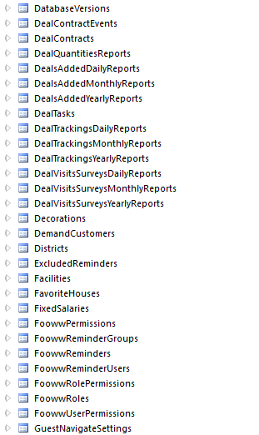
业务

Slide 8
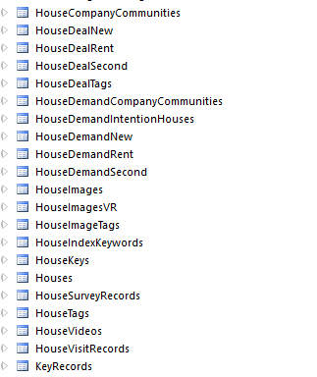
业务

Slide 9
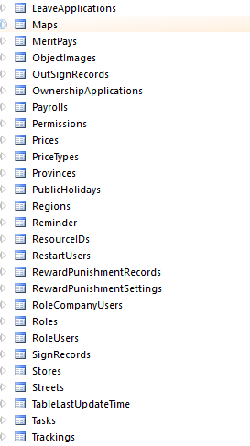
业务

Slide 10
业务
UploadImages 房源图片
UserWatchDealPhoneRecords
UserRecentPKCommunities
WatchedPhoneCount

Slide 11
其他
BusinessTracking
BusinessContracts
BusinessGroupDailyReports

