Slide 1
PowerEnjoy
Design Document
Arcari Leonardo
Bertoglio Riccardo
Galimberti Andrea

Slide 2
Overview
Architectural Design
Adopted Technologies
Car Architectural Choices
Deployment View
Algorithm Design

Slide 3
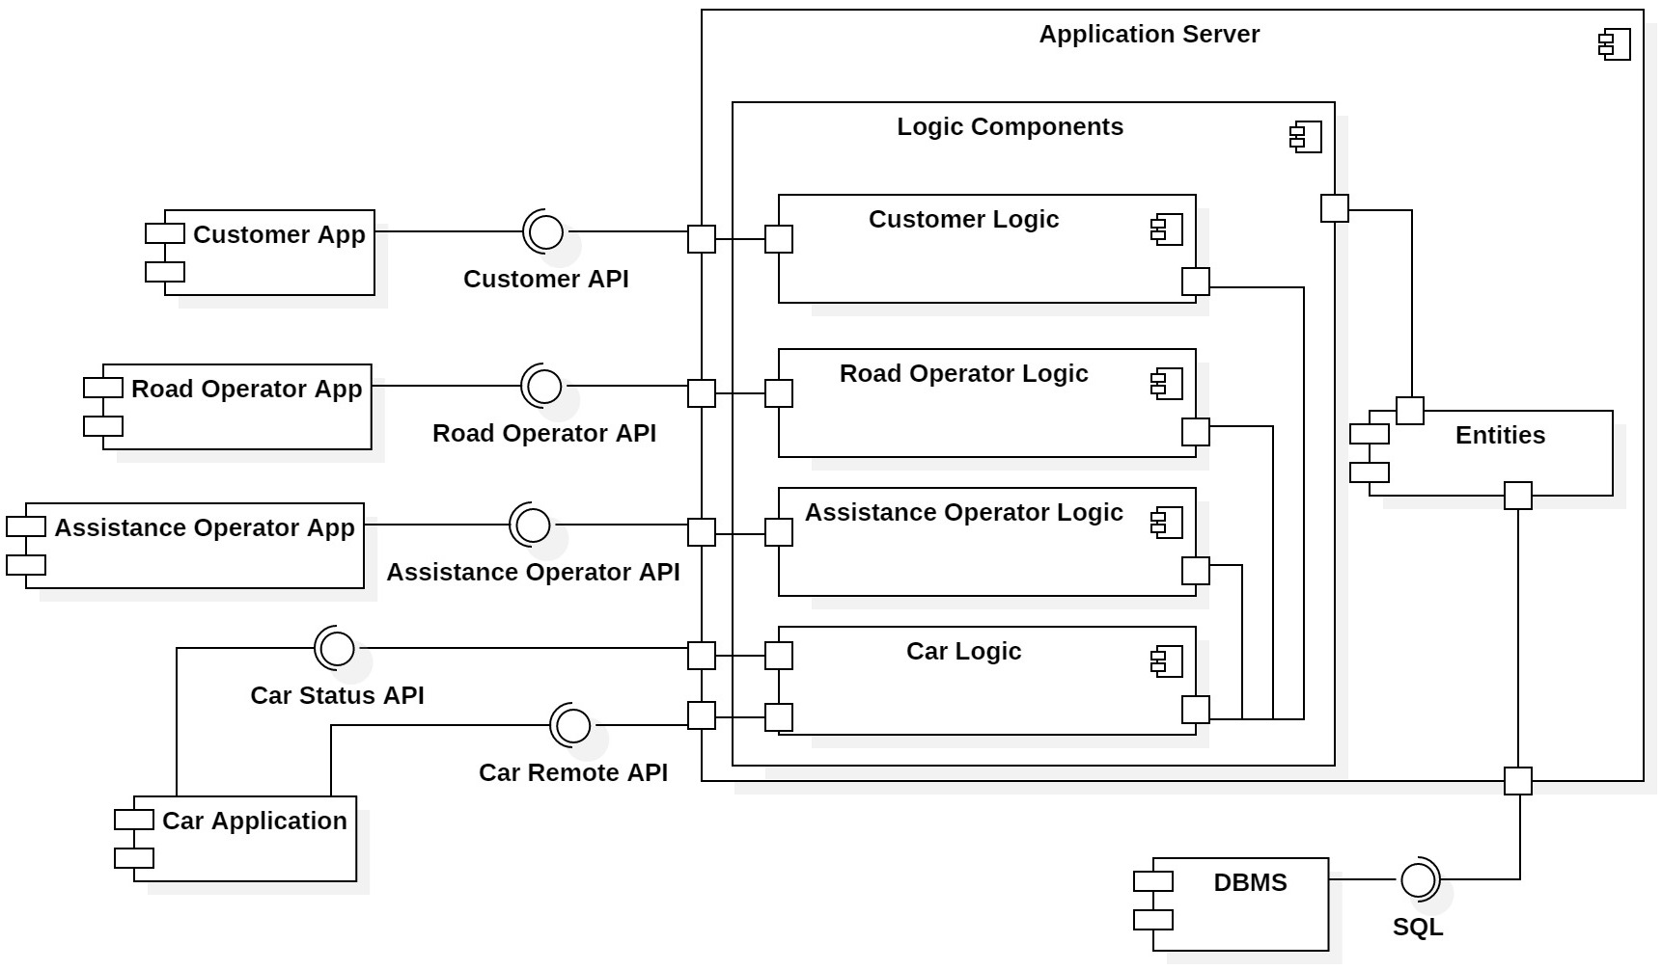
Architectural Design

Slide 4
Architectural Design
Presentation Layer Customer, Road Operator, Assistance Operator, Car Applications
Business Logic Layer Customer Logic, Road Operator Logic, Assistance Operator Logic, Car Logic
Data Management Layer DBMS
Each presentation component interacts only with the server; it will be an application server task to forward a message to another presentation component in case it is needed.
Since each presentation component requires some logic by the server, strictly related to the same domain, the application server is similarly divided in sub-components that perform the server side logic.
Each server logic component also communicates with the other server logic components and with the system entities which are across-the-board to the whole system.
Because of the distributed nature of the system, communication between presentation and business logic layers happens over the Internet exploiting a set of interfaces exposed by the application server.

Slide 5
Adopted Technologies
HTML + CSS + Javascript implement the Customer, the Road Operator and Assistance Service Operator web-applications.
RESTful API architectural style define the set of interfaces exposed by logic components, allowing cross-language, cross-platform RPC.
WebSocket communication protocol implement push notifications, providing full-duplex communication channels over a single TCP connection.
Java Enterprise Edition platform build the application server components
JSON format exchange message and data; perfectly pairs with REST interfaces for its well-known structure and interoperability among different languages and platforms
JSON Schema specify JSON documents structure

Slide 6
Component View

Slide 7
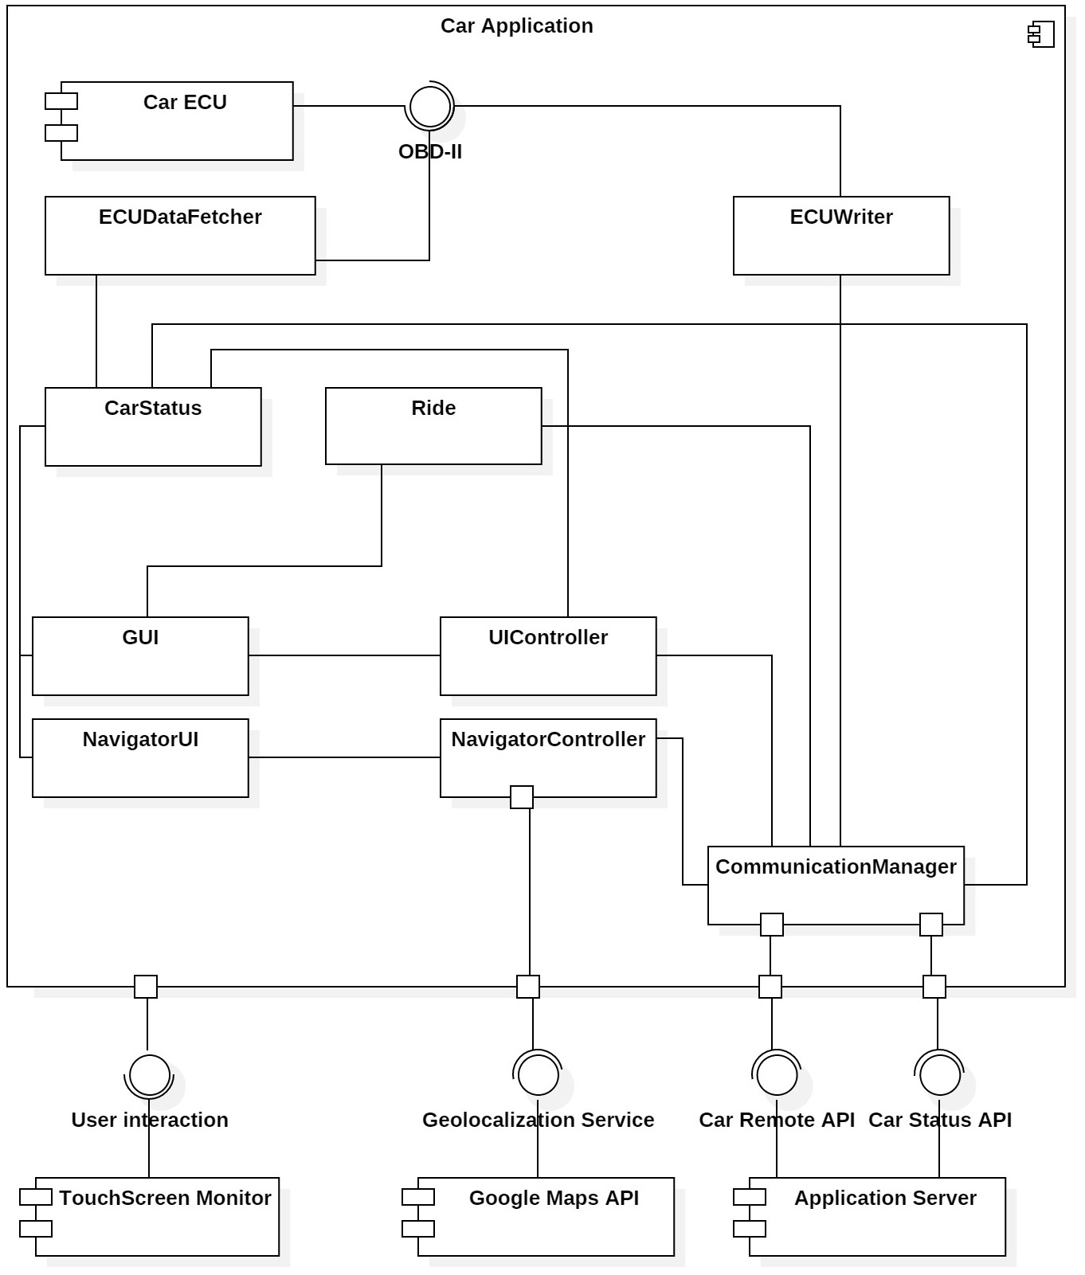
Component View - Car Application
Model local copy
View
Client-side Controller
Server-side controller

Slide 8
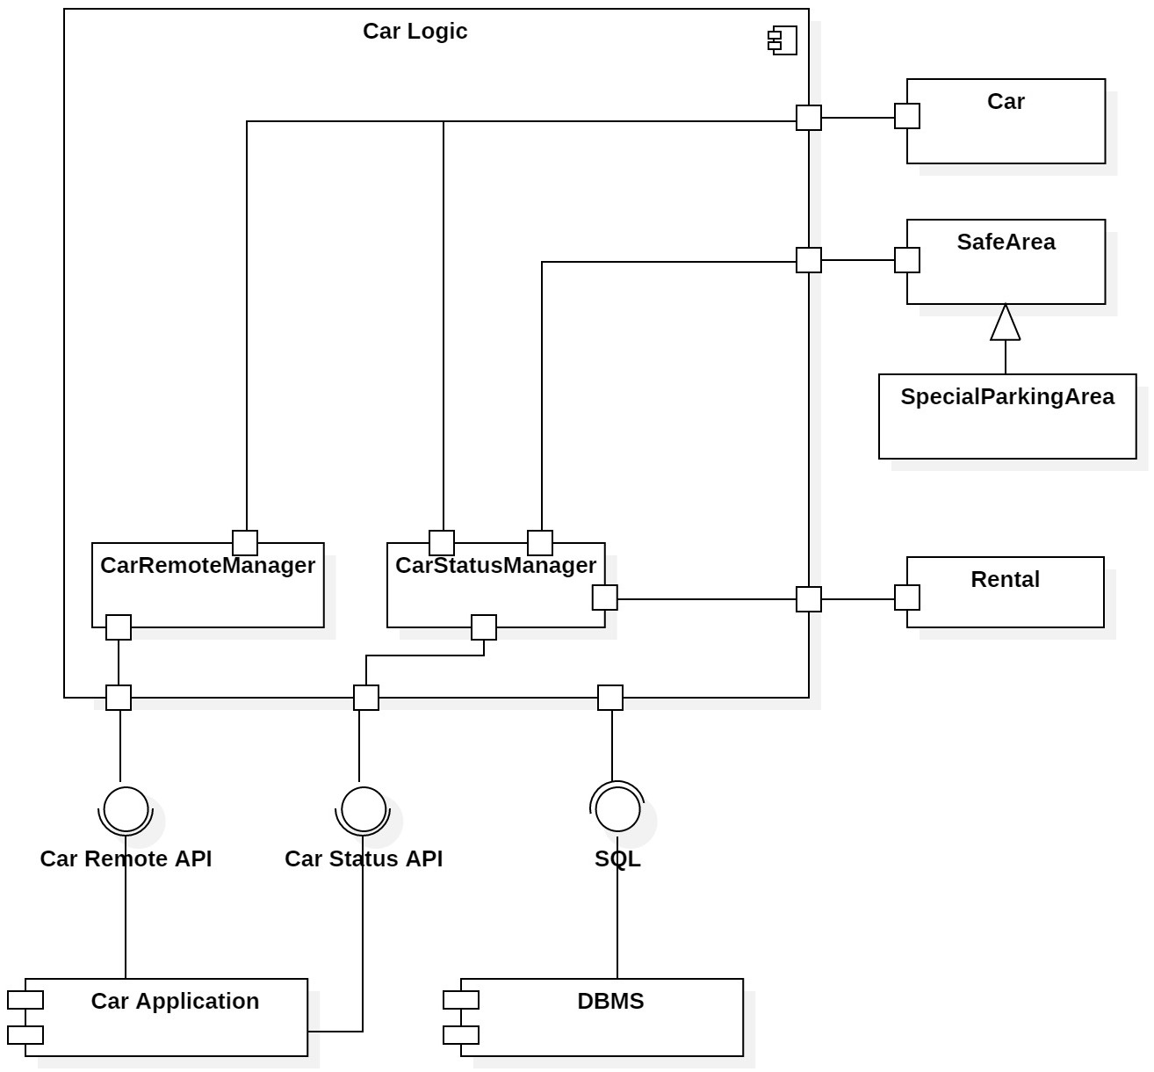
Component View - Car Logic
Model
Server-side Controller
Client

Slide 9
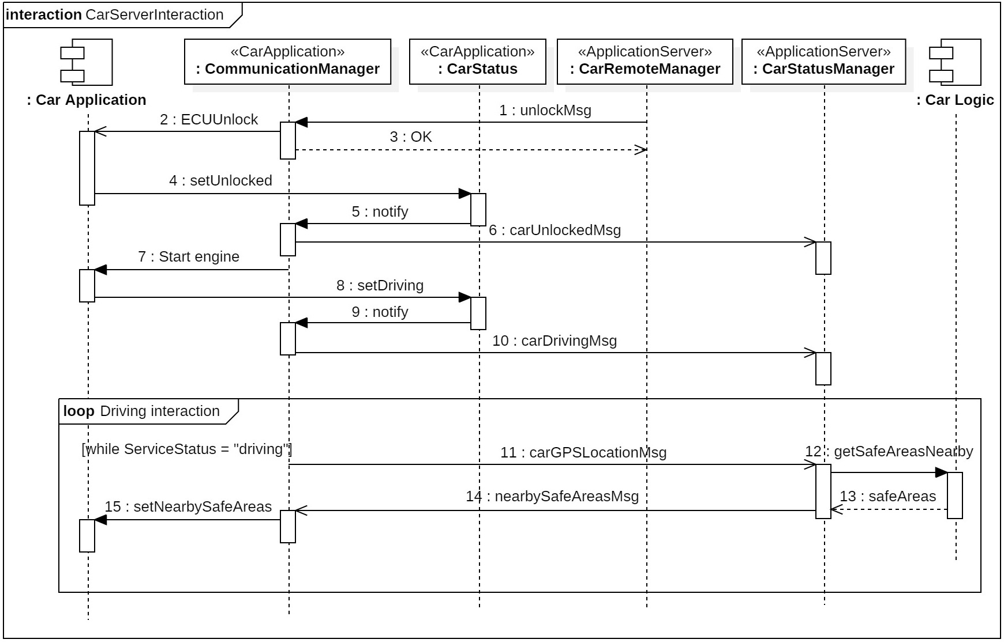
Runtime View - Car/Server Interaction (1)

Slide 10
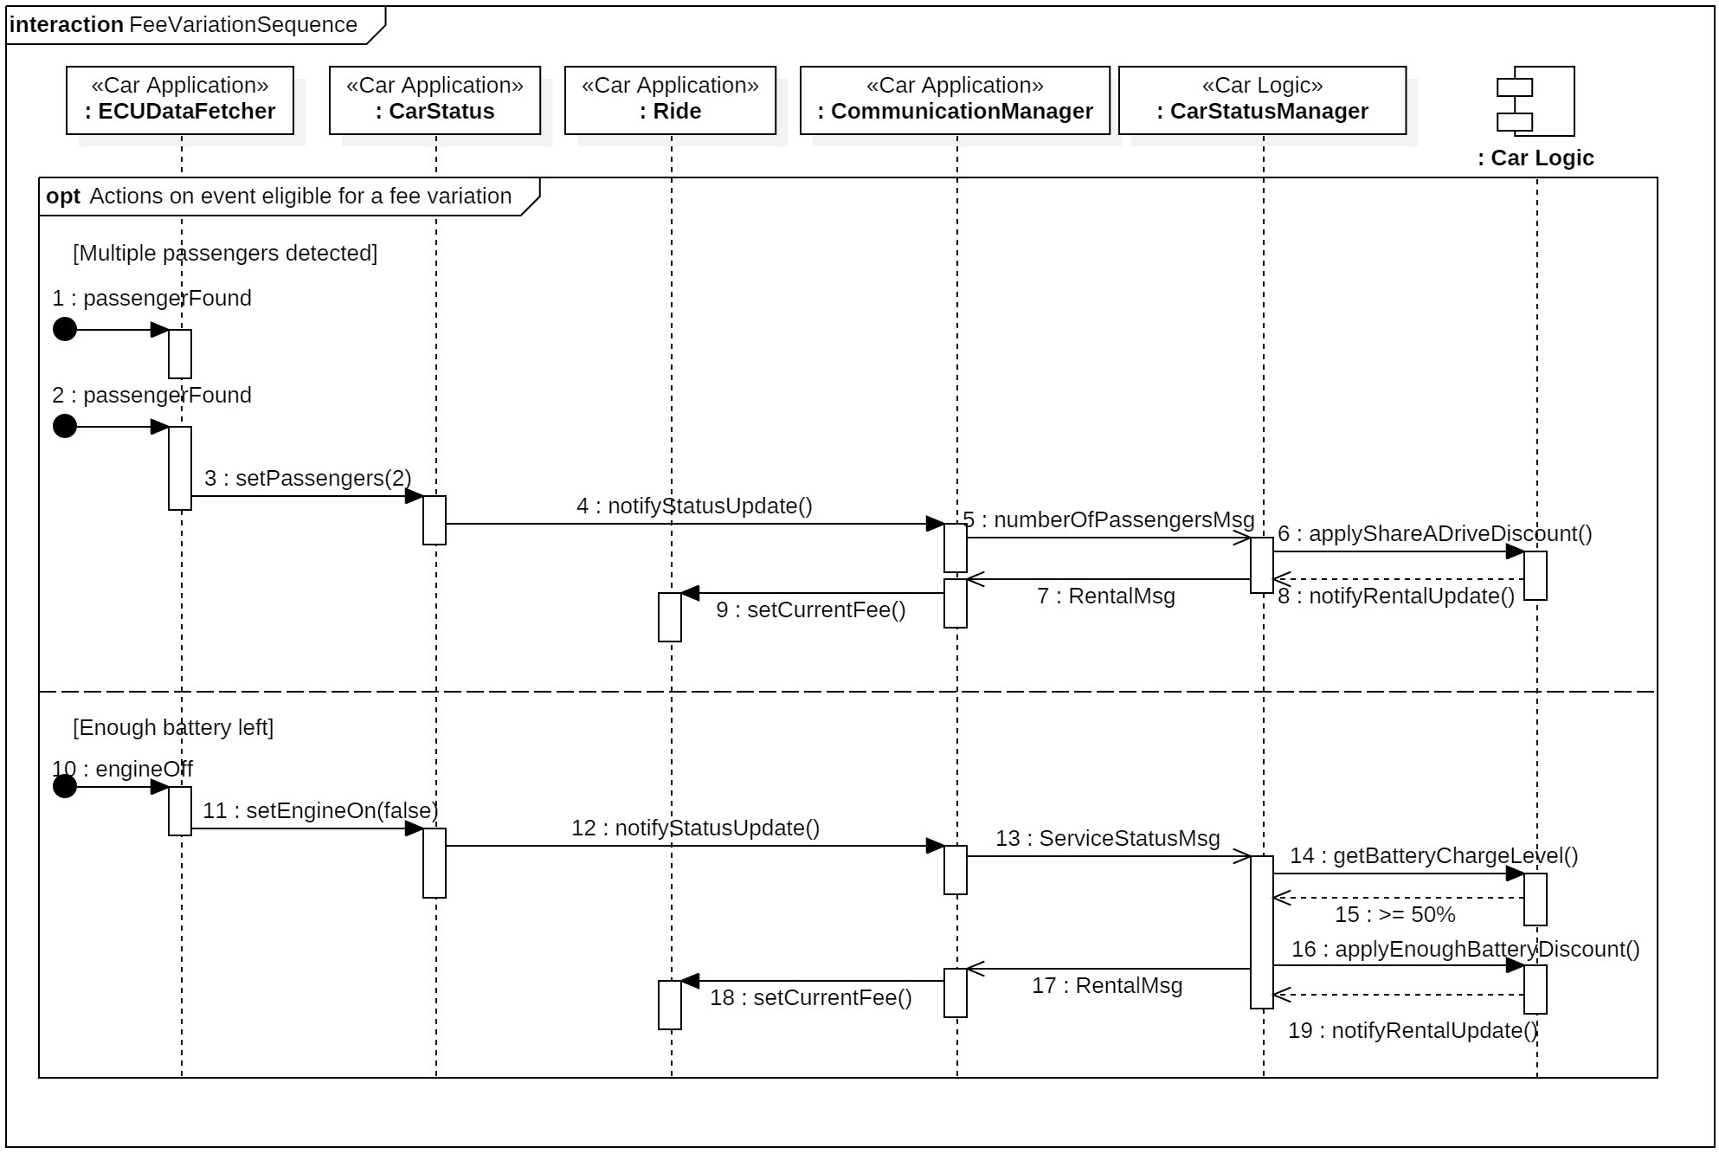
Runtime View - Car/Server Interaction (2)

Slide 11
Component interfaces (1)
HTTP Method | URI | Protocol
POST | /CarLogic/GPSLocation/{ID} | Car Status Update
POST | /CarLogic/LockingStatus/{ID} | Car Status Update
POST | /CarLogic/ServiceStatus/{ID} | Car Status Update
GET | /CarLogic/NearbySafeArea/{ID} | Safe Area Set

Slide 12
Component interfaces (2)
Car Remote Control
Car Status Update (partial)
{ "$schema": "http://json-schema.org/draft-04/schema#", "title": "Car Remote Control", "description": "Remote Control operations", "type": "object", "properties": { "id": { "description": "ID of the car", "type": "string" }, "operation": { "type": "string", "enum": [ "unlock", "lock", "ok" ] } }, "required": ["id", "operation"], "additionalProperties": false }
{ "NumberOfPassengers": { "description": "Number of passengers", "properties": { "type": { "enum": [ "NumberOfPassengers" ] }, "passengers": { "type": "integer", "minimum": 0 } }, "required": [ "type", "passengers" ] } }

Slide 13
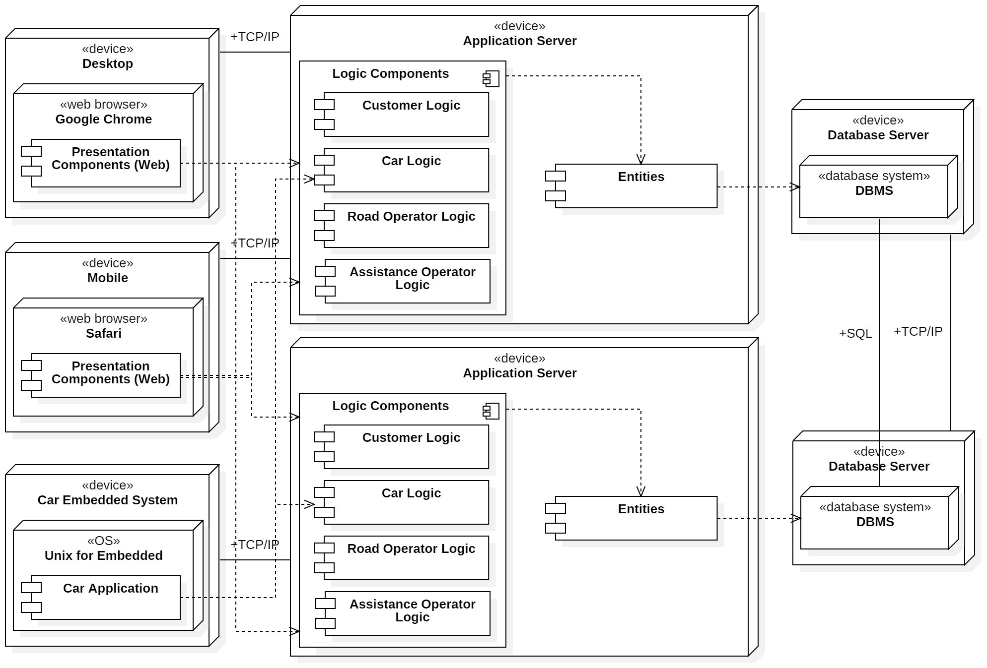
Deployment View

Slide 14
Deployment View
The presentation tier could theoretically be made of an infinite number of machines divided into three categories: desktop machines, mobile devices and the embedded system shipped inside the Car.
The first two are dedicated to users of the system, who interface with the web applications to exploit the features offered by the system, while the latter comes as a finite set of devices, equal to the number of Cars, and host the Car Application.
The application logic tier contains a set of machines aimed to handle the load generated by the presentation tier devices; a JEE-compliant platform, which necessary logic components are deployed on, shall run on them.
The number of application server machines should be sized to respect the constraints of reliability, availability and response time. A load-balancer between the presentation and business logic tiers could help in this sense.
The data management tier carries similar considerations, with a difference: in the case of application servers, the machines work independently serving their clients; on the other hand the database servers need to be connected together to keep the data consistent in case two components of different application servers are working on the same object persistent on two different database servers.

Slide 15
Algorithm
View nearby cars
define MIN_BATTERY_LEVEL 10 //percentage
define MAX_DISTANCE 500 //meters
define DISCHARGE_RATE 0.2 //Wh per meter
GeographicCoordinates requested_position;
read(inserted_position);
if(inserted_position != NULL)
requested_position = GeolocalizationAPI.getLocation(inserted_position);
else
requested_position = user.getLocation();
List<SafeArea> all_safe_areas = getSafeAreas();
List<SafeArea> close_safe_areas;
forall(SafeArea sa : all_safe_areas){
GeographicCoordinates safe_area_position = sa.getLocation();
if(safe_area_position.calcDistance(requested_position) < MAX_DISTANCE)
close_safe_areas.add(sa);
}

Slide 16
List<Car> available_cars;
forall(SafeArea s : close_safe_areas)
available_cars.add(s.parkedCars());
List<Car> available_cars_enough_battery;
forall (Car c : available_cars)
if(c.getBatteryLevel() >= MIN_BATTERY_LEVEL)
available_cars_enough_battery.add(c);
read(user_destination);
if(user_destination != NULL){
GeographicCoordinates destination_position;
destination_position = GeolocalizationAPI.getLocation(user_destination);
int estimated_battery_needed;
estimated_battery_needed = destination_position.calcDistance(requested_position) * DISCHARGE_RATE;
forall (Car c : available_cars)
if(c.getBatteryLevel() < estimated_battery_needed)
available_cars_enough_battery.remove(c);
}
return available_cars_enough_battery;

Slide 17
Thanks for your attention

