Slide 1
PowerEnJoy
Requirements Analysis and Specification Document
Arcari Leonardo
Bertoglio Riccardo
Galimberti Andrea

Slide 2
System Purpose
The required product is a digital management system for PowerEnJoy, a car-sharing service employing exclusively electric vehicles.
The system has to provide functionalities to support both the users of the service and the employees of the company who interact with customers and cars.
Typical functions of a car-sharing service have to be supported, such as reserving a car and finding a parking area where to plug it in at the end of the rental.
A critical issue that has to be considered is the management of the electric vehicles, which have to be continuously recharged as they get used by customers and have to be distributed in a quite uniform way around the town; hence, the user has to be incentivized through discounts to recharge the car in power plugs-equipped parking areas, don't leave the car with a low battery level and park the car where there are few other available vehicles.
The product also has to provide a way to attract more potential customers to the service, therefore sharing the car with other passengers will be incentivized through appropriate discounts.

Slide 3
Goals
[G.1] The customer shall be registered to rent a car
[G.2] The customer shall be able to find cars nearby
[G.3] The customer shall be able to reserve a car when he needs it
[G.4] The customer shall be encouraged to pick up the car he reserved in an hour
[G.5] The customer shall be encouraged to recharge the car after the rental end
[G.6] The customer shall be encouraged to share a ride with other people
[G.7] The customer shall be able to do a temporary stop
[G.8] A car shall be parked in a safe area
[G.9] A car shall not be picked without a reservation
[G.10] A car with low or empty battery shall be recharged by a road operator
[G.11] A car involved in an accident shall be reached by a road operator
[G.12] A faulty car shall be repaired

Slide 4
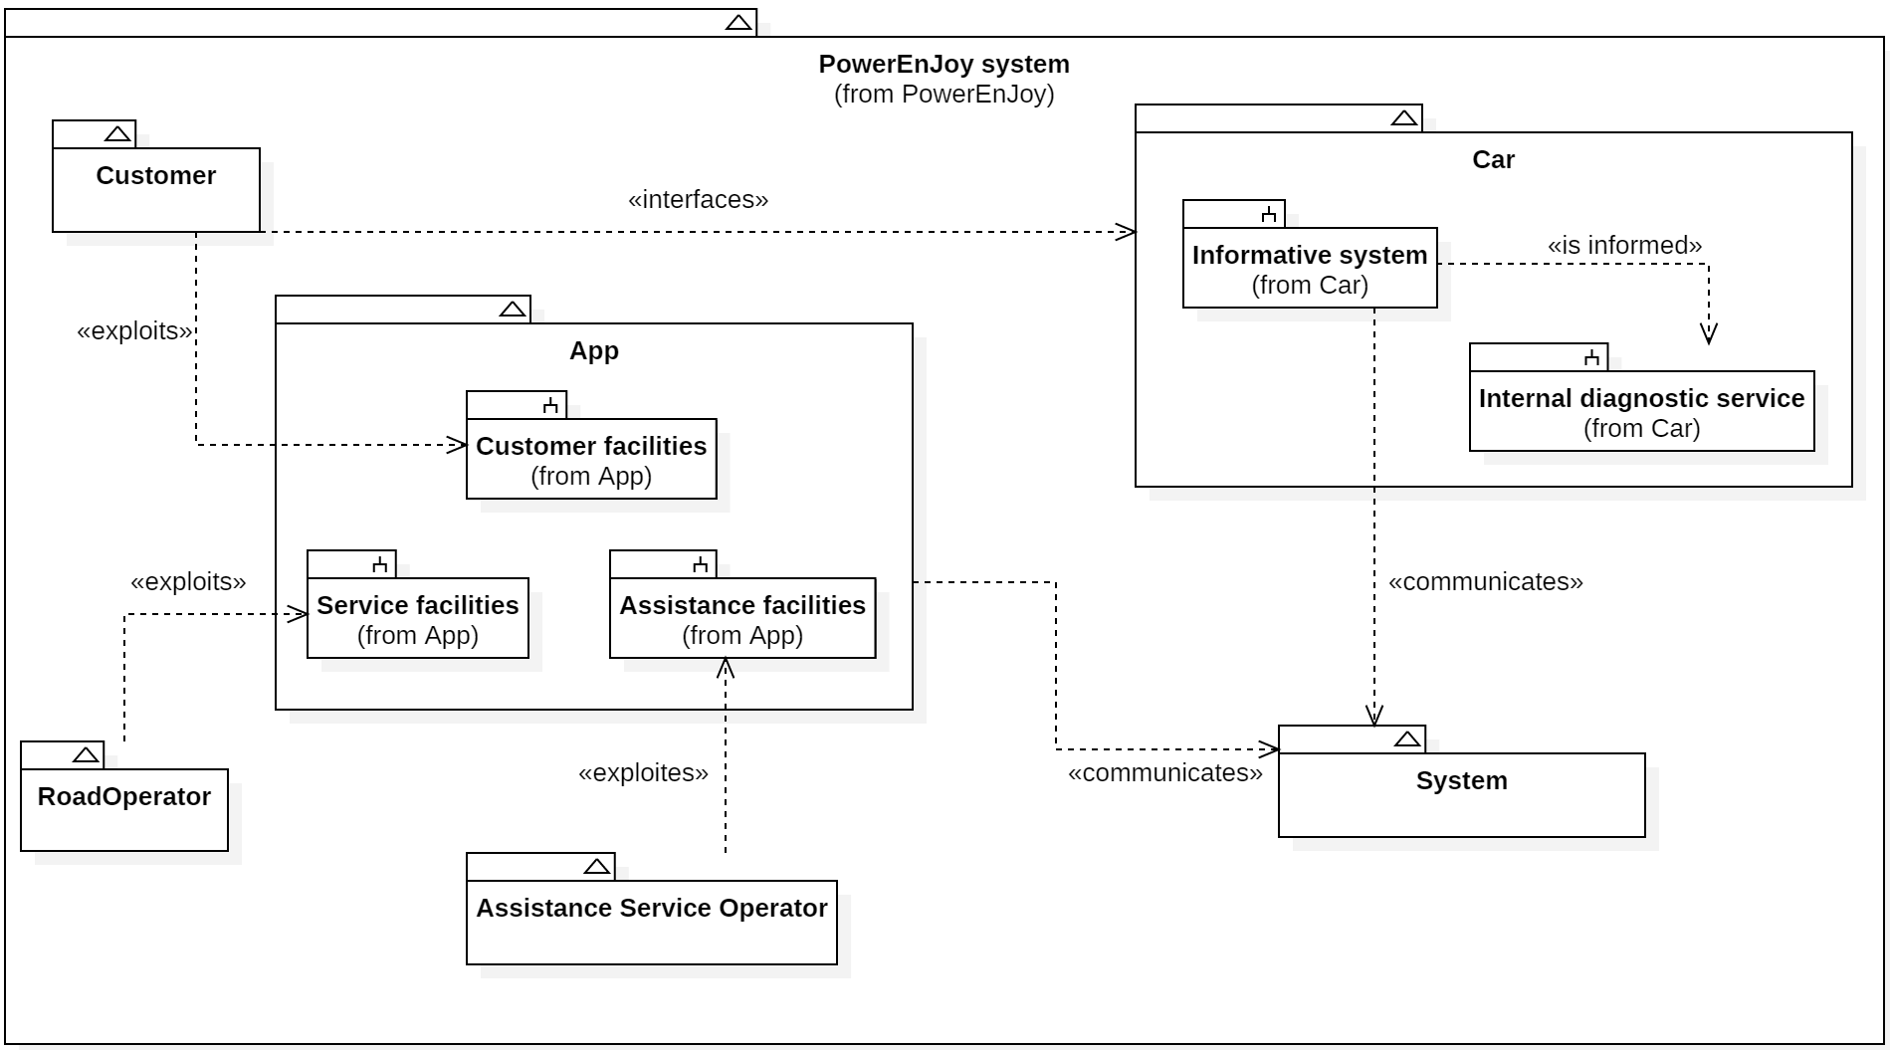
System Context (1)

Slide 5
System Context (2)
The Customer is a person registered to the service that is willing to rent a car. They exploit the App customer facilities in order to reserve a car, receive guidance to reach it and unlock it.
The Assistance Service Operator is a company employee responsible for responding to Customers' assistance requests and to Cars' failures. They have full access to the System facilities in order to remotely control Cars and dispatch Road Operators when on-field presence is required.
The Road Operator is a company employee responsible for granting the cars availability. They exploit the App back office facilities in order to be notified of a car fault or low battery level, receive guidance to reach it and restore its correct behaviour.

Slide 6
System Context (3)
The App is the front-end of the PowerEnJoy system. Depending on its user, the features it provides change. For a Customer, the App represents the only way to handle car reservation, unlock and manage personal information. For a Road Operator, the App represents a way of being helped in accomplishing their task, from locating a faulty car to receive a deeper acknowledgement of the fault diagnosis.
The Car is the set of internal car sensors and on-board informative system. The car status is constantly checked and in case of an anomaly the System is immediately notified. In addition a touch screen Monitor is available to provide the Customer a way to interact.
The System is the set of all the data and business logic facilities. It has to be interpreted, at this level, as an abstraction of all the background tasks to keep the system reliable and consistent.

Slide 7
Domain Assumptions
The company is not responsible for driving infractions committed by the customers, and eventual fines and charges are taken in charge by the external payment service.
All the payment transactions from the customer to the company are successful; if a customer's credit isn't enough to pay his fees or fines the external payment service will inform the company, which will ban the user from using the car-sharing service.
The customers can't drive out of the city limits and agree to this when they accept the terms of service; if they don't respect this rule, they will be legally prosecuted by the company.
The safe areas are hard-coded in the developed software, as they aren't expected to change often; a management console for updating safe areas may be added in the future.

Slide 8
System Functions (1)
Users are able to register to the system by providing their credentials and payment information. They receive back a password that can be used to access the system.
Customers are able to find the locations of available cars within a certain distance from their current location.
Among the available cars in a certain geographical area, customers are able to reserve a single car for up to one hour before they pick it up.
If a car is not picked-up within one hour from the reservation, the system tags the car as available again, and the reservation expires; the customer who didn’t use his reservation pays a fee.

Slide 9
System Functions (2)
A Customer that reaches a reserved car is able to tell the system they are nearby, so the System unlocks the car and the customer may enter.
As soon as the engine ignites, the System starts charging the customer for a given amount of money per minute; the customer is notified of the current charges though a Monitor on the Car.
The system stops charging the customer as soon as the car is parked in a safe area and the customer exits the car; at this point, the System locks the car automatically.

Slide 10
Internal diagnostic system detects a failure - Scenario
Alice is driving the car she rented but suddenly the engine stop working and the check engine light is illuminated. The car signals the failure to the Assistance Service. An operator of the assistance department dispatches a road operator to take the car to the closest repair center. Alice is notified on the screen that an operator has been dispatched. Then she has to leave the car, which gets locked by the system.

Slide 11
Manage a failure - Use Case
Participating actors: Customer, Assistance service operator, Road Operator
Entry conditions: A fault happens to the car
Flow of events:
The car notifies the customer about the failure, giving them information about what went wrong through the touch monitor
The customer exits the car
The car locks itself and closes all the windows, if possible
The system makes the car unavailable to rent
The car also notifies an assistance service operator about the failure, sending a complete failure report and the last recorded position in case the GPS is not working any more
The assistance service operator, after having tried to interact with the customer, opens an assistance request

Slide 12
Once an assistance request has been opened the system notifies the road operator nearest to the position of the car
The road operator accepts the assistance request and can see detailed information about the accident and the exact position of the car
The road operator picks up his tow truck and gets to the provided position following the app's directions
The road operator tows the car to the repair center
Exit conditions:
The customer gets charged a fee for the rent time until the failure
Exceptions:
The car has a failure but it hasn't been detected, hence the customer calls the assistance service in order to receive support

Slide 13
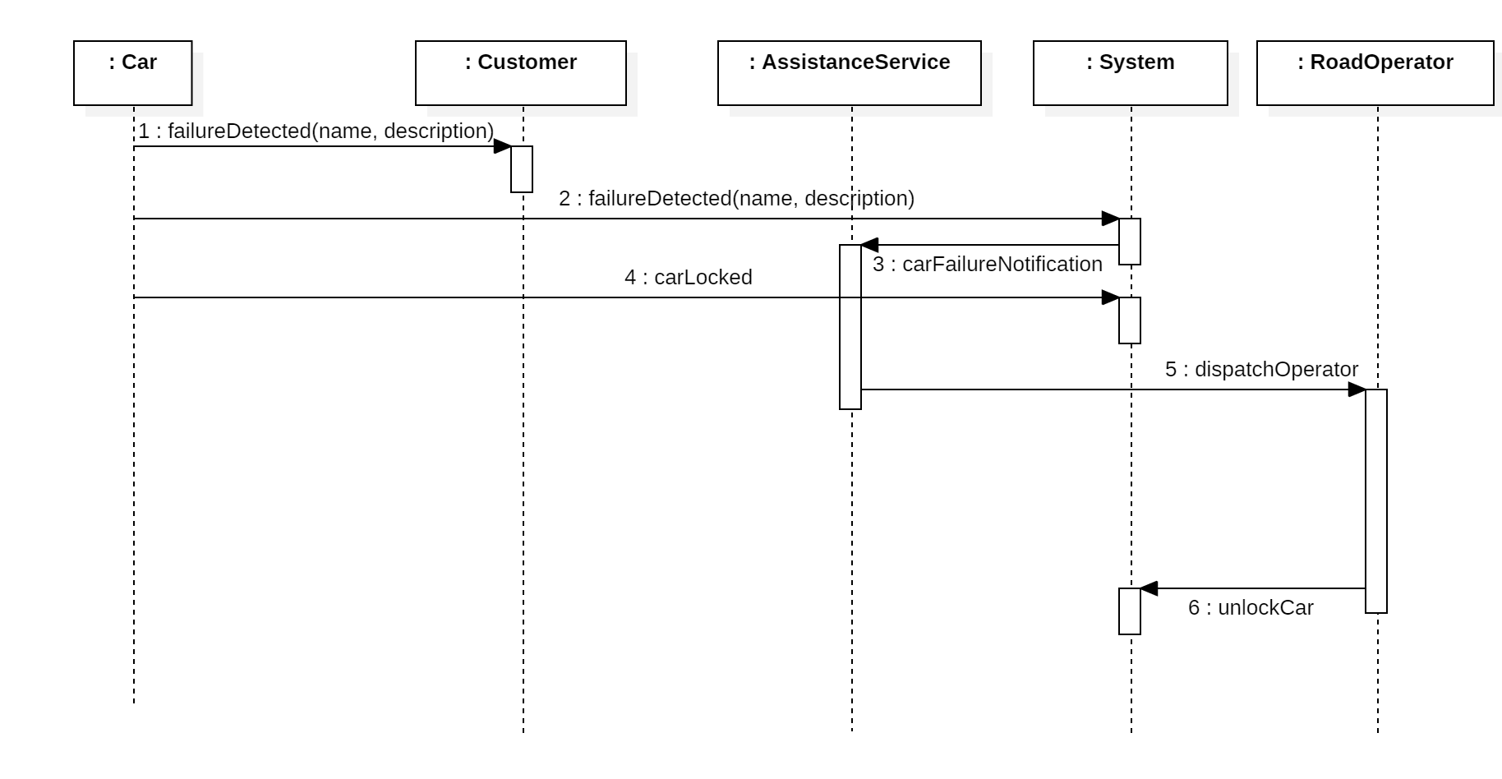

Slide 14
Manage a failure - Goals and Requirements
[G.12] A faulty car shall be repaired
[R.31] When the system is notified by a car of a failure it shall stop to charge the customer.
[R.36] When an assistance request has been opened the system shall notify the road operator nearest to the car position.
[R.37] When the road operator accepts the assistance request clicking on the “Accept” button the system shall mark the assistance request as accepted.
[R.41] When a car notifies the system that it has a failure, the system shall notify an assistance service operator about this failure.
[R.42] When a car notifies that it's faulty, the system shall make it unavailable to rent.
[R.43] When the road operator clicks on the “Solved” button in the context of an assistance request the system shall mark the assistance request as closed.

Slide 15
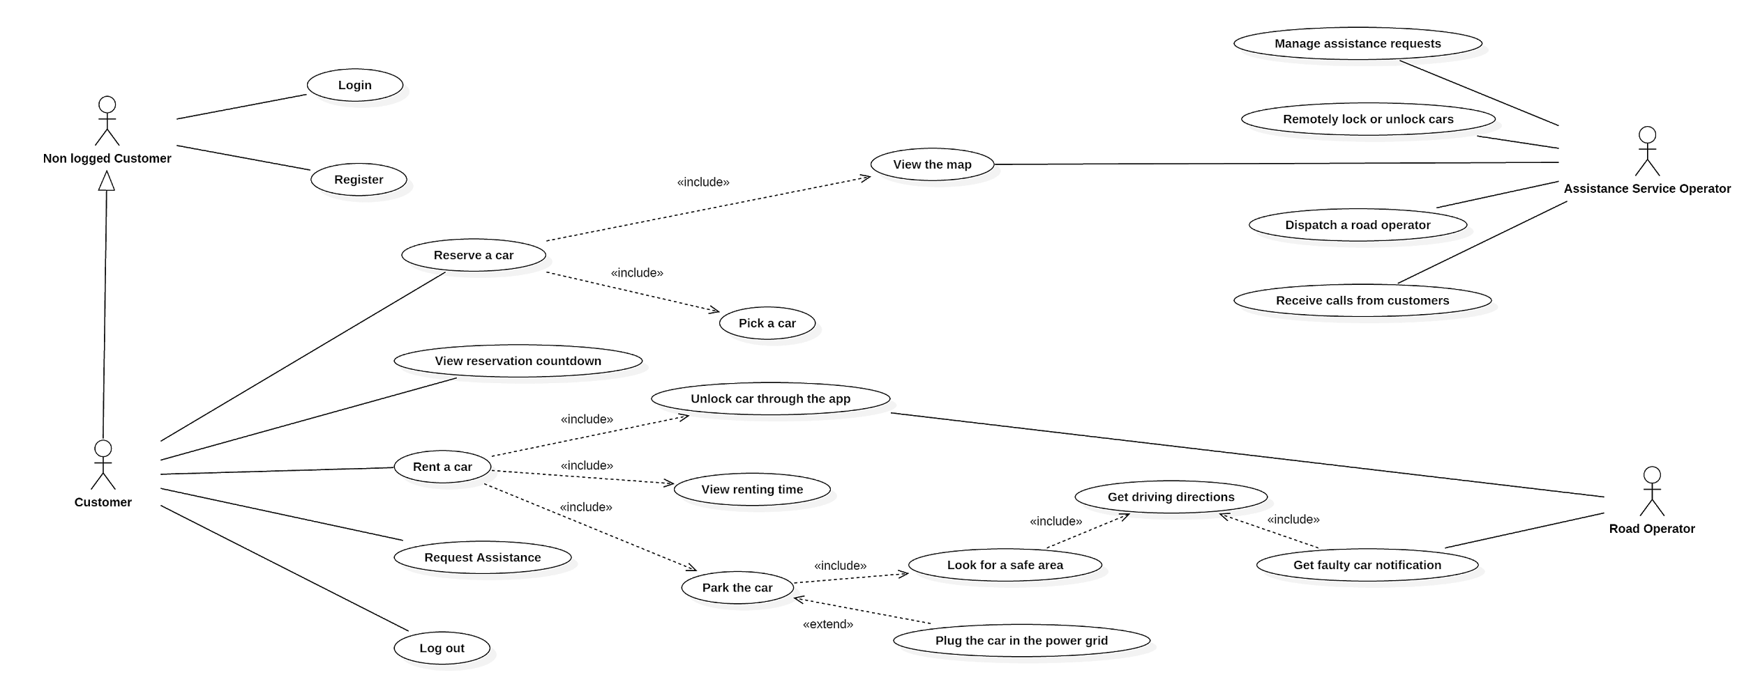
Use Case Diagram

Slide 16
System Interfaces - Internal
System communication The interaction showed in the system context between the App and the System and between the Car and the System happens over the internet. The System exposes a set of APIs that App and Car information system exploit in order to communicate user intentions, status updates and perform requests. A cross-platform cross-language communication protocol is due in order to face the PowerEnJoy heterogeneous system.
Human interaction A human being interacts with the PowerEnJoy system:
through the App
through the sensors inside the Car that perceive human presence
through the touch screen of the informative system inside the Car

Slide 17
System Interfaces - External
The system to be developed also has to interface with external systems to adequately provide all the required functionalities.
Payment service Billing operations are dealt by a payment service provider through a convenient communication protocol. The payment service provider verifies if the customer's credit card is valid and manages the payment of rental fees and additional charges.
Geolocalization service An external geolocalization service provides a map of the city, complete with localization of the safe areas and real time localization of the cars, and distances calculation.
Car internal diagnostic system The car manufacturer provides a car internal diagnostics system that signals eventual failures, the battery level, the locking status of doors and windows, and the presence of passengers through sensors.

Slide 18
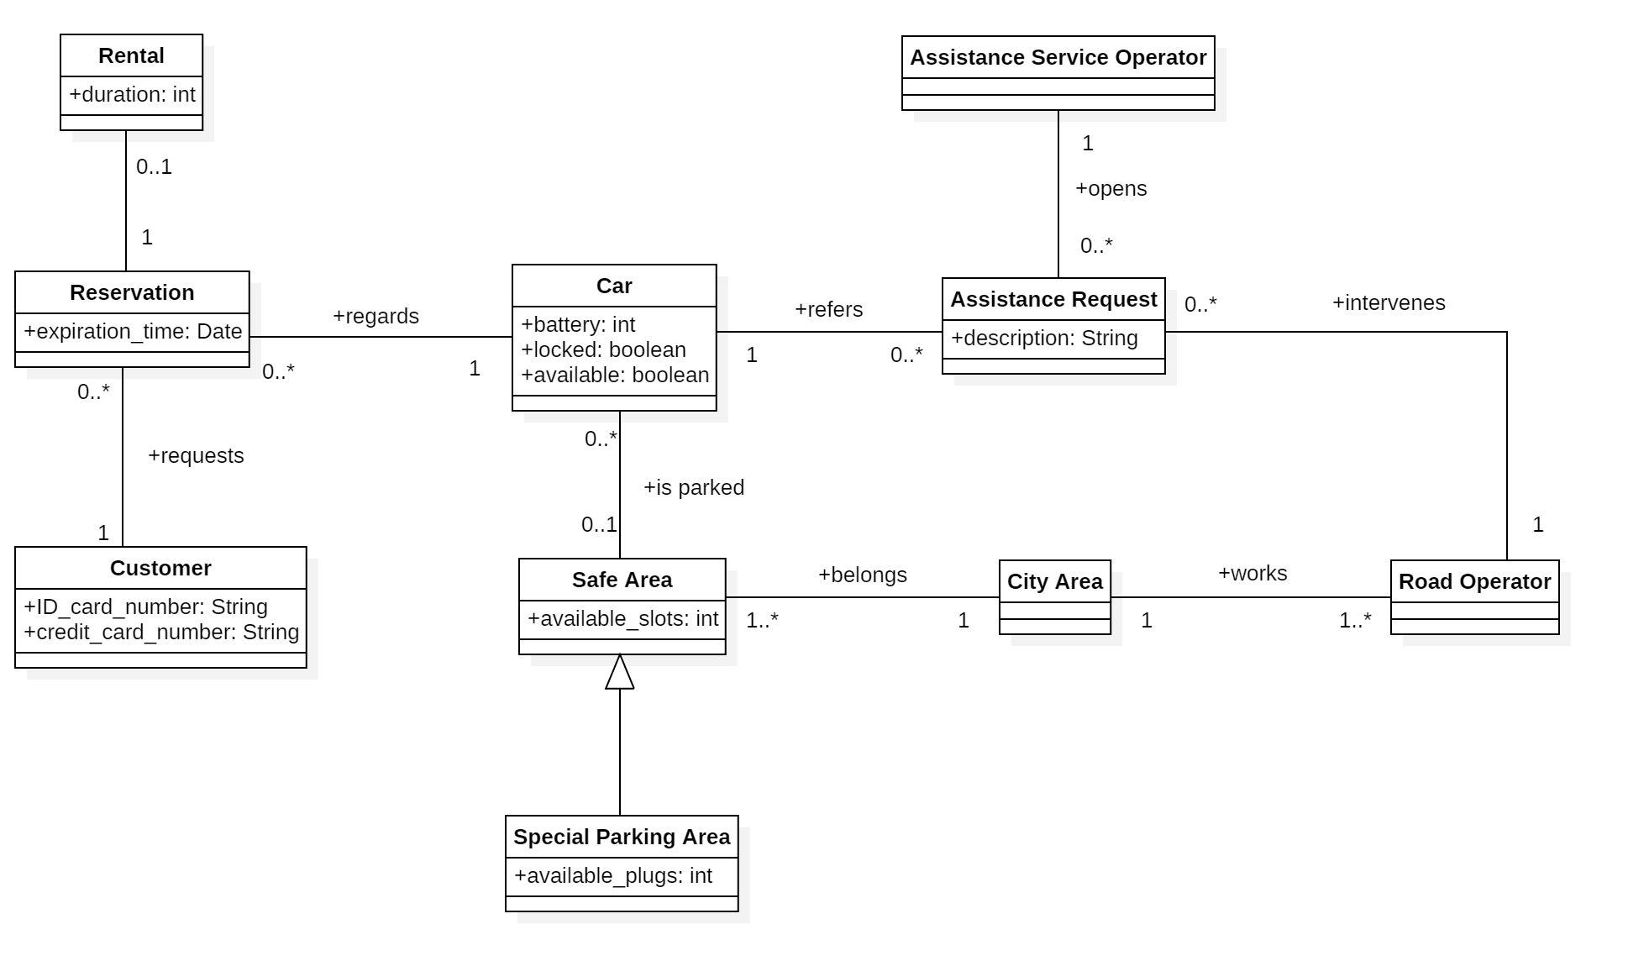
World Class Diagram

Slide 19
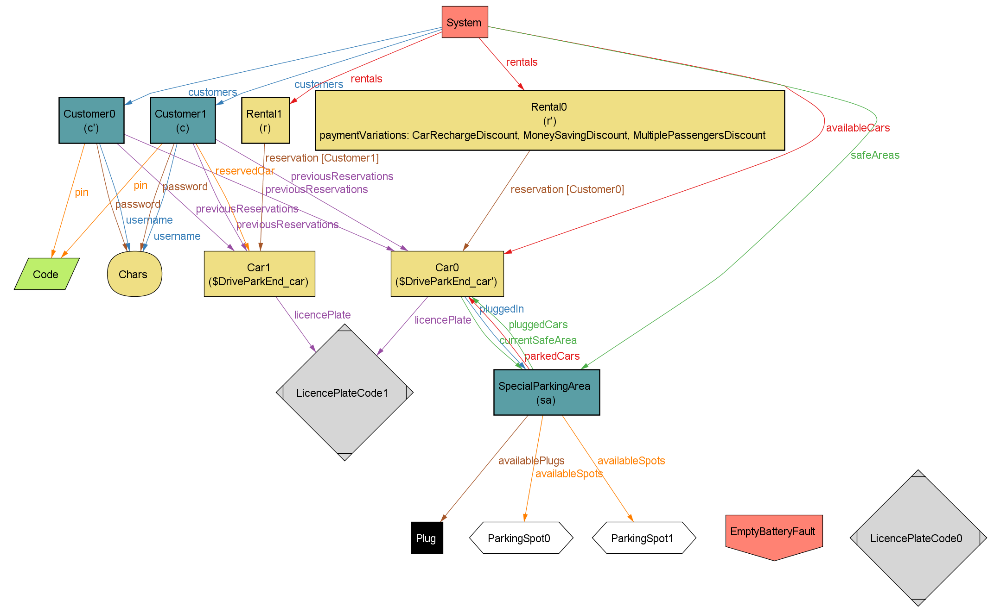
Alloy Model - DriveParkEnd

Slide 20
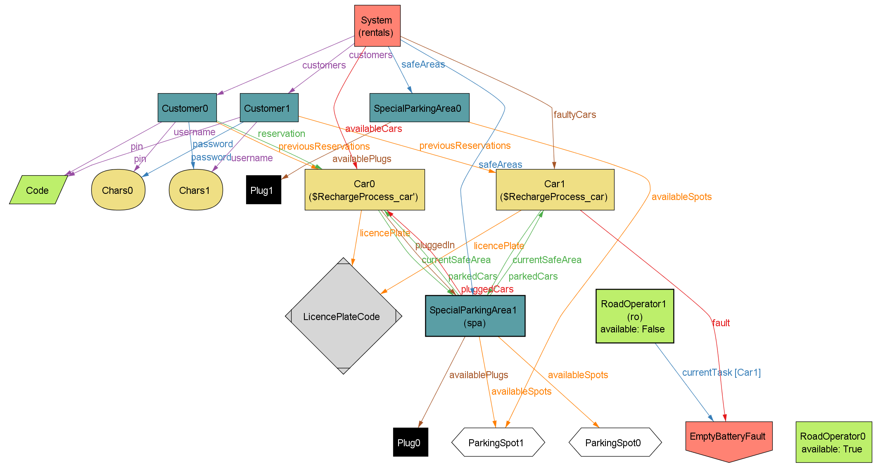
Alloy Model - RechargeProcess

Slide 21


Slide 22
Thank you for your attention

