Slide 1
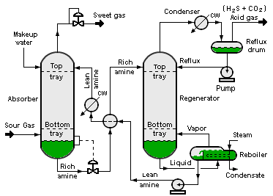

Slide 2
Zoom Shape 1
Zoom Shape 2
Zoom Shape 3

Slide 3
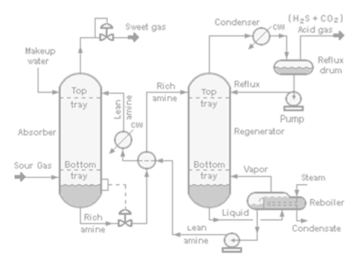

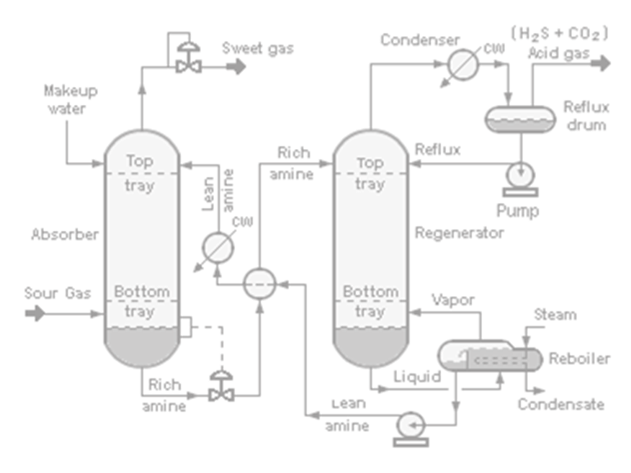

Slide 12
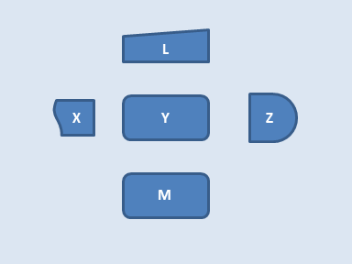

Slide 13


Slide 14
L
X
Y
Z
M

Slide 15
L
X
Y
Z
M

Slide 16
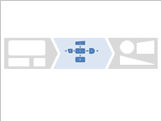

Slide 17
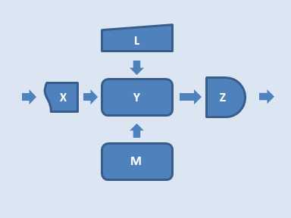

Slide 18
