Slide 1
PowerPointLabs Test Cases
General instructions:
DO NOT SAVE these slides after testing. Keep this file in its original form.
If your result is different from the expected output, please submit a bug report (attach slides/screenshots as necessary).

Slide 2
Sync Lab

Slide 3
Sync:: ArtisticEffects
Additional instructions:
Select the arrow.
Click SyncLab Ribbon button.
Click Copy to copy the format and select the formats to copy
Select the Shapes to sync the format
Click Paste to sync the format

Slide 4
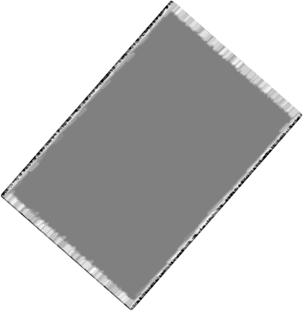
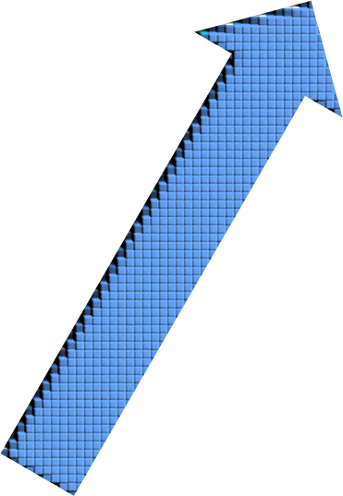

Notes:
Original Shapes

Slide 5

Notes:
Original Shapes

Slide 6


Notes:
Original Shapes

Slide 7
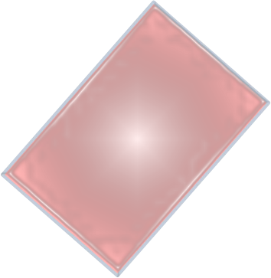

Notes:
Original Shapes

