Slide 1
PowerPointLabs Test Cases
General instructions:
DO NOT SAVE these slides after testing. Keep this file in its original form.
If your result is different from the expected output, please submit a bug report (attach slides/screenshots as necessary).

Slide 2
Auto Crop
Additional instructions:
Select the Blue shape(s).
Right click it and then select “Crop to Shape” in the context menu.
Compare the result with the expected output.

Slide 3
Auto Crop:: normal shape

Slide 4


Slide 5

Expected Output

Slide 6

Auto Crop:: multiple shapes
Select the blue shapes (ctrl + click) and click the button. It will crop the images behind to match the outlines of the shapes.

Slide 7

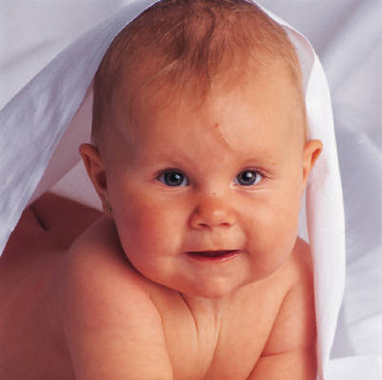
Notes:
This will play at the beginning.
[afterClick] This will play after you click.

Slide 8
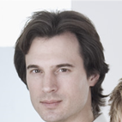



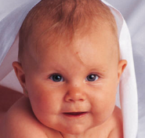

Expected Output
Notes:
This will play at the beginning.
[afterClick] This will play after you click.

Slide 9
Auto Crop:: rotated shape

Slide 11

Expected Output

Slide 12
