Slide 1

Congratulations on installing
Let’s take a quick tour of the main features.

Slide 2
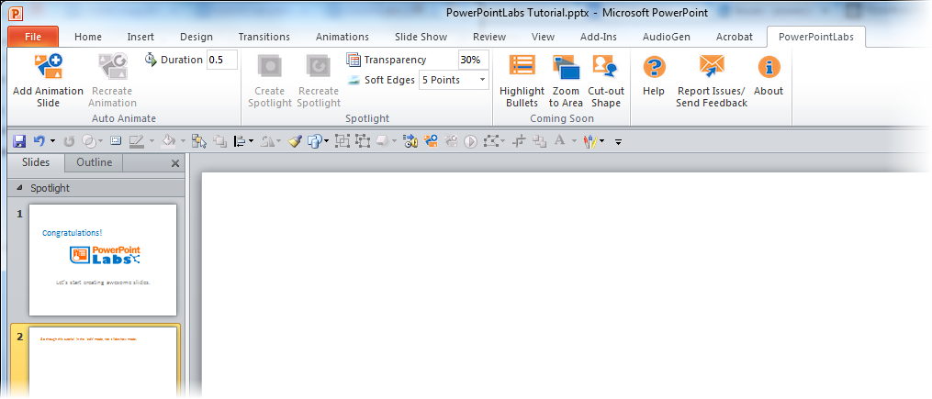
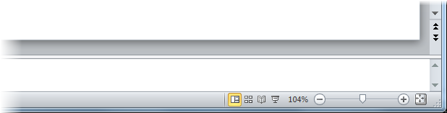
Please go through this tutorial in the ‘edit’ mode, not ‘slideshow’ mode.

Slide 3
This tutorial explains PowerPointLabs’ features at the point you installed the plugin.
If you installed the plugin some time back, please refer to the Documentation page of our website for more up-to-date instructions.

Slide 4

Some buttons may appear to be disabled like this:
That is because a button is enabled only when it can be used. This tutorial will show you when they can be used.

Slide 5
First up, let’s try the Highlight Points feature.

Slide 6


1. While this slide is selected, click the button in the ribbon.
A bullet point
Another bullet point
A sub-bullet point
A third-level bullet point
One more bullet point
2. ‘Play’ this slide as a slide show (click icon or press Shift+F5) to see how each bullet point is highlighted one at a time.
3. After that, go back to the edit mode (press ESC key) and move to the next slide.

Slide 7

4. While this slide is selected, click the button instead.
A bullet point
Another bullet point
A sub-bullet point
A third-level bullet point
One more bullet point
5. ‘Play’ this slide as a slide show ( or Shift+F5) to see how the background of each bullet point is highlighted one at a time.
6. More ways of using this feature – for instance, to highlight arbitrary segments of text – can be found on our website http://PowerPointLabs.info/docs.html

Slide 8
Next, let’s try the Spotlight feature

Slide 9


1. Click on this blue shape to ‘select’ it.
2. While the shape is selected, click the button in the ribbon
Phase A
Phase B
Phase C
Step 1
Step 2
Step 3

Slide 10
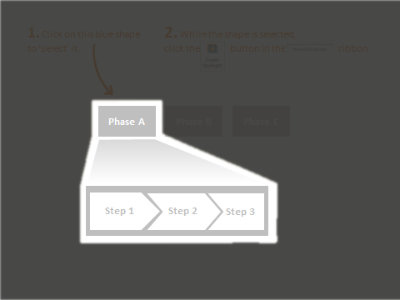

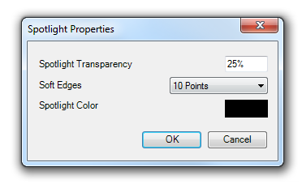
3. Did you notice the new slide with a spotlight? You can press Ctrl+Z (Undo) to reverse the effect.
4. You can also adjust the darkness (transparency), softness of the edges, and the color of the spotlight as below.
Note: the changed settings are applied to spotlights you create in future, not the existing ones.

Slide 11
Next, let’s try the Auto-Animate feature

Slide 12

1. Let’s say you want to animate these shapes so that they end up in the positions given in the next slide.
Research
Marketing
Profit
Development
2. While this slide is selected, click the button. That should insert a new slide containing the animation.

Slide 13
Research
Marketing
Development
Profit

Slide 14
Next, let’s try the Animate in slide feature

Slide 15

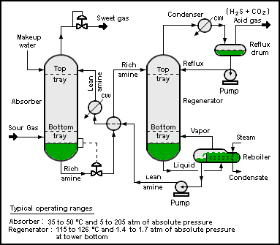
1. Select the four blue circles in any order (Ctrl+click) and click the button.
2. When you ‘play’ the slide show ( ), you should see a single circle animated in the order you selected the four circles previously.
Notes:
Picture credit: Wikipedia

Slide 16
Auto zoom features are next.

Slide 17

1. Select the blue rectangle s in any order (Ctrl+click) and click the zoom to area button.
2. ‘Play’ the slide show ( ) to see the zooming and panning effects generated by PowerPointLabs. If you would like each zoom/pan effect to be put in a separate slide, click the expand ( ) icon below the Zoom to Area button to access settings and select ‘Put all zoom effects on separate slides’ option.

Slide 18




2. Select the blue rectangle and click the button.
Inputs
Process
Output
Ingredient A (60%)
Ingredient B (25%)
C (15%)
3. ‘Play’ the slide show ( ) to see drill down effect generated by PowerPointLabs. The effect tells the audience which part of this slide corresponds to the content of the next slide. For example, here it gives audience the feeling that you are now drilling down to details about the ‘Process’ part of this slide.

Slide 19
L
X
Y
Z
M

Slide 20

4. Select the blue rectangle and click the button to generate a step back effect from the previous slide.
Inputs
Process
Output
Ingredient A (60%)
Ingredient B (25%)
C (15%)
5. Go back a couple of slides and ‘play’ the slide show to see the step back effect generated. This effect can be used to indicate that you are stepping back to take a look at where the details you have been discussing fit into the ‘big picture’.

Slide 21
Next, let’s try the Auto crop feature

Slide 22



1. Select the blue shapes (ctrl + click) and click the button. It will crop the images behind to match the outlines of the shapes.
Notes:
This will play at the beginning.
[afterClick] This will play after you click.

Slide 23

2. You can apply other default PowerPoint effects such as soft-edges to enhance the resulting cropped image even further.
Your child today is …
… the young adult of tomorrow.
Notes:
This will play at the beginning.
[afterClick] This will play after you click.

Slide 24
Next, let’s try the Auto narrate and Auto captions features

Slide 25

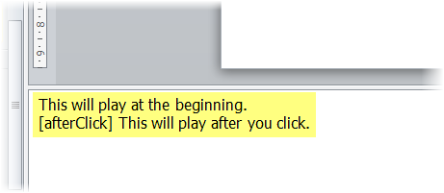

1. Click the button. It will generate an audio narration for this slide based on the slide notes. Play the slide and listen to the generated audio narration.
2. Click the button to generate sub-titles (captions) as well. Play again to experience both audio and captions at the same time.
Tip: You can select multiple slides and apply the above two effects to all selected slides.
Notes:
This will play at the beginning.
[afterClick] This will play after you click.

Slide 26
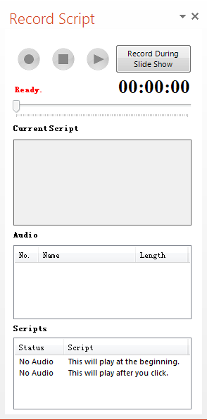
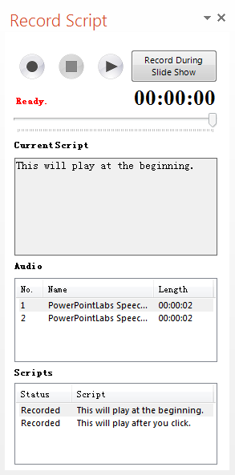



3. To record an audio in your own voice, click the drop down menu of button.
It will show Recorder Script Panel at right side of your screen, showing the recording status of the scripts of current slide.
4. Click on the script you want to record and
click button to start recording. When you
click button, the record will be auto-
embedded on the slide, and you can check it in the panel.
Notes:
This will play at the beginning.
[afterClick] This will play after you click.

Slide 27
Next, let’s try the Shapes Lab feature

Slide 28

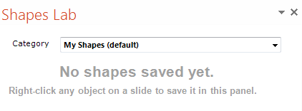
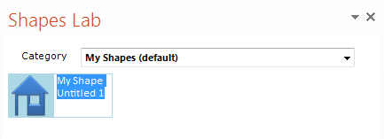
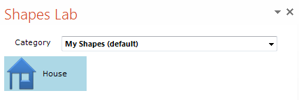
1. Click the button, it will
bring up the Shapes Lab Panel.
2. Right click the ‘house’ shape above and choose “Add to Shapes Lab”. Then you should see your shape in the panel, waiting for you to give it a name.
3. After entering a name, press enter to confirm.

Slide 29
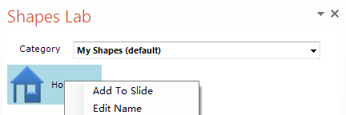
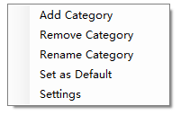
4. Double-click the ‘House’ shape in the Shapes Lab panel to add a copy of it to this slide.
5. To delete or rename the saved shape, right-click and choose the appropriate action from the context menu.
6. Right-click an empty area of the Shapes Lab to change the location where shapes are saved.
Tip: Save shapes in a shared folder (e.g. a Dropbox folder) to share saved shapes among multiple computers.

Slide 30
Next, let’s try the Colors Lab feature

Slide 31

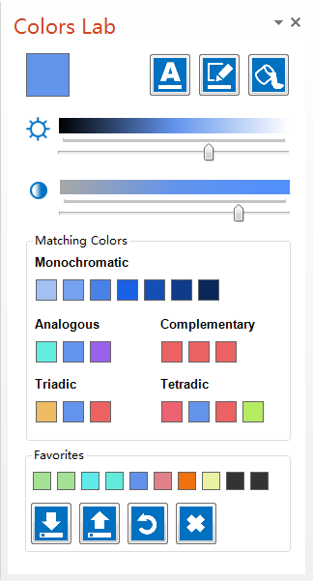

1. Click the button.
It will show the Colors Lab Panel at the right side of
your screen.
2. Click this button to change the main color of the panel.
Drag the same button to pick a color from the surrounding area (it works like a color picker).
You can use it to pick colors even from outside the PowerPoint window.
As you change the main color, other colors in the panel change to give show you matching colors to the one you picked.

Slide 32



3. Select the shape below:
Select me!
4. Drag the button in the panel to change the selected shape’s FONT color.
Drag the button to change its LINE color.
or button to change its FILL color.
Tip: clicking any of those three buttons let you choose a color from the standard color palette.

Slide 33
Next, let’s try the Effects Lab feature

Slide 34

1. Select the picture below, click and choose make transparent option.
Tip: After a picture has been made transparent, you can adjust transparency by right-clicking the picture and choosing format picture → fill.

Slide 35
1. Select the blue circle below, click and choose either Magnifying Glass option. It will create a magnified version of the area covered by the circle.
Tip: You can resize the newly created shape to match the magnifying level you need

Slide 36
1. Select the blue circle below, click and choose either blur selected.
It will blur the area covered by the circle.
Tip: You can create a tinted effect by selecting tint selected, then apply the feature again. You can also adjust the tint color and transparency by right-clicking the tint overlay shape and choosing format picture → fill.

Slide 37
1. Select the blue circle below, click and choose either blur remainder or recolor remainder. It will create a new slide with the desired effect.
Tip: You can apply these two effects to multiple shapes too. Just select the relevant shapes before clicking the button.

Slide 38
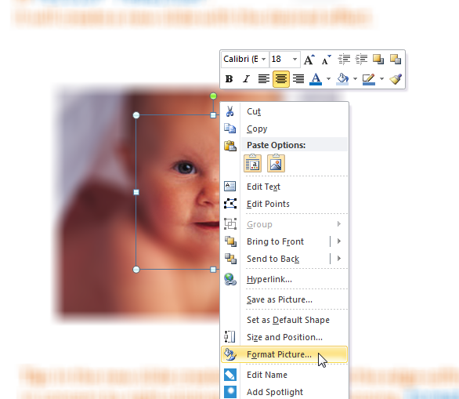
Tip: In the new slide created, you can adjust the edge-softness of the circular area in concern by right-clicking that area and choosing format picture → glow and soft edges.

Slide 39

Next, let’s try the Agenda Lab feature

Slide 40

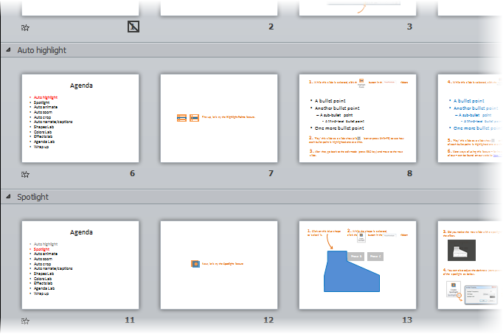
1. Click on the and choose agenda slides (text) option.
That will insert agenda slides into the slide deck. Items in the agenda slides will correspond to the names of the slide sections.

Slide 41
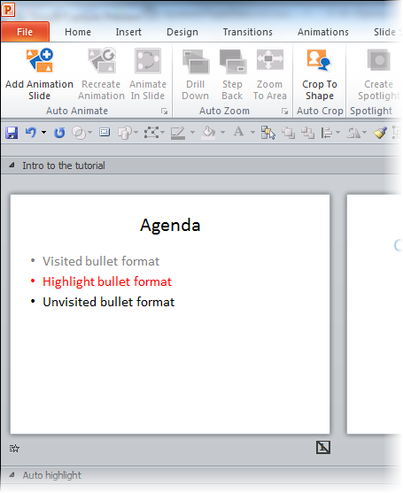
2. Agenda Lab also inserts a hidden ‘Template’ slide at the beginning of the slide deck. That slide can be used to tweak the appearance of the agenda slides, as explained in the next slide.
Template slide

Slide 42
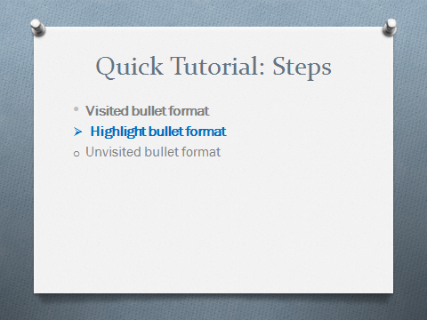
2a. First, modify the agenda slide to match the appearance you want the agenda slides to have.
2b. Then, click on the Agenda Lab button and choose the Synchronize agenda option. That will regenerate all agenda slides to match the template slide.

Slide 43
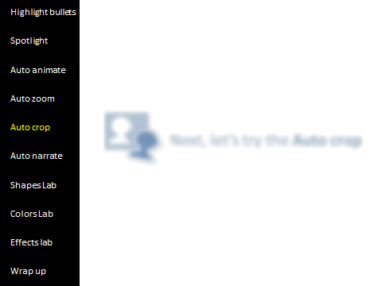
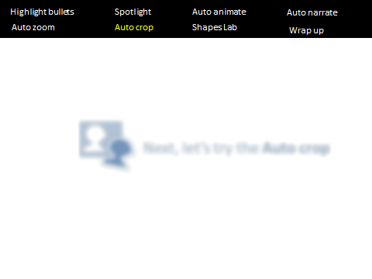
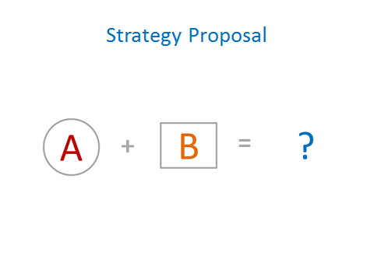
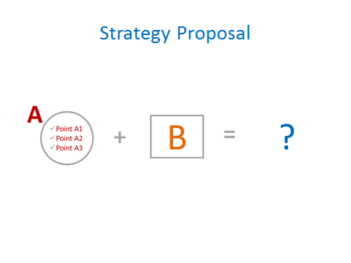
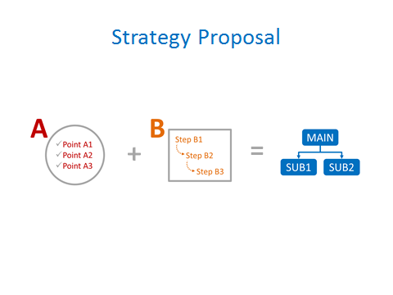
3a. It is possible to insert the Agenda as a sidebar on each slide. Here are two examples:
3b. It is also possible to generate agenda slides containing a visual representation of the topics.
Tip: To find more about Agenda sidebar and Visual agenda features, refer to PowerPointLabs documentation.

Slide 44



Next, let’s try the Picture Slides Lab feature
Notes:
[[Picture taken from https://flic.kr/p/5s5APp on 3/19/2016 4:47:38 PM]]

Slide 45

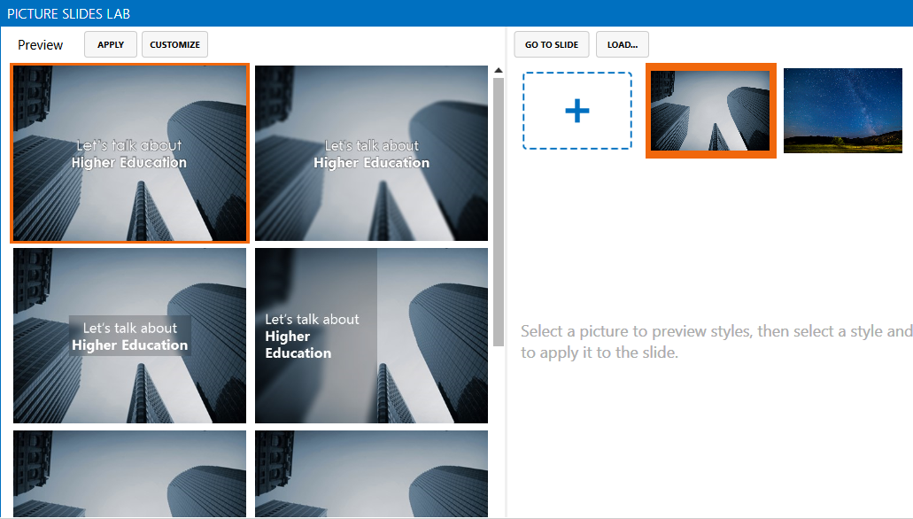
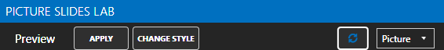
1. Go to the next slide and click the button.
It will show the Picture Slides Lab window. Choose a slide preview in the preview area and click the apply button to apply the style to current slide.
2. To customize slide previews, click the customize button. It will show you how the slide will look like with the various pictures you have on the picture collection area (the right half of the PSL window).
3. To add more pictures, click + and choose more pictures from your computer hard disk.
4. To tweak the design further, choose which aspect you want to tweak.
Tip: To find more about Picture Slides Lab, refer to PowerPointLabs documentation.

Slide 46
Learning is a never-ending journey.
Picture Slides Lab
Demo Slide
Notes:
Picture Slides Lab Demo Slide

Slide 47

Thanks for taking the quick tutorial.
For find more information about these features, visit the documentation on our website.
To give feedback or ask a question, contact us at pptlabs@comp.nus.edu.sg
Happy PowerPointing!

