Slide 1
Examples for Positions Lab

Slide 2

Align to point
Visuals
Visuals
Structure
Structure
Message
Message

Slide 3



Align to point
1/2
1/2

Slide 4




Slide 5
Align using visual edges
PowerPoint
PowerPointLabs

Slide 6
Vertical adjoin
ANALYSIS
DESIGN
IMPLEMENTATION
TESTING
Horizontal adjoin + align
ANALYSIS
DESIGN
IMPLEMENTATION
TESTING

Slide 7


ANALYSIS
DESIGN
ANALYSIS
DESIGN
IMPLEMENTATION
IMPLEMENTATION
TESTING
Horizontal adjoin + align
TESTING
ANALYSIS
TESTING
IMPLEMENTATION
ANALYSIS
DESIGN
IMPLEMENTATION
TESTING
DESIGN

Slide 8
Fruits
Protein
Protein
Fruits
Fats
Vegetables

Slide 9

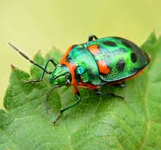


Horizontal distribute, equalize width between objects
Distribute between 1st and 2nd objects.
LAUNCH
TESTING
IMPLEMENTATION
DESIGN
ANALYSIS

Slide 10


Slide 12

LAUNCH
TESTING
IMPLEMENTATION
DESIGN
ANALYSIS
LAUNCH
TESTING
IMPLEMENTATION
DESIGN
ANALYSIS

Slide 14

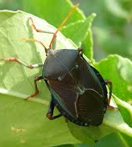


Grid, equalize space between edges

Slide 15
3
4
1
5
8
2
6
7

Slide 16
Left + Right
Within First and Second
Top + Bottom

Slide 17
Left
Center
Right
Top
Center
Bottom

Slide 18

Grid, equalize space between object centers
Male
Female
N/A
Canada
USA
Mexico

Slide 19
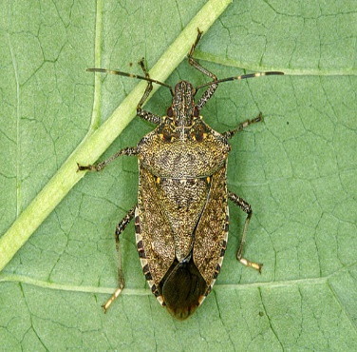

Swap

Slide 20
Cyclic Swap
Team F 19
Team F 19
Team A 15
Team B 17
Team C 15
Team A 15
Team D 13
Team C 15
Team B 11
Team D 13

Slide 21
Cyclic Swap by clicking order
Team C 16
Team B 20
Team D 13
Team F 19
Team A 15
Team C 16
Team F 19
Team A 15
Team B 20
Team D 13

Slide 22

Swap anchor point

Slide 23
Repack

Slide 24
Point away/towards object
Primary cause 1
Secondary causes
Primary cause 2
Primary cause 3

Slide 25

Rotate around object
Horizontal move
A
B
A
B

Slide 26

Snap horizontal

Slide 27

Snap away

