Slide 1
Examples for Positions Lab

Slide 2

Align to point
Visuals
Visuals
Structure
Structure
Message
Message

Slide 3
Message
Structure
Visuals
Visuals
Structure
Message
Message
Message
Structure
Structure
Visuals
Visuals

Slide 4

Message
Structure
Visuals
Visuals
Structure
Message

Slide 5

Visuals
Structure
Message

Slide 6


Slide 7

Research
Research
Writing
Essay
Writing
Essay
Plan
Plan
Write
Write
Edit
Edit

Slide 8




Slide 10
1/2
1/2

Slide 11
Align using visual edges
PowerPoint
PowerPointLabs

Slide 12
Vertical adjoin
ANALYSIS
DESIGN
IMPLEMENTATION
TESTING
Horizontal adjoin + align
ANALYSIS
DESIGN
IMPLEMENTATION
TESTING

Slide 13


ANALYSIS
DESIGN
ANALYSIS
DESIGN
IMPLEMENTATION
IMPLEMENTATION
TESTING
Horizontal adjoin + align
TESTING
ANALYSIS
TESTING
IMPLEMENTATION
ANALYSIS
DESIGN
IMPLEMENTATION
TESTING
DESIGN

Slide 14

Fruits
Protein
Protein
Fruits
Fats
Fats
Protein
Fruits
Protein
Fruits
Vegetables
Vegetables

Slide 15


1
1
2

Slide 16

2
1
2
1
3

Slide 17
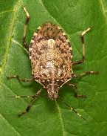
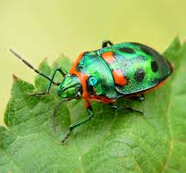
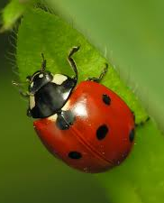
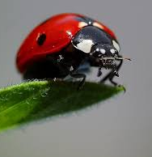
Shape Edges
Vs
Shape Centers

Slide 18
Horizontal distribute, equalize width between objects
Distribute between 1st and 2nd objects.
LAUNCH
TESTING
IMPLEMENTATION
DESIGN
ANALYSIS

Slide 21

LAUNCH
TESTING
IMPLEMENTATION
DESIGN
ANALYSIS
LAUNCH
TESTING
IMPLEMENTATION
DESIGN
ANALYSIS

Slide 22
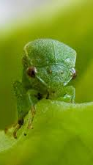
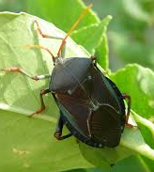
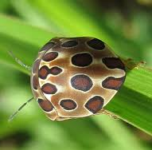
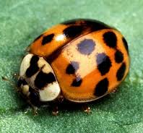
Grid, equalize space between edges

Slide 23
3
4
1
5
8
2
6
7

Slide 24
Left + Right
Within First and Second
Top + Bottom

Slide 25
Left
Center
Right
Top
Center
Bottom

Slide 26

Grid, equalize space between object centers
Male
Female
N/A
Canada
USA
Mexico

Slide 27
Clear
Clear
Concise
Current
Concise
5 C’s
5 C’s
Complete
Consistent
Consistent
Complete
Current

Slide 28
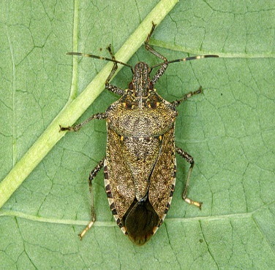

Swap

Slide 29
Cyclic Swap
Team F 19
Team F 19
Team A 15
Team B 17
Team C 15
Team A 15
Team D 13
Team C 15
Team B 11
Team D 13

Slide 30
Cyclic Swap by clicking order
2
Team C 16
Team B 20
5
Team D 13
Team F 19
3
Team A 15
Team C 16
4
Team F 19
Team A 15
1
Team B 20
Team D 13

Slide 31
Swap anchor point

Slide 32
Repack

Slide 33
Point away/towards object
Primary cause 1
Secondary causes
Primary cause 2
Primary cause 3

Slide 34

Rotate around object
Horizontal move
A
B
A
B

Slide 35

Snap horizontal

Slide 36

Snap away

