Slide 1
Phase A
Phase B
Phase C
Step 1
Step 2
Step 3

Slide 2
Phase A
Phase B
Phase C
Step 1
Step 2
Step 3

Slide 3

Phase A
Phase B
Phase C
Step 1
Step 2
Step 3

Slide 4
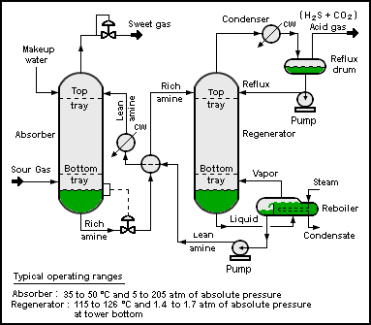
Magnify

Slide 5
Magnify

Slide 6
Blur remainder

Slide 7
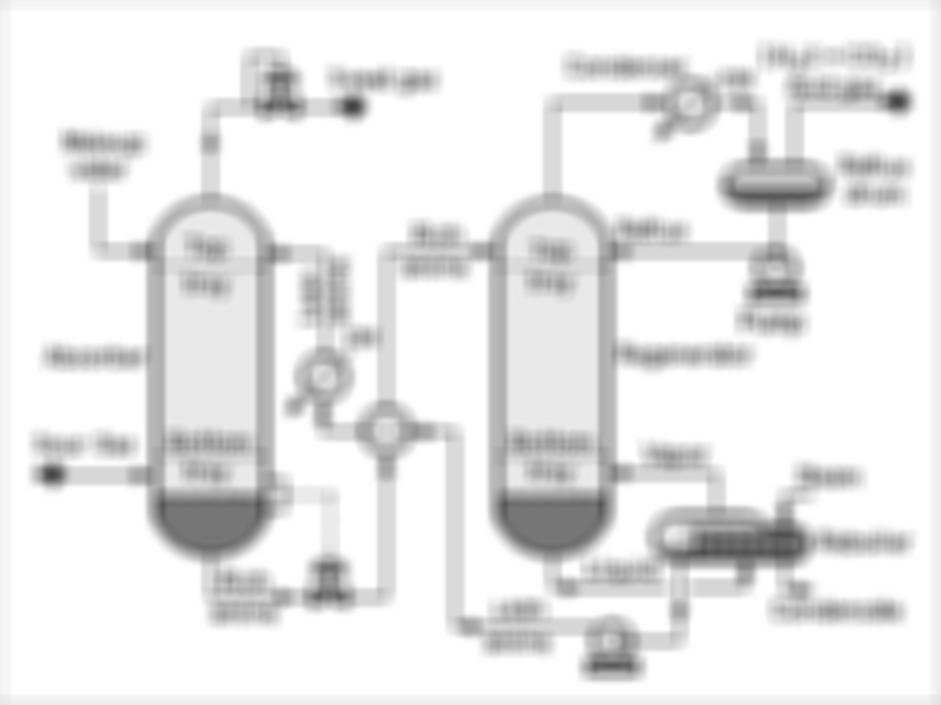


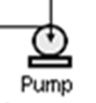
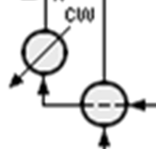
Blur remainder

Slide 8
Recolor remainder

Slide 9
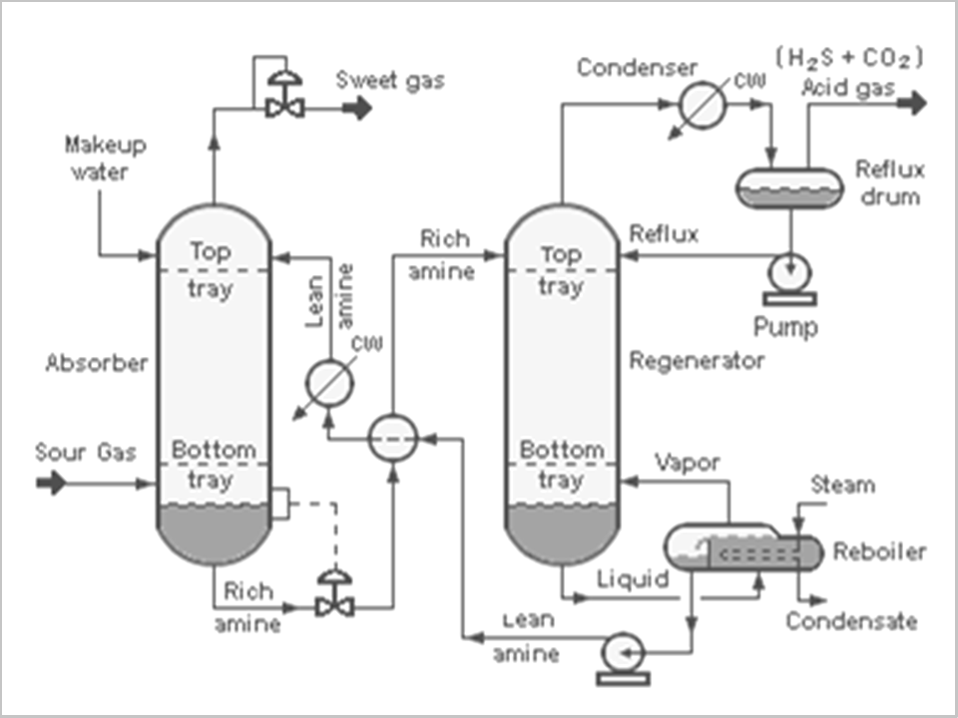
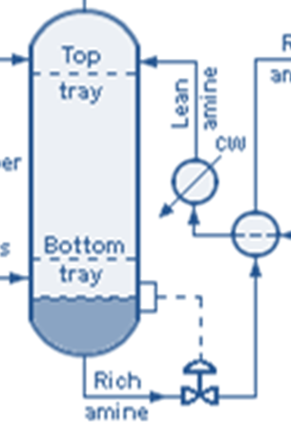
Recolor remainder

Slide 10
