Slide 1
PowerPointLabs Test Cases
General instructions:
DO NOT SAVE these slides after testing. Keep this file in its original form.
If your result is different from the expected output, please submit a bug report (attach slides/screenshots as necessary).

Slide 2
Zoom To Area
Additional instructions:
Select the BLUE color shape.
Click “Zoom To Area” button in the ribbon.
Compare the result with the expected output.

Slide 3
Zoom to Area:: Single Shape

Slide 4
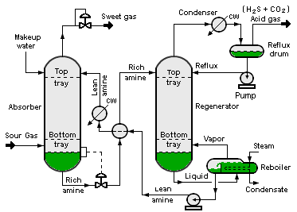

Slide 5
Zoom Shape 1

Slide 6
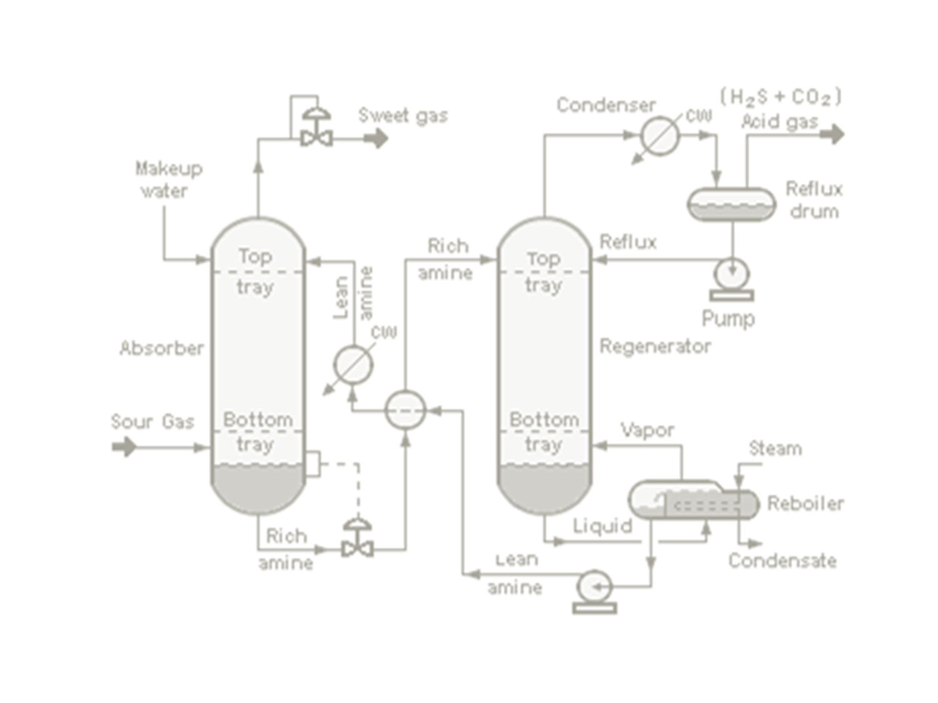


Slide 9
Zoom to Area:: Single Shape
Use these settings:
Include Slide Background: False
Put all zoom effects on separate slides: False

Slide 11
Zoom Shape 1

Slide 13
Zoom to Area:: Multiple Shapes
Select all blue rectangles sequentially.

Slide 14

2
1
TEXT IN SLIDE
3
4

Slide 15
Zoom Shape 1
Zoom Shape 2
2
Zoom Shape 3
1
TEXT IN SLIDE
3
Zoom Shape 4
4

Slide 16
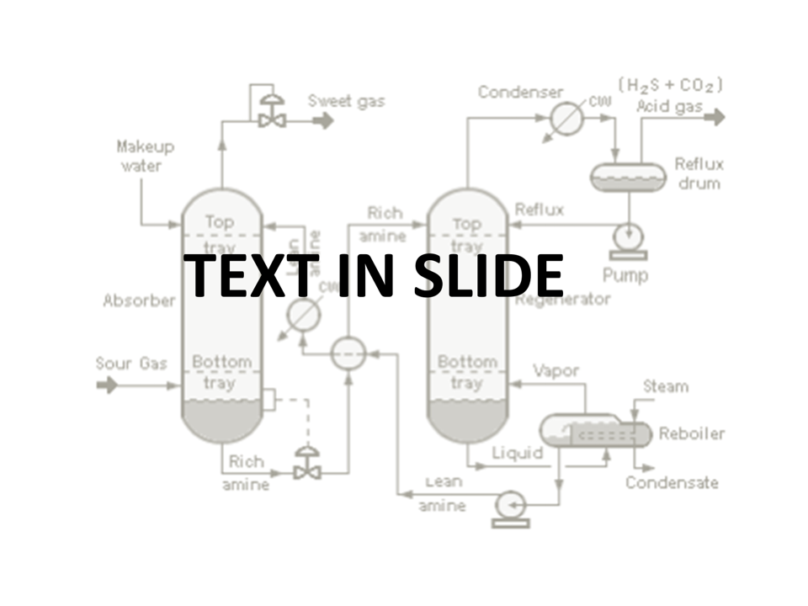

TEXT IN SLIDE

Slide 24
TEXT IN SLIDE

Slide 25
Zoom to Area:: Multiple Shapes
Select all blue rectangles sequentially.
Use these settings:
Include Slide Background: True
Put all zoom effects on separate slides: False

Slide 26
2
1
TEXT IN SLIDE
3
4

Slide 27
Zoom Shape 1
Zoom Shape 2
2
Zoom Shape 3
1
TEXT IN SLIDE
3
Zoom Shape 4
4

Slide 28

TEXT IN SLIDE
TEXT IN SLIDE

Slide 29
Zoom to Area:: Multiple Shapes
Select all blue rectangles sequentially.
Use these settings:
Include Slide Background: False
Put all zoom effects on separate slides: True

Slide 30
2
1
TEXT IN SLIDE
3
4

Slide 31
Zoom Shape 1
Zoom Shape 2
2
Zoom Shape 3
1
TEXT IN SLIDE
3
Zoom Shape 4
4

Slide 32
TEXT IN SLIDE

Slide 40
TEXT IN SLIDE

Slide 41
Zoom to Area:: Multiple Shapes
Select all blue rectangles sequentially.
Use these settings:
Include Slide Background: False
Put all zoom effects on separate slides: False

Slide 42
2
1
TEXT IN SLIDE
3
4

Slide 43
Zoom Shape 1
Zoom Shape 2
2
Zoom Shape 3
1
TEXT IN SLIDE
3
Zoom Shape 4
4

Slide 44
TEXT IN SLIDE
TEXT IN SLIDE

Slide 45
