Slide 1

ISASP Training:
Using and Interpreting Reports
Illustration by Lucy Vigrass
ISASP Reports Training
‹#›
Notes:
Welcome to the Iowa Statewide Assessment of Student Progress Reports Training on the Use and Interpretation of Reports.
Our objective today is to provide guidance on how to use and interpret the score reports being made available after the test has been administered. The slides used in this presentation are available for you to download and use locally as needed.

Slide 2
Purpose of the ISASP
Notes:
(Transition slide)

Slide 3
Purpose of the ISASP
The Iowa Statewide Assessment of Student Progress (ISASP) is aligned with the Iowa Core Standards, providing clear and accurate assessment of student learning outcomes. The ISASP is developed in collaboration with Iowa educators for the state of Iowa and aligns with the grade-specific Iowa Core Standards. Using a variety of item types (extended response, short answer, technology-enhanced items, and selected response), the ISASP provides assessment information that is relevant and actionable.
Notes:
The Iowa Statewide Assessment of Student Progress, or ISASP, was initiated after the Spring, 2018 Iowa Legislative session, during which the Iowa Department of Education and Iowa Testing Programs were charged with creating an assessment aligned to the Iowa Core Standards, to be ready for administration in Spring, 2019.

Slide 4
ISASP Blueprints and Specifications
Notes:
Test blueprints and specifications establish the composition of any assessment. They define what content and standards the test is intended to measure, the approximate length of the assessment, and the desired scores and data the test is expected to provide to end-users.

Slide 5
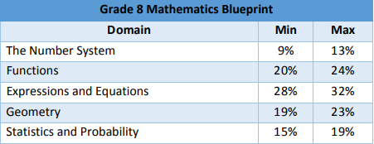
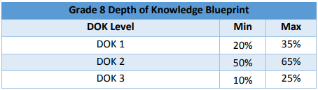
Grade 8 Mathematics Blueprint (For illustration purposes)
Notes:
This is an example of one of the blueprints for the ISASP. There are two dimensions to this table--one based on domain, and one based on depth of knowledge (or DOK). This blueprint establishes ranges for the percentages of test items (or questions) for the test form in Grade 8 Mathematics. All items selected for the assessment will be associated with a domain and a DOK level, and the final form of the test will be reviewed to confirm the balance of items within each of these categories.

Slide 6
Link to All ISASP Blueprints
ELA Blueprints (Grades 3 through 11):
http://iowa.pearsonaccessnext.com/resources/test-prep/ISASP2019ELABlueprints.pdf Note: ELA includes both Reading and Language/ Writing
Mathematics Blueprints (Grades 3 through 11):
http://iowa.pearsonaccessnext.com/resources/test-prep/ISASP2019MathematicsBlueprints.pdf
Science Blueprints (Grades 5, 8, and 10):
http://iowa.pearsonaccessnext.com/resources/test-prep/ISASP2019ScienceBlueprints.pdf
Notes:
The full set of test blueprints may be found on the ISASP portal via these URLs.

Slide 7
Cut Score Ranges and Performance Level Descriptors
Notes:
Performance levels are used to classify and describe student performance on an assessment. In order to classify student performance into different performance levels, the following components are required: General Performance Level Descriptors, Detailed Performance Level Descriptors (PLDs), and cut scores.

Slide 8
General Performance Level Descriptors
Advanced
Students performing at the Advanced level demonstrate thorough competency over the knowledge, skills, and abilities that meet the requirements for their grade level associated with academic readiness for college and career in the subject area
Proficient
Students performing at the Proficient level demonstrate adequate competency over the knowledge, skills, and abilities that meet the requirements for their grade level associated with academic readiness for college and career in the subject area
Not Yet Proficient
Students performing at the Not Yet Proficient level have not yet demonstrated the knowledge and skills to be classified as Proficient
Notes:
These are the General Performance Level Descriptors, sometimes referred to as “PLDs”. These PLDs provide general descriptions of what typical students at each performance level know and what they are able to do. Reviewed together with grade- and content-specific PLDs and cut scores, they convey the meaning of the ISASP results.

Slide 9
Performance Level Descriptors
Detailed Performance Level Descriptors for each grade level may be accessed at these links:
ELA: http://iowa.pearsonaccessnext.com/resources/reports/ISASP_ELAPLD_101119.pdf
Mathematics: http://iowa.pearsonaccessnext.com/resources/reports/ISASP_MathPLD_101119.pdf
Science: http://iowa.pearsonaccessnext.com/resources/reports/ISASP_Science_PLD_101119.pdf
Notes:
Detailed Performance Level Descriptors for each content area and grade level have been developed to provide more information about the typical students at each proficiency level. To view the grade- and content-specific PLDs, please visit the ISASP portal > Research > Performance Levels, or access them directly via these URLs.

Slide 10
Achievement Levels and Cut Scores
Both Achievement Levels and cut score ranges were established in a standard setting committee meeting in summer 2019.
185 educators from across Iowa participated
The Achievement Levels and cut score ranges were then approved by the Iowa State Board of Education in September 2019.
Notes:
Achievement Levels and proficiency cut scores were identified in a week-long process that took place in July, 2019. Following a process used by dozens of other states, 185 educators from across Iowa met in grade/subject teams to define achievement levels and to identify corresponding cut score points. The recommended Achievement Levels and cut scores were then presented to and approved by the Iowa State Board of Education in September.

Slide 11
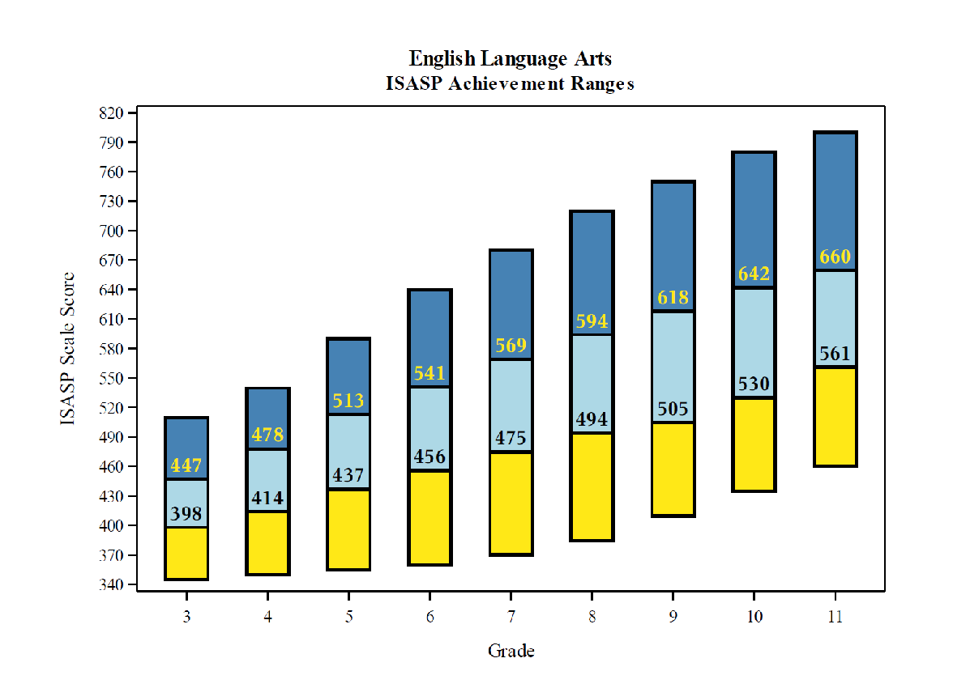
Cut Scores - English Language Arts
Notes:
Cut scores represent the lowest boundary of each achievement level on the scale used to report ISASP scores. This graph shows, by grade, the proficient and advanced cut scores for English Language Arts (or ELA). It also provides an illustration of the properties of the ISASP score scale, whereby the scores associated with a certain achievement level increase as students progress through the grades.
For example, in 3rd grade, a student who achieved a 398 in the ISASP English Language Arts test is considered proficient (the light blue are of the graph). If that student had achieved a 447 or more on the test, they would be considered advanced (the dark blue area of the graph).

Slide 12
Cut Scores - English Language Arts
 | Not Yet Proficient | Proficient | Advanced
Grade 3 | 345 to 397 | 398 to 446 | 447 to 510
Grade 4 | 350 to 413 | 414 to 477 | 478 to 540
Grade 5 | 355 to 436 | 437 to 512 | 513 to 590
Grade 6 | 360 to 455 | 456 to 540 | 541 to 640
Grade 7 | 370 to 474 | 475 to 568 | 569 to 680
Grade 8 | 385 to 493 | 494 to 593 | 594 to 720
Grade 9 | 410 to 504 | 505 to 617 | 618 to 750
Grade 10 | 435 to 529 | 530 to 641 | 642 to 780
Grade 11 | 460 to 560 | 561 to 659 | 660 to 800
Notes:
Those same ELA cut scores are presented here in table form.

Slide 13

Cut Scores - Mathematics
Notes:
This graph shows, by grade, the proficient and advanced cut scores for Mathematics. Please note that the cut scores for Mathematics differ from those for ELA.

Slide 14
Cut Scores - Mathematics
 | Not Yet Proficient | Proficient | Advanced
Grade 3 | 345 to 389 | 390 to 442 | 443 to 510
Grade 4 | 350 to 408 | 409 to 475 | 476 to 540
Grade 5 | 355 to 428 | 429 to 502 | 503 to 590
Grade 6 | 360 to 449 | 450 to 531 | 532 to 640
Grade 7 | 370 to 468 | 469 to 574 | 575 to 680
Grade 8 | 385 to 489 | 490 to 605 | 606 to 720
Grade 9 | 410 to 512 | 513 to 625 | 626 to 750
Grade 10 | 435 to 536 | 537 to 653 | 654 to 780
Grade 11 | 460 to 558 | 559 to 674 | 675 to 800
Notes:
Again, the same Math cut scores presented in table form.

Slide 15
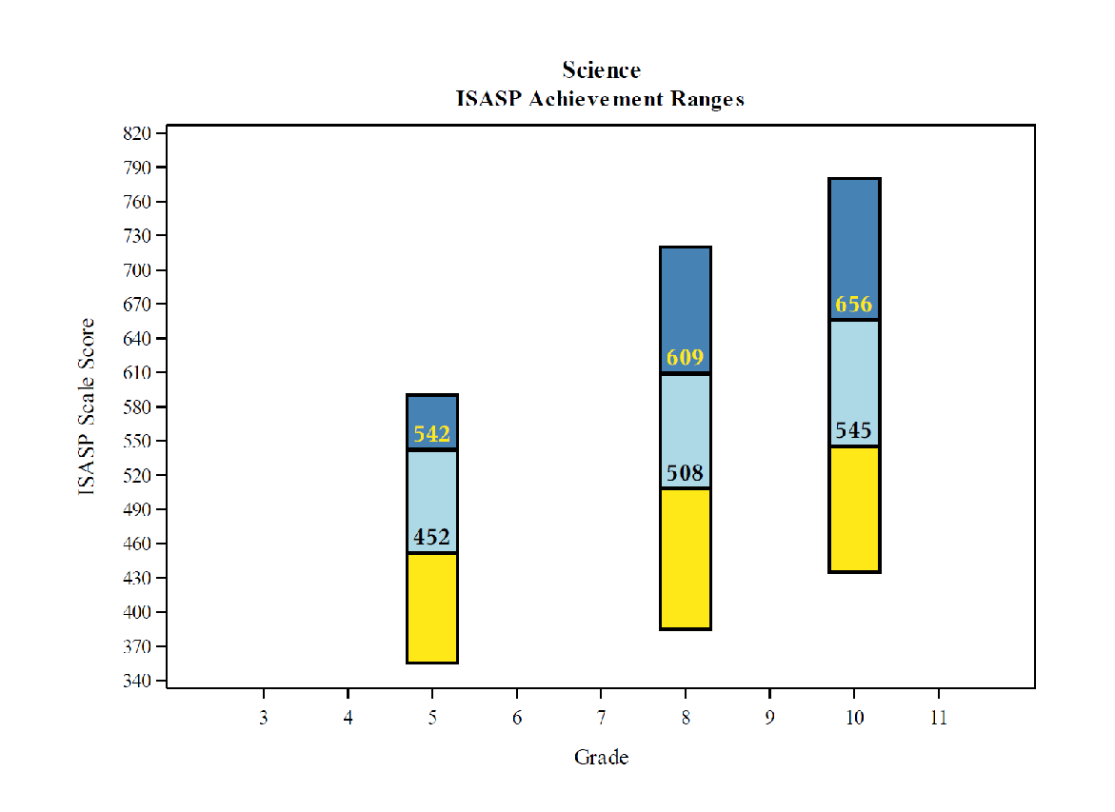
Cut Scores - Science
Notes:
Science is only tested in three grades, as represented by this graph. Again, you will note that the cut scores increase by grade, though changes in student performance between tests may not be as directly comparable as they may be with ELA or Mathematics.

Slide 16
Cut Scores - Science
 | Not Yet Proficient | Proficient | Advanced
Grade 5 | 355 to 451 | 452 to 541 | 542 to 590
Grade 8 | 385 to 507 | 508 to 608 | 609 to 720
Grade 10 | 435 to 544 | 545 to 655 | 656 to 780
Notes:
The table of Science proficient and advanced cut scores.

Slide 17
Scale Metrics

Slide 18
Vertical Scale Score Definition
The score scale of the ISASP is a vertical scale that spans the full performance continuum on each test from grades 3 to 11.
The scale addresses relative difficulty of tests
The scale ranges from 345 to 800
The scale is designed to allow for growth to be measured across years
Shows meaningful progress
Can be used to set goals
Unique to ISASP--should not be compared to other assessments’ scores
Notes:
ISASP uses a vertical scale that spans the full performance continuum on each test from grades 3 to 11.
The scale is designed to allow for growth to be measured across years, and can be used to show meaningful progress and to set goals.
The scale is unique to ISASP, and these scores should not be compared to other assessments’ scores

Slide 19
ISASP scores are not comparable to prior scores
ISASP | Prior to ISASP
All students tested in the spring of 2019 | Schools opted to test at any time throughout the year
ISASP was developed to be specifically aligned to the Iowa Core | A national assessment was used
English Language Arts standards in reading, writing and language were measured | Only standards in reading were measured
Essays and constructed-response questions were included in addition to multiple-choice questions | All questions were multiple-choice
Grade-specific content (as defined by the Iowa Core) was measured | Content across two grades was measured
A standard setting study was completed to define cut scores for the three levels of performance. | A statistical procedure was used to define cut scores for the three levels of performance.
Notes:
This table highlights some of the significant differences between ISASP and tests taken by students throughout the state. Decisions made by local districts around time of year, the content and standards being assessed, the types of test questions, and the process used to define standards all serve as reasons why scores should not be compared.

Slide 20
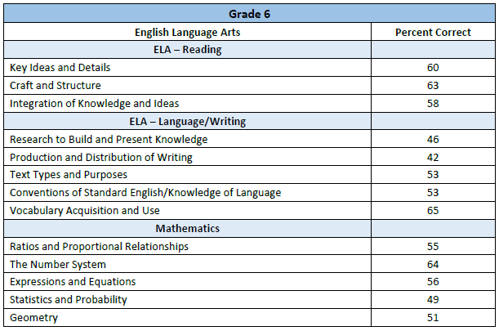
Domain Scores
Tables with Statewide percent correct in each domain will be available
Notes:
Page two of each individual student report (ISR) will display how the student responded to items in the various domains of the Iowa Core assessed at that grade. To help educators identify potential areas of focus, ITP makes available tables, sorted by grade-level, showing the average performance of all students across the state within those domains.

Slide 21
Interpreting Results

Slide 22
Information Provided by ISASP
Interpretations and inferences supported by ISASP
Performance on the Iowa Core
Scale Score
Achievement Level of Students
Easy-to-see graphical representation
Presented on Individual Student Reports (ISR) and Rosters
Notes:
Results on how students performed on the Iowa Core will be presented on Individual Student Reports (ISRs) and Student Rosters (which are lists of students, grouped by grade). On these reports, you will see students’ scale scores and achievement level.

Slide 23
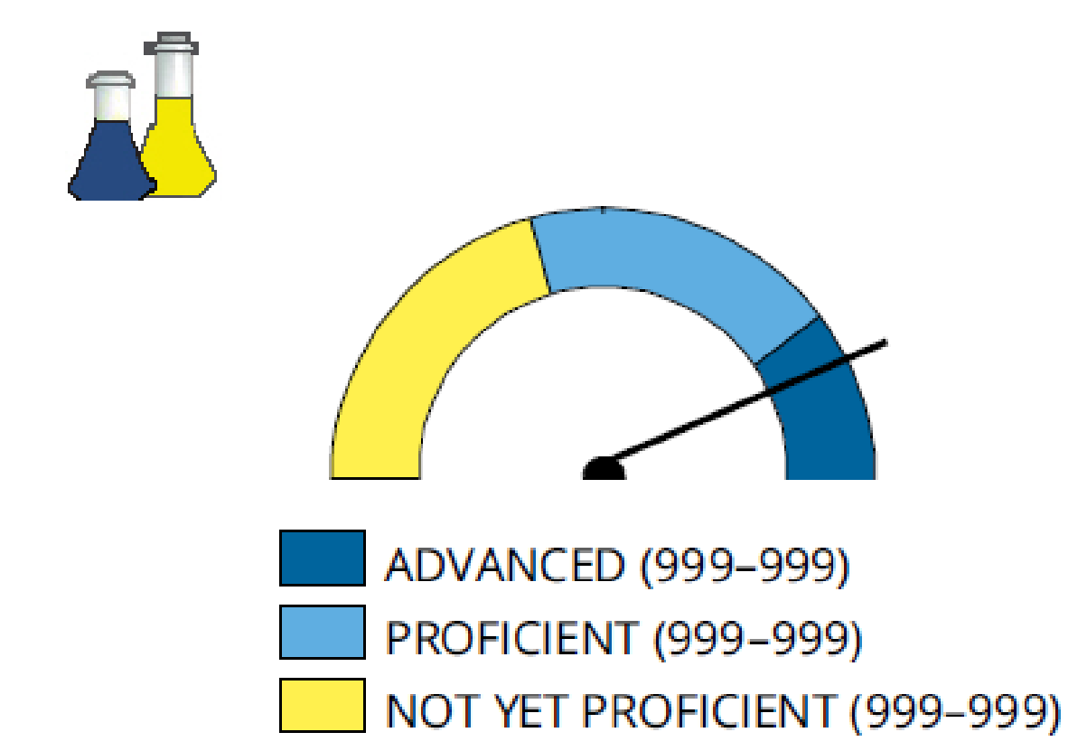
Clear Indicator of Achievement Level
Achievement Levels
Notes:
On the ISR, a large and easy-to-understand meter shows graphically the student’s achievement level.

Slide 24
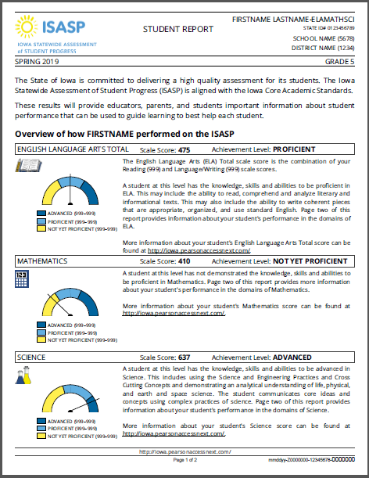
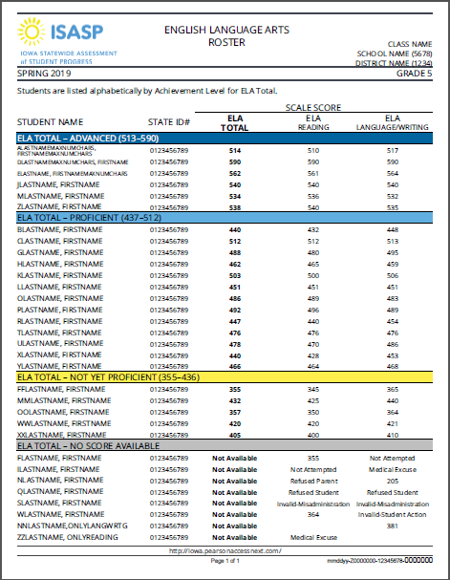
Individual Student Report Roster
Notes:
The student proficiency information is presented in a number of ways on the reports.
On the ISR, as mentioned before, the meter displays the student’s status (see the arrow). Information is provided under each meter with the appropriate proficiency cut scores. The ISR will also display a horizontal bar, with the student’s scale score and achievement level (see the second arrow).
The ISR should be provided to parents to share student results. Please be aware that you will only receive an ISR for the subject or subjects the student completed at your school. As a result, for students who have changed buildings, the student’s previous school must be contacted to obtain scores.
The roster also presents achievement at the individual student level. On this report, students are first grouped into achievement level (Advanced, followed by Proficient then Not yet Proficient), and then listed alphabetically. To the right of the student’s names are their ISASP scale scores.

Slide 25
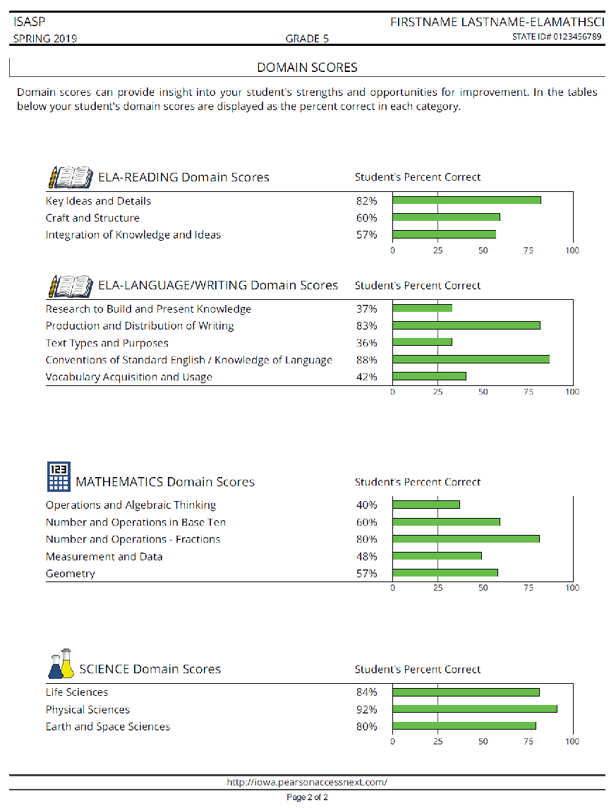
Information Provided by ISASP
Interpretations and Inferences supported by ISASP
(A) Relative areas of strength by domain
(B) Percent correct within the domains of each subject area
A
B
Notes:
The second page of the ISR outlines how a student scored in each of the Iowa Core domains, listing the percentage of questions the student answered correctly in the domains for each subject. The domain scores should not be averaged to determine whether the student should be Advanced, Proficient, or Not-Yet Proficient. And, as mentioned before, ITP provides tables of statewide percent correct for each domain to support additional analyses.

Slide 26
Rosters also provide information for students with no scores
Notes:
This section of the Roster will identify students who did not receive a score. It may indicate a reason for there being no score, but only if a reason was recorded in the system by the school.

Slide 27
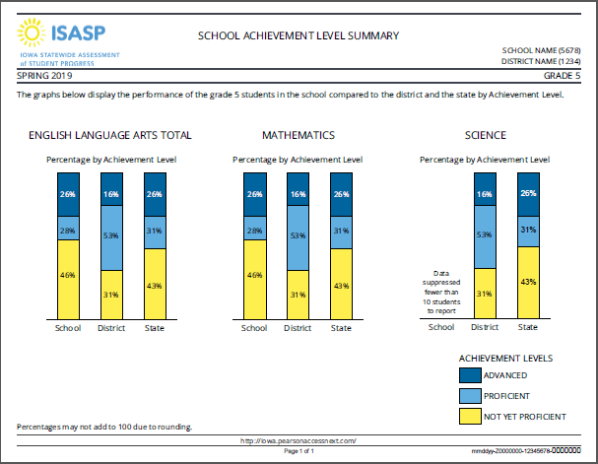
School Achievement Level Summary
Notes:
Reports of aggregated or group-level results are also available.
The School Achievement Level Summary shows the percentage of students at the school, district and state for each achievement level. This report should be used to compare your school to the state and the district.
(Please note, as you can see in this example, results will not be displayed if too few students were tested.)
You will also be able to access a District Achievement Level Summary, comparing your district to the state.

Slide 28



Additional Information
Iowa Percentile Ranks
Posted to ISASP Portal
Provides a point of reference
Growth
Available after 2020 data
College Readiness Information
Validity study
Link to ACT
Notes:
Tables with Iowa-specific percentile ranks associated with the ISASP scale scores will be posted on the portal. Educators may find these useful in identifying groups of students for whom additional educational services may be beneficial.
After the 2020 administration of the ISASP, we will have two observations of test scores for students in Mathematics and ELA. We will have additional information later this year on how changes in student scores will be presented.
A study is planned to identify appropriate links between ISASP scores and college readiness. Results will be available after sufficient data has accumulated on student ISASP scores, ACT scores, and college performance.

Slide 29
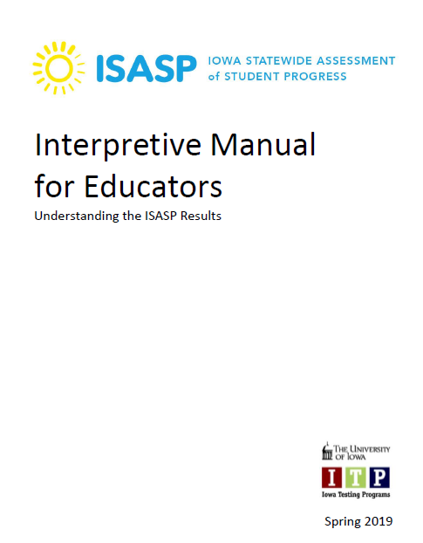
Interpretive Manual
Accessible on the Portal at:
http://iowa.pearsonaccessnext.com/addtl-rpt-resources/
Notes:
The information presented in this training module can also be found in the Interpretive Manual for Educators, accessible via the ISASP Portal or this URL.

Slide 30
Questions?
Please e-mail to Iowa Testing Programs
Iowa-testing-programs@uiowa.edu
Notes:
Thank you for your attention and interest. Please direct any questions about using and interpreting the ISASP reports to Iowa Testing Programs via e-mail: iowa-hyphen-testing-programs at uiowa dot edu.
Thank you.

