Slide 1
Understanding WCAS Score Reports
September 20, 2018
Office of Superintendent of Public Instruction
Chris Reykdal, State Superintendent
Notes:
Welcome
Slides are on the science assessment webpage.

Slide 2
Values:
Vision:
All students prepared for post-secondary pathways, careers, and civic engagement.
Mission:
Transform K–12 education to a system that is centered on closing opportunity gaps and is characterized by high expectations for all students and educators. We achieve this by developing equity-based policies and supports that empower educators, families, and communities.
Ensuring Equity
Collaboration and Service
Achieving Excellence through Continuous Improvement
Focus on the Whole Child
Notes:
This slide contains the agency’s new Vision and Mission statements and key values.
You’ve likely seen the Vision statement in agency email signature blocks.
Related to the agency Mission, the assessment development team is committed to providing supports to empower educators’ understanding of the standards, assessment, and assessment results. This webinar is work to provide you with resources to better understand the score reports for the WCAS and communicate results with parents.
From the values, we are providing and posting these slides and a recording of the webinar to increase equitable access to the information. You are welcome to use these slides, modified as you need, in any way you would like with your colleagues, parents, or others. As we can improve our practice related to these webinars, please do let us know using the Q&A feature or by email.

Slide 3
Assessment Development
Our Belief:
OSPI provides educators with critical tools, resources, and professional development to determine and communicate where students are in their learning and growth. An end-of-year, summative assessment is one tool for gaining information about student learning achievements during the year.
Our Goals:
Continue to develop high quality assessments that add value to Phase I of Superintendent Reykdal’s K–12 Education Vision for 2017–19.
Promote the message that a summative assessment is one tool for gaining information about student learning and growth.
Promote and expand relationships with the OSPI Career and Technical Education and Learning and Teaching departments, and establish and promote relationships with the Migrant & Bilingual Education, Educator Growth and Development, and Special Education departments to enhance educators’ understanding of student learning and assessment.
Continue to improve the quality and equitable access of the state assessments and the quality, equitable access, and usability of assessment resources that we make available to educators and district staff.
Notes:
This is our department’s belief around our role in the education community and the role of summative assessment. Specifically, we are committed to providing resources and support to educators to increase student learning and growth. We believe that summative assessment plays a role in that support as one of multiple measures about student learning during a year.
Our goals reflect a commitment to the superintendent’s vision and collaborative, ongoing work to support educators in moving student learning forward.
This webinar is the result of Goal #4.

Slide 4
Introductions
This presentation contains a script in the notes
Section. If you are accessing this information with a
screen reader, be sure you are reading the notes
Section as well as the text contained in the slides.
Anton Jackson – Director of Assessment Development
anton.jackson@k12.wa.us
Dawn Cope– Science Assessment Lead
dawn.cope@k12.wa.us
Kara Todd– Content Coordinator for Assessment Development
kara.todd@k12.wa.us
Notes:
Staff who are presenting and their contact information

Slide 5
Intended Audience and Purpose
Who
Teachers, Principals
District Administrators, District Test Coordinators
Family-School Partnership staff
What
Answer common questions & share resources for communicating test scores with families
Notes:
This webinar is designed primarily for educators:
First, to increase understanding of the reporting for the WCAS.
Second, to provide resources for communicating results with and answer questions from parents
Parents will be getting student score information, and may be attending this webinar.

Slide 6
Agenda
Overview
Categories of common questions
Resources for communicating test scores with families
This webinar will be recorded and posted (along with this PPT) for future use:
In PLCs, department, staff meetings
During back-to-school, parent-teacher, family outreach nights
To add to presentations (choose, modify slides as needed)
Notes:
Overview: We first want to provide some background. The background is tailored to answer many of the questions you submitted when you registered for the webinar.
Questions: Thank you for all your questions submitted during registration for the webinar. Those questions not answered in the overview section will be explored a bit in this Questions section.
Resources: Where to go for more information or to share with parents
Posting: A recording of this webinar will be posted for your use later in the year. As you have questions or comments during the webinar, please submit those using the Q&A feature of the webinar, and we will compile those for an FAQ and post it along with the recording.

Slide 7
Overview
Notes:
The bulk of the questions that were submitted for this webinar indicated that many attendees are new to thinking and learning about the new Washington Comprehensive Assessment of Science, so I am going to turn it over to Dawn Cope, who has been leading the development of the WCAS since we adopted new science learning standards in 2013. Dawn will give us all an introduction to the WCAS that will ground us for the remainder of the presentation.

Slide 8
Learning Standards
The WCAS is aligned to the Washington State 2013 K–12 Science Learning Standards which are the Next Generation Science Standards
The NGSS were adopted in October 2013
Different than the 2009 learning standards assessed on the Measurements of Student Progress (MSP) and Biology End-of-Course (EOC)
Different than the English language arts/literacy and mathematics learning standards
The NGSS Performance Expectations (PEs) are 3-dimensional:
Science and Engineering Practices (SEP)
Disciplinary Core Ideas (DCI)
Cross-Cutting Concepts (CCC)
Notes:
The items that make up the WCAS are aligned to the Washington State 2013 K–12 Science Learning Standards which are the Next Generation Science Standards. The NGSS were adopted in October 2013 as our state science learning standards. They are different than the 2009 learning standards that were tested using the MSP and the Biology EOC. The NGSS are also different than the Common Core State Standards that were adopted as our state learning standards for English language arts and mathematics.
One of the main differences between the NGSS and 2009 WA science learning standards is that, while our former standards included many components, such as systems and engineering/design, those components were assessed and reported independently from one another on the MSP and EOC. In the both NGSS and the WCAS, these types of components are woven together. Because of the differences in the standards assessed, comparisons between MSP/EOC results and WCAS results are not recommended; the WCAS represents a new baseline from which to measure growth in subsequent years related to student learning of the new standards.
The NGSS are different than the Common Core English language arts/literacy and mathematics learning standards. I included the word “literacy” with the ELA standards because the section titled, “Literacy in History/Social Studies, Science, and Technical Subjects” in those standards often causes confusion. That section was written to “allow teachers of ELA, history/social studies, science, and technical subjects to use their content area expertise to help students meet the particular challenges of reading, writing, speaking, listening, and language in their respective fields.” and are meant to “supplement content standards in those areas, not replace them.” [these quotes are from the Common Core website].
The NGSS are a completely separate set of science learning standards, with Performance Expectations each of which weave together 3 dimensions. The dimensions include the Science and Engineering Practices (SEPs), the Disciplinary Core Ideas (DCIs), and the Cross-Cutting Concepts (CCCs).
Since we adopted those learning standards in 2013, the Learning and Teaching team and the Science Assessment team from OSPI have been facilitating the transition to three-dimensional science instruction and a three-dimensional state summative assessment.

Slide 9
WCAS Features
First operational administration Spring 2018: Grades 5, 8, 11
Design
Comprehensive at each grade
5-6 item clusters per test plus standalones
Each cluster is 3-dimensional and assesses 1-2 PE’s
Phenomenon
Stimuli + 3-6 items
The clusters included on each test are chosen to mirror the representation of the three dimensional science domains in the NGSS.
Wide range of SEPs, DCI, CCCs are represented
Notes:
That 3-dimenstional state assessment made its debut this spring.
Whether a student is in grade 5, 8, or 11, when they take the WCAS, the student will experience a comprehensive test, composed mainly of item clusters, that requires them to use practices, core ideas, and crosscutting concepts to explain scientific phenomena or to design a solution to a problem.
An item cluster is a set of related stimuli and items. Each cluster is based on science phenomenon or design problem, and as a student works their way through a cluster, they have the opportunity to demonstrate their knowledge and understanding of the science and engineering practices, disciplinary core ideas, and crosscutting concepts in several ways. Each cluster includes 1-4 stimuli and 3-6 items. The stimuli can include text, diagrams, graphs, or animations that provide relevant information at the appropriate place in a cluster. The items could be one of many types like drag and drop, short answer, multiple choice, multi-select, constructed response, etc. are used. Each item is aligned to two or three dimensions of a Performance Expectation. The cluster, as a whole, must be “three dimensional” or align to all of the dimensions from the Performance Expectation or bundle of Performance Expectations which the cluster assesses.
The clusters included for a test are carefully chosen to mirror the representation of the three dimensional science domains in the NGSS. Careful planning ensures that a wide range of practices, disciplinary core ideas, and crosscutting concepts are also represented.

Slide 10
Washington Teacher Involvement
Standards review prior to adoption of NGSS
Test Development (on-going since 2015)
Item development
Item specifications
Test Planning*
Alignment Study*
Achievement Level Setting*
Notes:
Washington science teachers have been involved in every step of the development of the WCAS that is possible.
That involvement began with the development of the standards back in 2011 and 2012. Over 4,000 Washington educators participated in reviews of the NGSS during various stages of their development.
The teachers continued that involvement as we began to develop the WCAS items starting in fall 2015. Every item and rubric is written and reviewed by teachers. Teachers help prepare training materials for the scoring of constructed response items. Teachers review field test data for every item and determine whether or not the item is approved to move into our operational test bank. To facilitate this on-going item development, we hold multi-day work groups four times a year. Depending on the task, there are 5-12 educators per grade level on each work group. We always try to include both experienced and educators-new-to-item-development in each of these work groups. We also strive to include educators from around the state, so that our overall item development team represents the diversity of the students and schools in Washington.
The first few years of developing items for a new test are a steep learning curve for both us and the educators involved. This is because the item specifications, which eventually are the foundation of all item development, are under full construction those first few years. The item specifications are never final; we are always learning and improving them through the item development process. I will have an update on the item specifications in a few slides.
The last 3 meetings listed on this slide usually only occur one time in the development of a new state assessment. I’ll give you a few more details about them in the next few slides, I just wanted to be sure they were included here since teacher involvement in them is essential.

Slide 11
Test Planning Meeting
Grade | Total Points | Percent of Exam Approximate points
 |  | Science and Engineering Practices and Crosscutting Concepts in the context of Physical Sciences | Science and Engineering Practices and Crosscutting Concepts in the context of Life Sciences | Science and Engineering Practices and Crosscutting Concepts in the context of Earth & Space Sciences
5 | 35 | 40 % ~14 pts | 29 % ~10 pts | 31 % ~11 pts
8 | 40 | 35 % ~14 pts | 38 % ~15 pts | 27 % ~11 pts
11 | 45 | 36 % ~16 pts | 36 % ~16 pts | 28 % ~13 pts
WCAS samples the standards
November 2016
15 educators at each grade level (5, 8, 11)
Approval of Test Blueprints
Notes:
The WCAS samples the performance expectations from the NGSS. A test planning meeting was held in November 2016. One outcome of the meeting was approval of the test blueprint, which is shown in summary form in this table. We had conversations during all of our item development meetings up to this point, sharing ideas with educators and getting recommendations about what would make sense in terms representing the science domains for the WCAS, and what would reflect the expectations of the NGSS the best. The result is that the WCAS percentages on this table mirror the NGSS Performance Expectations percentages in three of four science domains. Please note that while the Engineering, Technology, and Applications of Science (ETS) domain is not shown on this table, a performance expectation from the ETS will be assessed in at least one item cluster on a test—bundled with a Performance Expectation from one of the other three domains.
The approval of the test blueprints enabled us to publish the first version of our Test Design and Item Specifications documents in December 2017.

Slide 12
Item Specifications Update
Currently 6 item specifications per grade are available
Approximately 12 more item specifications per grade will be published fall 2018
The balance of the Item Specifications will be available by the end of the 2018-2019 school year
Science Assessment webpage
Test Design and Item Specifications documents
Recorded Webinar 1/24/18
Notes:
There are currently 6 item specifications per grade available. It is important to note here that all of the NGSS performance expectations in a grade band are eligible for assessment in any given year on the WCAS, not just these 6.
The 6 specifications per grade were carefully chosen for the first publication to represent a range of science and engineering practices, disciplinary core ideas, and crosscutting concepts. Approximately 12 more item specifications per grade will be published fall 2018. The balance of the Item Specifications will be available by the end of the 2018-2019 school year. The documents are available on our website, along with a webinar we recorded in January.
That webinar goes into detail about the Test Design and Item Specifications document, and includes information about the item development process, the features and item types on the WCAS, the test blueprints, and the structure of the item specifications themselves. More information is available on the science assessment webpage:
URL for science assessment webpage: http://www.k12.wa.us/Science/Assessments.aspx

Slide 13
Alignment Study
July 31-Aug 1, 2018
5 educators at each grade level (5, 8, 11)
New to state science assessment development
Designed to answer two key questions:
How well does the test design/blueprint represent the NGSS?
How well do the set of items on each form match the design/blueprint?
Notes:
An alignment study was conducted over 2 days this summer. The alignment study was designed to answer two key questions:
How well does the test design/blueprint represent the NGSS?
and
How well do the set of items on each form match the design/blueprint?
Three grade level panels of five educators each participated in the study. These educators were chosen to carefully represent the state demographics, and were a mix of classroom teachers, science coaches, curriculum specialists, etc.
The educators were familiar with the NGSS, but had not participated in any of WCAS item development work groups. They looked at all of the items from the spring 2018 WCAS, and determined if and how those items were aligned to the performance expectations, including the dimensions of the NGSS. These educators did not use the item specifications, and they did not know which performance expectations the item writers had intended the items to assess. They only had the items and the NGSS. The alignment study was conducted by an assessment vendor called ACS Ventures. Their final report will be published soon, and preliminary indications are that the results are positive. We’ll send out information about where to access the report once it is final.

Slide 14
Achievement Level Descriptors (ALDs)
November 2017
15 educators at each grade level (5, 8, 11)
Make up half of each Achievement Level Setting panel
Group process
Draft descriptors in grade level group
Align with other two grade levels
Intended to describe the performance exhibited by students at Level 2, Level 3, and Level 4 on the WCAS.
Not “the standards” or an exhaustive list of learning
Posted to the State Testing Achievement Level webpage
Notes:
The Achievement Level Setting process includes two big meetings.
The first meeting is the drafting of the Achievement Level Descriptors. This meeting took place in November 2017, with the first ½ of our Achievement Level Setting panel. Fifteen educators at each grade level (5, 8, 11) went through a group process to draft these descriptions about what students performing at Level 2, Level 3, and Level 4 on the state science test know and can do.
One key piece about the Achievement Level Descriptors is that they are not a replacement for the standards, or an exhaustive list of the skills students should be learning. They are meant to guide educators’ thinking around what students have learned, what the expectations of student are on the WCAS, and think about how to move student learning forward.
The final version of the ALDs are now posted to the State Testing Achievement Level webpage.
URL for State Testing Achievement Level webpage: http://www.k12.wa.us/assessment/StateTesting/PLD/default.aspx

Slide 15
Achievement Level Setting
August 6-8
30 educators at each grade level (5, 8, 11)
Purpose: Develop cut score recommendations corresponding to each performance level (e.g., Level 2, Level 3)
Process:
Orientation to test development and achievement level setting process
Taking the online WCAS test
Examining the Achievement Level Descriptors (ALDs)
3 rounds of ratings using an Ordered Item Booklet (OIB)
Articulation Panel
Recommendations were accepted by the State Board of Education on August 9, 2018
Notes:
The culminating event in developing the WCAS was the Achievement Level Setting meeting where the minimum test scores (cut scores) necessary for students to be classified into each achievement level (Level 1, 2, 3, and 4) were recommended. This meeting was held in early August and included approximately 90 educators—30 each at grades 5, 8, and 11. For each grade level panel, the group of 15 educators who drafted the Achievement Level Descriptors were joined by 15 more educators. Again, these educators were chosen to carefully represent the state demographics, and were a mix of classroom teachers, science coaches, curriculum specialists, etc.
The grade level panels engaged in a 3-day process that included several key components. Prior to the first round of cut score recommendations, panelists took the WCAS in an online testing environment very similar to what students experienced. The panelists then engaged in a collaborative activity where they used the Achievement Level Descriptors to discuss the characteristics of students at the threshold of performance levels 2, 3, and 4. Panelists were also provided results from the contrasting groups study conducted just prior to the WCAS administration last spring. The contrasting group study was an opportunity for every educator in Washington to have a voice in the achievement level setting process. The study results represent educators’ thoughts on thousands of students across the state. The panelists engaged with the Achievement Level Descriptors and the Contrasting Group Study results in small and large and discussions, and used the information and the discussions to independently recommend cut scores in Round 1.
In rounds 2 and 3, panelists were provided group results of their recommended cut score and “just in time” information such as impact data: what percent of students would be categorized into each level based on their cut score recommendations. After further discussion, panelists revisited their recommendations and, independently, made any adjustments.
After round 3 was completed, the panels’ recommendations were reviewed by an articulation panel, comprised of three educators from each grade level panel. The articulation panel was satisfied with the recommendations, and no adjustments were made.
The recommendations from the Achievement Level Setting meeting were reviewed and adopted by by the State Board of Education on August 9th .

Slide 16
Scale Score Ranges
WCAS | Level 1 | Level 2 | Level 3 | Level 4
Grade 5 | <650 | 650-699 | 700-784 | >784
Grade 8 | <650 | 650-699 | 700-764 | >764
Grade 11 | <650 | 650-699 | 700-790 | >790
State Testing Scale Score webpage
Notes:
The cut scores adopted by the State Board of Education have been translated into scale scores and are posted on the OSPI website. Students with a scale score of 700 or above meet standard on the WCAS. The scale score ranges are posted on the OSPI website at the link show. You’ll learn more about the scale scores as we start talking about score reports.
URL for State Testing Scale Score webpage: http://www.k12.wa.us/assessment/StateTesting/ScaleScores.aspx

Slide 17
Common Questions
Notes:
Remember to put any questions you might have into the Q&A box.

Slide 18
Several Categories
Overview:
How does the WCAS represent the Next Generation Science Standards?
How is the WCAS different from the MSP and EOC?
Additional Questions:
What do WCAS scores mean?
What information beyond overall scores are available?
How can educators use WCAS data?
Notes:
The overview hopefully covered many of the questions submitted when you registered for the webinar. There are a few other categories of questions we wanted to provide information about. One of the themes that wove through all of these questions was “how will these scores be the same as, or different from the Smarter Balanced scores?” so we will attend to that as well.
You will have chance to provide OSPI with any “still burning” questions or “not that I know x, let me ask y” questions at end of this section.

Slide 19
What do WCAS scores mean?
Uses the same Levels as Smarter Balanced
Levels 1 and 2 have not met the achievement standard (accountability)
Levels 3 and 4 have met the achievement standard (accountability)
WCAS to be included in WSIF starting in 2020
Notes:
So, what the WCAS scores mean? We are using the same level numbers as the Smarter Balanced scores use, so levels 1 and 2 mean that the student has not met the achievement standard. Levels 3 and 4 mean that the student has met the achievement standard. Another way to say it is that level 3 and 4 students are proficient in the science learning standards. These are the levels that are reported for state and federal accountability. Currently there is not a separate/different graduation cut score for the grade 11 WCAS. The State Board of Education may consider setting a grad cut score, but since the first class of students whom the Legislature decided would need to pass the WCAS to graduate won’t take it until next school year, that decision is a few years away.
As for accountability, participation in the state science test continues to be reported to the Feds, with 95% participation as the goal.
Starting in 2020, student proficiency on the WCAS will be included in the measures in the Washington School Improvement Framework. The current plan is that the data used will include the test scores from Spring 2018, 2019, and 2020.
http://www.k12.wa.us/ESEA/ESSA/pubdocs/7WSIFProficiency.pdf
http://www.k12.wa.us/ESEA/ESSA/pubdocs/1WSIFHighlightsandUpdates.pdf

Slide 20
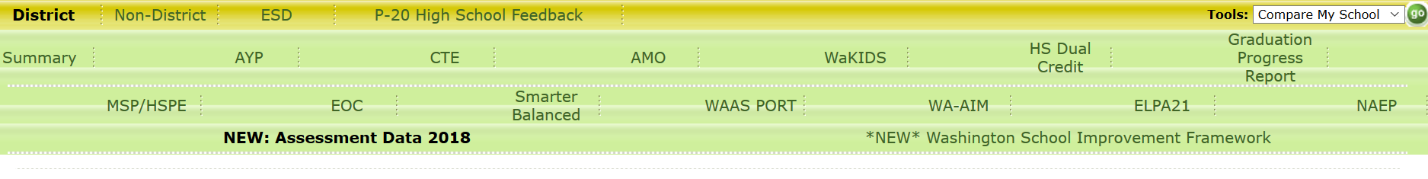
Report Card
Getting to Spring 2018 data
Notes:
You can find overall data on the State Report Card site.
You can compare your district/school to others using the Compare My School tool up in the right corner, which is marked with the green outline.
You have to select this New Assessment Data 2018 tab (circled in red) to get to the statewide scores.

Slide 21
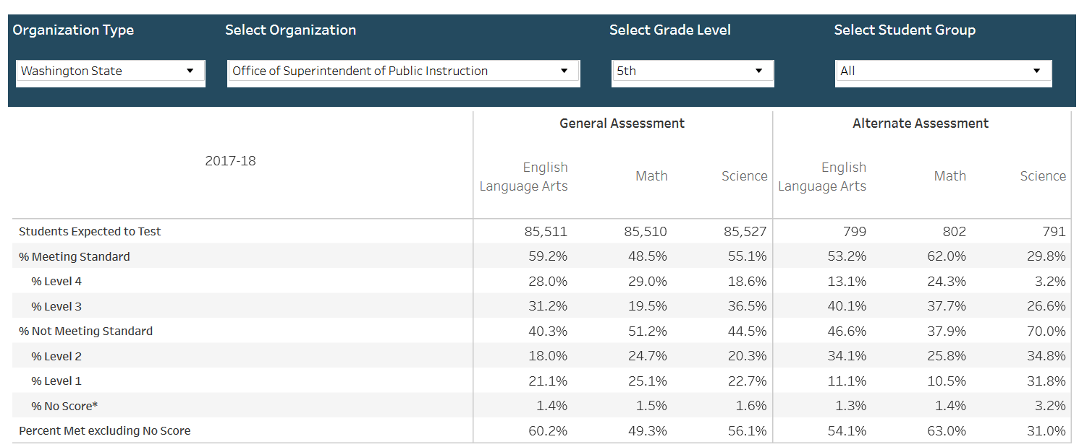
Science Results
Notes:
When you use that tab, you get a screen that shows the accountability information.
Use drop downs to see all publicly-available data; your school, other schools, etc. Suppression rules are in place for this publically facing data, so if there are a very small number of students in a school at a grade level, their data may not be available.
Attention: Second row is percent meeting standard. Includes all students who are expected to test, i.e., all students in the grade level. This row’s data may be different than what is seen in ORS as ORS only includes data for students who tested.
Second from bottom row is percent with no score. Data on the Report Card for the last row will be most similar to data in ORS.

Slide 22
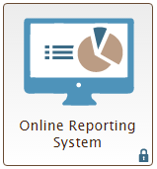
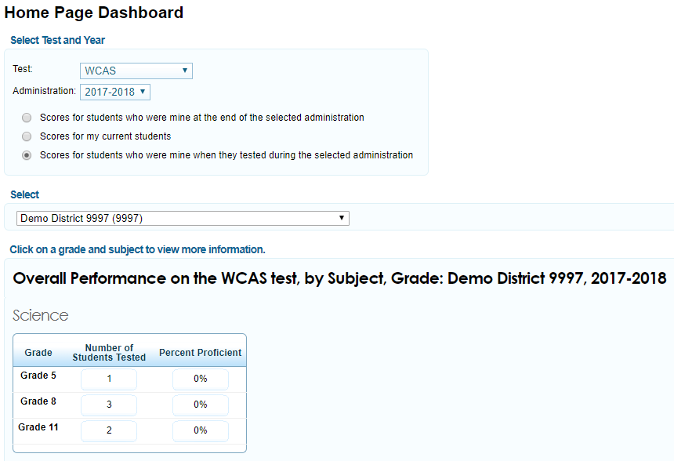
Online Reporting System (ORS)
Notes:
The Online Reporting System is the secure system where users can see the data for all students who tested. This site contains secure, confidential student information, so please treat it accordingly. In ORS you can only see data for your students/school/district based on your role set by the district. This means that you cannot see the data for other districts or other schools in your district—for those kinds of comparisons you have to use Report Card.
Educators who had students rostered to them during the WCAS last spring should be able to access the scores for those students in ORS right now. I took a screenshot of the home page for the Demo district that we use to test the system…After you change the Administration drop down to WCAS, be sure to choose the button for “scores for students who were mine when they tested”, the 3rd radio button. Users can select the number of students tested or the percent proficient in the box at the bottom to drill down to more detailed information …As you can see, our demo students didn’t do so well...and again, what you see in ORS will depend on your user role.

Slide 23
What information beyond overall scores are available?
School, District, and State averages
Scores in 3 science areas
Practices and Crosscutting Concepts in Physical Science
Practices and Crosscutting Concepts in Life Science
Practices and Crosscutting Concepts in Earth and Space Science
Percent of Total Points Earned
Range of Points Earned by students who performed in Level 3
Brief description of skills Level 3 students likely have for the 3 areas
FAQ and Resources (many described during this webinar)
Notes:
Beyond the overall scale score for a student, there are some other scores and information available.
This is the list of information that will be shown when you get into in ORS and on the Individual Student score Reports.
There are school, district, and state averages to compare to.
There are sub-scores for the 3 science areas, which I will get more into in a minute. And there are some descriptions and resources available.
I am going to share what this information looks like on the Printed score report since this is what you are likely going to be discussing with parents.

Slide 24
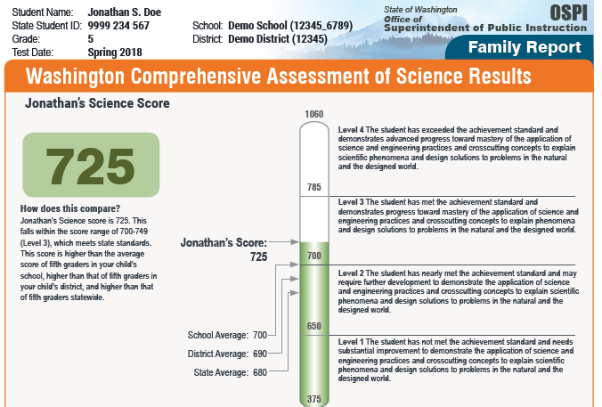
Sample Individual Student Score Report Overall Score
Printed Individual Score Report (aka Family Report)
Arriving in districts on Oct 9&10
Will be posted on OSPI’s Sample Score Reports webpage
Notes:
The picture on this slide is a sample of part of the printed family report that will be arriving in districts early next month and is expected to be shared with students and parents. A full sample will be on our Sample Score Reports webpage by the end of this week.
The first part of this report is very similar to the ELA/Math report. You’ll notice that we have the students scale score in big numbers on the left (this shows 725), then the barrel chart has the student score compared to the school, district, and state in the middle. The Achievement Level statements are on the right. These statements can help begin the conversation about what the scores mean.
The Level 3 statement is: “The student has met the achievement standard and demonstrates progress toward mastery of the application of science and engineering practices and crosscutting concepts to explain phenomena and design solutions to problems in the natural and the designed world.” We admit that is a big long statement….but it was carefully crafted to convey the 3-dimensional nature of the NGSS as assessed by the WCAS. The statements include those SEPs, CCCs, and DCIs that Dawn kept referring to in the test blueprint earlier.
URL for Sample Score Reports webpage: http://www.k12.wa.us/assessment/StateTesting/ScoreReport.aspx

Slide 25
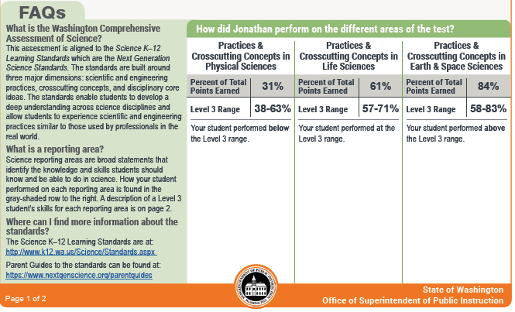
Sample Individual Student Score Report Reporting Areas
Notes:
Then the bottom half of the first page has an FAQ section on the left and the reporting areas on the right. The FAQ briefly describes the NGSS and what a reporting area is. It also has the urls for some resources we will share in a little bit.
The 3 reporting areas are the same 3 areas that Dawn shared earlier from the Test Blueprint. These scores are calculated in a different way than the Smarter Balanced claim scores that appear in this part of the report for ELA and Math, which is why we don’t have symbols in these columns.

Slide 26
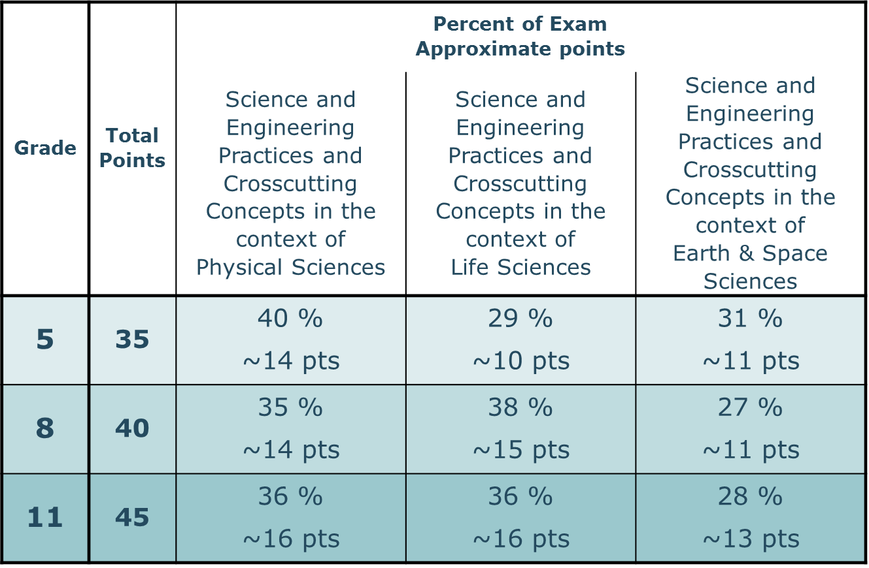
Test Blueprint
Notes:
The calculations start with the actual number of points in each of the three areas.
The approximate number of raw points for each of the three areas is shown on this chart that Dawn shared earlier. For example, a 5th grade test can have about 14 points in the area Practices & Crosscutting Concepts in Physical Sciences. The exact number of points can shift up and down a bit from year to year, so when we report out scores….

Slide 27
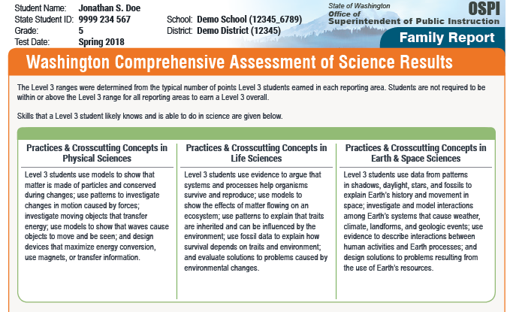
Sample Individual Student Score Report Reporting Areas (part 2)
Notes:
…to keep things consistent across years, we are reporting the percent of those points earned in that area. Our sample student here earned 31% of the points possible in the area Practices & Crosscutting Concepts in Physical Sciences. These individual student percentages are shown in the grey shaded row.
The next row is the Level 3 range. These ranges were determined from the typical number of points that Level 3 students earned in the area. So, when we looked only at Level 3 students and figured out how many points they typically earned in that area. In this sample report, the level 3 range for the Practices & Crosscutting Concepts in Physical Sciences was 38-63% of the points. Below the row with the ranges, there is a statement about whether or not the individual student was below, at, or above that range. Our sample student Jonathan Doe was below in Physical Sciences, within/at the range for the Life Sciences, and above the range for the Earth& Space Sciences. We did this intentionally for this sample report to show that a student does not have to be at or above in all three areas in order to pass the test.
[CLICK]
The back of the score report has a short description of how the Level 3 ranges were determined, and then has a description of the skills Level 3 students likely have for the reporting areas. These descriptions are summaries based in the ALDs for Level 3 for each grade level.

Slide 28
How can educators use WCAS data?
Spring 2018 results are a new baseline
Use results as one of multiple measures about student learning
Limitations of a single test results
Our belief of the role of summative assessment within an assessment system: One tool for gaining information about student learning achievement during the year
Use to evaluate instruction systemically at district, building, classroom levels
District-driven decisions on data use:
Inform system evaluations for implementation of the new standards
Using longitudinal data in the future
Notes:
Part of the data evaluation can be looking at how well the new standards have been implemented compared to the state.

Slide 29
Next Steps
Weren’t able to get to all questions submitted
In the Q&A box:
Put a question you still have related to one of these topics:
Next Generation Science Standards
Item development
WCAS scores
WCAS data uses

Slide 30
Resources to Inform Parents

Slide 31
Parent Guide to the Standards
On the Next Generation Science Standards (NGSS) website
Parent Guides (PDFs) for the standards
By grade bands: K–2, 3–5, 6–8, and 9–12
Both a static and a customizable version
Posted online at NGSS Parent Guides webpage
Notes:
The url for the NGSS website is on those printed ISRs. There are English and Spanish versions of these Parent Guide pdfs, both static and customizable versions. These might be helpful to have on-hand when you are sharing the score reports.
URL for NGSS Parent Guides webpage: https://www.nextgenscience.org/parentguides

Slide 32
ReadyWA website
ReadyWA website
“For Educators”
“For Families”
“For Students”
Search for “science”
Notes:
ReadyWA is another group that has resources for parents about state testing in Washington. They have a lot of great videos. We recommend searching for “science” on their website to find the videos they have produced about the NGSS.
URL for ReadyWA website: www.readywa.org

Slide 33
Using ORS Reports
Using Online Reporting System (ORS) with parents
Timeline for sharing reports in ORS
Spring 2018 results available in September
Spring 2019 and beyond results available in August
Not adaptive test
FERPA and student-specific information
Only share students’ information with their parent/guardian
Printing Reports, including Individual Student Reports
Exploring translation into Spanish for Spring 2019
Notes:
ORS is not as useful for WCAS scores as it is for Smarter Balanced scores. For Smarter Balanced, scores populate in ORS during the test window in the Spring. That will not happen for the WCAS. This year, the results were available in September because of Achievement Level Setting happening in August. In future years, we will likely have results available about a month earlier, so in early August. This is because the WCAS is not an adaptive test, and has to go through some different scoring procedures than the Smarter Balanced tests do before student scores can be posted.
If you choose to share from ORS, please make sure that parents/guardian’s only see their student’s information. Don’t have them sitting next to you as you walk through all the steps needed to get down to an individual student report.
You can also print ISRs from ORS. We are exploring the possibility of getting a Spanish version of the WCAS ISRs available for Spring 2019 testing, which would be available in Summer 2019.

Slide 34
WCAS FAQ and Training Test
FAQ
Posted on OSPI’s Science Assessment webpage
Training Test
On Washington Comprehensive Assessment Program (WCAP) Portal webpage
Practice with tools and online test features
Tools and features are very similar to Smarter Balanced online testing
Show example clusters and stand-alone items
No current plans/resources to create interim assessments
Notes:
A few other loose ends here. There are a few FAQs on the science assessment webpage that may be helpful. We are looking to update and consolidate them in the next few months.
Please share the Training Test with parents and other interested stakeholders. There is a Online Training Test Support document on the science webpage, along with a webinar we did last January about the training test, that educators will find helpful as they work through the training test with students.
URL for OSPI’s Science Assessment webpage: http://www.k12.wa.us/Science/Assessments.aspx
URL for direct link to FAQ: http://www.k12.wa.us/Science/pubdocs/FAQ.pdf
URL for WCAP Portal: https://wa.portal.airast.org/

Slide 35
Thank you!
For more information, email science@k12.wa.us

