Slide 1


Paris PowerShell & WinOps

Slide 2
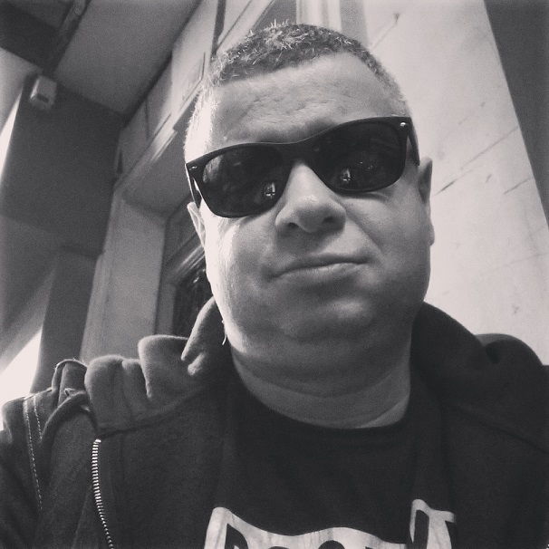
Olivier Miossec
Co-organisateur
French PowerShell User Group
Paris PowerShell & WinOps
@omiossec_med
https://github.com/omiossec
https://dev.to/omiossec https://www.linkedin.com/in/omiossec/

Slide 3


Paris PowerShell & WinOps
GitHub Actions& PowerShell
Workshop

Slide 4
Paris PowerShell & WinOps
* GitHub Actions

Slide 5
Paris PowerShell & WinOps

