Slide 1


Paris PowerShell & WinOps

Slide 2

Paris PowerShell & WinOps
Azure Functions & PowerShell
Workshop

Slide 3
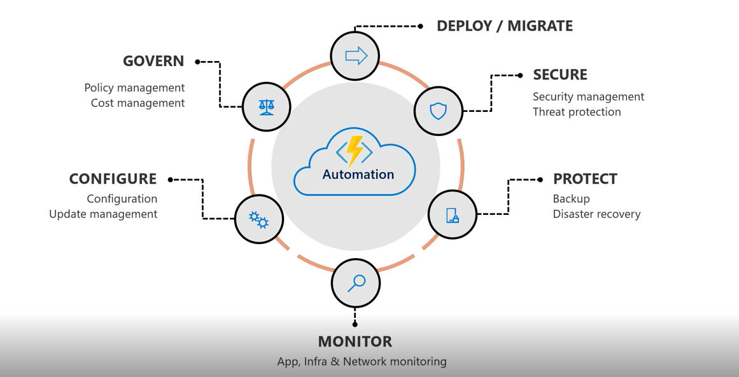
Azure Functions, An Event Based automation tool

Slide 4
When a VM is deleted, remove other compoments
Verify backup Service
Add tag to Resources Group during the creation
Start VM when new data arrive in a Storage account
Start/Stop VM on a schedule
Respond to queue, storage and other Azure Event
Use API Management service

Slide 5
Azure Functions
Special kind of App
Use App Plan
Use a storage Account
One runtime per function App
No limit to the number of function in a Function App
2 pricing models Consompution/Premium
Free Tiers 400Tb/s for resource consumption
1M execution
€0.000014/GB-s / €0.169 per M executions

Slide 6
PowerShell in Azure Functions
GA since November 2019!!!!
V3 in December 2019
PowerShell Core Support
Managed Identities to interact with Azure resources
Différents triggers and bidings
Use of private modules
Managed dependencies for module installation
Management a profile.ps1 to setup the host

Slide 7
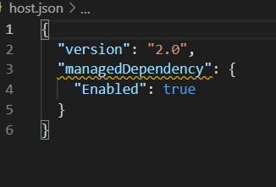
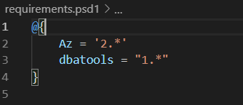
PowerShell in Azure Functions
Managed dependencies
Support module installation from PowerShellGallery
Enabled by default in Host.json
Requirements.psd1 to add module name and version number
Module are installed during Functions App startup

Slide 8
Pricing
Storage Account
There are two components of the price, memory consumption, and resource consumption.
If the script in the function uses 730 MB for 5 seconds and it’s executed 1500 per mouth you got.
1500 * 5 = 7500 seconds
(730/1024) * 7500 = 5346,68 GB/s
Resource consumption is measured by the number of the function execution, here 1500
Price €0.000014/GB-s and €0,169 per Millions of executions
Free tier, 400,000 GB-s (About 6666 minutes for a 1Gb scripts) and 1 million executions per subscription

Slide 9
Paris PowerShell & WinOps

