Slide 1
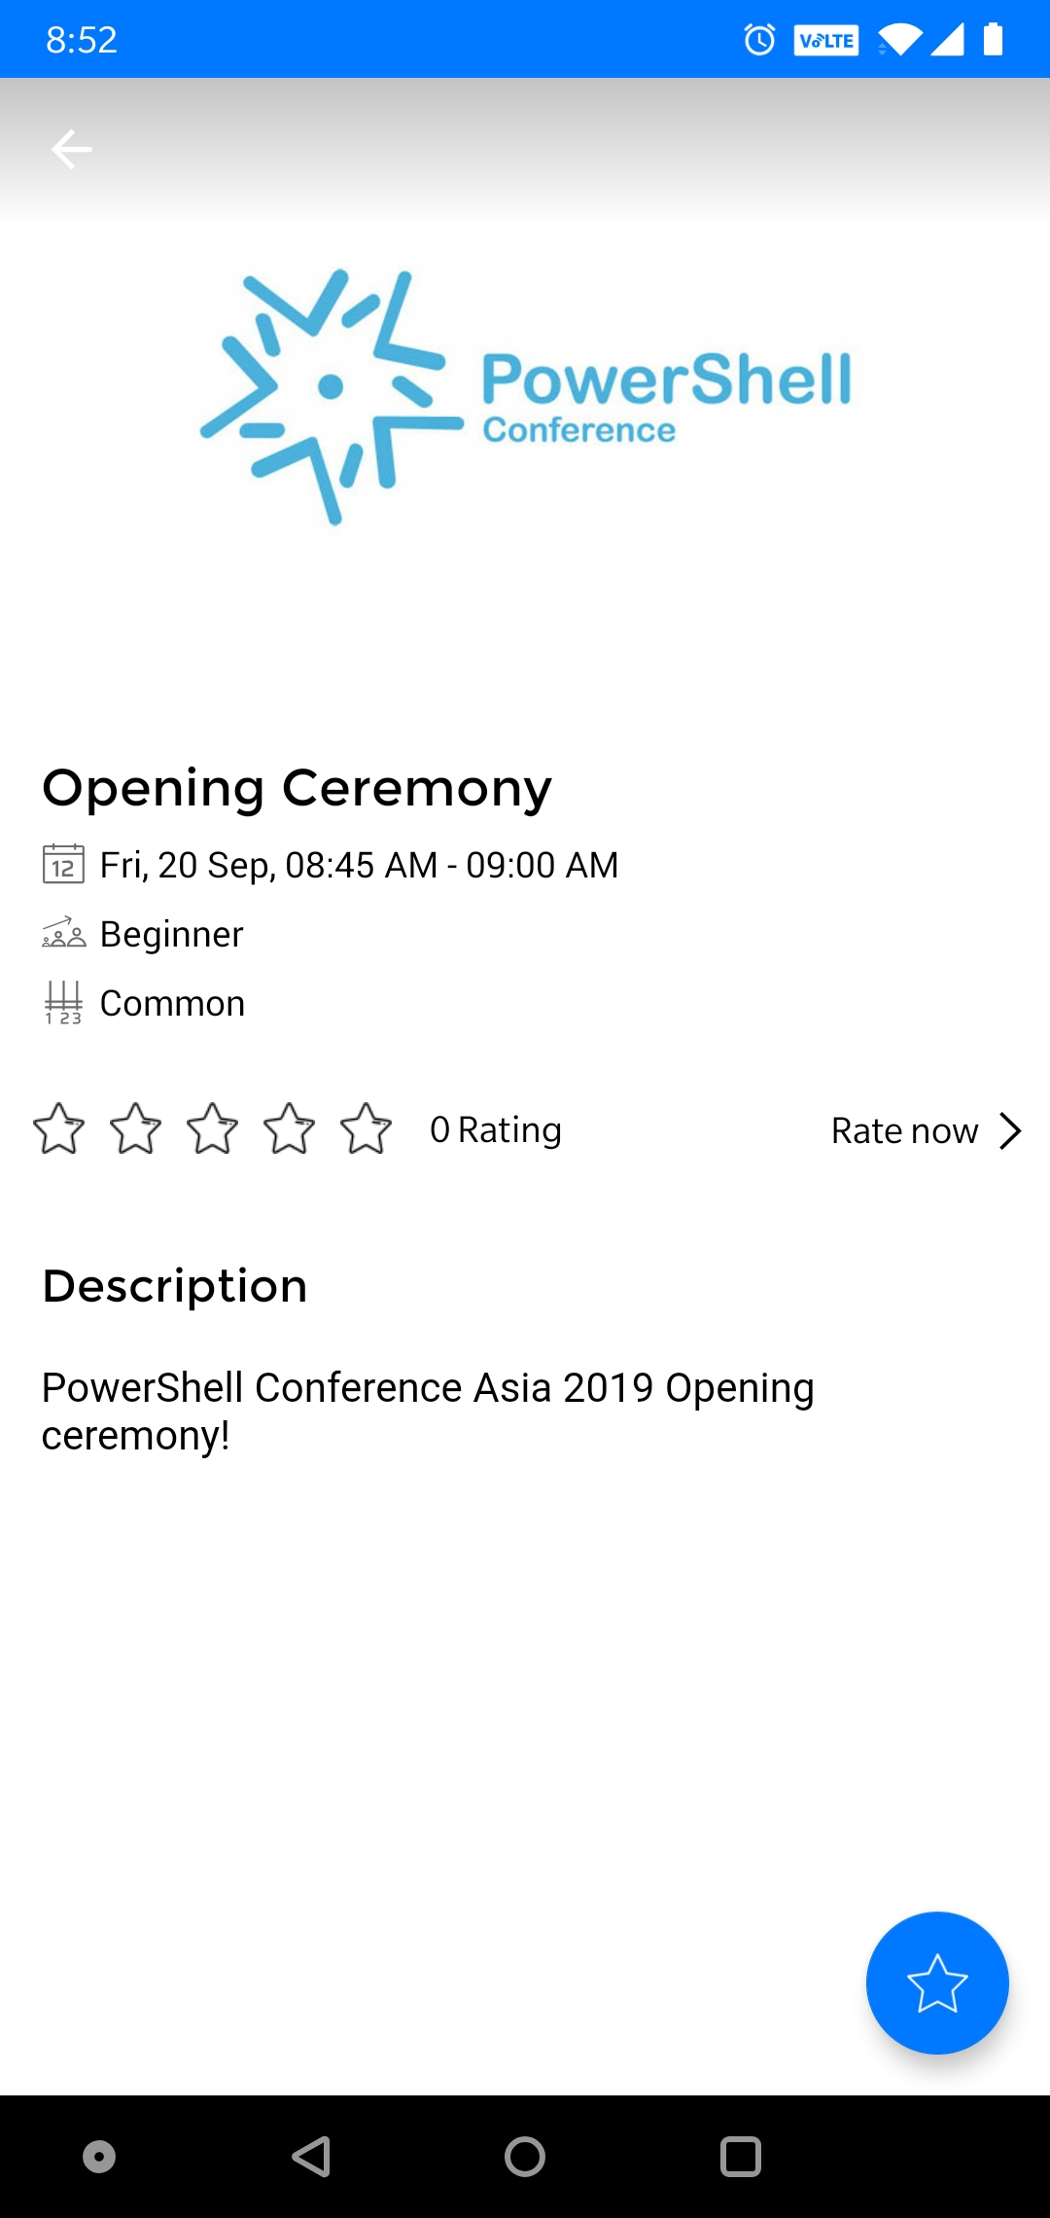
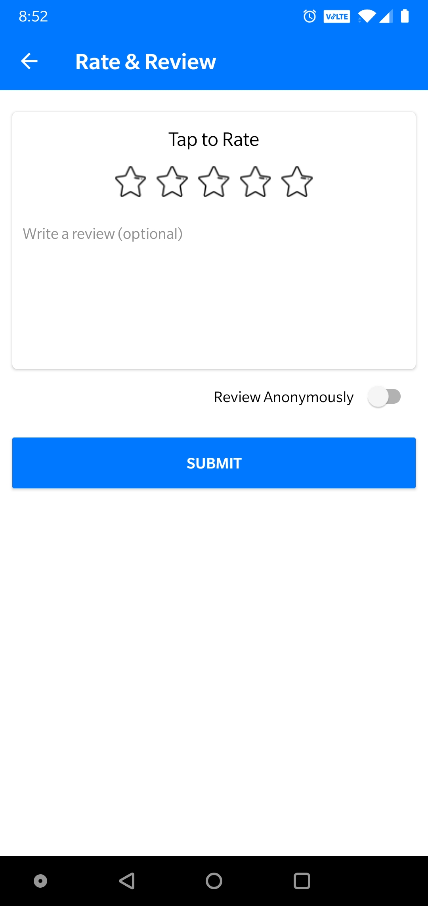

DO NOT Forget to rate the sessions!
https://my.eventraft.com/psconfasia19

