Slide 1
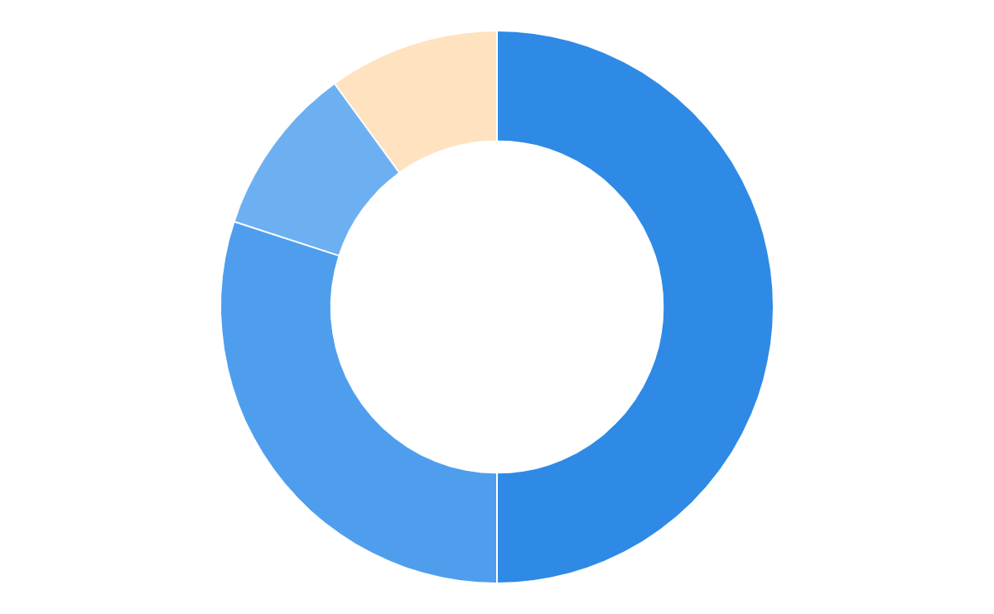
Recommended Portfolio
Infinite Very Aggressive L1
A high-conviction, growth-oriented portfolio designed to maximise long-term wealth creation
Equity
90%
Aggressive
50%
Portfolio
Allocation
Balanced
30%
Goal Coverage
Risk Profile Fit
Conservative
10%
{{main_goal}} {{secondary_goal}}
Yes
Hybrid
10%
Notes:
Infinite Ascend (Very Aggressive)
Infinite Propel (Aggressive)
Infinite Core (Balanced)
Infinite Secure (Conservative)
Infinite Anchor (Very Conservative)

Slide 2
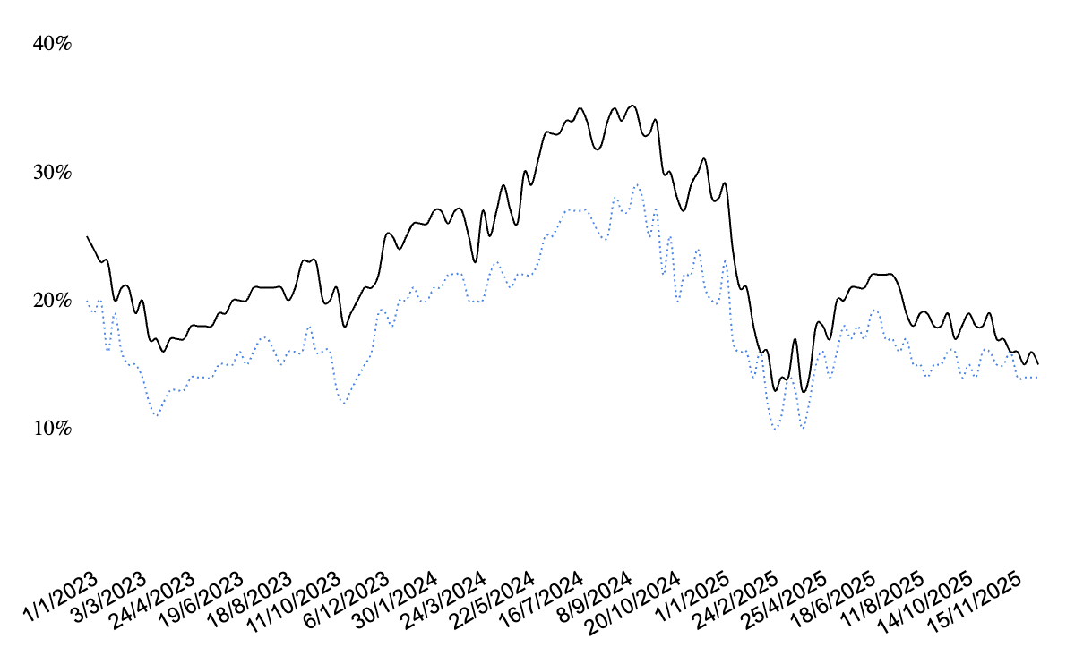
Performance of our recommended portfolio (Infinite Very Aggressive L1)
Benchmark (Nifty 500)
Infinite - VA L1
3Y XIRR trend
Last 1Y Avg | Infinite VA L1 | Benchmark (Nifty 500) | Alpha
3Y XIRR | 17.62% | 14.77% | 2.85%
5Y XIRR | 19.87% | 15.93% | 3.94%
7Y XIRR | 21.25% | 16.97% | 4.27%
Downside Capture | 90.18 | 100.0
Trailing Return*** (as on 10th Mar 2026) | 1M | 3M | 6M | 1Y | 2Y | 3Y | Since 2021
Infinite VA L1 | 0.94% | -3.40% | -0.09% | 17.73% | 8.74% | 20.43% | 20.23%
Benchmark (Nifty 500) | 2.53% | -3.04% | 2.27% | 17.62% | 7.72% | 17.56% | 15.54%
Alpha | -1.59% | -0.35% | -2.36% | 0.11% | 1.03% | 2.87% | 4.69%
**Downside Capture = (Fund return during down markets ÷ Benchmark return during down markets) × 100 | *** 1M 3M and 6M returns are absolute, while 1Y 2Y 3Y and Since 2021 are annualized | Past performance may not be indicative of future results; returns are subject to market risks.

Slide 3
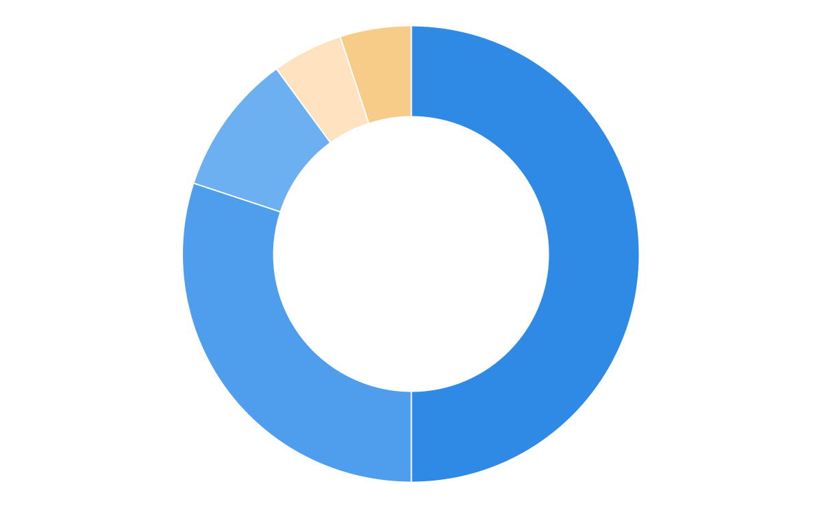
Recommended Portfolio
Infinite Very Aggressive S1
A high-conviction, growth-oriented portfolio designed to maximise long-term wealth creation
Equity
90%
Aggressive
50%
Portfolio
Allocation
Balanced
30%
Goal Coverage
Risk Profile Fit
Conservative
10%
Wealth Growth
Yes
Hybrid
5%
Gold
5%
Notes:
Infinite Ascend (Very Aggressive)
Infinite Propel (Aggressive)
Infinite Core (Balanced)
Infinite Secure (Conservative)
Infinite Anchor (Very Conservative)

Slide 4
Performance of our recommended portfolio (Infinite Very Aggressive S1)
Benchmark (Nifty 500)
Infinite - VA S1
3Y XIRR trend
Last 1Y Avg | Infinite VA S1 | Benchmark (Nifty 500) | Alpha
3Y XIRR | 17.94% | 14.77% | 3.17%
5Y XIRR | 20.03% | 15.93% | 4.10%
7Y XIRR | 21.33% | 16.97% | 4.35%
Downside Capture | 88.65 | 100.0
Trailing Return*** (as on 10th Mar 2026) | 1M | 3M | 6M | 1Y | 2Y | 3Y | Since 2021
Infinite VA S1 | 0.86% | -2.95% | 0.64% | 18.82% | 9.43% | 20.86% | 20.37%
Benchmark (Nifty 500) | 2.53% | -3.04% | 2.27% | 17.62% | 7.72% | 17.56% | 15.54%
Alpha | -1.67% | 0.09% | -1.63% | 1.19% | 1.71% | 3.30% | 4.83%
**Downside Capture = (Fund return during down markets ÷ Benchmark return during down markets) × 100 | *** 1M 3M and 6M returns are absolute, while 1Y 2Y 3Y and Since 2021 are annualized | Past performance may not be indicative of future results; returns are subject to market risks.

Slide 5
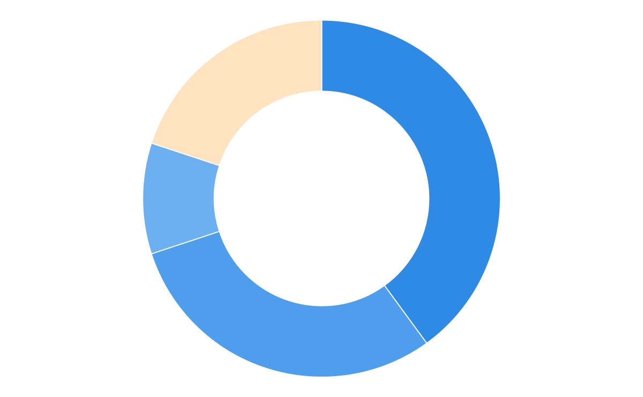
Recommended: Lumpsum
Infinite Aggressive- L
Designed for strong capital appreciation while managing risk through disciplined allocation
Equity
80%
Aggressive
40%
Portfolio
Allocation
Balanced
30%
Goal Coverage
Conservative
10%
Financial Freedom
Vacation &
Lifestyle Expense
Hybrid
20%
Notes:
Infinite Ascend (Very Aggressive)
Infinite Propel (Aggressive)
Infinite Core (Balanced)
Infinite Secure (Conservative)
Infinite Anchor (Very Conservative)

Slide 6
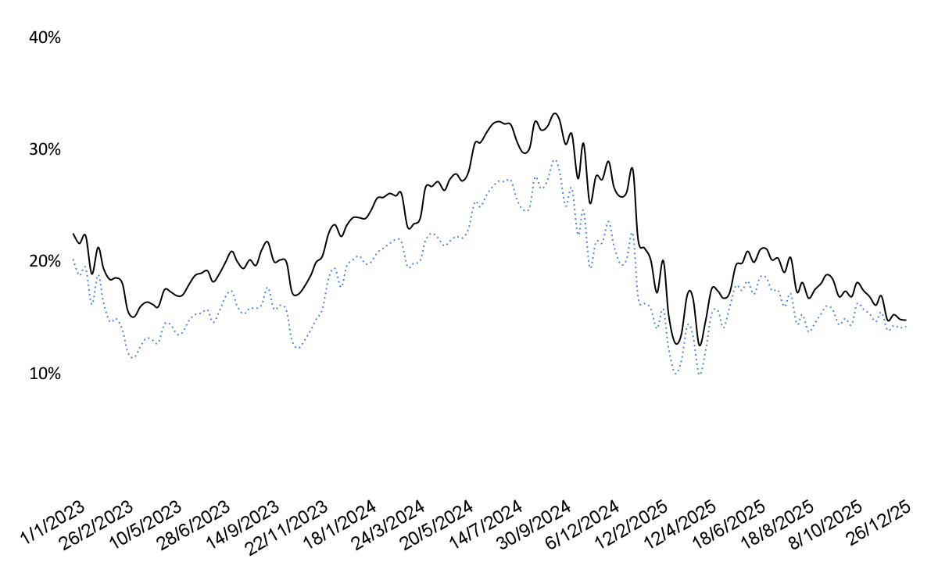
Performance of our recommended portfolio (Infinite Aggressive- L)
Benchmark (Nifty 500)
Infinite Aggressive-L
3Y XIRR trend
Last 1Y Avg | Infinite Aggressive- L | Benchmark (Nifty 500) | Alpha
3Y XIRR | 17.19% | 14.77% | 2.42%
5Y XIRR | 19.17% | 15.93% | 3.24%
7Y XIRR | 20.36% | 16.97% | 3.39%
Downside Capture | 87.31 | 100.0
Trailing Return*** (as on 10th Mar 2026) | 1M | 3M | 6M | 1Y | 2Y | 3Y | Since 2021
Infinite Aggressive-L | 0.85% | -3.19% | 0.27% | 17.39% | 8.67% | 19.90% | 19.41%
Benchmark (Nifty 500) | 2.53% | -3.04% | 2.27% | 17.62% | 7.72% | 17.56% | 15.54%
Alpha | -1.68% | -0.15% | -2.00% | -0.23% | 0.95% | 2.34% | 3.87%
**Downside Capture = (Fund return during down markets ÷ Benchmark return during down markets) × 100 | *** 1M 3M and 6M returns are absolute, while 1Y 2Y 3Y and Since 2021 are annualized | Past performance may not be indicative of future results; returns are subject to market risks.

Slide 7
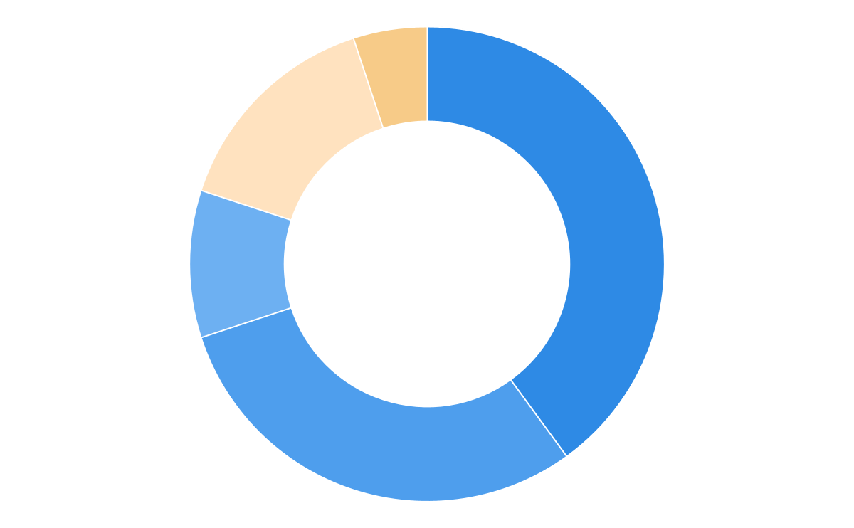
Recommended: SIP
Infinite Aggressive-S
Designed for strong capital appreciation while managing risk through disciplined allocation
Equity
80%
Aggressive
40%
Portfolio
Allocation
Balanced
30%
Goal Coverage
Conservative
10%
Financial Freedom
Vacation &
Lifestyle Expense
Hybrid
15%
Gold
5%
Notes:
Infinite Ascend (Very Aggressive)
Infinite Propel (Aggressive)
Infinite Core (Balanced)
Infinite Secure (Conservative)
Infinite Anchor (Very Conservative)

Slide 8

Performance of our recommended portfolio (Infinite Aggressive-S)
Benchmark (Nifty 500)
3Y XIRR trend
Last 1Y Avg | Infinite Aggressive-S | Benchmark (Nifty 500) | Alpha
3Y XIRR | 17.53% | 14.77% | 2.76%
5Y XIRR | 19.34% | 15.93% | 3.41%
7Y XIRR | 20.44% | 16.97% | 3.47%
Downside Capture | 85.63 | 100.0
Infinite Aggressiv-S
Trailing Return*** (as on 10th Mar 2026) | 1M | 3M | 6M | 1Y | 2Y | 3Y | Since 2021
Infinite Aggressive-S | 0.77% | -2.71% | 1.06% | 18.57% | 9.41% | 20.36% | 19.56%
Benchmark (Nifty 500) | 2.53% | -3.04% | 2.27% | 17.62% | 7.72% | 17.56% | 15.54%
Alpha | -1.77% | 0.33% | -1.21% | 0.94% | 1.69% | 2.80% | 4.01%
**Downside Capture = (Fund return during down markets ÷ Benchmark return during down markets) × 100 | *** 1M 3M and 6M returns are absolute, while 1Y 2Y 3Y and Since 2021 are annualized | Past performance may not be indicative of future results; returns are subject to market risks.

Slide 9
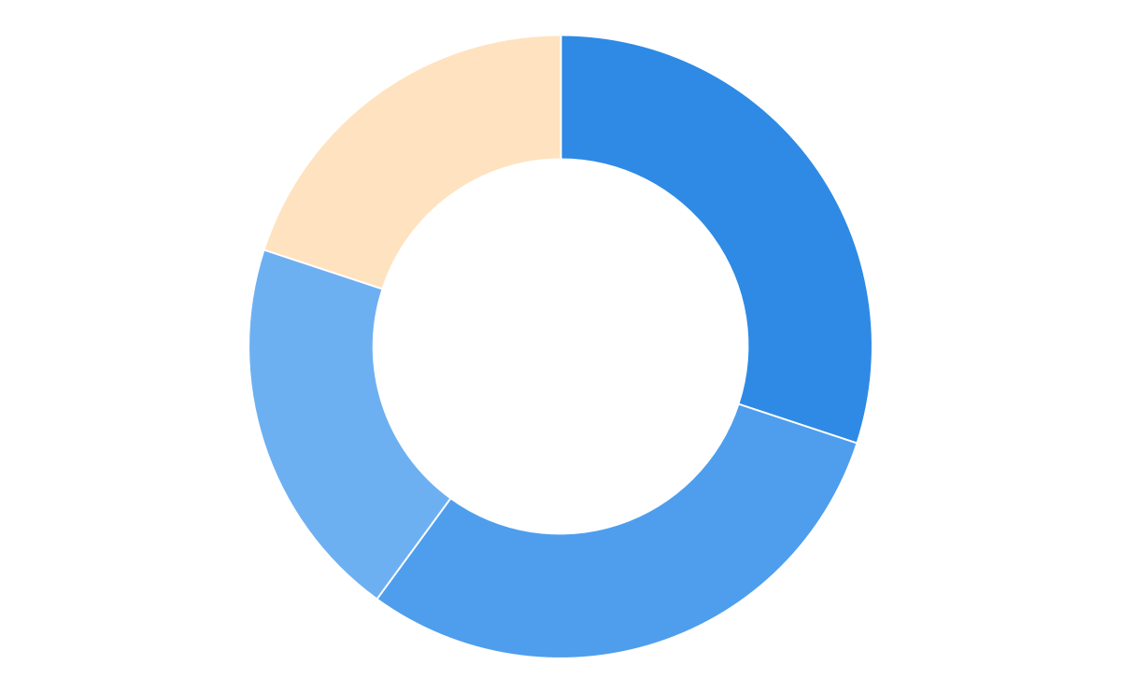
Recommended Portfolio: Lumpsum
Infinite Balanced- L
A balanced, steady plan that focuses on capital protection and predictable progress
Equity
80%
Aggressive
30%
Portfolio
Allocation
Balanced
30%
Goal Coverage
Risk Profile Fit
Conservative
20%
Financial Freedom
Vacation &
Lifestyle Expense
Yes
Hybrid
20%
Notes:
Infinite Ascend (Very Aggressive)
Infinite Propel (Aggressive)
Infinite Core (Balanced)
Infinite Secure (Conservative)
Infinite Anchor (Very Conservative)

Slide 10
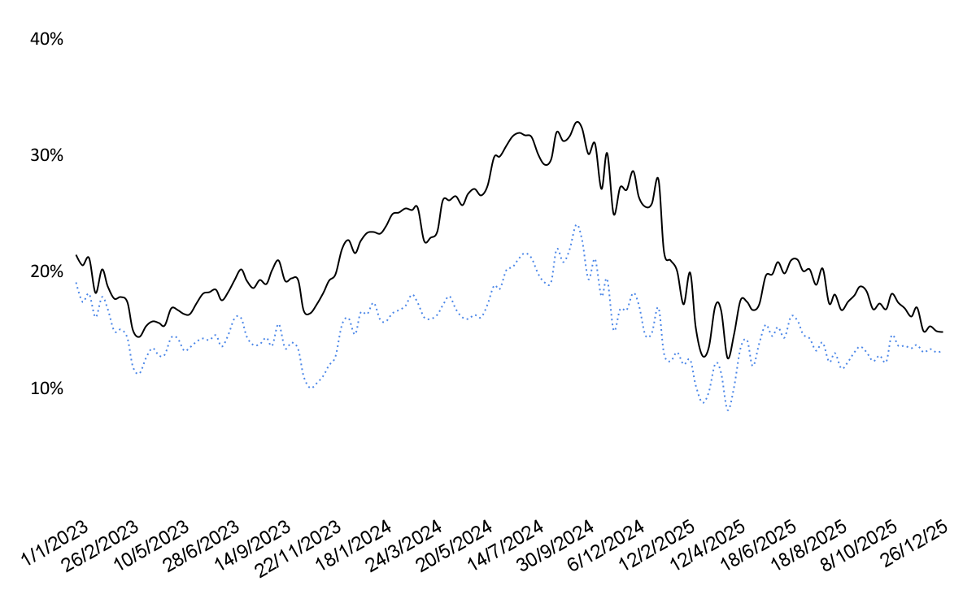
Performance of our recommended portfolio (Infinite Balanced- L)
Benchmark (Nifty 50)
Infinite - Balanced- L
3Y XIRR trend
Last 1Y Avg | Infinite Balanced- L | Benchmark (Nifty 50) | Alpha
3Y XIRR | 16.81% | 12.92% | 3.88%
5Y XIRR | 18.48% | 13.87% | 4.60%
7Y XIRR | 19.51% | 15.01% | 4.50%
Downside Capture | 86.05 | 100.0
Trailing Return*** (as on 10th Mar 2026) | 1M | 3M | 6M | 1Y | 2Y | 3Y | Since 2021
Infinite Balanced- L | 0.72% | -3.04% | 0.66% | 17.16% | 8.56% | 19.45% | 18.55%
Benchmark (Nifty 50) | 0.21% | -4.90% | 1.26% | 13.64% | 6.75% | 13.83% | 13.05%
Alpha | 0.51% | 1.86% | -0.60% | 3.52% | 1.81% | 5.63% | 5.50%
**Downside Capture = (Fund return during down markets ÷ Benchmark return during down markets) × 100 | *** 1M 3M and 6M returns are absolute, while 1Y 2Y 3Y and Since 2021 are annualized | Past performance may not be indicative of future results; returns are subject to market risks.

Slide 11
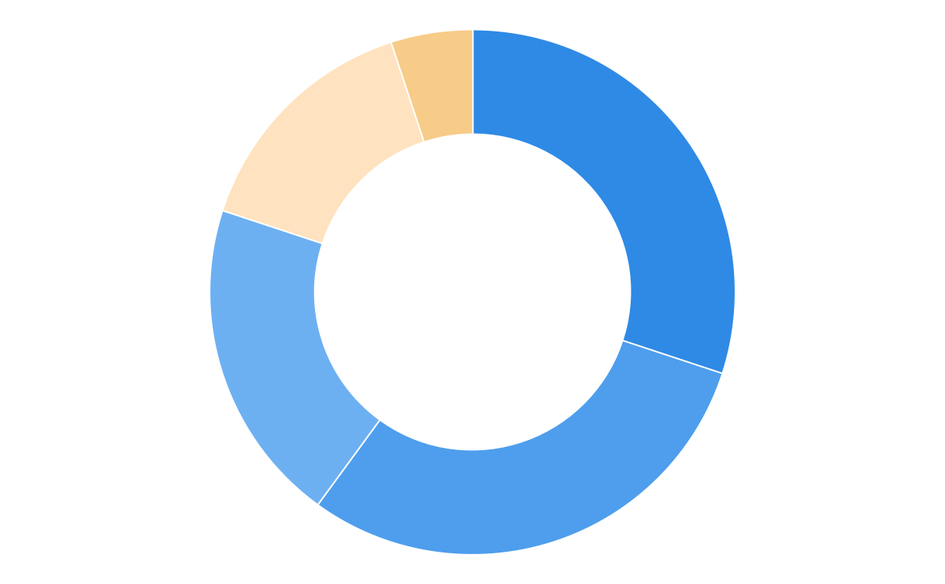
Recommended Portfolio: SIP
Infinite Balanced- S
A balanced, steady plan that focuses on capital protection and predictable progress
Equity
80%
Aggressive
30%
Portfolio
Allocation
Balanced
30%
Goal Coverage
Risk Profile Fit
Conservative
20%
Financial Freedom
Vacation &
Lifestyle Expense
Yes
Hybrid
15%
Gold
5%
Notes:
Infinite Ascend (Very Aggressive)
Infinite Propel (Aggressive)
Infinite Core (Balanced)
Infinite Secure (Conservative)
Infinite Anchor (Very Conservative)

Slide 12
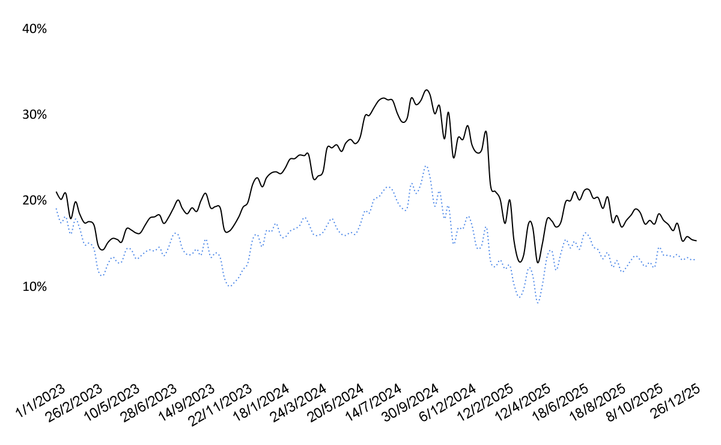
Performance of our recommended portfolio (Infinite Balanced- S)
Benchmark (Nifty 50)
Infinite - Balanced- S
3Y XIRR trend
Last 1Y Avg | Infinite Balanced- S | Benchmark (Nifty 50) | Alpha
3Y XIRR | 17.17% | 12.92% | 4.25%
5Y XIRR | 18.66% | 13.87% | 4.78%
7Y XIRR | 19.59% | 15.01% | 4.58%
Downside Capture | 84.21 | 100.0
Trailing Return*** (as on 10th Mar 2026) | 1M | 3M | 6M | 1Y | 2Y | 3Y | Since 2021
Infinite Balanced- S | 0.63% | -2.52% | 1.51% | 18.42% | 9.35% | 19.94% | 18.70%
Benchmark (Nifty 50) | 0.21% | -4.90% | 1.26% | 13.64% | 6.75% | 13.83% | 13.05%
Alpha | 0.41% | 2.38% | 0.26% | 4.77% | 2.60% | 6.11% | 5.65%
**Downside Capture = (Fund return during down markets ÷ Benchmark return during down markets) × 100 | *** 1M 3M and 6M returns are absolute, while 1Y 2Y 3Y and Since 2021 are annualized | Past performance may not be indicative of future results; returns are subject to market risks.

Slide 13
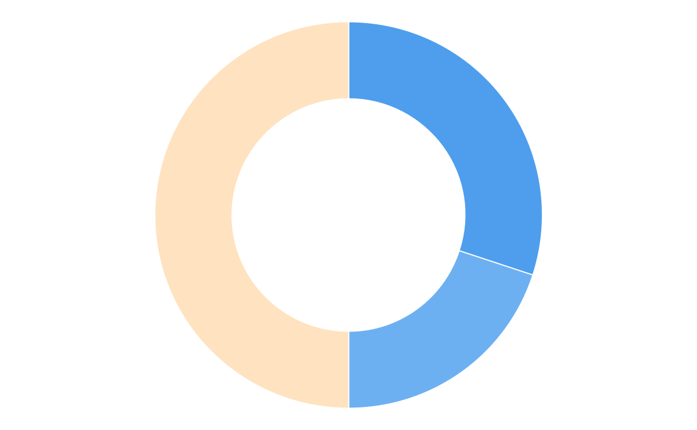
Alternative: Lumpsum
Infinite Conservative- L
A capital-first plan designed to minimise downside risk while delivering predictable, low-volatility returns.
Equity
50%
Aggressive
-
Portfolio
Allocation
Balanced
30%
Goal Coverage
Conservative
20%
{{main_goal}} {{secondary_goal}}
Hybrid
50%
Notes:
Infinite Ascend (Very Aggressive)
Infinite Propel (Aggressive)
Infinite Core (Balanced)
Infinite Secure (Conservative)
Infinite Anchor (Very Conservative)

Slide 14
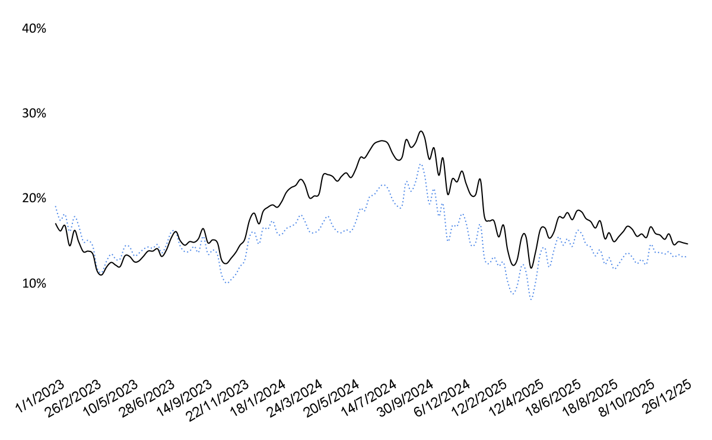
Performance of our recommended portfolio (Infinite Conservative- L)
Benchmark (Nifty 50)
Infinite - Conservative- L
3Y XIRR trend
Last 1Y Avg | Infinite Conservative- L | Benchmark (Nifty 50) | Alpha
3Y XIRR | 15.54% | 12.92% | 2.62%
5Y XIRR | 16.10% | 13.87% | 2.23%
7Y XIRR | 16.62% | 15.01% | 1.62%
Downside Capture | 74.39 | 100.0
Trailing Return*** (as on 10th Mar 2026) | 1M | 3M | 6M | 1Y | 2Y | 3Y | Since 2021
Infinite Conservative- L | 0.09% | -1.67% | 2.97% | 16.71% | 8.85% | 17.93% | 15.90%
Benchmark (Nifty 50) | 0.21% | -4.90% | 1.26% | 13.64% | 6.75% | 13.83% | 13.05%
Alpha | -0.12% | 3.23% | 1.71% | 3.07% | 2.10% | 4.10% | 2.85%
**Downside Capture = (Fund return during down markets ÷ Benchmark return during down markets) × 100 | *** 1M 3M and 6M returns are absolute, while 1Y 2Y 3Y and Since 2021 are annualized | Past performance may not be indicative of future results; returns are subject to market risks.

Slide 15
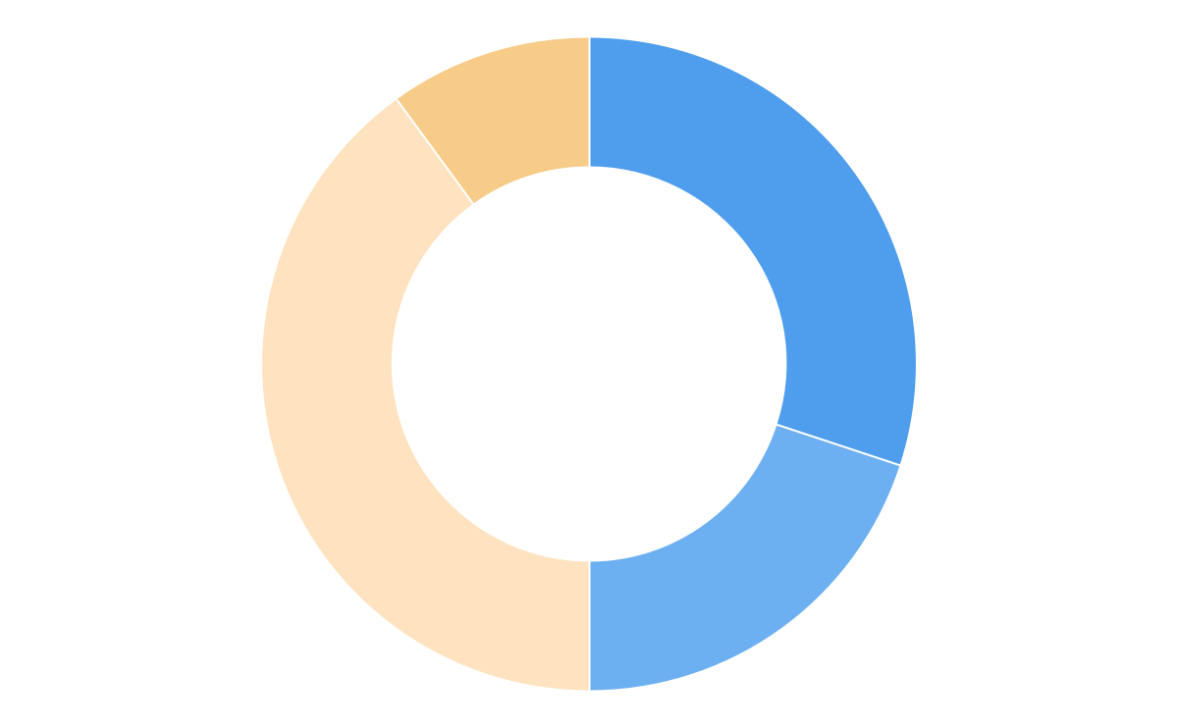
Alternative: SIP
Infinite Conservative- S
A capital-first plan designed to minimise downside risk while delivering predictable, low-volatility returns.
Equity
50%
Aggressive
-
Portfolio
Allocation
Balanced
30%
Goal Coverage
Conservative
20%
{{main_goal}} {{secondary_goal}}
Hybrid
40%
Gold
10%
Notes:
Infinite Ascend (Very Aggressive)
Infinite Propel (Aggressive)
Infinite Core (Balanced)
Infinite Secure (Conservative)
Infinite Anchor (Very Conservative)

Slide 16
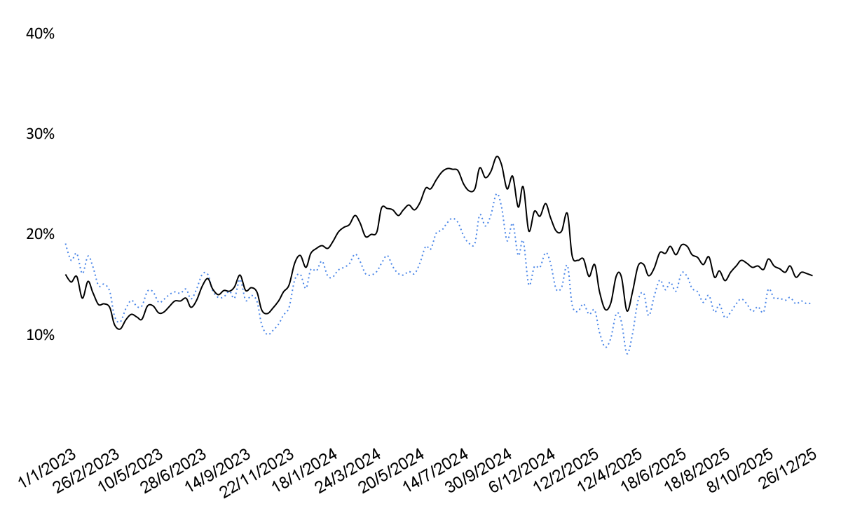
Performance of our recommended portfolio (Infinite Conservative - S)
Benchmark (Nifty 50)
Infinite - Conservative- S
3Y XIRR trend
Last 1Y Avg | Infinite Conservative- S | Benchmark (Nifty 50) | Alpha
3Y XIRR | 16.42% | 12.92% | 3.49%
5Y XIRR | 16.45% | 13.87% | 2.58%
7Y XIRR | 16.71% | 15.01% | 1.70%
Downside Capture | 68.69 | 100.0
Trailing Return*** (as on 10th Mar 2026) | 1M | 3M | 6M | 1Y | 2Y | 3Y | Since 2021
Infinite Conservative- S | -0.17% | -0.25% | 5.38% | 19.96% | 10.94% | 19.08% | 16.17%
Benchmark (Nifty 50) | 0.21% | -4.90% | 1.26% | 13.64% | 6.75% | 13.83% | 13.05%
Alpha | -0.38% | 4.65% | 4.12% | 6.32% | 4.19% | 5.25% | 3.12%
**Downside Capture = (Fund return during down markets ÷ Benchmark return during down markets) × 100 | *** 1M 3M and 6M returns are absolute, while 1Y 2Y 3Y and Since 2021 are annualized | Past performance may not be indicative of future results; returns are subject to market risks.

