Slide 1









Portfolio Transition for
Hari Vootori

Slide 2
Your Infinite plan is now ready to move from design to delivery
Every step carefully planned, every action aligned with your goals
Welcome Back,
Hari

Slide 3
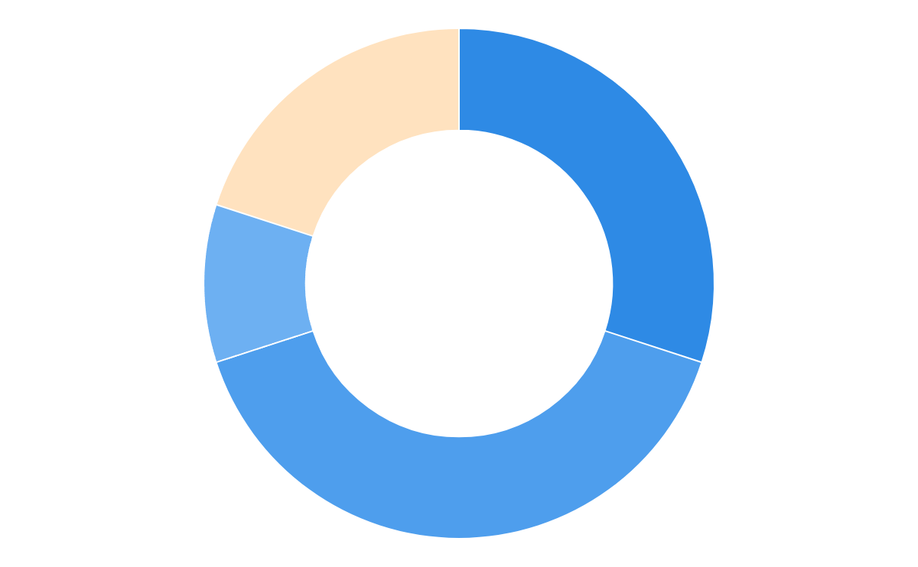
A quick recap, Hari
About you, your goals and investments with Infinite
Your Ideal Portfolio
Your Goal
Retirement Planning
Home Purchase
Children Education
Equity
80%
Risk Profile
Portfolio
Allocation
Aggressive
30%
Balanced
Balanced
40%
Conservative
10%
Investment with Infinite
Hybrid
20%
₹~3 Cr with ₹50K* monthly SIP
*Gold only for SIPs, for Lumpsum replaced with Hybrid

Slide 4

Now, let’s look at your ideal SIP strategy
100% direct, Optimally allocated & Top-ranked funds only
Monthly SIP with Infinite: INR 50,000*
Portfolio | Allocation | # of funds
Equity | 40K | 80% | 9
Aggressive | 15K | 30% | 4
Mid Cap | 7.5K | 15% | 2
Small Cap | 7.5K | 15% | 2
Balanced | 20K | 40% | 4
Flexi Cap | 10K | 20% | 2
Value & Contra | 10K | 20% | 2
Conservative | 5K | 10% | 1
Large Cap | 7.5K | 10% | 1
Hybrid | 10K | 20% | 2
Dynamic Asset | 5K | 10% | 1
Multi Asset | 5K | 10% | 1
Total | 50K | 100% | 11
100% Direct Funds
Lower expense ratio - Better overall returns
Optimal Allocation
Right mix across growth, core and stability
Top ranked funds
Only top ranked funds in every sub-category
*SIP dates to be finalised

Slide 5
Your SIP strategy - at a scheme level
Only the top schemes for every sub-category
Equity - Aggressive | 30%
Mid | Small
% Monthly
Allocation
Upside | Downside
5Y
Power Rank
5Y Rolling Return
(alpha against category)
AUM
(as of 31 Jan’26)
Invesco India Mid Cap Direct Growth
7.5%
110 | 102
1
24% (+1%)
10,058 Cr
HDFC Mid Cap Fund Direct Growth
7.5%
93 | 81
2
25% (+2%)
92,186 Cr
Bandhan Small Cap Fund Direct Growth
7.5%
96 | 82
2
-
19,266 Cr
Invesco India Small Cap Fund Direct Growth
7.5%
89 | 77
1
31% (+5%)
9,008 Cr

Slide 6
Your SIP strategy - at a scheme level
Only the top schemes for every sub-category
Equity - Balanced | 40%
Flexi | Value & Contra
% Monthly
Allocation
Upside | Downside
5Y
Power Rank
5Y Rolling Return
(alpha against category)
AUM
(as of 31 Jan’26)
Parag Parikh Flexi Cap Fund Direct Growth
10%
75 | 49
23% (+5%)
2
1,33,969 Cr
HDFC Flexi Cap Fund Direct Growth
10%
114 | 73
1
21% (+3%)
97,451 Cr
ICICI Prudential Value Fund Direct Growth
10%
98 | 65
1
23% (+3%)
61,272 Cr
SBI Contra Direct Growth
10%
118 | 76
2
26% (+6%)
49,967 Cr

Slide 7
Your SIP strategy - at a scheme level
Only the top schemes for every sub-category
Equity - Conservative | 10%
Large Cap
% Monthly
Allocation
Upside | Downside
5Y
Power Rank
5Y Rolling Return
(alpha against category)
AUM
(as of 31 Jan’26)
Nippon India Large Cap Direct Growth
10%
115 | 84
1
19% (+3%)
50,876 Cr

Slide 8
Your SIP strategy - at a scheme level
Only the top schemes for every sub-category
Hybrid | 20% Dynamic Asset | Multi Asset
% Monthly
Allocation
Upside | Downside
5Y
Power Rank
5Y Rolling Return
(alpha against category)
AUM
(as of 31 Jan’26)
HDFC Balanced Advantage Fund Direct Growth
10%
136 | 55
1
19% (+7%)
1,07,971 Cr
Quant Multi Asset Allocation Fund Direct Growth
10%
113 | 42
1
27% (+10%)
4,434 Cr

Slide 9
Your SIP strategy - at a scheme level
Only the top schemes for every sub-category
Gold | 5.1%
Gold
% Monthly
Allocation
Upside | Downside
5Y
Power Rank
5Y Rolling Return
(alpha against category)
AUM
(as of 31 Jan’26)
HDFC Balanced Advantage Fund Direct Growth
10%
136 | 55
1
19% (+7%)
1,07,971 Cr
Quant Multi Asset Allocation Fund Direct Growth
10%
113 | 42
1
27% (+10%)
4,434 Cr

Slide 10
Your ~3cr corpus - What could be better
Gaps we can help you fix
01
02
03
Over-Diversified Portfolio
Sub-Optimal
Allocation
Fund Quality &
Higher Costs
Invested across 15 sub-categories* (vs. 8-10 recommended) and 29 schemes (vs. 12-15 recommended), spread over 13 AMCs. Fragmented capital as 14/29 schemes hold <3% each
Over-allocated in certain categories: Large (4), Mid (4), Flexi (6), Sectoral (5), Under-allocated in Small (1), Value & Contra (1), Focused Fund (1) vs 2 recommended in each
30% PF (5/29 schemes) in off-track/out-of-form funds resulting in 49.5L of missed gains, 33% exposure to regular funds resulting in commissions of 60K, and you’ll end up paying 31.4L in next 10 years
#Current distribution of funds across categories is misaligned with your risk tolerance and investment horizon
*Sub-categories are just the different scheme types you’ve invested in for example Flexi Cap, Large Cap, ELSS, Aggressive Hybrid, Sector (Technology), and Global (USA)

Slide 11
The transition plan for the 1.5Cr corpus
Moves your portfolio to its ideal allocation in 5 months*
Portfolio Allocation | Current | Ideal - D0 | Ideal - D30 | Ideal - D60 | Ideal - D90 | Ideal - D120 | Ideal - D150
Equity | 1.5Cr | 98% | 1.5Cr | 96% | 1.5Cr | 93% | 1.4Cr | 90% | 1.4Cr | 87% | 1.3Cr | 83% | 1.3Cr | 80%
Aggressive | 62.8L | 40% | 61.1L | 39% | 58.3L | 37% | 55.6L | 35% | 52.9L | 33% | 50.1L | 32% | 47.4L | 30%
Balanced | 48.1L | 30% | 51.8L | 33% | 54.1L | 34% | 56.3L | 36% | 58.6L | 37% | 60.9L | 39% | 63.2L | 40%
Conservative | 43.7L | 28% | 39.3L | 25% | 34.6L | 22% | 29.9L | 19% | 25.2L | 16% | 20.5L | 13% | 15.8L | 10%
Hybrid | 3.4L | 2% | 5.8L | 4% | 11.0L | 7% | 16.1L | 10% | 21.3L | 13% | 26.4L | 17% | 31.6L | 20%
Total | 1.6Cr | 100% | 1.6Cr | 100% | 1.6Cr | 100% | 1.6Cr | 100% | 1.6Cr | 100% | 1.6Cr | 100% | 1.6Cr | 100%
Tax Liability: INR 9.32L
LTCG 9.06L + STCG 25.5K
D0: Sell 29.1L of existing MFs & Invest 29.1L as per allocation
D30 to D150: Sell 25.7L every month & invest 25.7L as per allocation
List of funds for ideal portfolio here
List of funds from existing portfolio to be sold (as per transition plan) here
List of funds from existing portfolio to be retained (as per transition plan) here

Slide 12
Ready to begin your Infinite journey
Confirm SIP alignment
Approve your transition plan
Begin execution
You

Slide 13
00
Appendix

Slide 14
01
List of schemes for ideal portfolio

Slide 15
Your SIP strategy - at a scheme level
Only the top schemes for every sub-category
Equity - Aggressive | 30%
Mid | Small
% Monthly
Allocation
Upside | Downside
5Y
Power Rank
5Y Rolling Return
(alpha against category)
AUM
(as of 31 Jan’26)
Invesco India Mid Cap Direct Growth
7.5%
110 | 102
1
24% (+1%)
10,058 Cr
HDFC Mid Cap Fund Direct Growth
7.5%
93 | 81
2
25% (+2%)
92,186 Cr
Bandhan Small Cap Fund Direct Growth
7.5%
96 | 82
2
-
19,266 Cr
Invesco India Small Cap Fund Direct Growth
7.5%
89 | 77
1
31% (+5%)
9,008 Cr

Slide 16
Your SIP strategy - at a scheme level
Only the top schemes for every sub-category
Equity - Balanced | 40%
Flexi | Value & Contra
% Monthly
Allocation
Upside | Downside
5Y
Power Rank
5Y Rolling Return
(alpha against category)
AUM
(as of 31 Jan’26)
Parag Parikh Flexi Cap Fund Direct Growth
10%
75 | 49
23% (+5%)
2
1,33,969 Cr
HDFC Flexi Cap Fund Direct Growth
10%
114 | 73
1
21% (+3%)
97,451 Cr
ICICI Prudential Value Fund Direct Growth
10%
98 | 65
1
23% (+3%)
61,272 Cr
SBI Contra Direct Growth
10%
118 | 76
2
26% (+6%)
49,967 Cr

Slide 17
Your SIP strategy - at a scheme level
Only the top schemes for every sub-category
Equity - Conservative | 10%
Large Cap
% Monthly
Allocation
Upside | Downside
5Y
Power Rank
5Y Rolling Return
(alpha against category)
AUM
(as of 31 Jan’26)
Nippon India Large Cap Direct Growth
10%
115 | 84
1
19% (+3%)
50,876 Cr

Slide 18
Your SIP strategy - at a scheme level
Only the top schemes for every sub-category
Hybrid | 20% Dynamic Asset | Multi Asset
% Monthly
Allocation
Upside | Downside
5Y
Power Rank
5Y Rolling Return
(alpha against category)
AUM
(as of 31 Jan’26)
HDFC Balanced Advantage Fund Direct Growth
10%
136 | 55
1
19% (+7%)
1,07,971 Cr
Quant Multi Asset Allocation Fund Direct Growth
10%
113 | 42
1
27% (+10%)
4,434 Cr

Slide 19
Your SIP strategy - at a scheme level
Only the top schemes for every sub-category
Gold | 5.1%
Gold
% Monthly
Allocation
Upside | Downside
5Y
Power Rank
5Y Rolling Return
(alpha against category)
AUM
(as of 31 Jan’26)
HDFC Balanced Advantage Fund Direct Growth
10%
136 | 55
1
19% (+7%)
1,07,971 Cr
Quant Multi Asset Allocation Fund Direct Growth
10%
113 | 42
1
27% (+10%)
4,434 Cr

Slide 20
Your SIP strategy - at a scheme level
Only the top schemes for every sub-category
Global | 5.1%
Global
% Monthly
Allocation
Upside | Downside
5Y
Power Rank
5Y Rolling Return
(alpha against category)
AUM
(as of 31 Jan’26)
HDFC Balanced Advantage Fund Direct Growth
10%
136 | 55
1
19% (+7%)
1,07,971 Cr
Quant Multi Asset Allocation Fund Direct Growth
10%
113 | 42
1
27% (+10%)
4,434 Cr

Slide 21
Your SIP strategy - at a scheme level
Only the top schemes for every sub-category
Debt Like | 5.1%
Gold
% Monthly
Allocation
Upside | Downside
5Y
Power Rank
5Y Rolling Return
(alpha against category)
AUM
(as of 31 Jan’26)
HDFC Balanced Advantage Fund Direct Growth
10%
136 | 55
1
19% (+7%)
1,07,971 Cr
Quant Multi Asset Allocation Fund Direct Growth
10%
113 | 42
1
27% (+10%)
4,434 Cr

Slide 22
Your SIP strategy - at a scheme level
Only the top schemes for every sub-category
Solution | 5.1%
Gold
% Monthly
Allocation
Upside | Downside
5Y
Power Rank
5Y Rolling Return
(alpha against category)
AUM
(as of 31 Jan’26)
HDFC Balanced Advantage Fund Direct Growth
10%
136 | 55
1
19% (+7%)
1,07,971 Cr
Quant Multi Asset Allocation Fund Direct Growth
10%
113 | 42
1
27% (+10%)
4,434 Cr

Slide 23
02
List of schemes from corpus to be sold

Slide 24
Complete Sell
Scheme Name | Sell Value | Reason
ICICI Pru Infrastructure Direct Growth | 1.4L | Insignificant allocation + Insignificant EL/STCG
ICICI Pru Phrm Hlthcare and Dgnstcs PHD Direct Growth | 27K | Insignificant allocation + Insignificant EL/STCG
Parag Parikh Conservative Hybrid Fund Direct Growth | 3.4L | Lost opportunity cost
Franklin India Large Cap Fund Direct Growth | 43.7L | Off-track + Missed gains + Insignificant EL/STCG
DSP Midcap Fund Direct Growth | 60.9L | Off-track + Missed gains + Insignificant EL/STCG
Mirae Asset Focused Fund Direct Growth | 4.1L | Out-of-form + Missed gains + Insignificant EL/STCG
UTI Flexi Cap Fund Direct Growth | 44.0L | Out-of-form + Missed gains + Insignificant EL/STCG

Slide 25
Partial Sell
Scheme Name | Sell Value | Reason
ICICI Pru Infrastructure Direct Growth | 1.4L | Insignificant allocation + Insignificant EL/STCG
ICICI Pru Phrm Hlthcare and Dgnstcs PHD Direct Growth | 27K | Insignificant allocation + Insignificant EL/STCG
Parag Parikh Conservative Hybrid Fund Direct Growth | 3.4L | Lost opportunity cost
Franklin India Large Cap Fund Direct Growth | 43.7L | Off-track + Missed gains + Insignificant EL/STCG
DSP Midcap Fund Direct Growth | 60.9L | Off-track + Missed gains + Insignificant EL/STCG
Mirae Asset Focused Fund Direct Growth | 4.1L | Out-of-form + Missed gains + Insignificant EL/STCG
UTI Flexi Cap Fund Direct Growth | 44.0L | Out-of-form + Missed gains + Insignificant EL/STCG

Slide 26
03
List of schemes from corpus to be retained

Slide 27
Complete Retain
Scheme Name | Retained Value | Reason
Bandhan Small Cap Fund Direct Growth | 27K | Fits into strategy - Risk group allocation + SIP allocation

Slide 28
Partial Retain
Scheme Name | Retained Value | Reason
Bandhan Small Cap Fund Direct Growth | 27K | Fits into strategy - Risk group allocation + SIP allocation

Slide 29
04
List of new schemes to be bought

Slide 30
Fresh Buy
Scheme Name | Buy Value | Reason
Invesco India Smallcap Fund Direct Growth | 11.9L | Risk group allocation + SIP allocation
HDFC Mid Cap Fund Direct Growth | 11.9L | Risk group allocation + SIP allocation
Invesco India Midcap Fund Direct Growth | 11.9L | Risk group allocation + SIP allocation
HDFC Flexi Cap Fund Direct Growth | 15.8L | Risk group allocation + SIP allocation
Parag Parikh Flexi Cap Fund Direct Growth | 15.8L | Risk group allocation + SIP allocation
ICICI Prudential Value Fund Direct Growth | 15.8L | Risk group allocation + SIP allocation
SBI Contra Fund Direct Growth | 15.8L | Risk group allocation + SIP allocation
Nippon India Large Cap Fund Direct Growth | 15.8L | Risk group allocation + SIP allocation
HDFC Balanced Advantage Fund Direct Growth | 15.8L | Risk group allocation + SIP allocation
Quant Multi Asset Allocation Fund Direct Growth | 15.8L | Risk group allocation + SIP allocation

Slide 31
Buy More
Scheme Name | Buy Value | Reason
Invesco India Smallcap Fund Direct Growth | 11.9L | Risk group allocation + SIP allocation
HDFC Mid Cap Fund Direct Growth | 11.9L | Risk group allocation + SIP allocation
Invesco India Midcap Fund Direct Growth | 11.9L | Risk group allocation + SIP allocation
HDFC Flexi Cap Fund Direct Growth | 15.8L | Risk group allocation + SIP allocation
Parag Parikh Flexi Cap Fund Direct Growth | 15.8L | Risk group allocation + SIP allocation
ICICI Prudential Value Fund Direct Growth | 15.8L | Risk group allocation + SIP allocation
SBI Contra Fund Direct Growth | 15.8L | Risk group allocation + SIP allocation
Nippon India Large Cap Fund Direct Growth | 15.8L | Risk group allocation + SIP allocation
HDFC Balanced Advantage Fund Direct Growth | 15.8L | Risk group allocation + SIP allocation
Quant Multi Asset Allocation Fund Direct Growth | 15.8L | Risk group allocation + SIP allocation

