Slide 1
JSW ENERGY LIMITED
A thermal balance sheet funding a renewable company
Institutional research note | July 2026 | NSE: JSWENERGY
Rating
HOLD
derived from the scenario table
CMP (17 Jul 2026)
Rs.561
Mkt cap Rs.98,584cr
Base target price
Rs.625
11.9x FY28E EV/EBITDA
Upside
+11.4%
bear Rs.286 / bull Rs.839
The build is real: 13,454MW at FY26A to 25,905MW by FY30E, EBITDA Rs.10,064cr to Rs.23,536cr. The equity is not. Net debt of Rs.75,038cr at FY27E-end is 4.7x FY28E EBITDA, so the equity is 29% of enterprise value and every 1.0x of EV/EBITDA is worth Rs.87 per share — 15.5% of the price. Reversion to the 16-year mean multiple of 9.0x is Rs.373.
Estimates: attached analyst model, used as given. Primary sources: FY26 annual report, Q4FY26 and Q1FY27 calls. Market data 17 July 2026. Strictly Confidential — internal circulation only. Not investment advice.

Slide 2
Company overview
India's fifth-largest private generator, mid-transformation
▪ What it is. 5,658MW thermal, 1,631MW hydro and 6,165MW renewables — 13.45GW at FY26A and 14.6GW after Q1FY27, 61% renewable. A further 14GW is under construction, all tied under long-term PPAs; locked-in capacity is 32.1GW against a 30GW-by-2030 target.
▪ How it grew. Almost entirely by acquisition: Mytrah (1,753MW, FY23), Ind-Barath (700MW, FY24–25), KSK Mahanadi (1,800MW via NCLT, FY25), O2 Power (4.7GW, Rs.12,468cr EV, FY26). No proprietary technology.
▪ FY26A was the step-change. Revenue +61% to Rs.18,901cr, EBITDA +93% to Rs.10,064cr — almost entirely first-time consolidation of KSK and O2. Reported PAT rose only 15%, and only because of a Rs.777cr net tax credit.
▪ What it cost. Net debt rose Rs.25,155cr in FY26A alone, to Rs.70,081cr. Leverage 7.0x on the model's measure, 5.2x on the company's (ex-CWIP debt); interest cover 1.70x.
▪ The funding is done. Rs.10,150cr raised across FY26 and Q1FY27 — Rs.3,000cr promoter preferential, Rs.3,150cr from the JSW Steel stake, Rs.4,000cr QIP. Leverage improved to 4.95x, inside the 5.0–5.5x guardrail. Cash Rs.12,881cr.
▪ Where it trades. 11.2x FY28E EV/EBITDA, 3.2x FY26A book. Its own 12-month forward multiple has averaged 9.0x since 2010 and sits at 13.9x today.
Source: analyst model. Strictly Confidential — internal circulation only. Not investment advice.

Slide 3
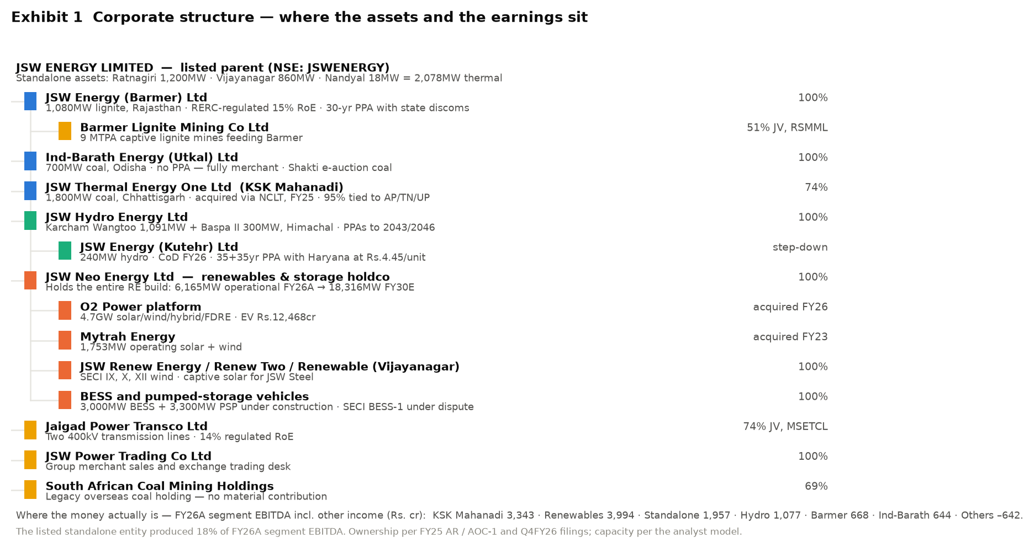
Corporate structure
The listed entity produced 18% of FY26A segment EBITDA
▪ The listed parent owns three old thermal plants (2,078MW).
▪ The entire renewable build sits two levels down, inside JSW Neo Energy.
▪ KSK Mahanadi — the largest single EBITDA contributor in FY26A at Rs.3,343cr — is 74% owned, and the call option on the balance 26% has been served.
▪ Capital sinks: 'Others' lost Rs.642cr of EBITDA in FY26A. The 1GW solar module plant is on hold; SECI BESS-1 (500MW) is in dispute with no impairment taken.
▪ Entity-level PAT is not disclosed by the company and is not in the model.
Source: FY26 Integrated Annual Report (AOC-1), Q4FY26 and Q1FY27 calls, analyst model.

Slide 4
Six business cycles
Every previous growth cycle ended on a lower return on capital
Cycle | Revenue (Rs.cr) | EBITDA margin | Net debt/EBITDA | ROCE | What happened
1. FY05–08 Captive merchant | 491 → 1,574 | 44% → 74% | 2.9x → 1.7x | 7% → 29% | Vijayanagar only; peak merchant tariffs
2. FY09–13 First build | 1,591 → 8,934 | 18% → 31% | 20.0x → 3.6x | 2% → 9% | Ratnagiri + Barmer; debt to Rs.10,377cr
3. FY14–19 Stagnation | 8,705 → 9,138 | 37% → 31% | 2.9x → 3.6x | 8% → 7% | No new capacity; Vijayanagar PLF 95% → 50%
4. FY20–22 Deleveraging | 8,273 → 8,167 | 36% → 44% | 3.3x → 2.2x | 9% → 7% | Cleanest balance sheet in a decade
5. FY23–26A Re-levering | 10,332 → 18,901 | 32% → 53% | 6.3x → 7.0x | 4% → 6% | Four acquisitions; net debt up 3.4x
6. FY27E–30E Renewables | 26,535 → 39,506 | 49% → 60% | 6.1x → 4.9x | 6% → 9% | 12,451MW built; first cycle ROCE rises
▪ ROCE was 29% in FY08, 9% in FY13, 7% in FY22 and 6.4% in FY26A. The model has it reaching 8.8% by FY30E — still below the 10% WACC in the model's own DCF.
Source: analyst model. Strictly Confidential — internal circulation only. Not investment advice.

Slide 5
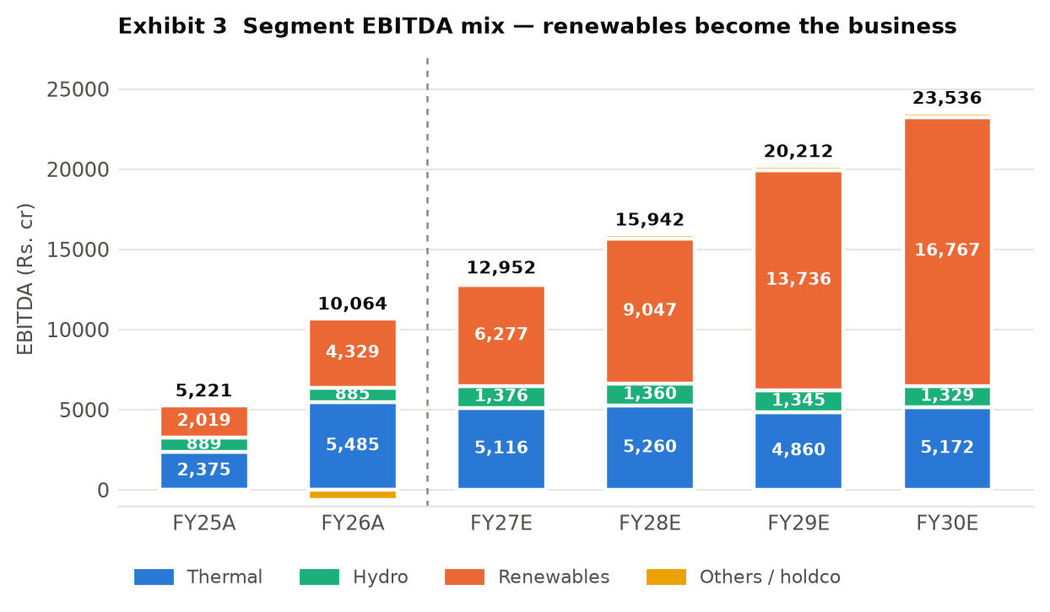
Segments
Renewables go from 40% of EBITDA to 71% by FY30E
Revenue (Rs.cr) | FY25A | FY26A | FY27E | FY28E
Total Thermal | 8,214 | 13,395 | 16,788 | 17,199
Hydro | 1,145 | 1,112 | 1,707 | 1,701
Renewables | 2,434 | 4,701 | 7,133 | 10,281
Consolidated revenue | 11,745 | 18,901 | 26,535 | 30,359
▪ Thermal is fully built — growth is realisation, not volume.
▪ Hydro converted 97% of revenue to EBITDA in FY26A. No new capacity planned.
▪ Renewables converted 85% vs 49% for thermal — the mix is the margin story.
▪ The model does not carry segment revenue beyond FY28E.
Source: analyst model. Strictly Confidential — internal circulation only. Not investment advice.

Slide 6
Business model and where the moat sits
Contracts and cost of capital — not technology
▪ Contractual. 25–40 year PPAs with SECI, NTPC, state discoms; a regulated 15% RoE at Barmer; 14% regulated RoE at Jaigad Transco.
▪ Site and connectivity. Land at scale and grid evacuation are the binding constraint on Indian renewable build — years to assemble.
▪ Group offtake. ~1,730MW sold to JSW Steel, Cement and Paints. A sticky customer base and a related-party concentration at the same time.
▪ Cost of capital. In a reverse auction everyone buys the same panels. The cheapest funder wins. AA rating helps; 2.3x net debt/equity does not.
▪ What there is not. No technology, no IP, no pricing power. This is an assets-and-contracts business.
▪ Capital intensity is the defining feature. Rs.88,885cr gross block on Rs.18,901cr revenue — a 0.25x asset turn, falling to 0.24x by FY30E. Rs.70,428cr of cumulative FY27E–FY30E operating cash flow does not cover Rs.89,565cr of capex, let alone Rs.33,098cr of interest.
Source: analyst model. Strictly Confidential — internal circulation only. Not investment advice.

Slide 7
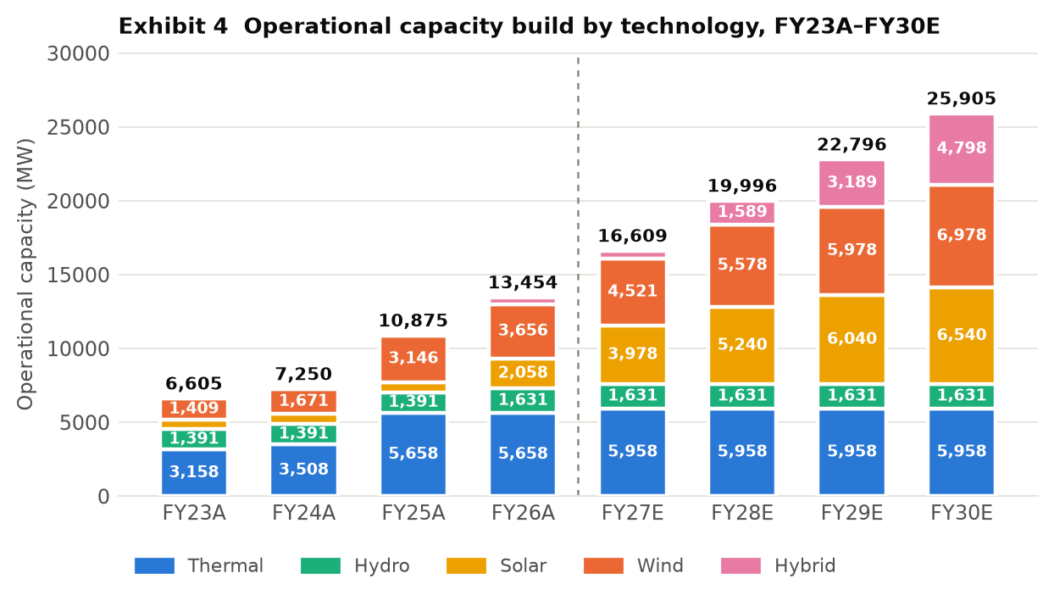
Capacity and capex
12,451MW to build in four years
 | FY26A | FY27E | FY28E | FY29E | FY30E
Capacity (MW) | 13,454 | 16,609 | 19,996 | 22,796 | 25,905
Added in year (MW) | 2,579 | 3,155 | 3,387 | 2,800 | 3,109
Storage (MW) | 0 | 0 | 875 | 875 | 2,375
Capex (Rs.cr) | 10,112 | 21,229 | 21,864 | 21,656 | 24,816
Capex per MW (Rs.cr) | 3.9 | 6.7 | 6.5 | 7.7 | 8.0
▪ Kutehr hydro: original CoD Sep-2024, commissioned FY26 — 18 months late.
▪ Hetero wind 125MW: CoD 31-Mar-2023 in the tracker, still under construction.
▪ SECI BESS-1 500MW: LoA Jul-2022, in dispute, no impairment taken.
▪ Salboni 1,600MW thermal is under construction but is NOT in the model.
Source: analyst model. Strictly Confidential — internal circulation only. Not investment advice.

Slide 8
Industry and growth drivers
Fast supply, slow demand — the tension in the story
▪ Where India is. 533GW installed at Mar-2026; 283.5GW non-fossil (53%), including 274.7GW renewables. JSW Energy is ~2.7% of national capacity.
▪ Visible now — renewable share gain. Solar generation +24% and wind +11% year-on-year in Q4FY26, against total generation growth of just 3%.
▪ Visible now — the policy mandate. 500GW of non-fossil by 2030 requires ~54GW of additions a year. The SECI/NTPC/state tender pipeline is the mechanism.
▪ Prospective — the storage premium. FDRE, hybrid and RTC tenders price above plain solar. JSW moves from 451MW of hybrid to 4,798MW plus 3,000MW BESS and 3,300MW of pumped storage.
▪ The tension. Q4FY26 generation growth of 3% was the slowest in six years while renewable capacity kept compounding. Flat demand plus fast supply is the classic setup for curtailment and merchant tariff compression.
Source: CEA / MNRE / PIB releases and press reports, July 2026; analyst model.

Slide 9
Competitive position
Cheap capital is the moat — and it is getting more expensive
Peer | EV/EBITDA | P/E | Comment
JSW Energy | 11.2x FY28E | 44.0x FY26A | 13.5GW; 2.3x net debt/equity; ROCE 6.4%
NTPC | ~11.0x | ~12.8x | ~80GW+, sovereign, regulated RoE — the floor
Tata Power | ~13.8x | ~33.4x | Closest structural comparable
Adani Power | ~24.4x | n/a | Largest listed private thermal by mkt cap
Adani Green | >17x | >50x | Pure-play RE — the implicit SOTP anchor
▪ JSW's ROCE averaged 5.4% over FY23A–FY26A. NTPC on a regulated base and Tata Power on an integrated model both run materially higher.
▪ A 60% EBITDA margin on a 0.24x asset turn is how a business looks highly profitable on the income statement and mediocre on capital.
▪ Peer multiples are trailing secondary-source figures, not reconciled to audited accounts. Like-for-like peer growth, margin and ROCE were not obtainable — a gap.
Source: analyst model. Strictly Confidential — internal circulation only. Not investment advice.

Slide 10
Investment thesis
The market is right about the EBITDA and wrong about who owns it
▪ Variant perception. The market treats JSW Energy as a renewable compounder deserving a growth multiple. The EBITDA does more than double. But 92% of that growth is debt-funded renewable capacity, and the equity is 29% of enterprise value — so the price is a geared bet on the exit multiple.
▪ 1. The build is real and checkable. 13,454MW to 25,905MW; EBITDA Rs.10,064cr to Rs.23,536cr, a 24% CAGR. 2,579MW came in FY26A, 1,081MW since April 2026 against a 3,155MW FY27E requirement.
▪ 2. The margin expansion is mechanical. Renewables convert 85% of revenue to EBITDA vs 49% for thermal. Consolidated margin 53.2% → 59.6% on mix alone. Fuel falls from 29.5% of revenue to 25.5%.
▪ 3. But the equity is a thin, geared claim. Net debt Rs.75,038cr at FY27E-end = 4.7x FY28E EBITDA. Each 1.0x of multiple = Rs.87/share = 15.5% of the price. 9.0x gives Rs.373; 11.9x gives Rs.625.
▪ 4. And returns still do not clear the cost of capital. ROCE 6.4% FY26A → 8.8% FY30E, against the 10% WACC in the model's own DCF.
Source: analyst model. Strictly Confidential — internal circulation only. Not investment advice.

Slide 11
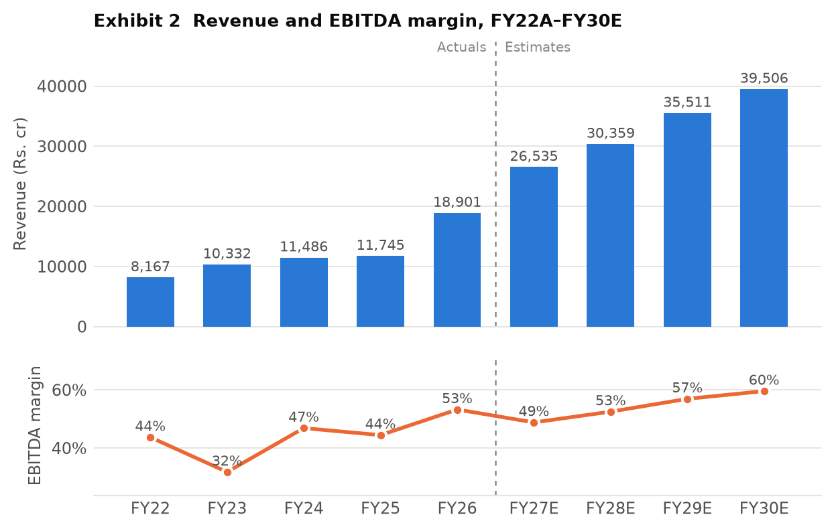
Financial performance
FY26A doubled EBITDA; PAT grew 15% and only on a tax credit
Rs. cr | FY26A | FY27E | FY28E | FY29E | FY30E
Revenue | 18,901 | 26,535 | 30,359 | 35,511 | 39,506
growth, yoy | 61% | 40% | 14% | 17% | 11%
EBITDA | 10,064 | 12,952 | 15,942 | 20,212 | 23,536
EBITDA margin | 53.2% | 48.8% | 52.5% | 56.9% | 59.6%
Interest expense | 5,816 | 6,196 | 7,510 | 9,309 | 10,084
Effective tax rate | -39.3% | 25.0% | 25.0% | 25.0% | 25.0%
PAT after minority | 2,239 | 2,823 | 3,626 | 4,704 | 5,791
EPS (Rs.) | 12.74 | 15.40 | 19.28 | 25.01 | 30.78
ROE | 7.9% | 8.3% | 9.1% | 10.6% | 11.8%
ROCE | 6.4% | 6.3% | 7.3% | 8.3% | 8.8%
▪ FY26A's tax charge was NEGATIVE Rs.777cr on positive PBT — deferred tax assets recognised at Utkal and KSK once PPAs were signed. Explained and legitimate, but not repeatable: management guides 23–24% from here. Normalised, FY26A PAT is ~Rs.969cr, not Rs.2,239cr — +15% becomes about –50%.
Source: analyst model. Strictly Confidential — internal circulation only. Not investment advice.

Slide 12
Cost structure and returns
Margin is mix; cash conversion is not the problem — capex is
% of revenue | FY26A | FY27E | FY28E | FY29E | FY30E
Fuel cost | 29.5% | 32.3% | 30.0% | 27.2% | 25.5%
Employee cost | 3.9% | 4.2% | 3.9% | 3.5% | 3.3%
Other expenses | 12.9% | 14.1% | 13.1% | 11.9% | 11.2%
EBITDA margin | 53.2% | 48.8% | 52.5% | 56.9% | 59.6%
▪ Fuel is the only variable cost. Renewables and hydro have none, so the cost base goes from ~63% fixed at the FY26A mix to ~75% fixed by FY30E.
▪ Operating leverage is asymmetric. A 10% renewable generation shortfall hits EBITDA almost one-for-one; a 10% thermal shortfall costs about half that.
▪ Cash converts at the EBITDA line. Pre-tax OCF/EBITDA of 101–110% through the forecast; debtor days improved from 81 to 57 in FY26A.
▪ It does not convert at the equity line. Cumulative FCF after interest of NEGATIVE Rs.53,993cr over FY27E–FY30E. There is no year in the model in which the company self-funds.
Rs. cr | FY26A | FY27E | FY28E | FY29E | FY30E
Operating cash flow | 9,898 | 12,720 | 16,319 | 19,486 | 21,902
Capex | (10,112) | (21,229) | (21,864) | (21,656) | (24,816)
Free cash flow | (213) | (8,509) | (5,545) | (2,170) | (2,915)
FCF post interest | (6,169) | (14,705) | (13,055) | (11,478) | (12,999)
Pre-tax OCF/EBITDA | 101% | 106% | 110% | 104% | 101%
Source: analyst model. Strictly Confidential — internal circulation only. Not investment advice.

Slide 13
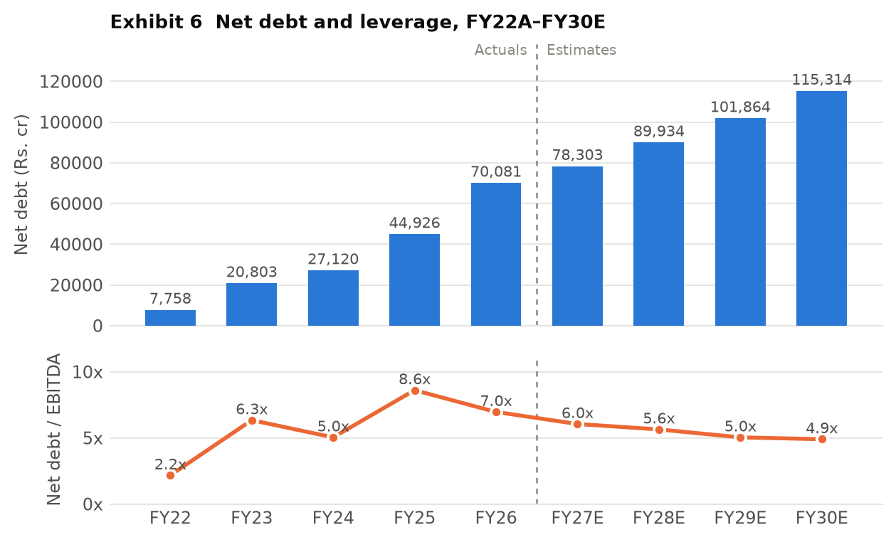
Balance sheet and capital allocation
Rs.73,000cr deployed in five years; ROCE went from 7.1% to 6.4%
▪ The record, FY22A–FY26A. Rs.25,007cr of operating cash flow. Spent Rs.31,382cr on capex and Rs.26,537cr acquiring subsidiaries, paid Rs.11,760cr of interest and ~Rs.1,700cr of dividends. Funded with Rs.66,953cr of new debt and Rs.6,069cr of new equity.
▪ The path from here. Net debt rises every single year, Rs.70,081cr to Rs.115,314cr. Leverage falls from 7.0x to 4.9x only because EBITDA rises faster. Management's sub-5.0x target is reached in FY29E at the earliest.
▪ The plan is funded. Rs.10,150cr raised; Rs.24,184cr of capex is now contractually committed in the audited accounts; reported cost of debt fell 67bp to 8.36%. The CFO says FY27's Rs.20,000cr needs no further equity.
▪ Two flags remain. A dividend maintained through four years of large negative free cash flow; and Rs.7,862cr of JSW Steel shares still held while borrowing at 8.36% — a cross-holding that runs both ways, since JSW Steel owns 4.86% of JSW Energy.
Source: analyst model. Strictly Confidential — internal circulation only. Not investment advice.

Slide 14
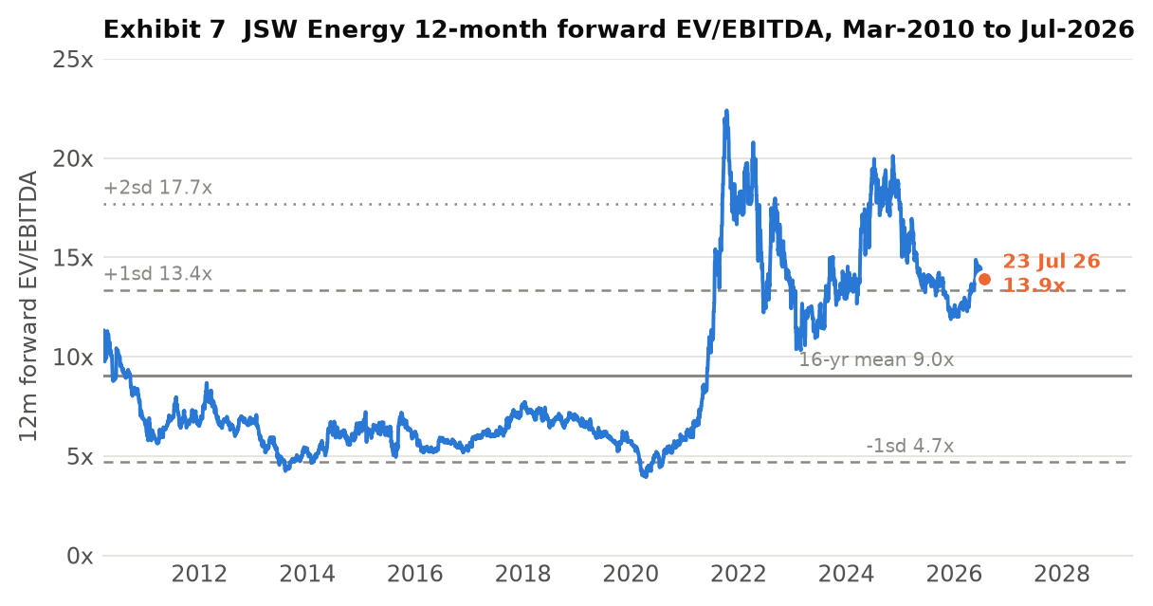
The multiple, 2010–2026
EBITDA doubled in FY26A and the multiple compressed
▪ FY11–20. Derated 9–11x to 5–6x, trough 3.9x. No new capacity; Vijayanagar PLF 95% → 50%.
▪ FY21–22. 5.8x to 22.4x. JSW Neo formed, 20GW target announced, leverage at 2.2x — the cleanest balance sheet in a decade.
▪ FY23. Back to 10.3x. EBITDA fell 8% on imported coal; leverage jumped to 6.3x on Mytrah.
▪ FY24–25. Back to a 20.1x peak on Ind-Barath, KSK and a Rs.4,944cr QIP.
▪ FY26A to date. 12.0x–14.9x, now 13.9x. EBITDA nearly doubled while the average multiple fell from 16.9x (2024) to 13.2x (2026). The market took the EBITDA and refused to keep paying for it.
▪ Gap. A monthly closing-price series is not in the model — the narrative is told through the multiple plus the 52-week range of Rs.428–617.
Source: analyst model. Strictly Confidential — internal circulation only. Not investment advice.

Slide 15
Valuation
Base Rs.625 = 11.9x FY28E EV/EBITDA less FY27E-end net debt
Scenario | Mult. | Applied to | EBITDA | Equity value | Target | vs CMP
Bear | 8.0x | FY28E | 15,942 | 52,497 | Rs.286 | (49%)
Downside case | 10.2x | FY28E | 15,942 | 87,569 | Rs.478 | (15%)
Base | 11.9x | FY28E | 15,942 | 114,671 | Rs.625 | +11%
Bull | 11.9x | FY29E | 20,212 | 153,849 | Rs.839 | +50%
16-yr mean multiple | 9.0x | FY28E | 15,942 | 68,439 | Rs.373 | (33%)
▪ Sensitivity. FY28E EBITDA 10% below forecast → Rs.522, a 7% DOWNSIDE. Margin at 50.0% instead of 52.5% → Rs.576. Mean-reversion to 9.0x → Rs.373.
▪ Minority adjustment. The call option on KSK's 26% has been served, so full consolidation is right — but the ~Rs.1,170cr price is not in FY27E net debt. Adjusting takes the base to ~Rs.619, not the ~Rs.582 it would have been without the buyout.
▪ Not credited in the base. Residual JSW Steel stake Rs.34/share; Salboni 3,200MW; KSK units 3–6.
▪ The cross-check. The model's own asset-based SOTP is Rs.510 — BELOW the market price. The two methods bracket the CMP. That is what fairly valued looks like.
▪ Why no DCF. FCFE is negative in four of seven forecast years and the terminal value is negative; the model's DCF returns minus Rs.376 per share. An artefact, not a signal. No weight placed on it.
Source: analyst model. Strictly Confidential — internal circulation only. Not investment advice.

Slide 16
Governance and management
Clean audit, aligned promoter, one open item
Parameter | Status | Comment
Promoter holding | 66.5% (Jun-26) from 69.3% (Sep-24) | Dilution from QIPs, not selling. Rs.625cr of warrants already subscribed at Rs.525; Rs.1,875cr still payable.
Institutional trend | FII 14.9% → 11.4%; DII 9.8% → 16.2% | Foreign investors have sold for two years; domestic institutions absorbed the stock and the QIP.
Concalls / disclosure | Quarterly, granular | Segment and commissioning detail above sector norm.
Related party | Material, quantum unverified | ~1,730MW sold to JSW Steel, Cement, Paints; fuel JV with a state entity.
Auditor | Deloitte Haskins & Sells LLP — unmodified | Clean FY26 opinion, no emphasis of matter. One key audit matter: tariff disputes with customers.
Contingent liabilities | ~Rs.4,506cr, ~15% of net worth | Claims Rs.2,520cr (down yoy), tariff disputes Rs.340cr, guarantees Rs.605cr, JV share Rs.1,041cr. Not growing.
Promoter pledge | Not disclosed in the AR | Only project-level lender pledges. Still to be checked in the quarterly shareholding filing — the one open item.
Guidance vs delivery | On plan in aggregate, late on projects | Kutehr 18 months late; Hetero wind 3 years late; SECI BESS-1 stalled; solar module plant on hold. But 2,579MW did commission in FY26A.
▪ Sajjan Jindal (Chairman & MD) — the key-man and capital-allocation authority. Sharad Mahendra (Joint MD & CEO since Feb-2024). Chandrasekaran Prabhakaran (CFO since 1 Jan 2026, replacing Pritesh Vinay) — a CFO change six months before the sector's largest capital raise, which was then delivered.
▪ The model's own target of 28.3GW by FY30E is ~6% below the company's stated 30GW — the estimates used here are slightly more conservative than guidance.
Source: analyst model. Strictly Confidential — internal circulation only. Not investment advice.

Slide 17
Triggers and risks
What to watch, and what would break the thesis
TRIGGERS — dated and checkable
▪ Q2FY27 (Oct-2026): EBITDA must run Rs.3,360cr/quarter for 9 months vs Rs.2,873cr in 1QFY27.
▪ Standalone segment revenue: FY27E assumes Rs.6,612cr vs Rs.3,030cr in FY26A and Rs.1,101cr delivered in 1QFY27.
▪ KSK minority buyout price — not yet crystallised, expected end-Q2FY27; ~Rs.1,170cr is absent from the model's net debt.
▪ First 600MW of KSK units 3-6, mid-FY27 — pure upside, ~Rs.35/share.
▪ Rajasthan evacuation line, July 2026 — ends the curtailment that cost Rs.50cr in FY26A.
▪ Quarterly MW commissioned — 3,155MW needed in FY27E, 873MW came in Q1.
▪ Final DSM regulations — 1.5-2% of RE revenue on management's worst case; substation-level grouping would reduce it.
RISKS — most damaging first
▪ Multiple compression. Each 1.0x = Rs.87/share. Mean reversion to 9.0x is Rs.373, a 33% loss with no operational change.
▪ Renewable execution slippage. A one-year slip removes Rs.3,000–4,000cr of FY30E EBITDA — over Rs.200/share of target.
▪ Funding. De-risked for FY27 (raise complete, cash Rs.12,881cr); unresolved for FY29-30, ~Rs.46,000cr on 2.1x interest cover.
▪ Evacuation, not merchant price. Only 9,500 of a planned 15,000 ckm built; eases ~2029. Open capacity is just ~5% of the base.
▪ Three items the model omits: the non-repeatable FY26A tax credit, the cost of the KSK minority buyout, and the Supreme Court's 18% Himachal free-power ruling (~287 MU/yr, permanent).
▪ Per-MW economics. The model implies Rs.1.02cr/MW of incremental RE EBITDA against management's own Rs.0.75cr/MW steady state — a Rs.3,325cr gap to FY30E.
Falsification test: sell if FY27 EBITDA lands below Rs.11,500cr AND net debt/EBITDA is above 6.5x at FY27-end — the build has neither delivered nor been funded. Upgrade to buy if FY27 EBITDA exceeds Rs.13,000cr and leverage closes below 5.5x on the model's all-in measure.
Source: analyst model. Strictly Confidential — internal circulation only. Not investment advice.

Slide 18
Final outlook
HOLD | Base TP Rs.625 | +11.4% | CMP Rs.561
Bear 8.0x FY28E
Rs.286
(49%)
Base 11.9x FY28E
Rs.625
+11%
Bull 11.9x FY29E
Rs.839
+50%
Model SOTP
Rs.510
(9%) — below CMP
▪ The business is genuinely better than it was. From 6,605MW to 13,454MW in four years, from a stagnant thermal generator to a company where renewables supply 71% of EBITDA by FY30E, on 25–40 year fixed-tariff PPAs, with an AA rating and a promoter subscribing equity at Rs.525.
▪ The base target requires nothing heroic. Only that FY28E EBITDA of Rs.15,942cr is delivered and the market keeps paying roughly what it pays today. No re-rating, no acquisition, and no credit for Salboni, KSK units 3–6 or the Rs.34/share residual JSW Steel stake.
▪ But the risk-reward is not asymmetric. 11% base upside against 33% downside on a mean-reverting multiple; a 10% EBITDA miss alone flips +11% to –7%; and terminal ROCE of 8.8% is still below the model's own 10% WACC. An asset-based SOTP of Rs.510 and a forward-multiple target of Rs.625 bracket the current price.
▪ What caps position sizing. Less than we thought before reading the primary sources — the audit is clean and contingent exposure is ~15% of net worth and not growing. What remains: ~Rs.46,000cr of FY29-30 capex on 2.1x interest cover, the Himachal free-power ruling absent from the forecast, per-MW economics 36% above management's own benchmark, and an unseen promoter pledge position. Buy on evidence — FY27 EBITDA above Rs.13,000cr with leverage under 5.5x — or nearer Rs.480.
Source: analyst model. Strictly Confidential — internal circulation only. Not investment advice.

