Slide 1
COMPETITIVE TEARDOWN
Creatify Ad Launcher vs FabAds Launch
Where their AI launcher wins, where ours does, and what we deliberately skip
9 Gaps
8 Parity
7 We win
8 Not our lane
Read-only recon of app.creatify.ai (2 passes, nothing launched or modified) · FabAds prototype audit + updated Figma Launch design · 7 July 2026

Slide 2
METHOD & SCOPE
How we compared
Creatify — live product
FabAds — prototype + design
Logged-in walkthrough, two passes, read-only
Ad Launcher walked to the final Launch button — never clicked
Covered: launcher, AI Media Buyer, Automations, Projects, Brand Kit, Ad Clone, Competitor Tracker, Ad Flow, Inspiration
Not verified: TikTok / Google / AppLovin launch forms (real OAuth walls — declined)
Baseline: Launch v2 + updated Figma design (4 steps: Start → Setup → Ad & Distribution → Review & Launch)
3 parallel repo agents, every claim file-cited, adversarial monitor pass
The repo simulates data & connectivity by design — it's the UX prototype. Production app is a separate build with full validations (per team; not audited here)
Adjacent: Genie, Creative Library, Insights, Reports, Campaign URLs, RRM, AutoPilot
Comparison unit = the launch job: from “I have a creative / an idea” to “ads are live and being optimized.”

Slide 3

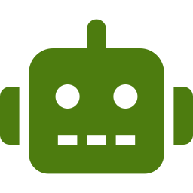
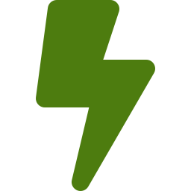
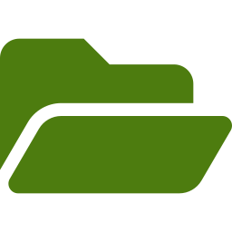
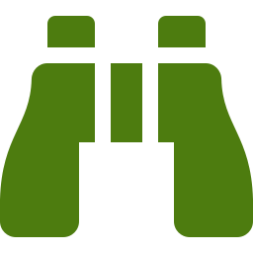
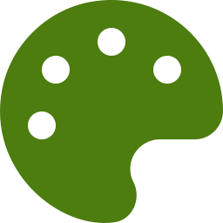
WHAT WE FOUND
Creatify's launch ecosystem at a glance
Ad Launcher
AI Media Buyer
Automations
Single-page Meta form: account → audience → budget → creative. Traffic objective only. Meta · TikTok · AppLovin · Google connect.
Chat agent over connected ad accounts (runs Opus 4.8). Reads & audits; “nothing changes until you approve it.”
7 routines: fatigue detect → auto-regenerate creative → queue into same ad set; guarded weekly budget / pause moves.
Projects → Launch
Competitor Tracker
Brand Kit + Ad Clone
3,550-file library, folders, bulk select → “Launch Ads.” Every asset detail page has a working Launch Ad button.
Follow 20 brands; hooks / selling-point / copy analytics; “Clone this ad” on every competitor ad.
Products, avatars, voices, colors; ad accounts assigned per brand. Product + reference ad → cloned ad.
Gating: the whole launch + optimization loop is Pro-tier ($99/mo) — not on the $39 Starter plan.

Slide 4
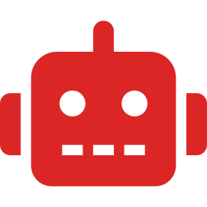


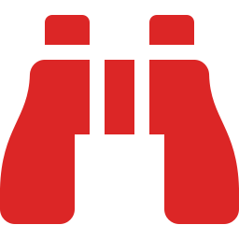
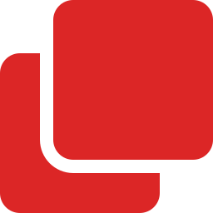
LIST 1 · GAPS — CRITICAL
They have it. We don't — yet.
Post-launch AI loop — Media Buyer + Automations: detect creative fatigue → regenerate replacements → queue into the live ad set → guarded budget/pause moves with approval mode. Our Automation surface is still roadmap.
Working AI inside the launcher — AI ad-copy button + brand-info autofill at the creative step. Our launcher (design + prototype) has no generative assist inline yet.
Multi-platform launch — Meta + TikTok + AppLovin + Google Ads connect vs our Meta-only launcher (TikTok exists only as a Reports tab).
Competitor intelligence depth — 10M+ tracked Meta ads, per-brand hooks / selling-point / copy / headline analytics, DCO version tracking. Our Industry Insights feeds launch, but has no analytics layer like this.
Ad Clone (product × reference ad) — Pick your product + any trending/competitor ad → cloned creative in your brand. We clone launches, not creatives.

Slide 5




LIST 1 · GAPS — SECONDARY
Smaller gaps that still shape the experience
Brand Kit as one source of truth — Logo, colors, selling points, products, avatars, voices in one place — feeding generation — with ad accounts assigned per brand. Our brand data is split across Catalogue / Genie Assets / Library.
Append into a live campaign — Their launcher pushes new creatives into an already-launched campaign. Our clone / relaunch / auto-fill always builds a new launch.
Live audience estimate — Creatify inherits Meta's real delivery estimate in-form. Ours is mocked in the prototype — confirm it's wired in the production build.
Cost transparency at the button — Exact credit cost shown on the generate action (e.g. “Generate — 18.85”). Our plan-gating shows tiers, not per-action cost.

Slide 6

LIST 2 · PARITY
Both products do this
Advantage+ audience & placement toggles
Core audience controls: locations, age, gender + saved audiences / templates
Budget + schedule, CBO/ABO, optional end date
Standard Meta CTA set (Learn More, Shop Now, …)
UTM / URL-parameter builder on the destination link
Media from upload or asset library, folders + bulk launch
In-form placement / feed previews
Clone a previous run (their “launched campaigns” picker · our relaunch + auto-fill from previous launches)
FabAds side verified against the prototype + updated Figma Launch design; production wiring per team, not audited here.

Slide 7
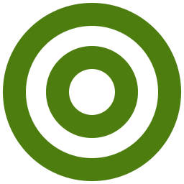
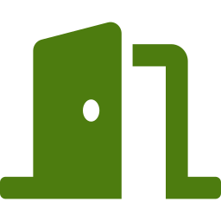
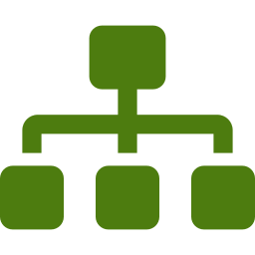

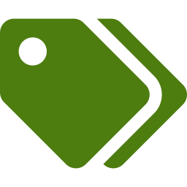

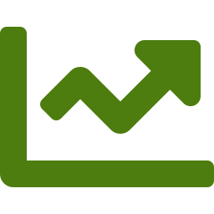
LIST 3 · WHERE FABADS LAUNCH WINS
Our launcher is structurally deeper
All 6 Meta objectives — Full ODAX picker + Advantage+ Catalogue toggles on Leads/Sales (new design, Step 1). Creatify: Traffic only — no Conversions, Sales, Leads.
Launch entry points everywhere — From Genie, Creative Library, folders, Industry Insights, Reports (clone a campaign/adset/ad), Campaign URLs, and relaunch/auto-fill. Creatify: library assets + clone-this-ad.
Multi-account distribution engine — Per-account assignment, page split (equal / fill-first / duplicate), creative distribution modes (rotating / one-per-adset / stacked / multiply / custom). Creatify: one account, one ad set per run.
Preflight + dedicated Review step — Review & Launch step with structure tree/table, bulk edit and policy checks (13 groups, ~28 rules in prototype). Creatify: form straight to Launch, minimal validation.
Nomenclature system — Token-based naming templates ({brand}_{objective}_{date}) at campaign/adset/ad level + workspace launch defaults. Creatify: auto-generated timestamps.
Templates, strategies & A/B test — Setup + targeting templates, saved strategies, Meta-side A/B test toggle, special ad category + EU DSA handling. Creatify saves audiences only.
Built for agency scale — Hundreds of ads across accounts and pages in one run — Creatify's flow is single-advertiser by design.

Slide 8

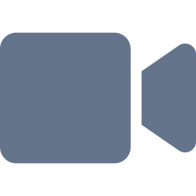
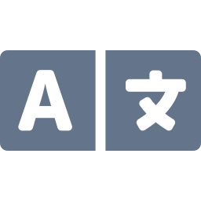



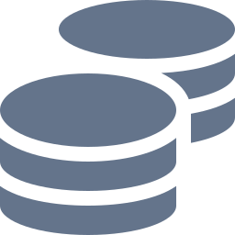

LIST 4 · NOT IN SCOPE
Creatify features we deliberately skip
AI avatar actors
300–1,500 stock actors, custom avatars, voice cloning — creative-gen company DNA, not ours.
Video editor + Ad Flow canvas
Full node-based creative editing suite. We integrate with creatives, we don't edit them.
75+ language dubbing
Localization pipeline for global UGC — outside our launch lane.
HTML / playable ads
Interactive ad units for the AppLovin gaming lane.
Done-for-you Studio
Enterprise human service arm — an org decision, not a product gap.
Template community
Public inspiration marketplace with usage counts.
Credit-based metering
Per-action credit pricing. We stay on plan tiers.
Decide later: Google / AppLovin
Platforms beyond Meta + TikTok — revisit against ICP, not a today-gap.

Slide 9
STRUCTURAL EDGE
Launch entry points: we out-cover them
FabAds — 7 ways in
Creatify — 4 ways in
Launch module (new / 3-click / catalogue)
Genie — generated output → launch
Creative Library — asset / adgroup launch
Folders — fast launch a creative bundle
Industry Insights — launch from an insight
Reports — clone a campaign / ad set / ad
Campaign URLs + relaunch / auto-fill previous
Home → Ad Launcher (platform picker)
Projects — per-asset “Launch Ad” + bulk select
My Brand — “Generate ads” per product
Competitor / trending ad — “Clone this ad” (goes to generation first, then launch)
Every FabAds surface that produces or holds a creative can launch it. Their strength is the loop after launch; ours is the coverage before it.

Slide 10
SO WHAT
Recommended order of attack
NOW
NEXT
LATER
AI ad copy + brand autofill inside the creative step — their clearest in-launcher edge, cheapest to match
Post-launch loop v1: creative-fatigue detection + guarded budget rules (RRM + AutoPilot already sketch this)
Competitor analytics layer on Industry Insights: hooks / selling-points / copy frequency + clone-this-ad
Append-creatives-into-live-campaign mode (today every path builds a new launch)
Unify brand data (Catalogue / Genie Assets / Library) into one Brand Kit
TikTok as platform #2
Full agentic media buyer (chat over ad accounts) once the post-launch loop is proven
Confirm live audience estimate is wired in the production build
⚠ Ops note: Creatify's Competitor Tracker burned ~80 account credits from passive viewing during recon — background AI insight generation. Inform the account owner.

