Slide 1




SDG 7: Affordable and Clean Energy
Ensuring access to affordable, reliable, sustainable, and modern energy for all is the focus of Sustainable Development Goal (SDG) 7. This critical goal aims to transform the global energy landscape and drive the transition to a clean energy future.
by Winnie mutheu

Slide 2

Why SDG 7 is important
1
Lack of Access
2
Climate Change
Over 770 million people worldwide lack access to electricity, hindering economic and social development.
Fossil fuel-based energy production is a major contributor to greenhouse gas emissions and climate change.
3
Sustainable Growth
Affordable and clean energy is essential for sustainable economic growth and improving quality of life.

Slide 3
Key targets and indicators for SDG 7
Targets
Indicators
Ensure universal access to affordable, reliable, and modern energy services
Proportion of population with access to electricity
Renewable energy share in the total final energy consumption
Increase substantially the share of renewable energy in the global energy mix
Energy intensity measured in terms of primary energy and GDP
Double the global rate of improvement in energy efficiency

Slide 4
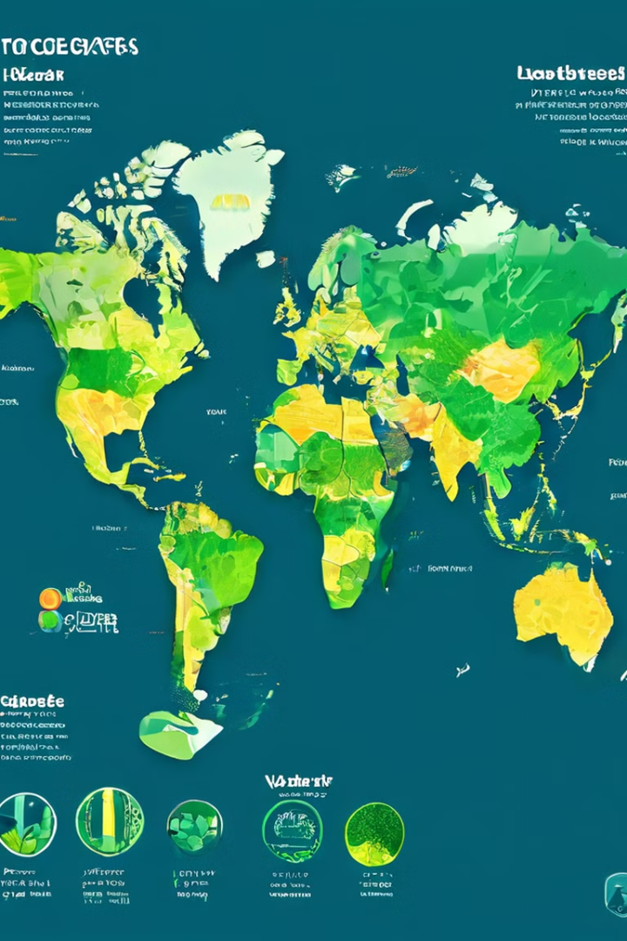
Current global progress on SDG 7
1
Access to Electricity
Global access to electricity has increased from 83% in 2010 to 90% in 2020.
2
Renewable Energy
The share of renewable energy in the global energy mix has grown from 17.3% in 2010 to 20.1% in 2020.
3
Energy Efficiency
The global rate of improvement in energy efficiency has increased from 1.3% in 2010 to 2.1% in 2020.

Slide 5
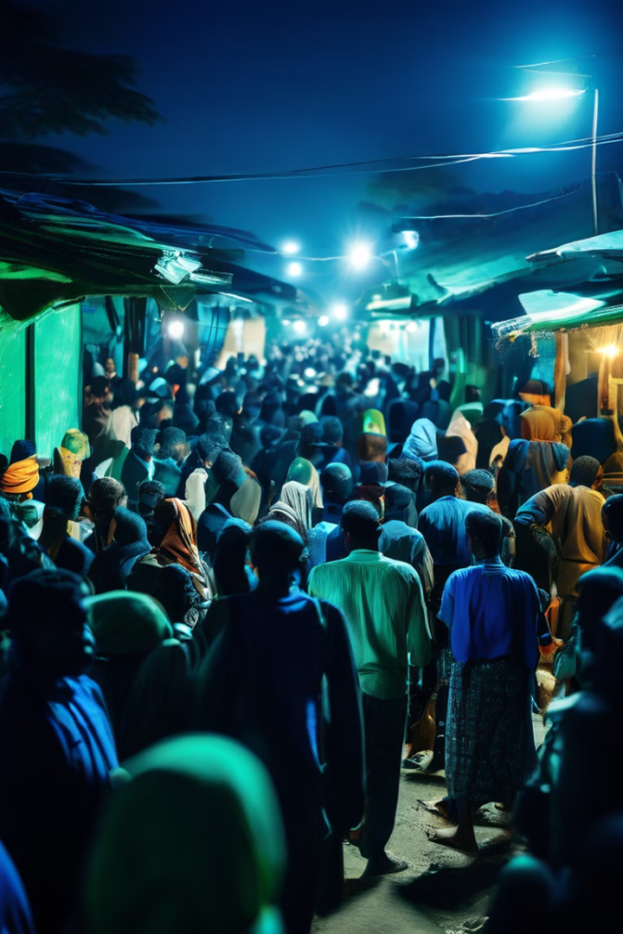
Challenges in achieving SDG 7
Infrastructure Gaps
Financing Barriers
Lack of grid infrastructure and distribution networks hinders universal energy access.
Mobilizing the necessary investment for renewable energy and efficiency projects remains a challenge.
Policy Inconsistencies
Technological Limitations
Inconsistent or unstable policies can discourage private sector investment in clean energy.
Certain renewable technologies still face constraints in terms of cost, reliability, and scalability.

Slide 6





Opportunities for advancing SDG 7
Renewable Energy
Energy Efficiency
Rapidly falling costs and technological advancements in renewable energy sources like solar and wind.
Improved energy-efficient technologies can significantly reduce energy consumption and costs.
Grid Modernization
Financing Innovations
Investments in smart grid infrastructure can improve energy access and system reliability.
Innovative financing mechanisms can mobilize the necessary investments for clean energy projects.

Slide 7





Partnerships and collaboration for SDG 7
Government
Private Sector
Civil Society
International Cooperation
Policymakers and regulators set the enabling environment through policies, incentives, and regulations.
Businesses invest in clean energy projects and drive innovation in technology and financing.
NGOs and community groups advocate for energy access and sustainable energy solutions.
Global partnerships and initiatives mobilize resources and share best practices.

Slide 8
How our organization can contribute to SDG 7
Advocacy
Capacity Building
Partnerships
Raise awareness and advocate for policies that support affordable and clean energy access.
Provide training and technical assistance to communities on renewable energy solutions.
Collaborate with government, private sector, and other stakeholders to scale up clean energy initiatives.

