Slide 1
SDG 6: Clean Water and Sanitation - Data-Driven Solution

Slide 2
Project Overview
This project focuses on Sustainable Development Goal (SDG) 6: Clean Water and Sanitation. The objective is to design and implement a data-driven solution to improve water quality and access to clean water in rural communities. The solution involves database design, data analysis, and visualization to support decision-making.

Slide 3
SDG Alignment
SDG 6 aims to ensure availability and sustainable management of water and sanitation for all. The project aligns with SDG 6 by addressing the need for clean water in underserved communities, improving water quality, and enhancing sanitation through data-driven approaches.

Slide 4
Problem Definition
The problem addressed in this project is the lack of access to clean water in rural communities. Contaminated water sources, limited infrastructure, and inadequate monitoring systems contribute to waterborne diseases and poor health outcomes. The project aims to create a reliable data-driven solution to monitor, analyze, and improve water quality in these areas.

Slide 5
Problem Significance
Access to clean water is fundamental to human health, economic development, and environmental sustainability. Inadequate water quality and sanitation lead to preventable diseases and exacerbate poverty in rural communities. Addressing this issue is crucial for achieving SDG 6 and improving the overall well-being of affected populations.

Slide 6
Database Design
The database was designed to store and manage data related to water sources, quality tests, community profiles, projects, funding, and beneficiaries. The Entity-Relationship Diagram (ERD) outlines the relationships between these entities, ensuring data consistency and enabling comprehensive analysis.

Slide 7
Database Schema
The database schema includes tables for communities, water sources, water quality tests, projects, project funding, and beneficiaries. SQL statements were written to create the schema, ensuring efficient data storage, retrieval, and analysis capabilities.

Slide 8
Data Analysis Insights
Data analysis revealed key insights, such as the correlation between community location and water quality, the effectiveness of ongoing projects, and the impact of funding on project success. These insights are vital for informed decision-making and prioritizing interventions.

Slide 9
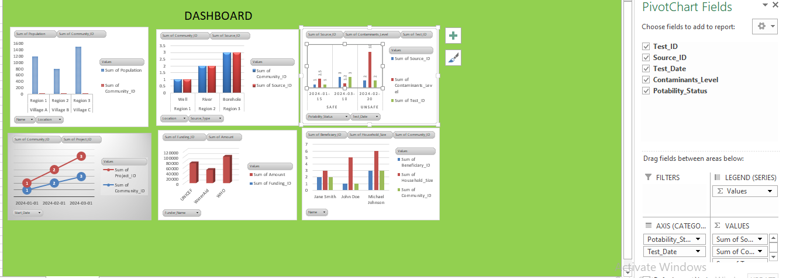
Excel Dashboard
The Excel dashboard provides an interactive visualization of the analyzed data, allowing users to explore key metrics and trends related to water quality and project performance.

Slide 10
Conclusion and Next Steps
The data-driven solution developed in this project provides a solid foundation for improving water quality and sanitation in rural communities. Next steps include deploying the solution, monitoring its impact, and scaling the approach to other regions in practical.

