Slide 1

Improving Student Attendance in Rural Schools
A Data-Driven Approach to Overcoming Barriers in Transportation, Health, and Economics

Slide 2

Project Overview
This project focuses on addressing low student attendance rates in rural schools, which is a significant barrier to achieving quality education (SDG 4). By analyzing data on transportation, health issues, and economic hardships, we aim to identify key factors impacting attendance and develop data-driven solutions to improve access to education in rural areas. The project includes designing a database, performing data analysis, and creating an interactive Excel dashboard to visualize insights and support decision-making.

Slide 3
Problem Definition
Low student attendance in rural schools is a significant challenge, often driven by barriers such as inadequate transportation, health issues, and economic hardships. These factors prevent students from consistently attending classes, leading to poor academic performance and limiting their educational opportunities. Addressing these barriers through targeted interventions and data-driven strategies is crucial to improving attendance rates and ensuring that all students have equal access to quality education.

Slide 4
Importance
Addressing low student attendance in rural schools is vital for ensuring equal educational opportunities for all students. Consistent attendance is crucial for academic success, social development, and long-term opportunities. By overcoming barriers like transportation, health, and economic challenges, we can improve attendance rates, enhance educational outcomes, and contribute to breaking the cycle of poverty in rural communities. Solving this issue is essential for achieving SDG 4: Quality Education, which aims to provide inclusive and equitable education for all.

Slide 5
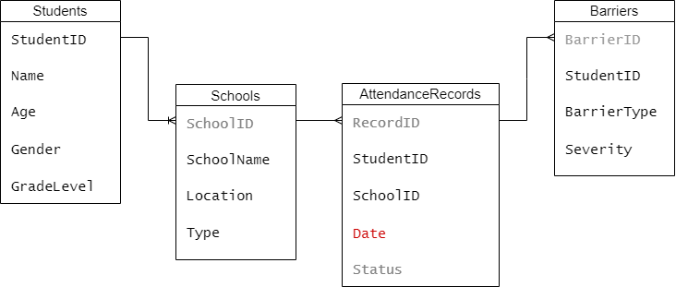
Database Design - ERD

Slide 6
Data Analysis
Barriers Impacting Attendance: Jane Smith's multiple barriers, particularly economic hardship and health issues, appear to correlate with her absenteeism. Addressing these barriers could improve attendance.
School Type Influence: Public schools in this data set show better attendance rates than private schools, suggesting a potential trend that could be explored further with more data.

Slide 7
Impact on Attendance and Education Quality
Improved Attendance Rates: Addressing barriers like transportation, economic hardship, and health issues will reduce absenteeism.
Enhanced Learning: Consistent attendance leads to better academic performance and retention.
Long-Term Benefits: Higher graduation rates and overall community development, aligning with SDG 4.

Slide 8
Challenges and Solutions
Data Collection: Difficulty in obtaining accurate data from rural areas was overcome by collaborating with local schools and community leaders.
Complex Data Relationships: Managing many-to-many relationships in the database was challenging but resolved by designing a robust ERD and using SQL joins effectively.
Integration with Excel: Importing large datasets into Excel caused performance issues, which were mitigated by optimizing the data import process and using pivot tables efficiently.

Slide 9
Project Summary
This project addressed low student attendance rates in rural schools by identifying barriers such as transportation, health issues, and economic hardships. Through data analysis, it was found that students facing multiple barriers had higher absenteeism. A comprehensive database was designed, and an Excel dashboard was created to visualize the insights. The findings highlighted the critical need for targeted interventions to remove these barriers and improve overall attendance and educational outcomes.

Slide 10
Conclusion
Improving student attendance in rural schools is essential for enhancing education quality and ensuring equal opportunities for all children. By addressing barriers like transportation, health issues, and economic hardships, we can create a more supportive environment for students to thrive. Let’s take action by implementing targeted interventions and collaborating with communities to remove these obstacles, ultimately paving the way for a brighter future for every child.

