Slide 1
Sustainable Development Goals By Ntomfuthi Ntshangase

Slide 2

Clothing Donation Tracking System(#No Poverty
The project focuses on efficiently managing and tracking clothing donations to orphanages, ensuring resources are optimally distributed. The system helps address poverty by providing necessary clothing to children in need.
SDGs: A new blueprint for the world

Slide 3
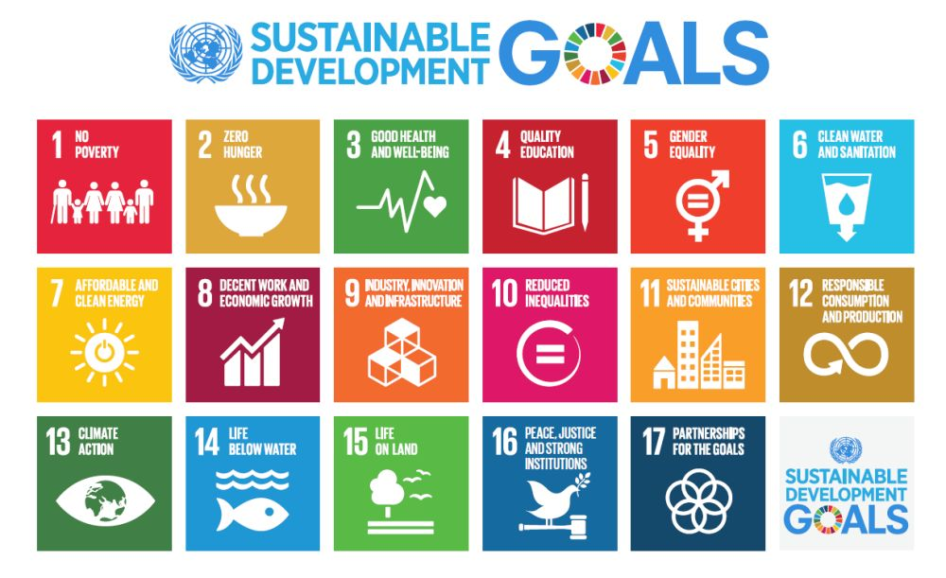

Big
concept
Local
Not really….
Global

Slide 4
Problem Definition and Its Significance
Problem Definition: Many orphanages struggle with inconsistent and inefficient distribution of clothing donations, leading to shortages or excesses of certain items.
Significance: By optimizing donation tracking and distribution, the project aims to ensure that orphanages receive the right types and quantities of clothing, improving the well-being of children.

Slide 5
SDGs Poverty; Hunger; Agriculture; Health & Well-Being; Education; Gender Equality; Water; Economic Growth; Employment; Infrastructure; Innovation; Energy; Inequality; Cities; Consumption; Climate Change; Oceans; Forests; Peace; Justice; Partnership and more…
What issues are involved with the SDGs?
Every country to develop a National Action Plan!!!

Slide 6

Applies to ALL countries
The SDGs are UNIVERSAL… meaning that it is about what happens in Ireland AND what happens throughout the world…linking the local to the global

Slide 7
What do we want?
End Extreme Poverty
Fight Inequality
Address Climate Change

Slide 9
Development of the system in the youth sector is unique because...
Impact: The system has streamlined the donation process, reduced waste, and ensured equitable distribution across orphanages. It has improved operational efficiency and transparency.
Potential Improvements: Future enhancements could include automating donor notifications for needed items, integrating with more orphanages, and using predictive analytics to anticipate future needs.

Slide 10
Q&A and Conclusions
Content: Summary of key findings, including how the system addresses the problem effectively. Open the floor for questions, discuss any remaining points, and conclude with the potential long-term impact of the system on poverty alleviation.

