Slide 1

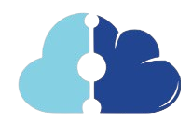
MD Vault
Collaborative Real-Time Healthcare Software
Remofilwe Semaushu
26 – September - 2024

Slide 2
Inspired by my experience of struggling to communicate my chronic tonsillitis history during a severe episode, highlighting the need for real-time, accessible medical records to improve patient care.
We transforms healthcare by enabling secure, real-time data sharing and collaboration among professionals, improving patient care and health outcomes while supporting the goal of universal health coverage.
Universal Health Coverage
Improving Health Outcomes
Data-Driven Healthcare
Collaboration and Partnerships
Strengthening Health Systems
Focus on Vulnerable Populations
Continuous Improvement
To revolutionize healthcare by providing a secure, real-time collaborative platform for medical data sharing, empowering healthcare professionals to deliver more informed and effective patient care.
To create a world where seamless and secure data sharing transforms healthcare delivery, ensuring equitable access to high-quality care and improving health outcomes for all communities.

Slide 3
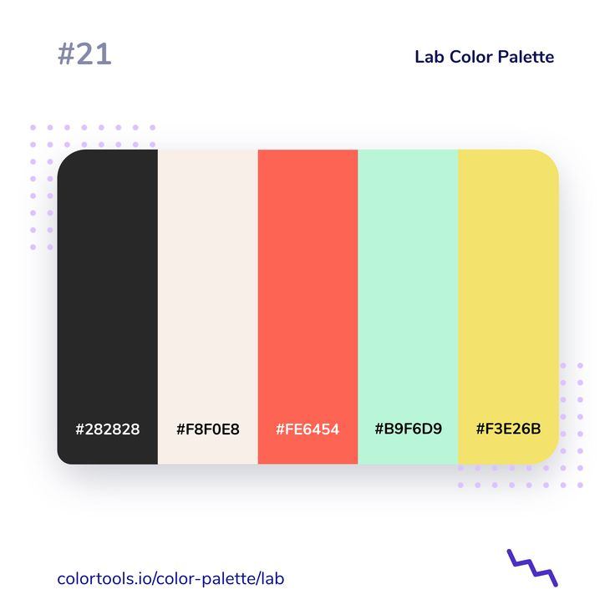



Fragmented Communication & Collaboration
Lack of secure, real-time collaboration features
Privacy Concerns
Enables sharing of medical records, real-time updates, and collaborative treatment planning.
Seamless and secure collaboration among healthcare professionals.
Real-time collaborative healthcare Software

Slide 4
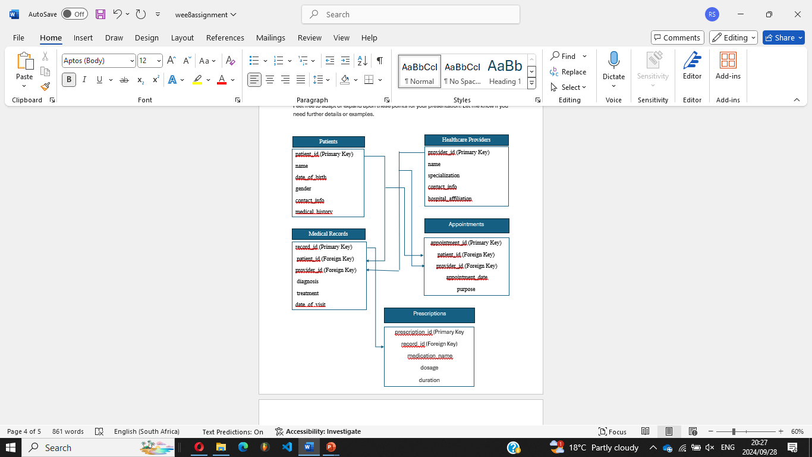
Relationships:
Patients to Medical Records:
One-to-Many (A patient can have multiple medical records).
Healthcare Providers to Medical Records:
One-to-Many (A healthcare provider can be associated with multiple medical records).
Patients to Appointments:
One-to-Many (A patient can have multiple appointments).
Healthcare Providers to Appointments:
One-to-Many (A healthcare provider can have multiple appointments).
Medical Records to Prescriptions:
One-to-Many (A medical record can have multiple prescriptions).

Slide 5
CREATE TABLE Medical_Records (
record_id INT PRIMARY KEY,
patient_id INT,
provider_id INT,
diagnosis TEXT,
treatment TEXT,
date DATE,
FOREIGN KEY (patient_id) REFERENCES Patients(patient_id),
FOREIGN KEY (provider_id) REFERENCES Healthcare_Providers(provider_id)
);
CREATE TABLE Patients (
patient_id INT PRIMARY KEY,
name VARCHAR(100),
age INT,
gender VARCHAR(10),
medical_history TEXT,
current_conditions TEXT
);

Slide 6
1
SELECT name, medical_history, current_conditions FROM Patients WHERE patient_id = 1;
SELECT Patients.name, Medical_Records.diagnosis, Medical_Records.treatment
FROM Medical_Records
JOIN Patients ON Medical_Records.patient_id = Patients.patient_id
WHERE Medical_Records.provider_id = 1;
2
SELECT Healthcare_Providers.name, Medical_Records.diagnosis, COUNT(*) as case_count
FROM Medical_Records
JOIN Healthcare_Providers ON Medical_Records.provider_id = Healthcare_Providers.provider_id
GROUP BY Healthcare_Providers.name, Medical_Records.diagnosis;
3

Slide 7
MD Vault revolutionizes healthcare by enabling seamless, real-time data sharing and collaboration among professionals. With its secure platform, MD Vault not only improves patient care and health outcomes but also aligns with the broader goal of achieving universal health coverage.
Join us in transforming the future of healthcare! Support MD Vault in creating a world where healthcare professionals have the information they need, when they need it, to provide the best care possible. Together, we can make high-quality healthcare accessible to all.

