Slide 1
Addressing Maternal Mortality Through Data-Driven Solutions

Slide 2
Addressing Maternal Mortality Through Data-Driven Solutions
Aligning with SDG 3 - Good Health and Well-being.
Name : Saddam Saku

Slide 3
Project Overview and SDG Alignment
Project Overview:
A data-driven solution to reduce maternal mortality rates in rural areas.
Focus on analyzing healthcare infrastructure, mortality rates, and population data.
SDG Alignment:
Directly supports SDG 3: Good Health and Well-being.
Targets SDG 3.1: Reduce global maternal mortality ratio to less than 70 per 100,000 live births by 2030.

Slide 4
Problem defination
Problem: High maternal mortality rates in rural areas due to:
Limited access to healthcare facilities.
Lack of skilled healthcare professionals.
Poor infrastructure and transportation.
Impact:
Devastates families and communities.
Hinders economic development.
Exacerbates inequalities.

Slide 5
Significance of the Problem
Human Impact: Maternal mortality leaves children without mothers and households without primary caregivers.
Economic Impact: Reduces workforce participation and productivity, perpetuating poverty.
Global Relevance: Maternal mortality is a critical indicator of healthcare system effectiveness and a key focus of SDG 3.

Slide 6
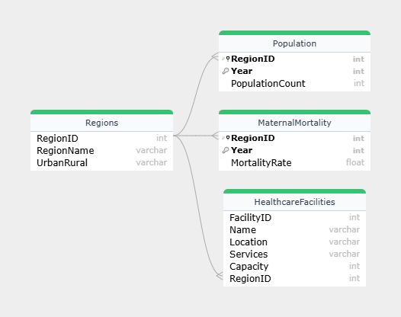
Database Design and ERD
Entities:
HealthcareFacilities (FacilityID, Name, Location, Services, Capacity)
MaternalMortality (RegionID, Year, MortalityRate)
Population (RegionID, Year, PopulationCount)
Regions (RegionID, RegionName, UrbanRural)

Slide 7
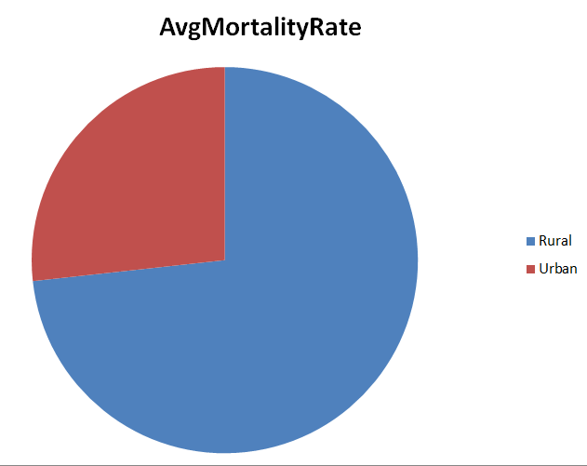
Data analysis insight
Key Insights:
Rural areas have significantly higher maternal mortality rates compared to urban areas.
Regions with low healthcare facility capacity correlate with higher mortality rates

Slide 8
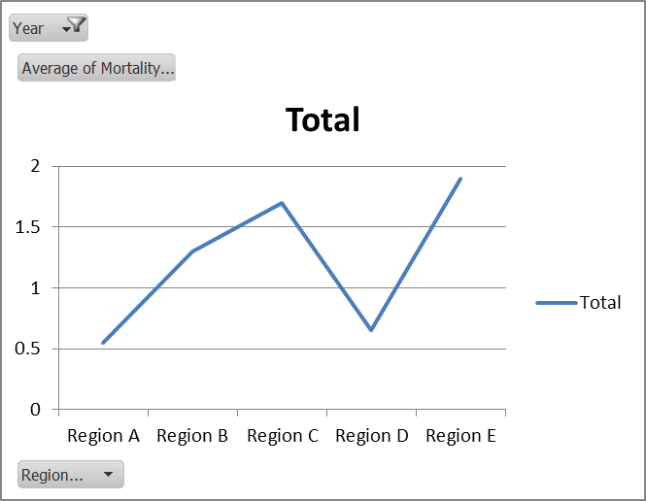
Excel dashboard demonstration
Dashboard Features:
Interactive filters for region and year.
Key metrics: Mortality rates, healthcare capacity, population density.

Slide 9
Impact and Recommendation
Impact:
Identifies regions with the highest need for healthcare infrastructure.
Supports targeted interventions to reduce maternal mortality.
Recommendations:
Increase healthcare facility capacity in underserved regions.
Train and deploy skilled healthcare professionals in rural areas.
Improve transportation infrastructure for better access to healthcare.

Slide 10
Conclusion
Join us in our mission to reduce maternal mortality and ensure healthy lives for all. Together, we can make a difference.
Contact us to collaborate, share insights, or support this initiative.
LinkedIn : https://www.linkedin.com/in/saddamlsc

Slide 11
Thank you for your attention and support in addressing this critical issue.
Together, we can save lives and ensure healthy futures for all.

