Slide 1

Enhancing Remote Learning with Data-Driven Insights
Name: Enzama Brian
Date: 14/08/2024

Slide 2
OVERVIEW
Objective
SDG Alignment
Solution
To develop a data-driven solution for improving remote learning by analyzing student performance and internet connectivity.
Focus on SDG 4: Quality Education. Specifically, addressing the challenge of unequal access to quality education due to connectivity issues.
A comprehensive dashboard that provides insights into student performance and connectivity, helping educators make informed decisions.

Slide 3
Problem Definition and Significance
Problem Statement: Remote learning faces challenges due to inconsistent internet connectivity and varying student performance. These issues hinder effective learning and equitable education.
Significance: Understanding and addressing these issues is crucial for ensuring that all students have access to quality education, regardless of their location or connectivity status.

Slide 4
Database Design and Schema
ERD Overview: Display the ERD (Entity-Relationship Diagram) with the following tables:
Students
Courses
Teachers
Enrollments
Internet Connectivity
Schema Highlights:
Students Table: StudentID (PK), Name, Age, Gender, etc.
Courses Table: CourseID (PK), CourseName, Credits, etc.
Enrollments Table: EnrollmentID (PK), StudentID (FK), CourseID (FK), DateEnrolled, etc.
Internet Connectivity Table: ConnectivityID (PK), StudentID (FK), Quality, etc.

Slide 5
Data Analysis Insights
Key Insights
Performance Trends: Summary of student performance across different courses.
Connectivity Impact: Analysis of how internet connectivity affects student performance.
Course Enrollments: Trends and distribution of enrollments across different courses.

Slide 6
Excel Dashboard Overview
Dashboard Features
Key Metrics: Display of total students, average scores, and connectivity distribution.
Interactive Charts: Bar charts, line charts, and pie charts showing performance and connectivity data.
Slicers and Filters: Tools for users to filter data by course, teacher, or connectivity quality.

Slide 7
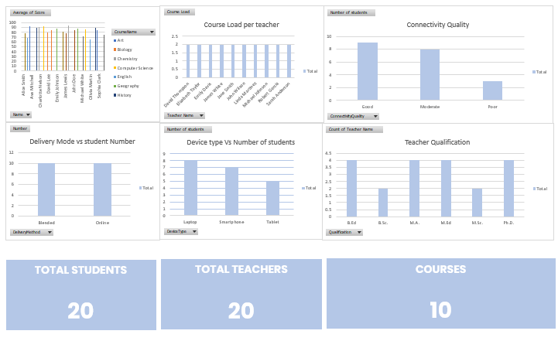
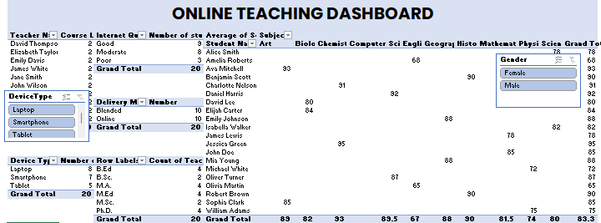
Excel Dashboard Demonstration

Slide 8
Key Findings and Recommendations
Findings
Connectivity Issues: How varying internet quality affects student engagement and performance.
Performance Insights: Trends in student performance across different courses and time periods.
Recommendations
Improvement Strategies: Suggestions for improving internet access or support for students with low connectivity.
Educational Interventions: Recommendations for educators based on performance data.

Slide 9
Thank you
Brian Enzama

