Slide 1

ADDRESSING FOOD INSECURITY IN RURAL AREAS: A DATA-DRIVEN APPROACH
Aligning with SDG 2: Zero Hunger
Presented by: Faridah Kaberia
Date: 15th August, 2024.

Slide 2
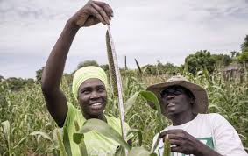
PROJECT OVERVIEW AND SDG ALIGNMENT
INTRODUCTION
The project aims to leverage data to analyze food production, distribution, and nutritional outcomes to address food insecurity in rural areas.
SDG 2 focuses on ending hunger, achieving food security, improving nutrition, and promoting sustainable agriculture.
Our project aims to achieve these goals by identifying food access gaps and developing data-driven solutions.
Objective: To improve food security in rural communities by enhancing access to nutritious food and optimizing agricultural resource distribution.

Slide 3
PROBLEM DEFINITION AND SIGNIFICANCE
Problem statement:
Rural areas face food insecurity due to climate change, limited accessibility to nutritious food, insufficient agricultural resources, and poor distribution networks.
Significance:
This challenge causes malnutrition, stunted growth in children, and increased disease prevalence, negatively impacting the well-being of these communities.
Scope:
Millions of people in rural areas are negatively impacted by food insecurity, which leads to long-term negative effects on education and economic development.

Slide 4
CONTEXT AND BACKGROUND
Areas affected:
80% of Kenya’s land mass is arid and semi-arid with most people in these areas living under the poverty line.
29% of the children in rural areas are stunted.
Challenges:
Access to nutritious food in arid and semi-arid areas remains challenging due to climate change, poor infrastructure, limited market access, stagnating agricultural production, and inefficient food systems.
Stakeholders:
International organizations like WHO, WFP, FAO; Government agencies, Private institutions, local farmers etc

Slide 5
DATA-DRIVEN APPROACH
Data Sources:
Health records data: health status, nutritional deficiency
Distribution data: Quantity, location
Crops data: Crop name, nutritional value
Household data: Income level, region, number of members
Methodology:
Data will be collected from community health assessments, agricultural surveys, government reports
Data will be analyzed to identify patterns of food scarcity, nutritional deficiencies, and food scarcity.
Goals:
To identify areas with critical food shortages and distribution inefficiencies and develop targeted interventions to improve food access and distribution.

Slide 6
DATABASE DESIGN AND SCHEMA
ERD Overview:
Entities:
Households - represent families in rural areas.
Crops- type of crop and its nutritional value
Food distribution center – facilities where food is distributed.
Food supplies – Specific food items distributed to a household.
Health records – Data on nutritional and health status of individuals in households.
Relationships: Households get food from distribution centers, crops are grown by households, health records are linked to households, and food supplies are associated with crops and distribution centers.

Slide 7
DATA ANALYSIS INSIGHTS
Used histograms, pie charts, bar graphs, and line graphs to visualize the data.
Households with low incomes have a poor health status.
Food distribution was down in the middle of the month.
Regions where average income was low exhibited higher cases of nutritional deficiencies.
Some regions received more food than others this could be due to poor road networks.

Slide 8
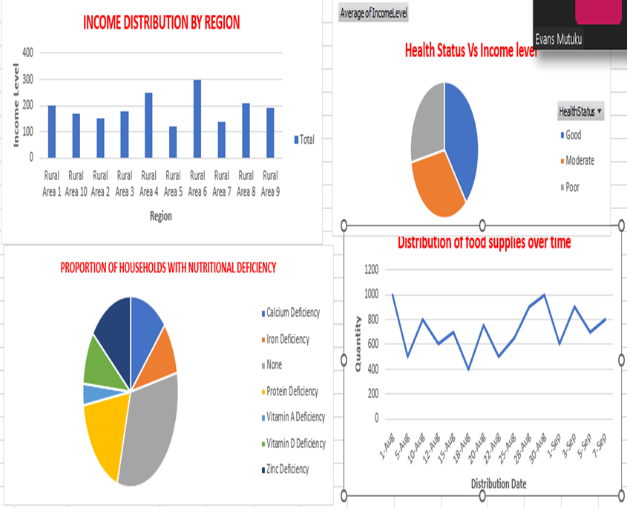
EXCEL DASHBOARD DEMONSTRATION
Pie charts, column charts, pivot tables, and line graphs were used in visualizing the data on nutritional deficiencies in households, trends in distribution, relationships between income and health status, and nutritional deficiencies in households.
The dashboard will help stakeholders identify areas of weakness and develop interventions to address them.

Slide 9
IMPACT AND FUTURE WORK
Implementation of targeted food distribution strategies in the most affected regions.
Use of data to guide policy decisions.
Development of sustainable agricultural practices tailored to local conditions.
Collaboration with stakeholders to build resilient food systems in rural communities.
Develop road networks to make food distribution easy and enable it to reach people deep in the villages.
Strengthen local markets which will improve access to food items and reduce dependency.
Next- steps: Collect more data, refine the database based on feedback and additional data, and partner with NGOs and local government to pilot data-driven food interventions.

Slide 10
CALL TO ACTION
Collaborate with us to help us implement the proposed solutions.
Donations and support are welcome. This will help us further our research and expand the project.
We are open to sharing insights and data with interested parties to drive broader efforts to end hunger in rural communities.
THANK YOU
Contact phone: 0712345678, email: endhungerfoundation@gmail.com for follow-up questions and collaboration interest.

