Slide 1
AFFORDABLE AND CLEAN ENERGY: Reducing the Cost of Renewable Energy Technologies
Leveraging Data Analysis to Address SDG 7
Moses Ochieng
21st/August/2024

Slide 2
INTRODUCTION
Problem Statement: High costs of renewable energy technologies are a barrier to achieving SDG 7.
Goal: Analyze and reduce the costs by comparing different energy sources and regions.

Slide 3
SDG 7 OVERVIEW
Affordable and Clean Energy: Affordable and Clean Energy
Current Challenges: The high upfront costs of renewable energy technologies, such as solar, wind, and hydro, pose a significant barrier to their widespread adoption, particularly in developing regions.

Slide 4
PROPOSED SOLUTION
Data-Driven Approach: Use a relational database to store cost data, analyze trends with SQL, and visualize findings in Excel.
Objectives:
- Identify cost trends across regions and energy sources.
- Provide actionable insights for cost reduction.

Slide 5
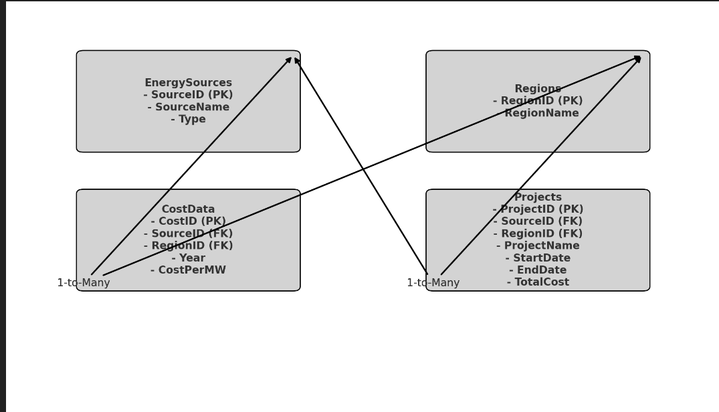
DATABASE DESIGN
ERD Overview:
Key Entities:
- EnergySources
- Regions
- CostData
- Projects

Slide 6
DATA ANALYSIS
SQL Queries: Regions with the Highest Average Cost for Renewable Energy:
SELECT r.RegionName, AVG(cd.CostPerMW) AS AverageCost FROM CostData cd JOIN Regions r ON cd.RegionID = r.RegionID GROUP BY r.RegionName ORDER BY AverageCost DESC;

Slide 7
EXCEL DASHBOARD
Data Visualization:

Slide 8
INTERGRATION AND TECHNOLOGY
Technology Stack: Tools and technologies used:
- MySQL/PostgreSQL for Database
- SQL for Data Analysis
- Microsoft Excel for Visualization

Slide 9
IMPACT AND FUTURE WORK
Immediate Impact:
- Data-driven insights into cost reduction.
- Informed decision-making for renewable energy projects.
Future Enhancements:
- Real-time data integration.
- Predictive analytics using machine learning.

Slide 10
CONCLUSION
Summary: Recap the problem, solution, and impact.
Call to Action: How stakeholders can use these insights to further the goals of SDG 7.
Thank You: Contact +254793030042

