Slide 1
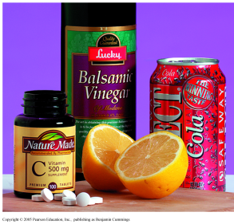
Chapter 8 Acids and Bases
BrØnsted-Lowry Acids and Bases

Slide 2
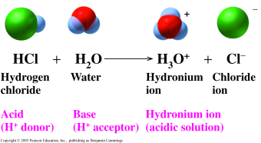
BrØnsted-Lowry Acids and Bases
According to the BrØnsted-Lowry theory,
acids donate a proton (H⁺).
bases accept a proton (H⁺).

Slide 3
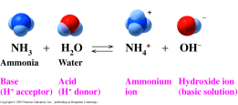
NH₃, a BrØnsted-Lowry Base
In the reaction of ammonia and water,
NH₃ is the base that accept H⁺.
H₂O is the acid that donates H⁺.

Slide 4
Conjugate Acid-Base Pairs
In any acid-base reaction, there are two conjugate acid-base pairs.
Each pair is related by the loss and gain of H⁺ .
One pair occurs in the forward direction.
One pair occurs in the reverse direction.
conjugate acid-base pair 1
HA + B A⁻ + BH⁺
conjugate acid-base pair 2

Slide 5
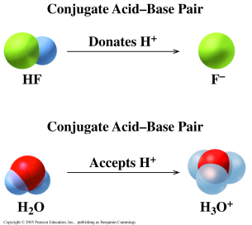
Conjugate Acids and Bases
In this acid-base reaction,
an acid, HF, donates H⁺ to form its conjugate base, F⁻.
a base, H₂O, accepts H⁺ to form its conjugate acid, H₃O+.
there are two conjugate acid-base pairs.

Slide 6
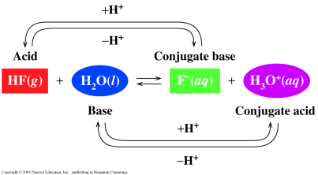
Conjugate Acid-Base Pairs
In the reaction of HF and H₂O,
one conjugate acid-base pair is HF/F⁻.
the other conjugate acid-base pair is H₂O/H₃O⁺.
each pair is related by a loss and gain of H⁺.

Slide 7
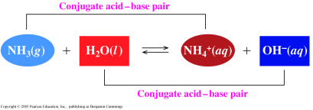
Conjugate Acid-Base Pairs
In the reaction of NH₃ and H₂O,
one conjugate acid-base pair is NH₃/NH₄⁺
the other conjugate acid-base is H₂O/H₃O⁺.

Slide 8
Learning Check
A. Write the conjugate base of the following.
1. HBr
2. H₂S
3. H₂CO₃
B. Write the conjugate acid of the following.
1. NO₂⁻
2. NH₃
3. OH⁻

Slide 9
Solution
A. Remove H⁺ to write the conjugate base.
1. HBr Br⁻
2. H₂S HS⁻
3. H₂CO₃ HCO₃⁻
B. Add H⁺ to write the conjugate acid.
1. NO₂⁻ HNO₂
2. NH₃ NH₄⁺
3. OH⁻ H₂O

Slide 10
Learning Check
Identify the sets that contain acid-base conjugate pairs.
1. HNO₂, NO₂⁻
2. H₂CO₃, CO₃²⁻
3. HCl, ClO₄⁻
4. HS⁻, H₂S
5. NH₃, NH₄⁺

Slide 11
Solution
Identify the sets that contain acid-base conjugate pairs.
1. HNO₂, NO₂⁻
4. HS⁻, H₂S
5. NH₃, NH₄⁺

Slide 12
Learning Check
A. The conjugate base of HCO₃⁻ is
1. CO₃²⁻ 2. HCO₃⁻ 3. H₂CO₃
B. The conjugate acid of HCO₃⁻ is
1. CO₃²⁻ 2. HCO₃⁻ 3. H₂CO₃
C. The conjugate base of H₂O is
1. OH⁻ 2. H₂O 3. H₃O⁺
D. The conjugate acid of H₂O is
1. OH⁻ 2. H₂O 3. H₃O⁺

Slide 13
Solution
A. The conjugate base of HCO₃ ⁻ is
1. CO₃²⁻
B. The conjugate acid of HCO₃⁻ is
3. H₂CO₃
C. The conjugate base of H₂O is
1. OH⁻
D. The conjugate acid of H₂O is
3. H₃O⁺

Slide 14
Retrieved from chemistry.csudh.edu/faculty/.../Ch8.../8_2_Bronsted-Lowry_Acids_and_Bases.ppt
27 July 2017

