Slide 1
Asteroids, meteors and comets
Year 7 Science

Slide 2
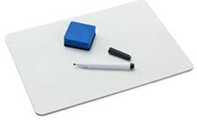
Review
What names does our sun have? | Show the position of the Sun, Earth and moon during a solar eclipse.
Why don’t solar eclipses happen every month? | Draw a telescope with two convex lenses.

Slide 3
Learning Intentions
Predictable phenomena on Earth, including seasons and eclipses, are caused by the relative positions of the Sun, Earth and the Moon.

Slide 4
Success criteria
Compare asteroids, comets, meteors and meteorites.

Slide 5
The Solar System: Worksheet

Slide 6
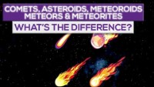

Slide 7
Success criteria
Compare asteroids, comets, meteors and meteorites.

