Slide 1

Case Study: PAVLOV’S DOGS
ATPSY Year 12 ATAR Psychology

Slide 2
Review
Explain the difference between unconditioned and conditioned stimulus.
Under which circumstances would a neutral stimulus be conditioned? Give an example.
List the three phases of classical conditioning.

Slide 3
Learning Intentions
Study: Pavlov’s dogs (Pavlov, 1902)

Slide 4
Success Criteria
Describe the procedures, findings and limitations of Pavlov’s Classical Conditioning Experiment.
Apply Classical Conditioning Theory to Pavlov’s Dog Experiment

Slide 5


Slide 6
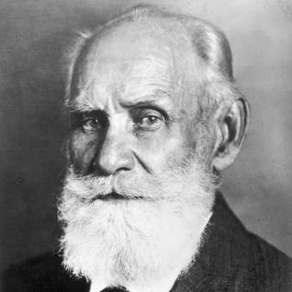
Ivan Pavlov
Russian Neurologist (1849-1936) most famous for his experiments with dogs.

Slide 7


Slide 8
Strengths
Empirical Research - High Credibility
(evidence based, valid, reliable) Pavlov used experiments to test his theory. He can infer cause and effect due to objectivity, control over variables and precise measurements
Generalisability- Pavlov's research of learning via stimulus-response has been successfully applied to humans.

Slide 9
Valuable contribution to society
Pavlov's research provides powerful explanations for the development of a variety of behaviours including psychological disorders, phobias.
It also provides useful counter conditioning treatments, including systematic desensitisation.

Slide 10
Limitations
Ethicals: The use/misuse of animals
Classical conditioning is limited to explaining reflex responses. However, much human behaviour is voluntary - there must be other learning processes involved.
(Ignores the role of cognitive and biological factors which have also been shown to play a role in learning).

Slide 11
Success Criteria
Describe the procedures, findings and limitations of Pavlov’s Classical Conditioning Experiment.
Apply Classical Conditioning Theory to Pavlov’s Dog Experiment

