Slide 1

Piaget’s Theory of Cognitive Development
AEPSY Year 11 ATAR Psychology

Slide 2
Review
Name the stages of infant neuroplasticity
In which order does myelination occur?
Name 5 structures of the brain which undergo dramatic development in adolescence.
Child psychologist Jean Piaget studied his own daughter intensively as she grew and learned. What type of study is this an example of?

Slide 3
Learning Intentions
domains of development
theory of cognitive development – Piaget (1936)

Slide 4
Success criteria
Describe schema formation
Define and give examples of assimilation, accommodation, equilibrium and disequilibrium

Slide 5
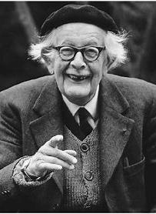
Jean Piaget
Piaget was employed at the Binet Institute in the 1920s, where his job was to develop French versions of questions on English intelligence tests. He became intrigued with the reasons children gave for their wrong answers to the questions that required logical thinking.
He believed that these incorrect answers revealed important differences between the thinking of adults and children.

Slide 6
Piaget’s Theory of Cognitive Development
Piaget’s (1936) theory of cognitive development explains how a child constructs a mental model of the world. Piaget regarded cognitive development as a process which occurs due to biological maturation and interaction with the environment.

Slide 7
Schemas
A schema can be defined as a set of linked mental representations of the world, which we use both to understand and to respond to situations. The assumption is that we store these mental representations and apply them when needed.
Operations are more sophisticated mental structures which allow us to combine schemas in a logical way.

Slide 8
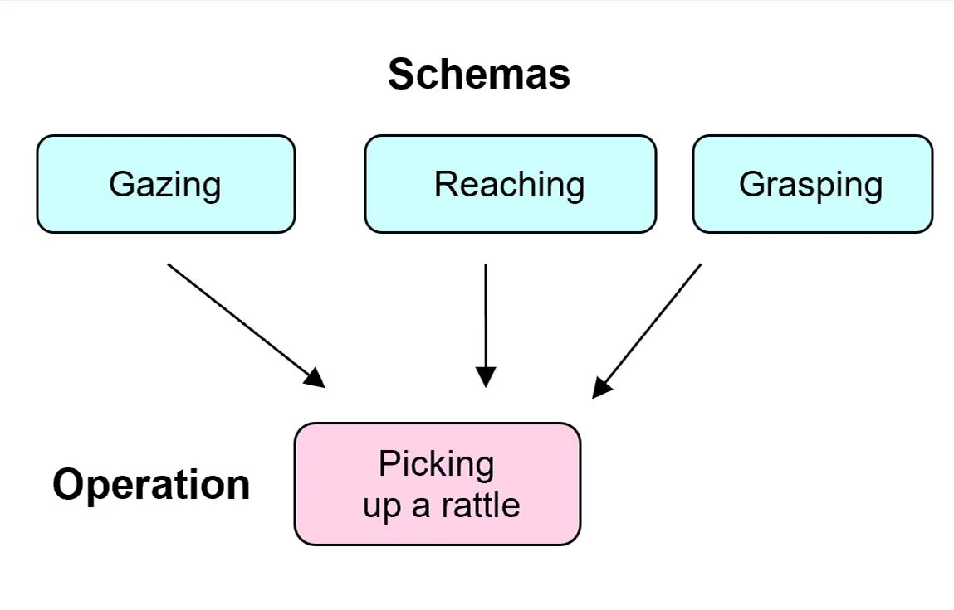

Slide 9
Example:
A person might have a schema about buying a meal in a restaurant. The schema is a stored form of the pattern of behavior which includes looking at a menu, ordering food, eating it and paying the bill.
Whenever they are in a restaurant, they retrieve this schema from memory and apply it to the situation.

Slide 10


Slide 11
Adaptation, assimilation and accommodation
Adaptation is the process by which the child changes its mental models of the world to match more closely how the world actually is.
Adaptation is brought about by the processes of assimilation (solving new experiences using existing schemata) and accommodation (changing existing schemata in order to solve new experiences).

Slide 12
Assimilation or adaptation?
A baby learns to pick up a rattle he or she will then use the same schema (grasping) to pick up other objects
A 2-year-old child sees a man who is bald on top of his head and has long frizzy hair on the sides, the toddler shouts “clown, clown” (the man is not impressed).
A baby tries to use the same schema for grasping to pick up a very small object. It doesn’t work. The baby then changes the schema by now using the forefinger and thumb to pick up the object.
A child may have a schema for birds (feathers, flying, etc.) and then they see a plane, which also flies, but would not fit into their bird schema.
In the “clown” incident, the toddler’s father explained to his son that the man was not a clown and that even though his hair was like a clown’s, he wasn’t wearing a funny costume and wasn’t doing silly things to make people laugh.

Slide 13
Equilibrium and disequilibrium
When our existing schemas can explain what we perceive around us, we are in a state of equilibrium. However, when we meet a new situation that we cannot explain it creates disequilibrium, this is an unpleasant sensation which we try to escape, this gives the motivation for learning.

Slide 14
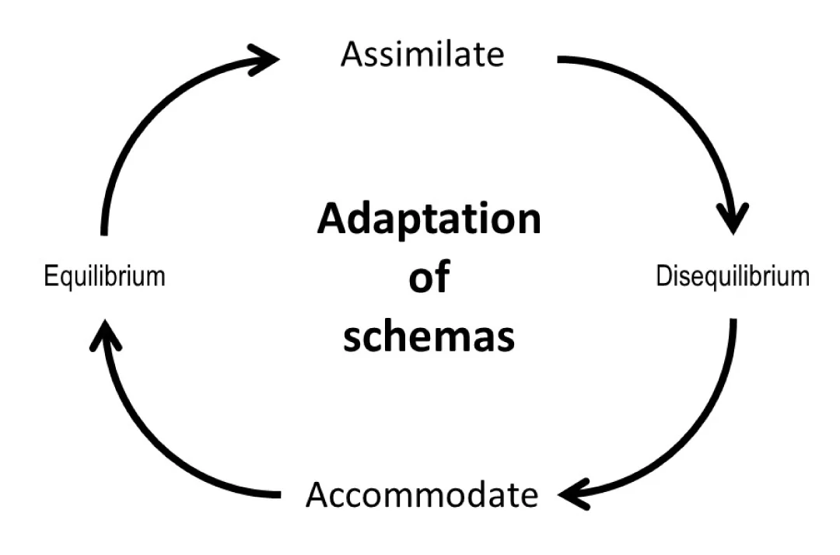

Slide 15
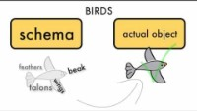

Slide 16
According to Piaget, reorganization to higher levels of thinking is not accomplished easily. The child must “rethink” his or her view of the world. An important step in the process is the experience of cognitive conflict.

Slide 17
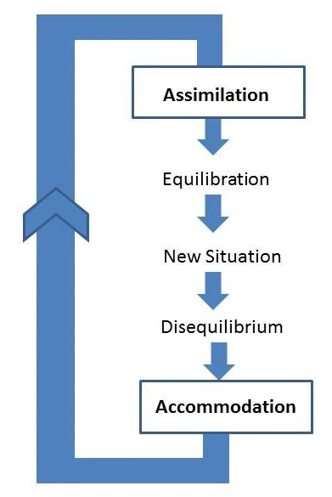

Slide 18
The child is seen as an active participant in its own development rather than a passive recipient of either biological influences (maturation) or environmental stimulation.

Slide 19
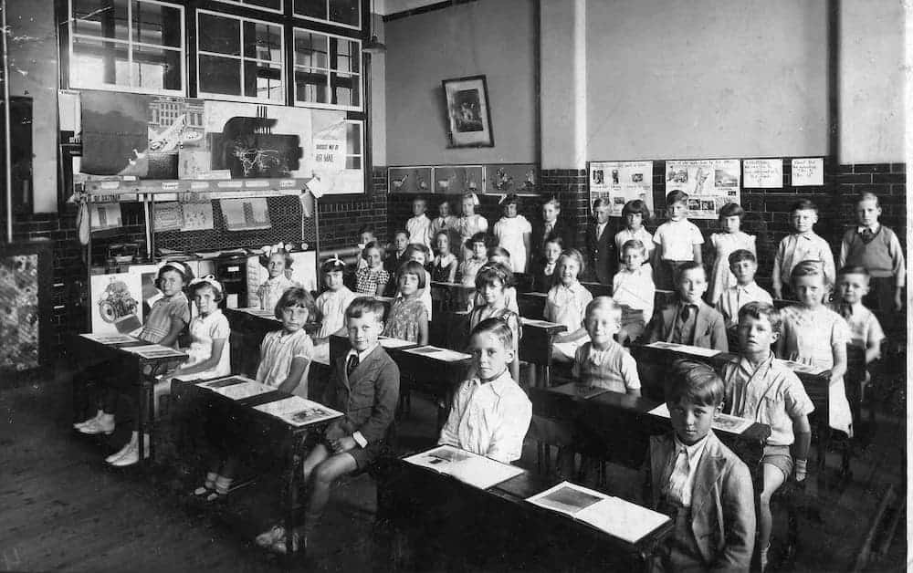

Slide 20
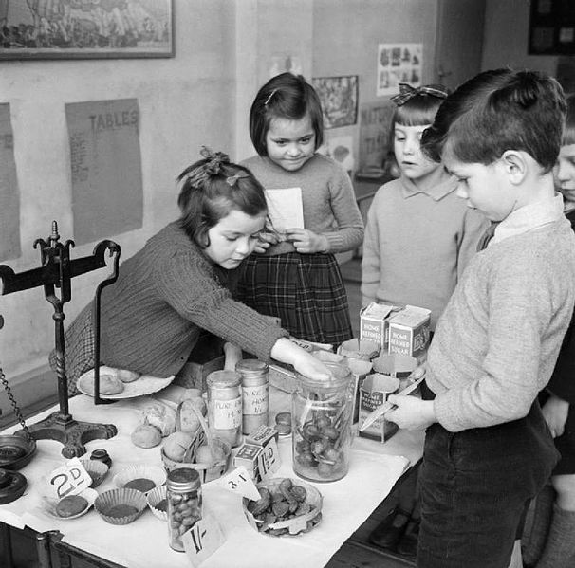

Slide 21
Success criteria
Describe schema formation
Define and give examples of assimilation, accommodation, equilibrium and disequilibrium

