Slide 1

Attachment Theory
AEPSY Year 11 ATAR Psychology

Slide 2
Review
1.What is a schema?
2.List the linked schema of ordering your lunch at the school canteen using eftpos.
3.On the sports carnival day, the canteen staff come to collect orders from the rec centre, the menu is limited and cash only. Which processes would Piaget describe as you cope with this change?

Slide 3

Review
Which Piagetian Task is being demonstrated?
What concept does a child require to successfully complete this task?
In which stage would a child be able to demonstrate this?

Slide 4
Learning Intentions
theories of social and emotional development – attachment
study: emotion over physiological needs with Rhesus monkeys (Harlow, 1958)
theory of attachment – Bowlby (1969, 1988)
definition of attachment
evolutionary perspective
monotropy, critical and sensitive periods, maternal deprivation, internal working model

Slide 5
Success criteria
Define attachment, monotropy, critical period, sensitive period and maternal deprivation
Explain the evolutionary perspectives of attachment.
Describe the internal working model, using examples

Slide 6
Bowlby’s Attachment Theory
Children come into the world biologically pre-programmed to form attachments with others, because this will help them to survive.
A child forms many attachments, but one of these is qualitatively different - primary attachment or monotropy.

Slide 7
Bowlby suggested that there is a critical period for developing attachment (2.5 years). If an attachment has not developed during this time period, then it may well not happen at all. Bowlby later proposed a sensitive period of up to 5 years.

Slide 8
Bowlby’s maternal deprivation hypothesis suggests that continual attachment disruption between the infant and primary caregiver could result in long-term cognitive, social, and emotional difficulties for that infant.

Slide 9
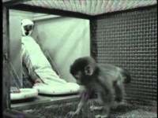
Case Study:Harlow’s Monkeys

Slide 10
Internal working model
According to Bowlby, an internal working model is a cognitive framework comprising mental representations for understanding the world, self, and others, and is based on the relationship with a primary caregiver.
It becomes a prototype for all future social relationships and allows individuals to predict, control, and manipulate interactions with others.

Slide 11
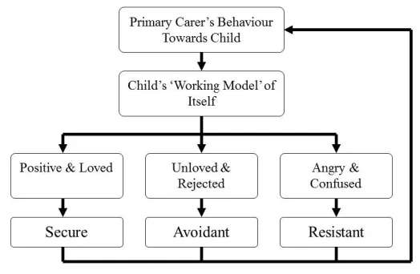
Type B Attachment
“I am worthy” Trusting relationships
Type A Attachment
“I am unworthy” Avoiding relationships
Type C Attachment
“My carer is inconsistent” Attention-seeking relationships

Slide 12
Success criteria
Define attachment, monotropy, critical period, sensitive period and maternal deprivation
Explain the evolutionary perspectives of attachment
Describe the internal working model, using examples

