Slide 1

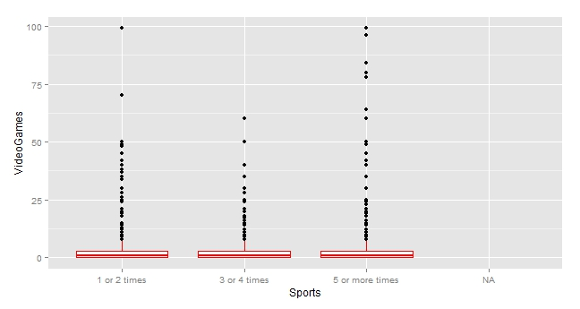
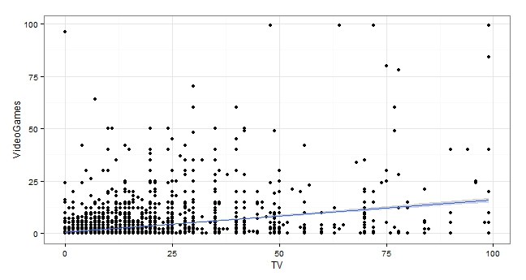
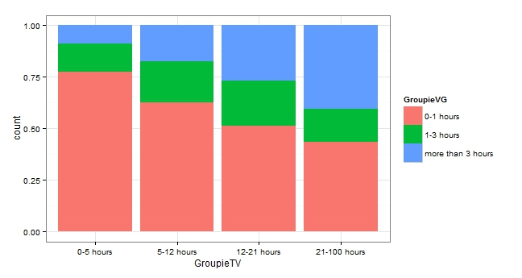
Using Statistical analysis to find an association between physical activity's and stationary activity's
By Teirra Powe
Introduction
Methods
Discussion
Concern over the rapid increase in childhood obesity in the U.S. has been widely expressed in the medical literature. @ekelund_tv_2006 Over the past couple of decades, the obesity rate has been on a steady increase. Also with this increase, there has also been an increase in amount of time adolescents spends watching TV and playing video games. Less physically active children and those who watched more television after school were more likely to become overweight. @ekelund_tv_2006 The correlation between BMI (body mass index) and how it has an effect on individuals that spend in increase amount of time watching TV, will also show a correlation between people that are less physically active in their daily life. This research will see if the is any statistical significance to the association of the amount of time adolescences are physically active such as playing sports, and the amount of time the participate in stationary activities such as watching TV and or playing Video Games.
The primary sampling frame for Add Health is a database collected by Quality Education Data, Inc. Systematic sampling methods and implicit stratification ensure that the 80 high schools and 52 middle schools that were selected are representative of US schools with respect to region of country, urban city, size, type, and ethnicity. Eligible high schools included an 11th grade and enrolled more than 30 students. More than 70 percent of the originally sampled high schools participated. Each school that declined to participate was replaced by a school within the stratum. Using the data set from these numbers, we can see that the sampling size is N=6504. In order to collect this data, an in home interview was conducted for 1-2 hours. All the data was recorded on laptops, and to insure that the questions were understood, some where read out loud and some where listened to on headphones (for sensitive information) to make the subject more comfortable with answer and provide accurate information. Each subject was also given a vocabulary test before the interview to make sure that they were able to comprehend the questions that would be asked. In measuring this data, there were 41 sets of questions for each subject to answer, there were questions such as their age which can be represented by the variable H1GI1M (date of birth). Using this data set, as well a research from other articles in this area, I will be able to determine how watching TV affects children’s BMI. I will also be able to determine some alternatives to watching TV in order to decrease their BMI and help them be more active to fight the obesity epidemic
In the beginning of my research I chose three variables from the Add Health data set. These variables are there to show Hours spent watching TV and Hours spent playing videogames by adolescents, all while being compared to Number of times playing sports this week by those same adolescents. Then I went and organized these variables for my data management. The number times adolescents did NOT play any type of sport during the week. Then is shows how many adolescences watch between 0-99 hours of TV during the week. As well as how many hour adolescents spent between 0-99 hours playing video games.
After putting these three variables in a data frame labeled AHS, I ran an ANOVA test. I rejected the null hypothesis when comparing the Video Game variable and Sports variable. When running the ANOVA test on these variables, it has been determined that there is at least one great significance in this data frame, because our p value is 4.04e-05.While this does not specify what set has the significant difference, it does tell us that there is one and that is what we need to look for. This is where the Post Hoc test comes into play. After running the Post Hoc test, This table shows the comparison between Adolescents the play sports during a given week, and those same adolescents number of hours playing video games. The mean number of people the play an active sport ‘5 or more times’ during a given week has a significant difference than those that play an active sport ‘1 or 2 times’ a week. Next I run the Pearson Chi-square test and discover the my two quantitative variable that I made categorical. This test tells us there is an association with the amount of time adolescent spend watching TV and the amount of time the spend playing video games. When the amount of time the spend watching TV increase, the amount of time they spend playing video games also increase, showing that these to variable to be dependent. Then I look at the regression of the correlation of these two variables. The equation for the line is represented as Y = a + bX. For my model, my response variable (Y) is represented as video games. My intercept (a) has a value of 0.721346. My slope (b) has a value of 0.153250. And my explanatory variable (X) is represent as TV. These number make the equation for my line of best fit to be Y=0.721346 + 0.153250(X). This graph shows that there is a weak positive relationship because our correlation is closer to zero, but there is still a statistic significance between the variables. The P value is very small (2.2e-16) which is less than 5%, but the correlation is only about 32%. Since this correlation is small we can only predict about 10% variability in our variables.
Research Questions
Does the amount of time spent being physically active, such as playing a sport and the amount of time spent on stationary activities, such as watching TV and playing video games have a correlation?
Results
References
AddHealth is a database collected by Quality Education Data, Inc.
Ekelund, Ulf, Soeren Brage, Karsten Froberg, Maarike Harro, Sigmund A. Anderssen, Luis B. Sardinha, Chris Riddoch, Lars Bo Andersen, and Anrew Prentice. 2006. “TV Viewing and Physical Activity Are Independently Associated with Metabolic Risk in Children: The European Youth Heart Study.” PLOS Medicine 3 (12). doi:http://0-dx.doi.org.wncln.wncln.org/10.1371/journal.pmed.0030488. http://0-search.proquest.com.wncln.wncln.org/healthcomplete/docview/289062282/33AB5CFF5B014706PQ/1?accountid=8337.

