Slide 1

M11 SQLITE

Slide 2
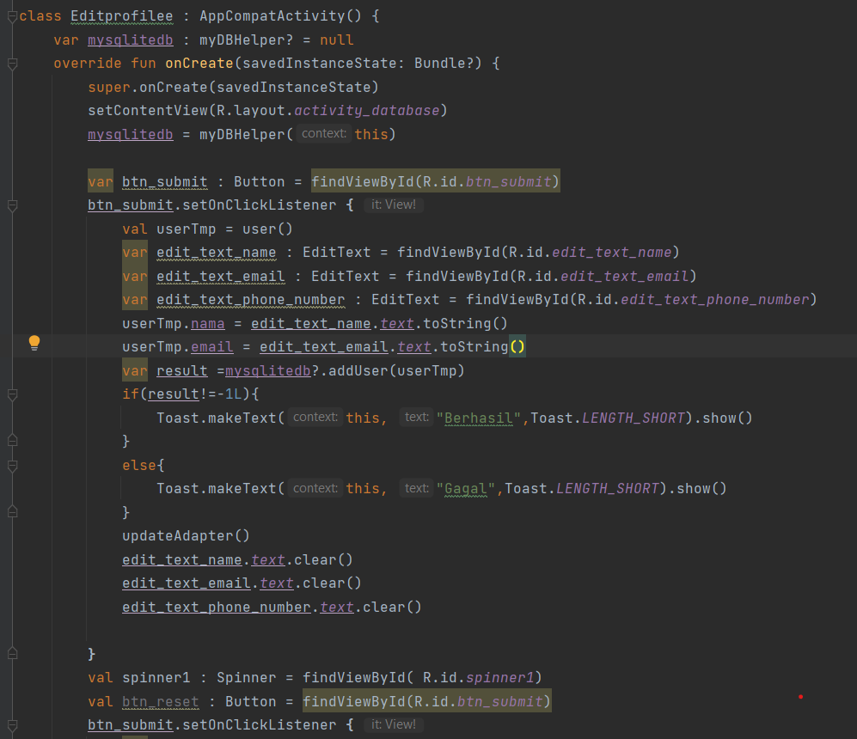
EDIT PROFILE

Slide 3
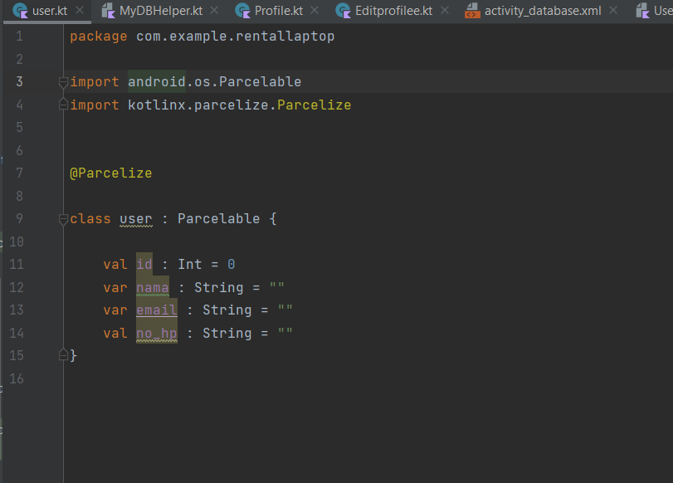
User

Slide 4
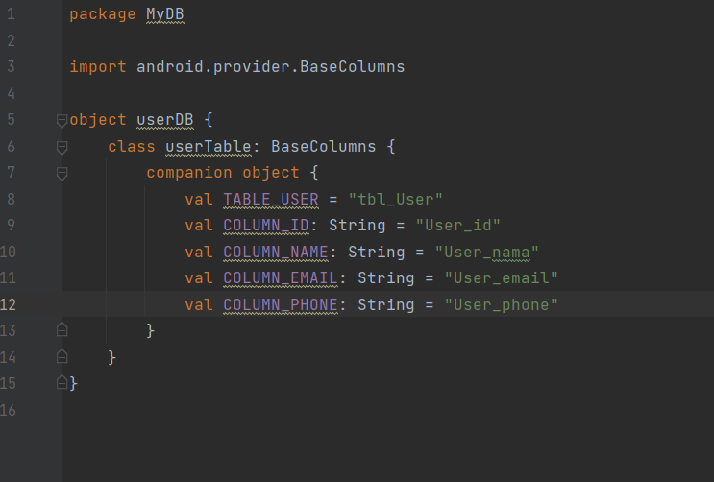
UserDB

Slide 5
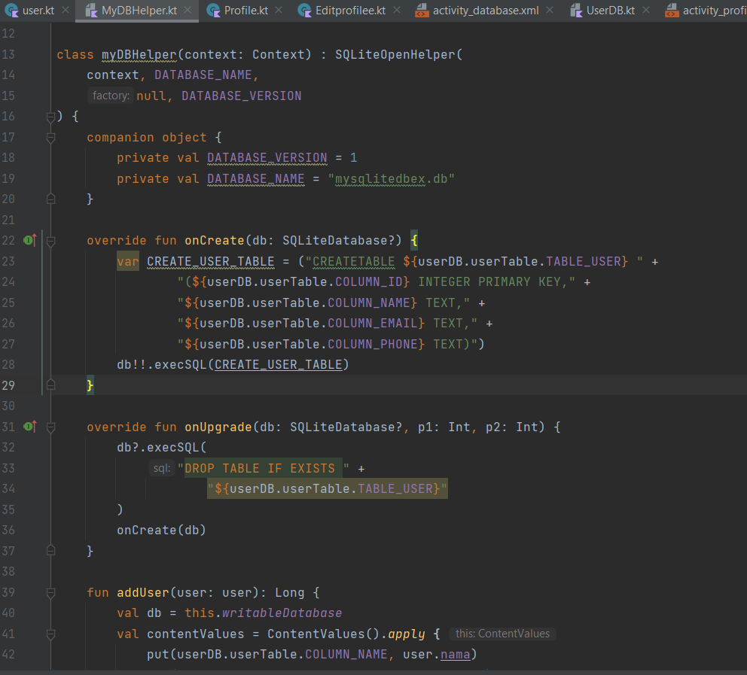
MyDBHELPER

Slide 6
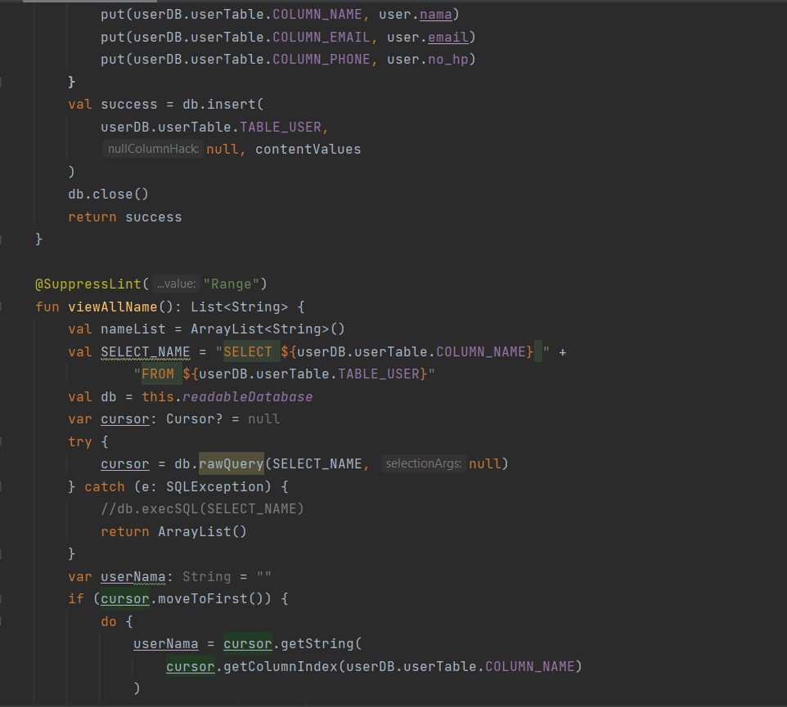
MYDBHELPER2

Slide 7
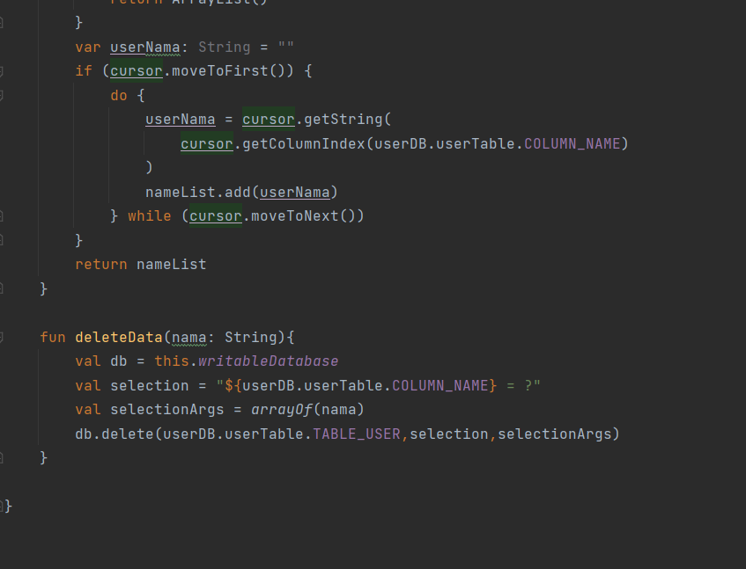
MYDBHELPER3

