Slide 1
Android Development
Zoltán Polgár
zoltan_polgar@epam.com
Confidential

Slide 2
Agenda
L1.01 Core concept / Activities / Intents
L1.02 Layouts / Multi threading
L1.03 Broadcasts / Services / Storages
L1.04 Compatibility layer / Fragments
Confidential

Slide 3
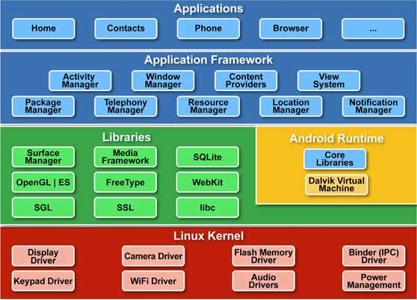
Android architecture
Confidential
Notes:
https://github.com/android/platform_frameworks_base/tree/master/core/java/android/app

Slide 4
Comparison of Dalvik and Java Bytecode
The Dalvik Virtual Machine (DVM) is developed by Google and optimized for the characteristics of mobile operating systems (especially for the Android platform).
The bytecode running in Dalvik is transferred from traditional JVM bytecode to the dex-format by translating Java .class files with the conversion tool dx.
JVM bytecode is composed of one or more .class files (each of these contains one Java class). During run time, JVM will dynamically load the bytecode for each class from the corresponding .class file. While Dalvik bytecode is only composed of one .dex file, containing all the classes of the application.
Confidential

Slide 5
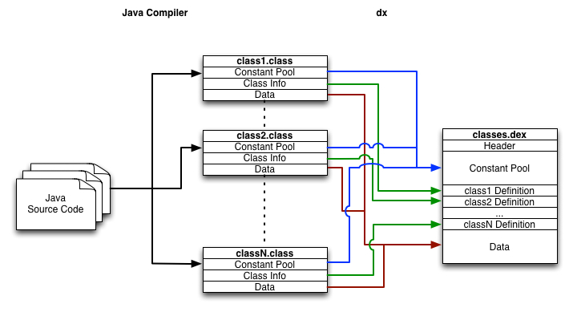
Comparison of Dalvik and Java Bytecode
Confidential

Slide 6
App Basics
An activity is an instance of Activity , a class in the Android SDK. An activity is responsible for managing user interaction with a screen of information.
You write subclasses of Activity to implement the functionality that your app requires. A simple application may need only one subclass; a complex application can have many.
A layout defines a set of user interface objects and their position on the screen. A layout is made up of definitions written in XML. Each definition is used to create an object that appears on screen, like a button or some text.
Confidential

Slide 7
SQL
Confidential

Slide 8
References
Comparison of Dalvik and Java Bytecode
Confidential

