Slide 1
The ELK stack is a popular log aggregation and visualization solution that is maintained by elasticsearch. The word “ELK” is an abbreviation for the following components:
ElasticSearch: this is where the data gets stored.
Logstash: the program responsible for transforming logs to a format that is suitable for being stored in the ElasticSearch database.
Kibana: where you can communicate with the Elasticsearch API, run complex queries and visualize them to get more insight into the data. You can also use Kibana to set and send alerts when a threshold is crossed. For example, you can get notified when the number of 5xx errors in Apache logs exceeds a certain limit.

Slide 2
Installing Elasticsearch
We start by installing the Elasticsearch component. We are going to create a service account to be used by the component. We don’t want to give it admin access, it only needs read access to services, namespaces, and endpoints. Let’s start by creating the necessary resources to activate this account: the service account, the cluster role, and the cluster role binding:

Slide 3
we need to deploy the actual Elasticsearch cluster. We use a Statefulset for this purpose because we need elasticsearch to have well-defined hostnames, network and storage. Our Statefulset definition may look as follows:
Lines 35-39: We inject the namespace that Elasticsearch is using through an environment variable, NAMESPACE. We are using the downward API to grab the name of the current namespace.
Lines 40-42: we are using the emptyDir volume type. In a real scenario, you may want to use persistent volumes.
Lines 43-48: Notice that Elasticsearch requires that you set the vm.max_map_count Linux kernel parameter to be at least 262144. So, we use an init container that sets this parameter for us before the application starts. Setting kernel parameters requires that the container has root privilege and access to modify kernel parameters. So, we set the privileged parameter to true.

Slide 4
The last part we need here is the Service through which we can access the Elasticsearch databases. Add the following to a YAML file and apply it:
Notice that we didn’t specify any means for external access through this Service. The Service type is clusterIP which means that it is accessible only from within the cluster.
Let’s apply that last definition to create the service. You should now be able to view the default welcome message of Elasticsearch by using port forwarding as follows:
kubectl port-forward -n kube-system svc/elasticsearch-logging 9200:9200
Now, you can use curl or just open your browser and navigate to localhost:9200. For example, curl localhost:9200

Slide 5
Installing Logstash
Logstash acts as an adapter that receives the raw logs, and formats it in a way that Elasticsearch understands. The tricky part about Logstash lies in its configuration. The rest is just a deployment that mounts the configuration file as a configMap and a Service that exposes Logstash to other cluster pods. So, let’s spend a few minutes with the configMap. Create a new file called logstash-config.yml and add the following lines to it:
The configMap contains two files: logstash.yml and logstash.conf. The first file has just two lines: it defines the network address on which Logstash will listen, we specified 0.0.0.0 to denote that it needs to listen on all available interfaces. The second line specified where Logstash should find its configuration file which is /usr/share/logstash/pipeline. This configuration path is where the second file (logstash.conf) resides. That second file is what instructs Logstash about how to parse the incoming log files. Let’s have a look at the interesting parts of this file:
The input stanza instructs Logstash as to where it should get its data. The daemon will be listening at port 5044 and an agent (Filebeat in our case) will push logs to this port.
The filter stanza is where we specify how logs should be interpreted. Logstash uses filters to parse and transform log files to a format understandable by Elasticsearch. In our example, we are using grok. Explaining how the Grok filter works is beyond the scope of this article but you can read more about it here. We are using one of the options available for Grok out of the box, which is used for parsing Apache logs in the combined format (COMBINEDAPACHELOG). Since it’s a popular log format, grok can automatically extract key information from each line and convert it to JSON format.
The date stanza is used for adding a timestamp to each logline. You can use the timestamp to configure exactly how the timestamp would appear.
The geoip part is used to add the client’s IP address to the log so that we know where it is coming from.
The output part defines the target, where Logstash should forward the parsed log data. In our lab, we want Logstash to forward it to the Elasticsearch cluster. We specify the service name without the need to add the namespace and the rest of the URL (like in elasticsearch-logging.kube-system.svc.cluster.local) because both resources are in the same namespace.
Let’s apply this configMap and create the necessary deployment.

Slide 6
Create a new file called logstash-deployment.yml
he deployment uses the configMap we created earlier, the official Logstash image, and declares that it should be reached on port 5044. The last resource we need here is the Service that will make this pod reachable. Create a new file called logstash-service.yml

Slide 7
Installing Filebeat Agent
Filebeat is the agent that we are going to use to ship logs to Logstash. We are using a DaemonSet for this deployment. A DaemonSet ensures that an instance of the Pod is running each node in the cluster. To deploy Filebeat, we need to create a service account, a cluster role, and a cluster role binding the same way we did with Elasticsearch. We also need a configMap to hold the instructions that Filebeat would use to ship logs. I’ve combined all the required resources in one definition file that we’ll discuss:
Lines 1-36: We create the necessary service account, cluster role and cluster role binding with read-only access to the resources of interest (pods and namespaces).
Lines 57,58: in the configMap that holds the Filebeat configuration, we specify that it needs to ship the log data to Logstash. We’re specifying the Service short URL since both resources live in the same namespace.
Lines 119-121: Among the mounted filesystems that Filebeat will have access to, we are specifying /var/lib/docker/containers. Notice that the volume type of this path is hostPath (line 120), which means that Filebeat will have access to this path on the node rather than the container. Kubernetes uses this path on the node to write data about the containers, additionally, any STDOUT or STDERR coming from the containers running on the node is directed to this path in JSON format (the standard output and standard error data is still viewable through the kubectl logs command, but a copy is kept at that path).

Slide 8
Installing Kibana
Kibana is just the UI through which you can execute simple and complex queries against the Elasticsearch database. Kibana needs to know the URL through which it can reach Elasticsearch, we’ll add this through an environment variable. No further configuration is needed (as far as this lab is setup) so we are not using a configMap. The definition file for Kibana may look as follows:
Lines 22,23: we’re specifying the Elasticsearch URL. As usual, we’re putting the short form of the service URL.
Lines 38,43: the Service we are creating needs to have external exposure so that we can log in and view the logs. So, we are using the NodePort Service type and specifying 32010 as the port number. This port is accessible for any node in your cluster. Note that - depending on your underlying infrastructure or the cloud provider hosting - you may need to enable this port on the firewall.
Apply the above definition to the cluster, wait for a few moments for the pod to get deployed and navigate to http://node_port:32010. You should see Kibana’s dashboard, click on “Skip” to avoid Kibana adding sample data. Now, click on Discover on the left panel. You should see something similar to the following:

Slide 9
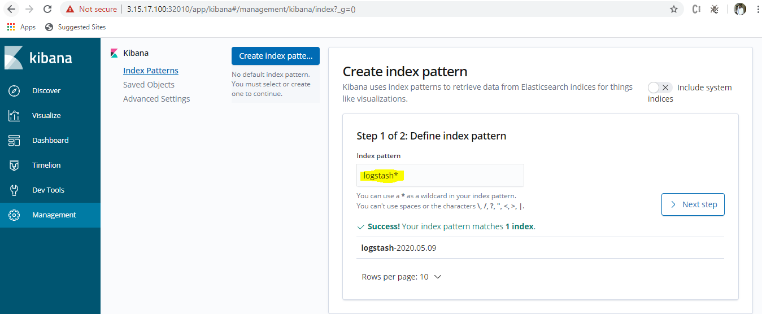
Type logstash* as the index pattern. This instructs Kibana to query Elasticsearch’s indices that match this pattern. Click “Next step”.

Slide 10
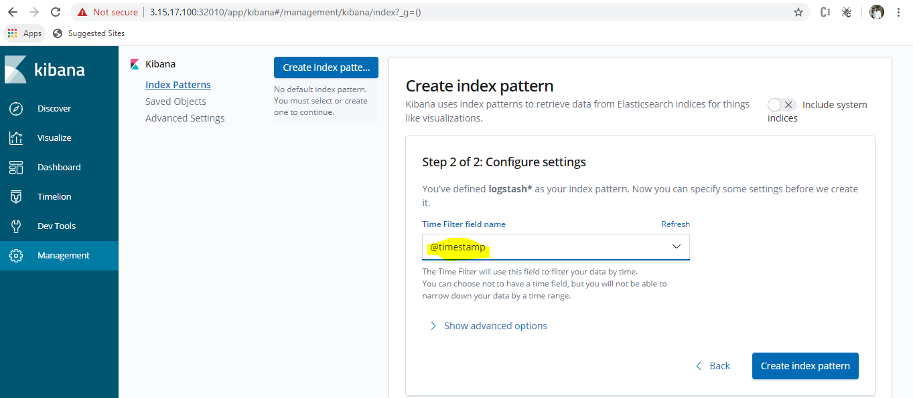
Select @timestamp as the Time Filter field name and click “Create index pattern”.

Slide 11
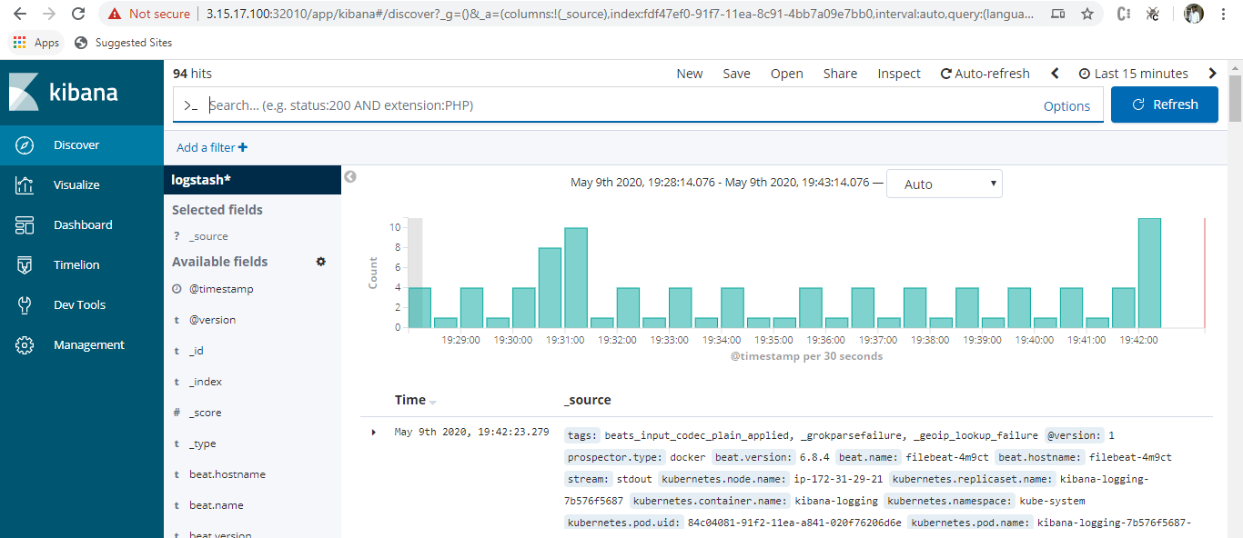
That’s a lot of data! The reason is that Filebeat is shipping all the log data that the node is generating about the containers running inside it. Let’s make things more interesting by deploying a sample web server and demonstrating how we can grab its logs collectively from multiple pods.

Slide 12
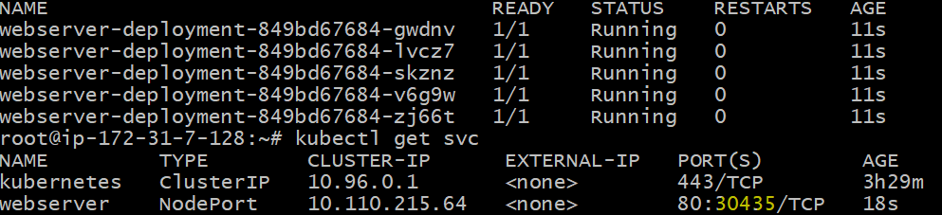

Deploying A Sample Application: Apache Webserver
Applications should be designed so that they log their output and error messages to STDOUT and STDERR. As mentioned earlier, Docker (and Kubernetes in clustered environments) automatically keep a copy of those logs on the node, so that agents like Filebeat can ship them together with the node logs. The Apache image (httpd) follows this logging pattern so we’ll deploy it as a sample application. The following definition file contains the Deployment and Service resources necessary to bring the webserver up on multiple pods:
root@ip-172-31-7-128:~# kubectl apply -f apache.yml
deployment.apps/webserver-deployment created
service/webserver created

Slide 13
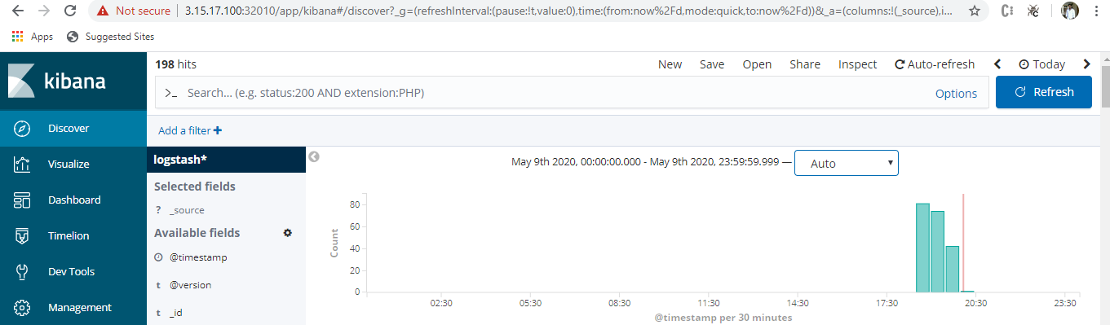
Testing The Workflow
By now you should have five components running on your cluster: Apache, Filebeat, Logstash, Elasticsearch, and Kibana. In the previous step, you made a few requests to the web server, let’s see how we can track this in Kibana.
Open the dashboard and make sure you cover at least the past hour as shown:
If you click on “Add a filter” on the left, you can see a lot of possible tags that you can use to select the log messages that we are interested in:

Slide 14
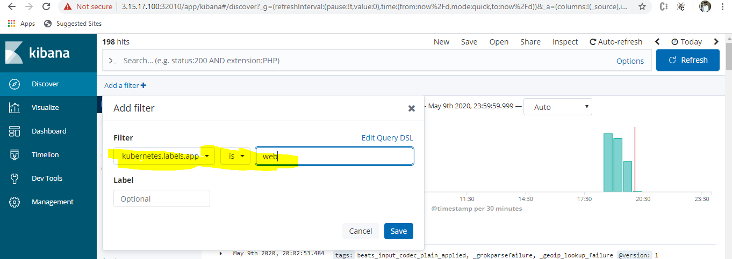
Since our web server pod had the label app=web, we can select that in our filters as shown:

Slide 15
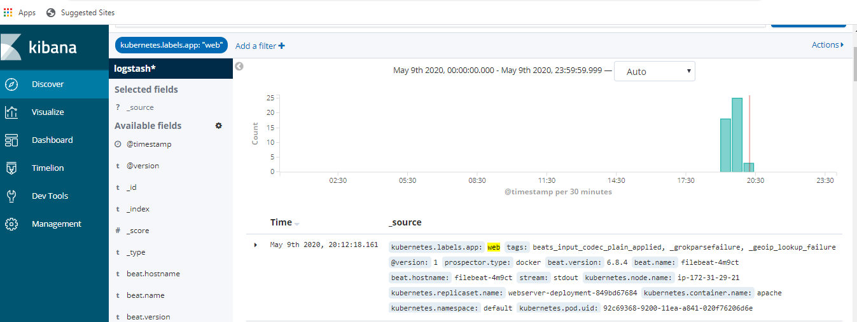

Slide 16

Note that the graph is displaying the number of times the log message matches our filter (that it is coming from the resource with label app=web) and when.
The message tag is displaying the exact logline that was output by Apache. But this is not very useful as we can always get the same output using the kubectl log command. The real power of the ELK stack comes from the ability to aggregate several logs from different sources. So, for example, we can count all the 404 errors that occurred in the last hour on all pods that serve our application, even a specific pod. Let’s test that.
In your browser, generate several requests to http://IP:8080/notfound. We do not have a file in our web directory called notfound, so Apache will simply generate the appropriate 404 messages that the requested resource was not found on the server.
On Kibana, and while you still have the previous filter set, add the following filter

Slide 17
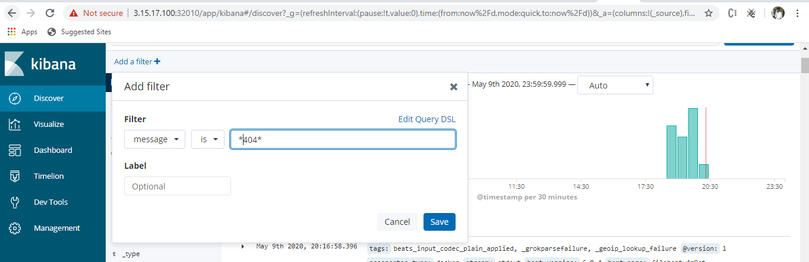

Slide 18
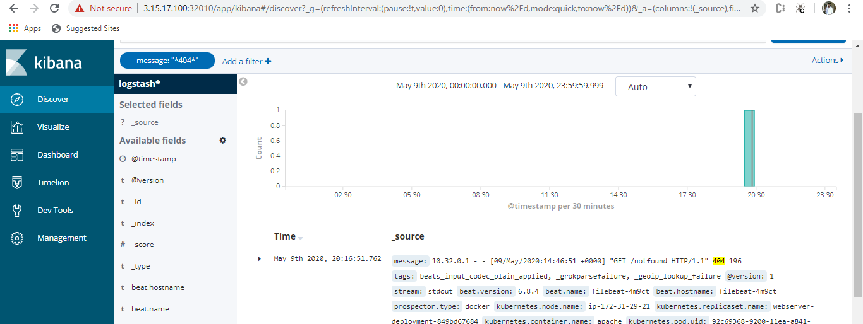
The graph displays the number of 404 messages that occurred and their time of occurrence. The logline has the message itself specifying which file was requested and was not found. You also have additional data that you can use for narrowing down the selection even further like the node name, the container name, and the pod name.

