Slide 1
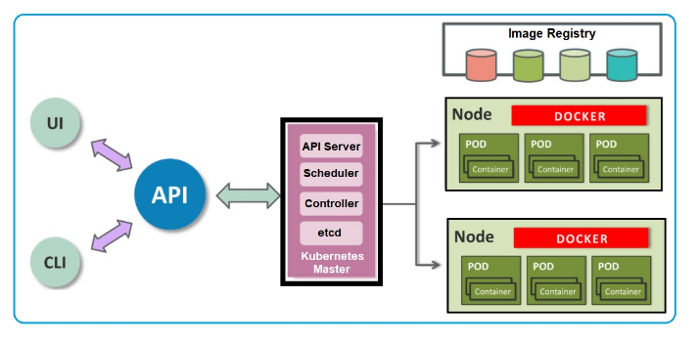
KUBERNETES
Kubernetes is an open-source container management (orchestration) tool. It’s container management responsibilities include container deployment, scaling, and descaling of containers and container load balancing. There are Cloud-based Kubernetes services called as KaaS (Kubenetes as a Service ) also available namely AWS ECS, EKS, Azure AKS, and GCP GKE.

Slide 2
Master Components: Master components provide the cluster’s control plane and are responsible for global activities about the cluster such as scheduling, detecting and responding to cluster events.
API Server: Exposes the Kubernetes API and is the front-end for the Kubernetes control plane. The API server is the entry points for all the REST commands used to control the cluster. It processes the REST requests, validates them and executes the bound business logic.
etcd: All cluster data is stored in etcd storage and its a simple, distributed, consistent key-value store. It’s mainly used for shared configuration and service discovery. It provides a REST API for CRUD operations.
Controller-manager: Controller manager runs controllers that handle routine tasks in the cluster e.g. Replication Controller, Endpoints Controller etc. A controller uses API server to watch the shared state of the cluster and makes corrective changes to the current state to change it to the desired one.
Scheduler: The scheduler has the information regarding resources available on the members of the cluster. The Scheduler also watches newly created pods that have no node assigned and selects a node for them to run on.

Slide 3
Node Components: Node components run on every node, maintain running pods and provide them the Kubernetes runtime environment.
kubelet: The primary node agent that watches for pods that have been assigned to its node and performs actions to keep it healthy and functioning e.g. mount pod volumes, download pod secrets, run containers, perform health checks etc. kubelet gets the configuration of a pod from the apiserver and ensures that the described containers are up and running. This is the worker service that’s responsible for communicating with the master node. It also communicates with etcd, to get information about services and write the details about newly created ones.
kube-proxy: Enables the Kubernetes service abstraction by maintaining network rules on the host and performing connection forwarding. kube-proxy acts as a network proxy and a load balancer for a service on a single worker node. It takes care of the network routing for TCP and UDP packets.
Docker: It used for actually running containers. Docker runs on each of the worker nodes, and runs the configured pods. It takes care of downloading the images and starting the containers.

Slide 4
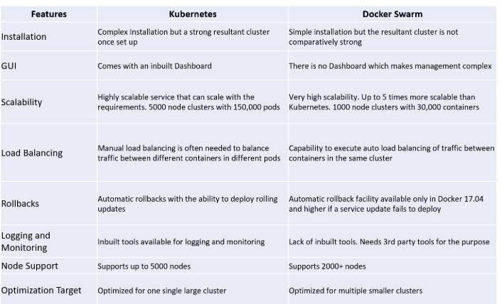
Kubernetes vs Docker Swarm

Slide 5
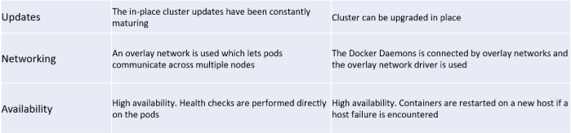

Slide 6
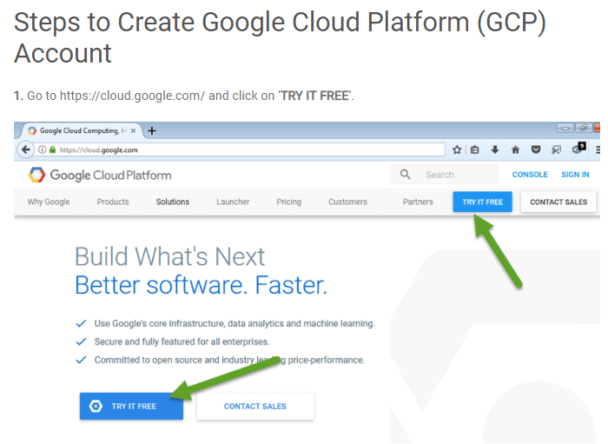
Create Google Account :
You will get $300 free credit when you sign up which can be used over the next 12 months. Earlier this was only 2 months or 60 days.

Slide 7
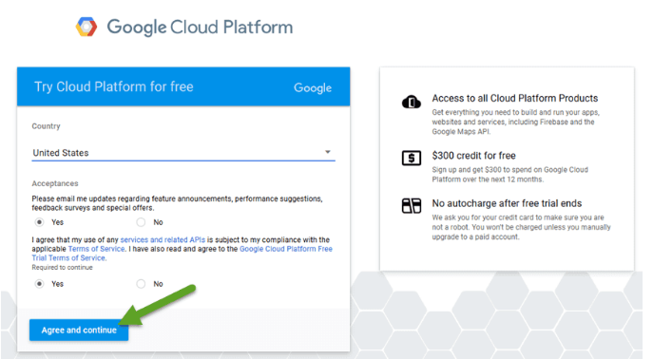
Now, it will ask you to login to your Gmail account and choose your country and accept the terms & conditions

Slide 8
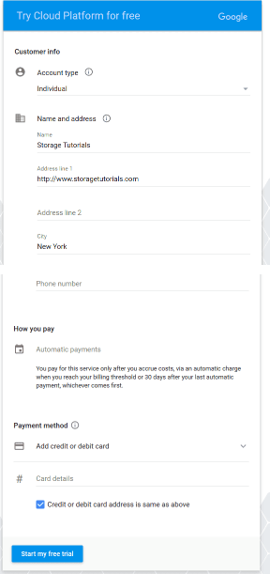
In the third step, you have to fill your details, like account type, Name, Address, credit card details, tax information, etc. If you have old Gmail account and all the information is already there it would take it and you might not have to fill all the details

Slide 9
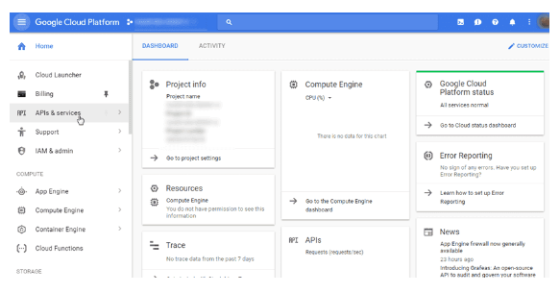
Now Google will setup your cloud account and in few seconds your Google Cloud Platform account will be ready. It will look like below

Slide 10

Kubernetes Setup
Step 1 : Create GCP account
Step 2 : Create Project or choose default one
Step 3 : Go to Navigation Menu → Compute Engine -→ VM Instances
Step 4 : Create VM
Step 5 : click on SSH under connect to connect machine
Step 6 : switch to root user
Step 7 : install Kubectl (yum install kubectl)
Step 8 : Configure project id
export PROJECT_ID=reliable-mode-223918
Step 9 : configure cloud (gcloud init)

Slide 11
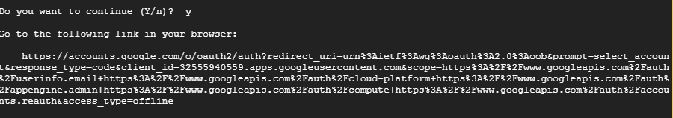
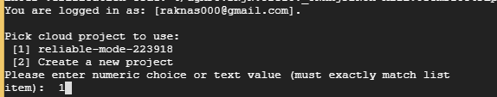

Click on the link to get verification code
After verification completed, choose the project
Choose default zone with value 1
Step 10 : create cluster (gcloud container clusters create kubecluster )
(by default three nodes will be created undier kubernetes cluster)
Complete Optoins :https://cloud.google.com/sdk/gcloud/reference/container/clusters/create

Slide 12
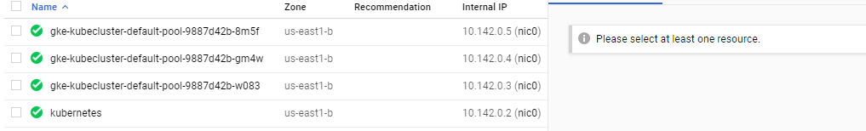

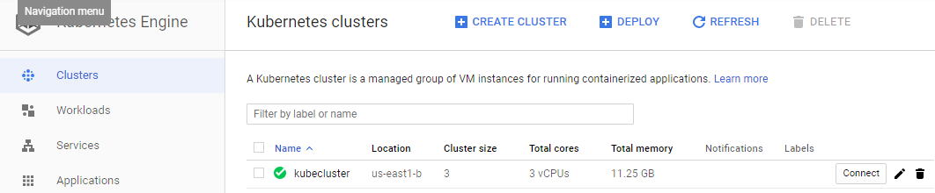
Nodes info
Cluster info

Slide 13
Step 11 : create pod.yml with below content
apiVersion: v1
kind: Pod
metadata:
name: sample-pod
labels:
zone: prod
version: v1
spec:
containers:
- name: sample-ctr
image: devopstrainer/ubuntu:sample
ports:
- containerPort: 8080
Apiversion : kubernetes version
Metadata : name or label of the pod for identification
Label : identify or tags
Spec: inside the pod
Example for outside expose : https://blog.tekspace.io/exposing-pod-as-a-nodeport-service/

Slide 14

Step 12 : deploy the pod.yml to api server (kubectl create –f pod.yml )
Step 13 : Get the pod details (kubectl get pods )
To check pods details : kubectl describe pods
Deployment thru Deployment object instead of pods
It makes deployment more effieceint
It creates replica set (it manages the pods)
Scale up become easy
Exposing to external world is easy
Rolling updates and rollbacks are more efficient
Deleting the pods : kubectl delete pods pod name
kubectl delete pods sample-pod

Slide 15
Create deployment file (deploy.yml)
apiVersion: extensions/v1beta1
kind: Deployment
metadata:
name: sample-deploy
spec:
replicas: 5
template:
metadata:
labels:
app: sample-ctr
spec:
containers:
- name: sample-pod
image: nginx
ports:
- containerPort: 80
Replicas : number of pods
Template : template will describe the configuration details

Slide 16
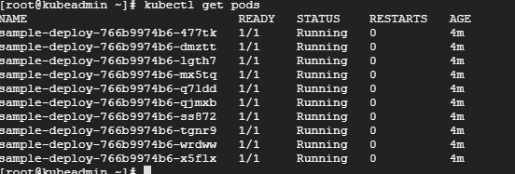
Pod details:
To check on which node pods are running

Slide 17
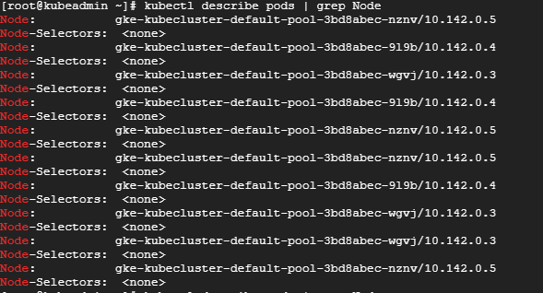
To check the Replica set details :

Slide 18
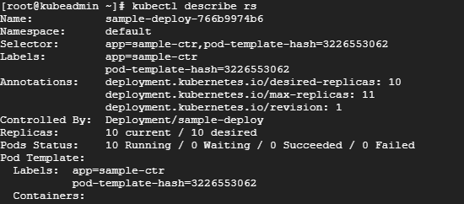
To check the Replica set details :
Service Obect : To access the application which are running in the pods we need one
permanent ip so service object will take care of it
Attach the pods to service object :
All the pods are replications so all will be having same labels , with the label
names pods will be attached to the service object so if pods are moving
from one node to another node due the same label name it will be still
attached to the service object
To know the name of the label : kubectl descibe pods | grep app

Slide 19

Create Service Object : create service.yml file with below content
apiVersion: v1
kind: Service
metadata:
name: sample-svc
labels:
app: sample-ctr
spec:
type: NodePort
ports:
- port: 80
nodePort: 30005
protocol: TCP
selector:
app: sample-ctr

Slide 20
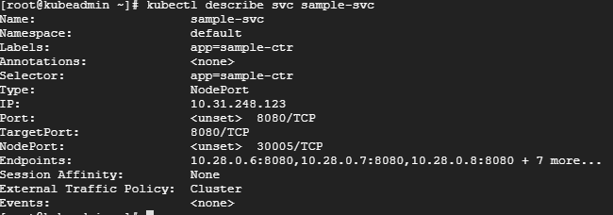
Create a firewall rule to allow TCP traffic on your node port
gcloud compute firewall-rules create test-node-port --allow tcp:[NODE_PORT]
If the nodes in your cluster have external IP addresses, find the external IP address of one of your nodes:
kubectl get nodes --output wide
Now take the ip address of any of the node and access it into the browser with node port, service will be launched (we can observe same service running on all the nodes with same port)

Slide 21
Rolling updates:
During continous deployment, if new change comes for that change new docker image
will be created with the required configurations and that image will be deployed into
the kubernetes cluster and traffic will be routed to the new pods and old pods will be
deleted like that we can deploy the new changes with zero downtime
Create deployment file (deploy.yml)
apiVersion: extensions/v1beta1
kind: Deployment
metadata:
name: sample-deploy
spec:
replicas: 5
template:
metadata:
labels:
app: sample-ctr
spec:
containers:
- name: sample-pod
image: httpd
ports:
- containerPort: 80

Slide 22
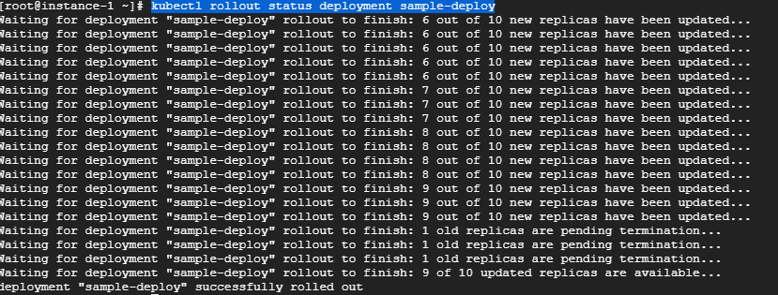
Deploy the new changes:
kubectl apply -f deploy.yml --record
Check the status :
kubectl rollout status deployment sample-deploy

Slide 23

Now check the service , jenkins will be running on the same node with same port, we can
Observer with out down time new changes are reflected.
Syntax : <ipadress of node in the cluster>: <nodeport>
Ex : http://34.73.212.137:30005
Check the replica set : kubectl get rs
we can observer old rs pods are deleted (it is like blue green deployment approach)

Slide 24

Rollback : Rever the changes
Check the deployment history:
kubectl rollout history deployment sample-deploy
Note : while deploying if we give option record then we can see the command in the chang-cause column otherwise it will show none
Rollback to previous version :
kubectl rollout undo deployment sample-deploy --to-revision=1
Now go to the browser and check the application , we can observer previous changes
are running
<any node ip of cluster> : <nodeport>

Slide 25
Cleaning up
Deleting your Services
kubectl delete services sample-svc (service name)
Deleting your Deployments
kubectl delete deployments sample-deploy
Deleting your firewall rule
gcloud compute firewall-rules delete test-node-port
Deleting cluster
gcloud container clusters delete kubecluster (cluster name)
Deleting vm
gcloud compute instances delete instance-1
Deleting pod forcefully
kubectl delete pod <PODNAME> --grace-period=0 --force --namespace <NAMESPACE>

Slide 26
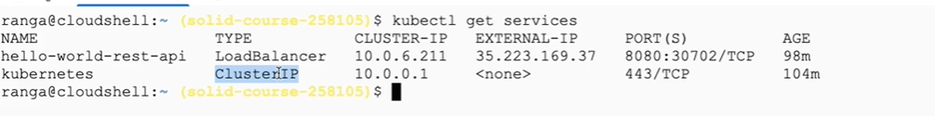
Kubernetes ServiceTypes allow you to specify what kind of Service you want. The default is ClusterIP
ClusterIP: Exposes the Service on a cluster-internal IP. Choosing this value makes the Service only reachable from within the cluster. This is the default ServiceType.
NodePort: Exposes the Service on each Node’s IP at a static port (the NodePort). A ClusterIP Service, to which the NodePort Service routes, is automatically created. You’ll be able to contact the NodePort Service, from outside the cluster, by requesting <NodeIP>:<NodePort>.
LoadBalancer: Exposes the Service externally using a cloud provider’s load balancer. NodePort and ClusterIP Services, to which the external load balancer routes, are automatically created.
ExternalName: Maps the Service to the contents of the externalName field (e.g. foo.bar.example.com), by returning a CNAME record

Slide 27
Creating a service for an application running in five pods
Run a Hello World application in your cluster:
kubectl apply -f https://k8s.io/examples/service/load-balancer-example.yaml
Display information about the Deploymen
kubectl get deployments hello-world
kubectl describe deployments hello-world
Display information about your ReplicaSet objects:
kubectl get replicasets
kubectl describe replicasets
Create a Service object that exposes the deployment:
kubectl expose deployment hello-world --type=LoadBalancer --name=my-service
Display information about the Service:
kubectl get services my-service

Slide 28
Display detailed information about the Service:
kubectl describe services my-service
Make a note of the external IP address (LoadBalancer Ingress) exposed by your service. In this example, the external IP address is 104.198.205.71. Also note the value of Port and NodePort. In this example, the Port is 8080 and the NodePort is 32377.
In the preceding output, you can see that the service has several endpoints: 10.0.0.6:8080,10.0.1.6:8080,10.0.1.7:8080 + 2 more. These are internal addresses of the pods that are running the Hello World application. To verify these are pod addresses, enter this command:
kubectl get pods --output=wide
Use the external IP address (LoadBalancer Ingress) to access the Hello World application:
curl http://<external-ip>:<port>

Slide 29
where <external-ip> is the external IP address (LoadBalancer Ingress) of your Service, and <port> is the value of Port in your Service description. If you are using minikube, typing minikube service my-service will automatically open the Hello World application in a browser.
Cleaning up
To delete the Service, enter this command
kubectl delete services my-service
To delete the Deployment, the ReplicaSet, and the Pods that are running the Hello World application, enter this command
kubectl delete deployment hello-world
kubectl delete daemonsets,replicasets,services,deployments,pods,rc --all

Slide 30
CI/CD for containerized application
Building Docker Image for Tomcat with Specified War file from Nexus
Dockerfile
FROM tomcat
MAINTAINER sankar
ARG CONT_IMG_VER
WORKDIR /usr/local/tomcat
COPY tomcat-users.xml /usr/local/tomcat/conf/tomcat-users.xml
EXPOSE 8080
ADD http://52.14.64.164:8081/nexus/content/repositories/releases/com/geekcap/vmturbo/hello-world-servlet-example/${CONT_IMG_VER}/hello-world-servlet-example-${CONT_IMG_VER}.war /usr/local/tomcat/webapps
Building Image
docker build -t new-tomcat-image2 --build-arg CONT_IMG_VER=1.0 .
tomcat-user.xml
<role rolename="manager-gui"/>
<role rolename="manager-script"/>
<role rolename="manager-jmx"/>
<role rolename="manager-status"/>
<user username="admin" password="admin" roles="manager-gui,manager-script,manager-jmx,manager-status"/>

Slide 31
KUBERNETES SETUP ON AWS - 1
Update and install transport-https with user ubuntu
sudo apt-get update -y
sudo apt-get install apt-transport-https -y
Switch to root
curl -s https://packages.cloud.google.com/apt/doc/apt-key.gpg | apt-key add -
cat <<EOF> /etc/apt/sources.list.d/kubernetes.list
deb http://apt.kubernetes.io/ kubernetes-xenial main
EOF
Install Docker:
apt update -y
apt-get install docker -y
apt install docker.io
usermod -aG docker ubuntu
systemctl restart docker
systemctl enable docker.service

Slide 32
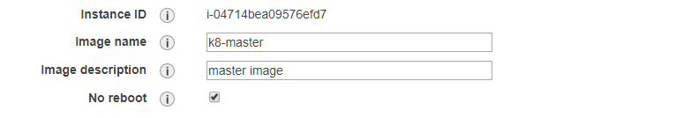
apt-get install kubelet kubectl kubeadm kubernetes-cni -y
If Kubernetes-cni error :
Sudo dpkg –i --force-overwrite /var/cache/apt/archives/kubernetes_cni_0.7.5-00_amd64.deb
Configure Cgroup in kubedam.conf file:
vim /etc/systemd/system/kubelet.service.d/10-kubeadm.conf
Environment="cgroup-driver=systemd/cgroup-driver=cgroupfs"
Create Image:
kubeadm init

Slide 33
kubeadm init output :
Your Kubernetes control-plane has initialized successfully!
To start using your cluster, you need to run the following as a regular user:
mkdir -p $HOME/.kube
sudo cp -i /etc/kubernetes/admin.conf $HOME/.kube/config
sudo chown $(id -u):$(id -g) $HOME/.kube/config
You should now deploy a pod network to the cluster.
Run "kubectl apply -f [podnetwork].yaml" with one of the options listed at:
https://kubernetes.io/docs/concepts/cluster-administration/addons/
Then you can join any number of worker nodes by running the following on each as root:
kubeadm join 172.31.47.81:6443 --token 6pp9p8.quhtnm4kc05lsmn2 \
--discovery-token-ca-cert-hash sha256:ce25b809592df99e81cefccb3861024220b06ee30546cc7abdbf7362d55cf85e

Slide 34
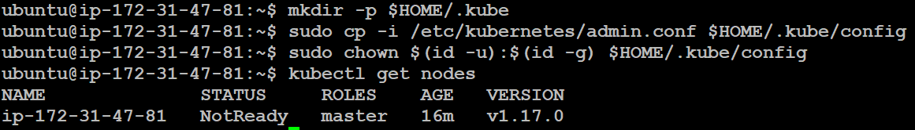
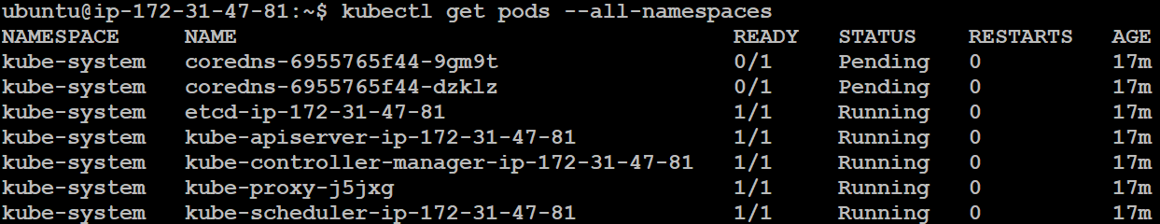
Run the commands on Master with user ubuntu:
Check the Namespace: kubectl get pods --all-namespaces
Coredns are not running , we need to install them to run
Switch to root then enter below command to install
sysctl net.bridge.bridge-nf-call-iptables=1

Slide 35
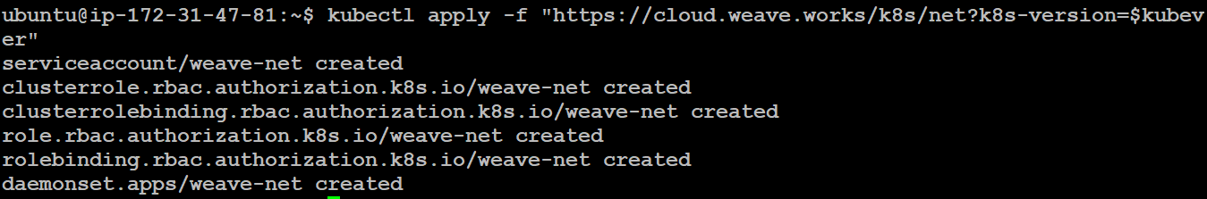
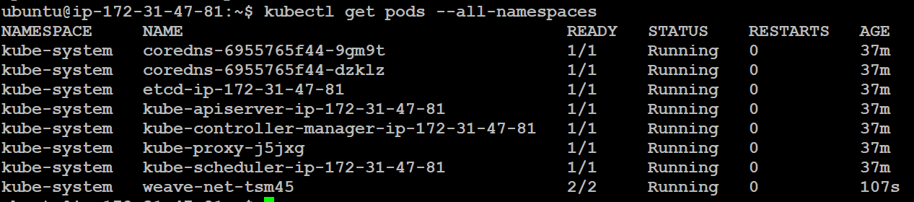
Switch to user ubuntu
Export key to kubever variable
export kubever=$(kubectl version | base64 | tr -d '\n')
Creating wave network for pod communication
kubectl apply -f "https://cloud.weave.works/k8s/net?k8s-version=$kubever"
Now check namespaces again, cni will be in running state

Slide 36

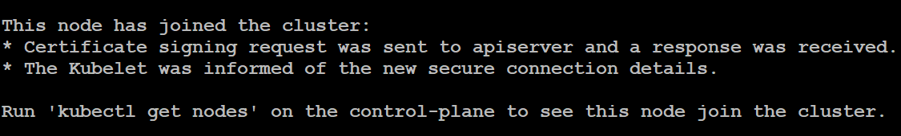
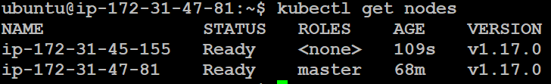
WORKER NODE SETUP
Create worker node by using custom AMI, once node is created add the node to the cluster
by running below command
kubeadm join 172.31.47.81:6443 --token 6pp9p8.quhtnm4kc05lsmn2 \
--discovery-token-ca-cert-hash sha256:ce25b809592df99e81cefccb3861024220b06ee30546cc7abdbf7362d55cf85e
Now check nodes on master, new worker node added

Slide 37
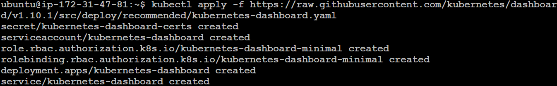
Dash Board Setup:
kubectl apply -f https://raw.githubusercontent.com/kubernetes/dashboard/v1.10.1/src/deploy/recommended/kubernetes-dashboard.yaml
To access the dashboard, user has to have admin privilages, so will create service.yaml
File with to provide the access
service.yaml
apiVersion: v1
kind: ServiceAccount
metadata:
name: admin-user
namespace: kube-system
Reference https://medium.com/@kanrangsan/creating-admin-user-to-access-kubernetes-dashboard-723d6c9764e4
kubectl apply -f service.yaml

Slide 38
rolebinding.yaml
apiVersion: rbac.authorization.k8s.io/v1
kind: ClusterRoleBinding
metadata:
name: admin-user
roleRef:
apiGroup: rbac.authorization.k8s.io
kind: ClusterRole
name: cluster-admin
subjects:
- kind: ServiceAccount
name: admin-user
namespace: kube-system
kubectl apply -f rolebinding.yaml

Slide 39
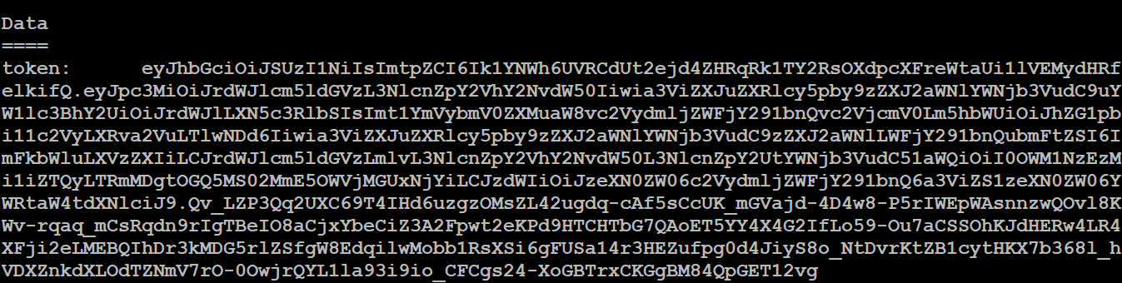
Pull the admin-user secret key:
kubectl -n kube-system describe secret $(kubectl -n kube -system get secret | grep admin-user | awk '{print $1}’)
Allow out side of the cluster
nohup kubectl proxy --address 0.0.0.0 --accept-hosts '.*' &
To Access dash board , type shoud nodeport
kubectl -n kube-system get service kubernetes-dashboard

Slide 40
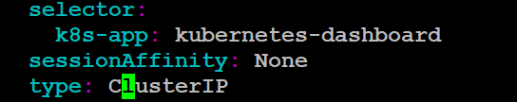
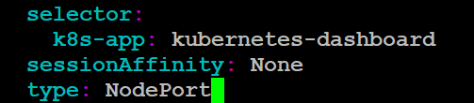
Modify the kubernetes-dashboard to change clusterip to nodeport
kubectl -n kube-system edit service kubernetes-dashboard
Verify
Access the dashboard → https://masterip:dashboard-port
https://13.126.159.43:32682
Chrome will block due to security reasons, open with firefox

Slide 41
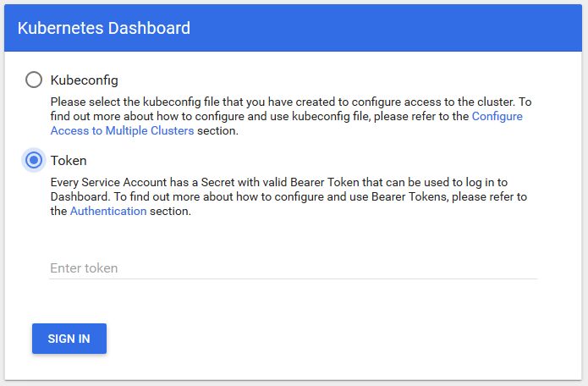
It will ask the user token, when trying to open dash board, enter the token which generated
Earlier for the user cluster-admin
To get token :
kubectl -n kube-system describe secret $(kubectl -n kube-system get secret | grep admin-user | awk '{print $1}')

Slide 42
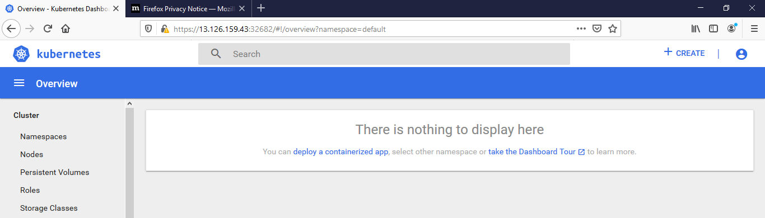

Slide 43
Resources Info:
kubectl get secret,sa,role,rolebinding,services,deployments --namespace=kube-system | grep dashboard
Delete Resources:
kubectl delete deployment kubernetes-dashboard --namespace=kube-system
kubectl delete service kubernetes-dashboard --namespace=kube-system
kubectl delete role kubernetes-dashboard-minimal --namespace=kube-system
kubectl delete rolebinding kubernetes-dashboard-minimal --namespace=kube-system
kubectl delete sa kubernetes-dashboard --namespace=kube-system
kubectl delete secret kubernetes-dashboard-certs --namespace=kube-system
kubectl delete secret kubernetes-dashboard-key-holder --namespace=kube-system
kubectl delete sa admin-user -n kube-system
Kubectl delete all –l app=app-name (to delete all the resources which belongs to that app)
https://github.com/kubernetes/dashboard
https://gist.github.com/chukaofili

Slide 44
KUBERNETES SETUP ON AWS-2
Login to aws and spin up an ubuntu 18.04 ec2 instance with a min requirement of 2vcpu & 2gb memory (8GB HDD is sufficient for this tutorial)
While setting up an instance make sure under the configure instance, click on advanced details and add the below steps as text (copy & paste), the below script should be run initially on all the instances (master and slave nodes)
#!/bin/bash
sudo su;
git clone https://github.com/raknas999/servicemesh.git && chmod 755 servicemesh/initial.sh && sh servicemesh/initial.sh;
On the Kube master node, initialize the cluster
sudo kubeadm init --pod-network-cidr=10.244.0.0/16 #(Master ip)

Slide 45
mkdir -p $HOME/.kube
sudo cp -i /etc/kubernetes/admin.conf $HOME/.kube/config
sudo chown $(id -u):$(id -g) $HOME/.kube/config
Verify that the cluster is responsive and that Kubectl is working
kubectl version
Run below commands to configure the network in the cluster (weavenet Network)
export kubever=$(kubectl version | base64 | tr -d '\n')
kubectl apply -f https://cloud.weave.works/k8s/net?k8s-version=$kubever
Create a kubernetes Dashboard
kubectl apply -f https://gist.githubusercontent.com/initcron/32ff89394c881414ea7ef7f4d3a1d499/raw/4863613585d05f9360321c7141cc32b8aa305605/kube-dashboard.yaml
To access Dashboard
publicipofanynode:31000

Slide 46
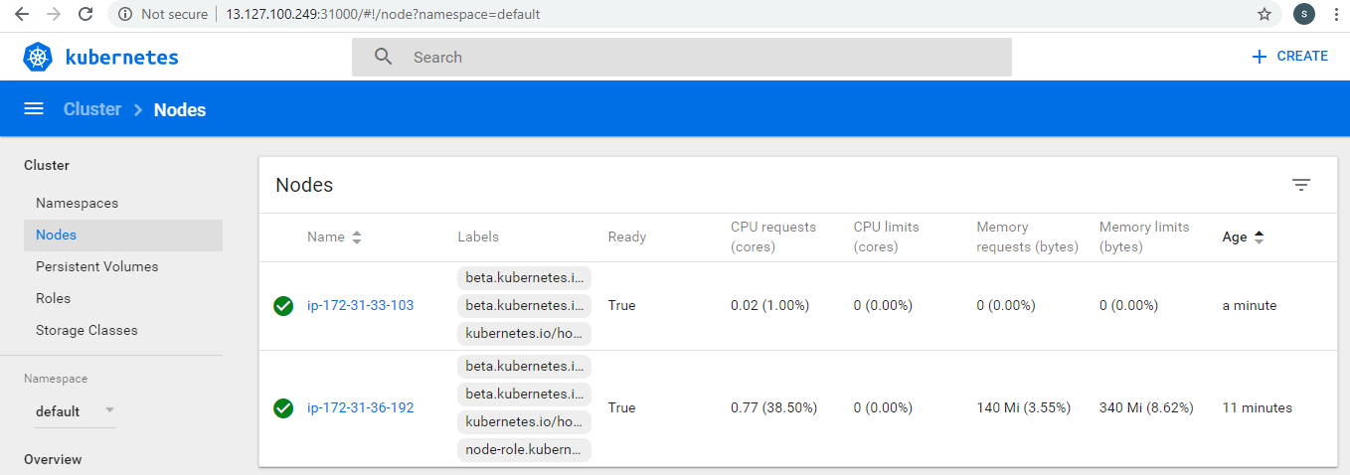
Kubernetes Dash Board

Slide 47
Get cluster info
kubectl cluster-info
Run the below command on master node to get the token to join the slaves to the cluster
kubeadm token create --print-join-command
Worker Node Setup
Create Worker Node with bootable script then run the command (above command output)
to join worker node (with user root)
#!/bin/bash
sudo su;
git clone https://github.com/raknas999/servicemesh.git && chmod 755 servicemesh/initial.sh && sh servicemesh/initial.sh;

Slide 48
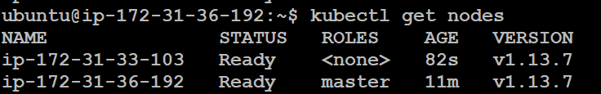
Verify that all nodes have successfully joined the cluster
kubectl get nodes

Slide 49
Horizontal Pod Auto Scaling (HPA)
HPA needs Heapster to monitor pods, by default heapster will not avialable in nodes
Code Path: (if it is not working refer slide no : 57)
git clone https://github.com/raknas999/metric-server
Go to the Path : metrics-server/deploy/1.8+ and deploy metric-server deploy file
Note : Deploy file validate certification to ignore validation add the below code into
The file (yellow highlighted code)
edit metric-server deployment to add the flags
# args:
# - --kubelet-insecure-tls
# - --kubelet-preferred-address-types=InternalIP,ExternalIP,Hostname
Deploy all the files from the directory : kubectl crate –f .
kubectl edit deploy -n kube-system metrics-server

Slide 50
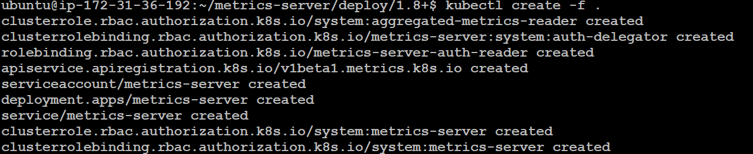
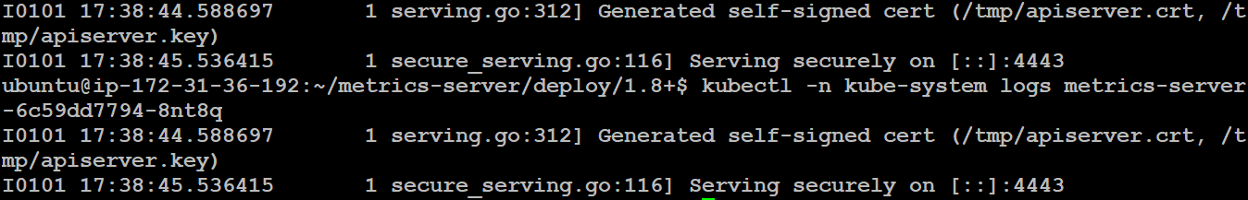
kubectl -n kube-system get pods → for metric server information
After creation check the logs of metric-server :
kubectl -n kube-system logs metrics-server-6c59dd7794-8nt8q(id) --ex

Slide 51
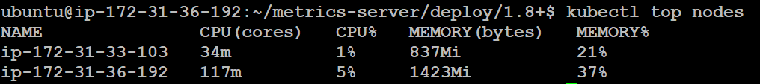
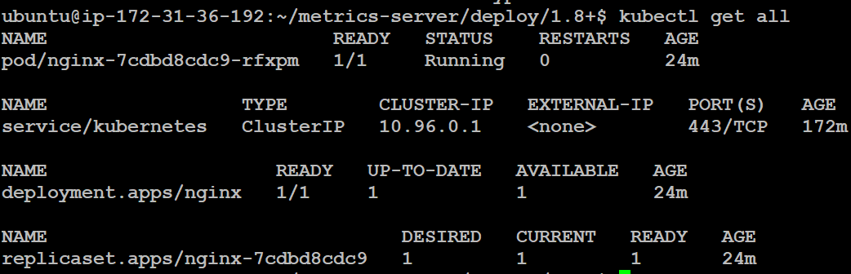
Nginx Deployment:
kubectl run nginx --image nginx
To check all the services:
kubectl get all
Expose into outer world:
kubectl expose deploy nginx --port 80 --type NodePort

Slide 52
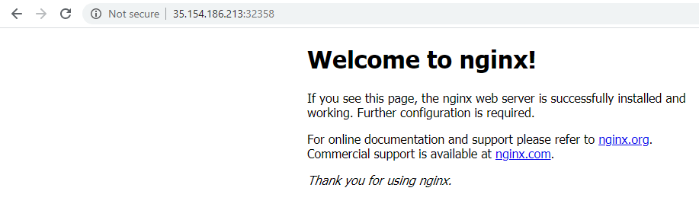
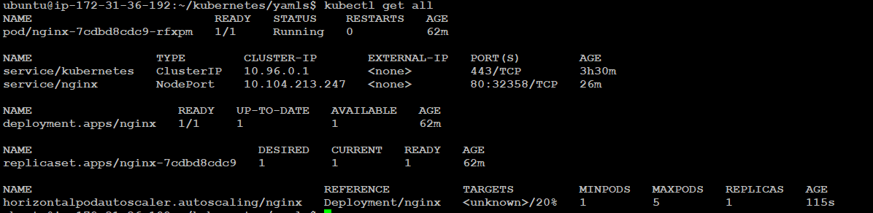
kubectl get all (to check the services also node port )
Clone the code https://github.com/justmeandopensource/kubernetes.git, and switch to yaml directory and run the below command
kubectl autoscale deploy nginx --min 1 --max 5 --cpu-percent 20

Slide 53
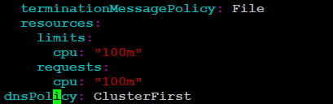
kubectl describe hpa
To Handle this error , delete hpa nginx
Kubectl delete hpa nginx
Modify nginx hpa deployment and add the below code
kubectl edit deploy nginx
Now redeploy with autoscale:
kubectl autoscale deploy nginx --min 1 --max 5 --cpu-percent 20

Slide 54
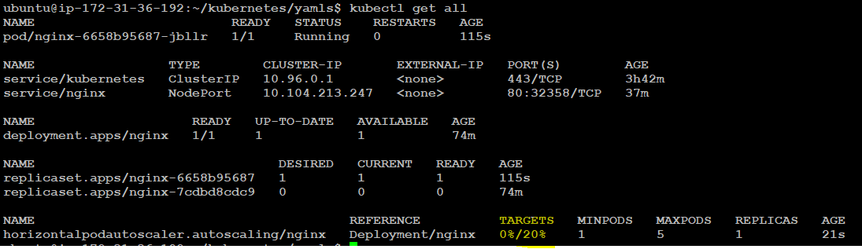
For more information
kubectl describe hpa nginx
To check cpu utilization : kubectl top pods
For webserver load testing install tool siege
sudo apt install siege

Slide 55

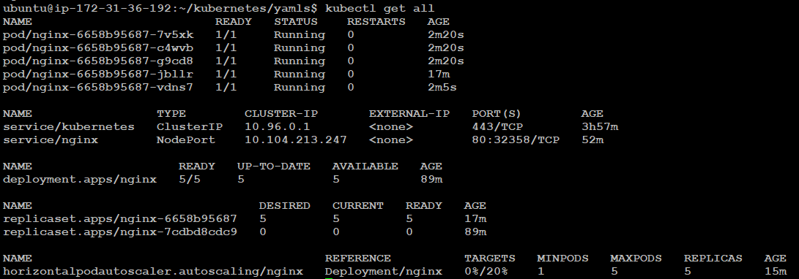
Command :
siege -q -c 5 -t 2m http://13.127.100.249:32358
-q : quite mode
-c : conquerent requests
-t : time
Application URL
Check the load : kubectl top pods
Now, we can observer replicas are increased to maximum based on the load

Slide 56
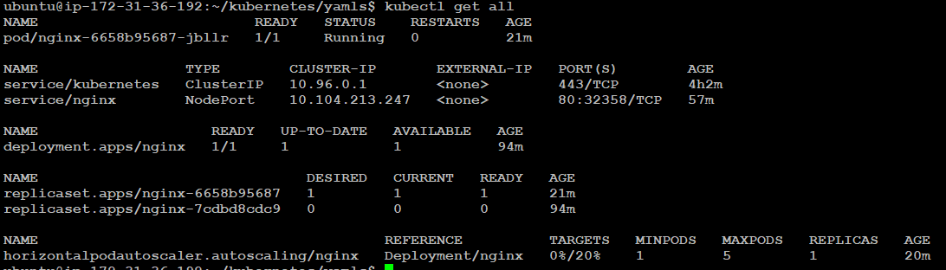
Verify after some time , replicas will be scaled in and set to default value - 1

Slide 57
Metric-server setup :
DOWNLOAD_URL=$(curl -Ls "https://api.github.com/repos/kubernetes-sigs/metrics-server/releases/latest" | jq -r .tarball_url)
DOWNLOAD_VERSION=$(grep -o '[^/v]*$' <<< $DOWNLOAD_URL)
curl -Ls $DOWNLOAD_URL -o metrics-server-$DOWNLOAD_VERSION.tar.gz
mkdir metrics-server-$DOWNLOAD_VERSION
tar -xzf metrics-server-$DOWNLOAD_VERSION.tar.gz --directory metrics-server-$DOWNLOAD_VERSION --strip-components 1
kubectl apply -f metrics-server-$DOWNLOAD_VERSION/deploy/1.8+/

Slide 58
apiVersion: extensions/v1beta1
kind: Deployment
metadata:
name: jenkins-deployment
spec:
replicas: 1
selector:
matchLabels:
app: jenkins
template:
metadata:
labels:
app: jenkins
spec:
containers:
- name: jenkins
image: jenkins/jenkins:lts
ports:
- containerPort: 8080
volumeMounts:
- name: jenkins-home
mountPath: /var/jenkins_home
volumes:
- name: jenkins-home
emptyDir: {}

Slide 59
apiVersion: v1
kind: Service
metadata:
name: jenkins
spec:
type: NodePort
ports:
- port: 8080
targetPort: 8080
nodePort: 44000
selector:
app: jenkins
Set Namespace
kubectl config set-context --current --namespace=<insert-namespace-name-here>

Slide 60
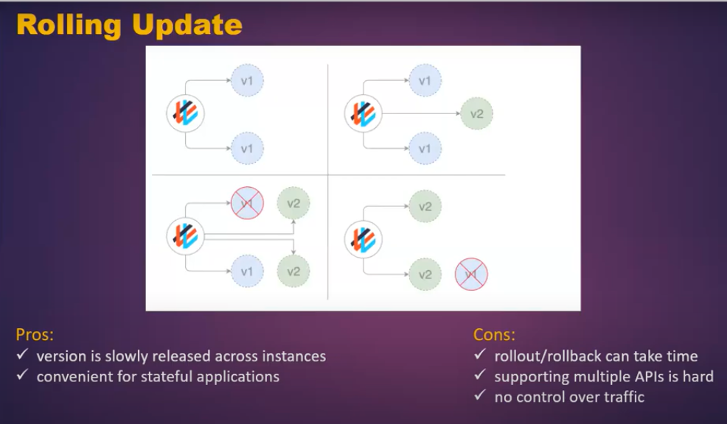
Deployment Strategies

Slide 61
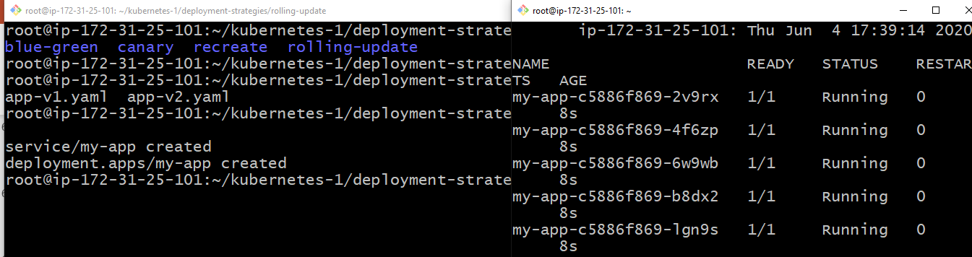
Clone the Repo: https://github.com/raknas999/kubernetes-1.git
Go to rolling-update directory and deploy app-v1.yml file
Open new window and monitor the pod deployment process
5 replicas created and those are up and running , now try to access the application using
Nodeport

Slide 62
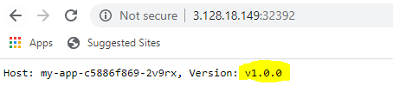
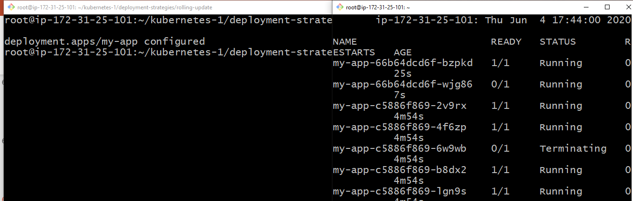
V1.0.0 is the environment variable which passed in the deployment file
We can observer the deployment strategy section with properties in the deployment file
Now try to deploy app-v2.yml and observe the deployment of pods in another window
One pod is going to create with latest and one pod is going to terminate
During the deployment process, if we try to access the app will see the older version
Once all the pods are up with new version then we can observe the latest

Slide 63
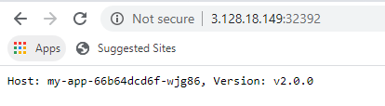
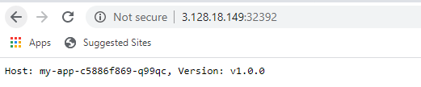
RollBack:
Rollback can be done easily by using rollout undo command
kubectl rollout und deploy <deployment name>
kubectl rollout undo deploy my-app
Access the Application:

Slide 64
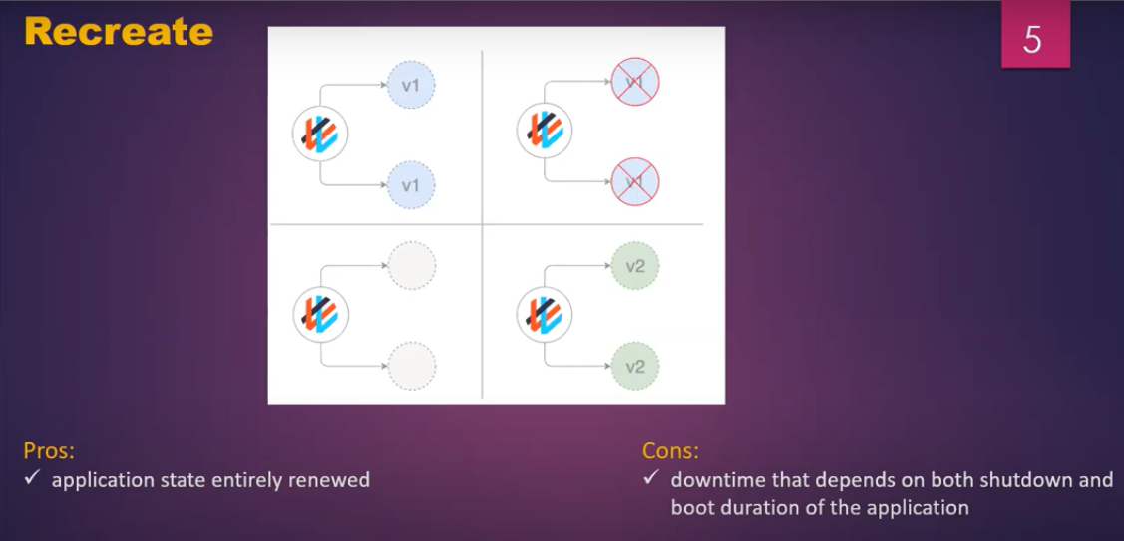
Go to recreate directory and deploy app-v1.yml file
With this deployment file we are going to create 3 replicas
Strategy is recreate
Observe the deployment in another window

Slide 65
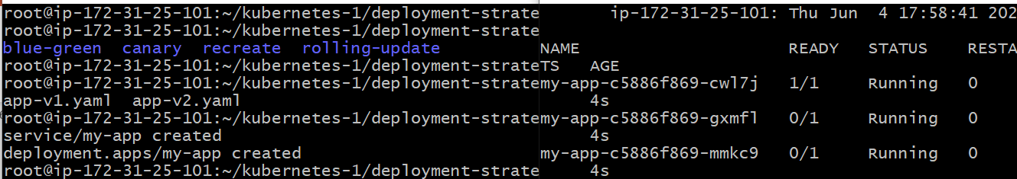


we can observer 3 pods are created , now try to access the application using nodeport
Now deploy the v2.0.0 and observe the deployment process
We can observer all the replicas getting terminated , during that time application will be down
Until new pods came up

Slide 66

Verify the application once after new pods are created

Slide 67

Go to Blue-green directory
Deploy both the files at a time , it will create 3 replicas for v1 and 3 replics for v2

Slide 68


6 pods are created , try to access the application with nodeport
Once the testing completed on the V2, switch the load to V2 using label
kubectl patch service my-app -p '{"spec":{"selector":{"version":"v2.0.0"}}}'

Slide 69


Application will be switched to V2, try to access the application
If the application is not switched try to access using incognito(might be caching issue)
If we want to revert the changes switch to the other version using patch
kubectl patch service my-app -p '{"spec":{"selector":{"version":"v1.0.0"}}}'
If the changes are not reflected, close the browser and start and check

Slide 70

Go to canary directory and deploy app-v1 file
It will create 5 replicas
Try to access it

Slide 71


Access the application with nodeport
Now scale down the v1.0.0 to 2
kubectl scale --replicas=2 deploy my-app-v1
Deploy app-v2
kubectl apply -f app-v2.yaml
Scale up v2.0.0 to 3 to match total replicas 5
kubectl scale --replicas=3 deploy my-app-v2

Slide 72


We can observer, out of 5 replicas 2 are running with v1 and 3 are running with v3
Now try to access the application , after multiple hits we can get the v2
Means the v2 is deployed and tested with some set of users, if no issue found the it
Will be rollout completely
If caching issue facing, try to check in another browser

Slide 73

Monitoring:
Clone the Repo : https://github.com/raknas999/kubernetes-1.git
Switch to Prometheus directory which will be under Monitoring directory
Create Namespace “Monitoring” and deploy all the files
For Rolebinding namespace is not required, it is going to apply on the cluster
Deploy config-map.yml, Prometheus-deployment.yml and Prometheus-service
Yaml files into “Monitroing” namespace.
If you have taken low configuration machine remove resources section from
Deployment file.
Access the Prometheus dashboard using nodeport

Slide 74

We can check the kuberentes metrics
For better visualization, we can go with Grafana
Grafana Installation : Switch to Kubernetes-Grafana directory
Deploy configmap, deployment and service files into “Monitoring” namespace
kubectl apply –f . –n monitoring
In the configmap , pointed Prometheus dns name

Slide 75

Grafana dashboard: Open browser and access using ip:nodeport
Default username and passwords is : admin , admin
Import Prometheus into Grafana : go to left side and click on “+” symbol then select
import option

Slide 76

Template number for Prometheus is : 8588
Enter template number and click on load , you will get below screen

Slide 77

Select Prometheus from Prometheus drop down list and leave the other fields ,
Click on Import button

Slide 78

We can find the kuberenetes cluster details(Memory consumption, CPU utilization, etc…)
On the dashboard
We can create New dashboards, click on “+” symbol , select dashboard, click on
New Panel

Slide 79

In the panel section, give name
For the panel
Under visualization, select
Visualization mode

Slide 80

Under Quety tab, choose Prometheus
In the Metrics section : give the query (you an get the query from prometheus metrics)
Save the panel

Slide 81

We can observer new dashboard for podcount will be created

Slide 82
Labeling
kubectl label nodes ip-172-31-0-74 kubernetes.io/role=worker
root@ip-172-31-13-118:~# kubectl get nodes
NAME STATUS ROLES AGE VERSION
ip-172-31-0-74 Ready worker 10d v1.13.7
ip-172-31-13-118 Ready master 10d v1.13.7
ip-172-31-6-107 Ready <none> 5d13h v1.13.7
ip-172-31-6-16 Ready <none> 10d v1.13.7
Taint
kubectl taint nodes worker key1=value1:NoSchedule
The taint has the format <taintKey>=<taintValue>:<taintEffect>
Remvoe all Taints
kubectl patch nodes ip-172-31-0-74 -p '{"spec":{"taints":[]}}'
WeaveScope Monitoring tool
https://collabnix.github.io/kubelabs/weave-pwk.html

