Slide 1
DVD RENTAL SYSTEM (Relational Model)
Nisarg Koradia : 19BCP088
Kumar Shashank: 19BCP120
Aditya Kishtawal: 19BCP147
Parth Raval: 19BCP090
Pathik Viramgama: 19BCP093

Slide 2
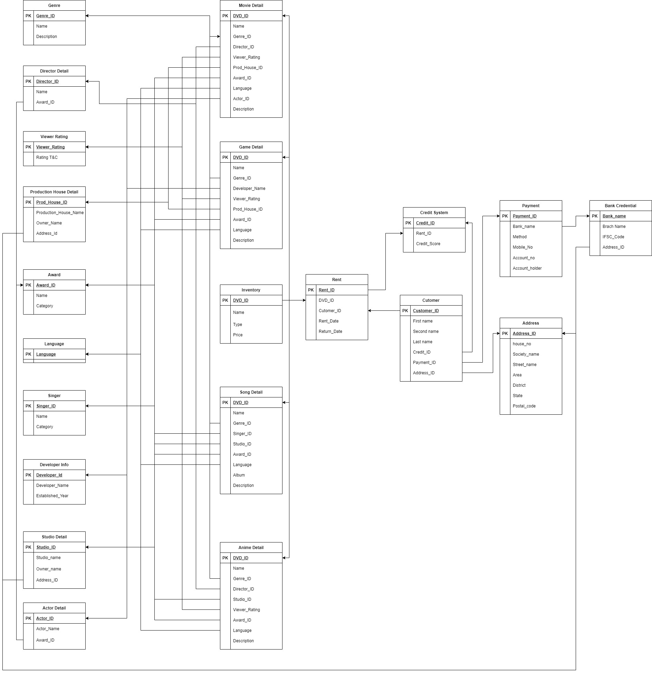
Relational Model
@30_assignment2_relationalmodel

Slide 3
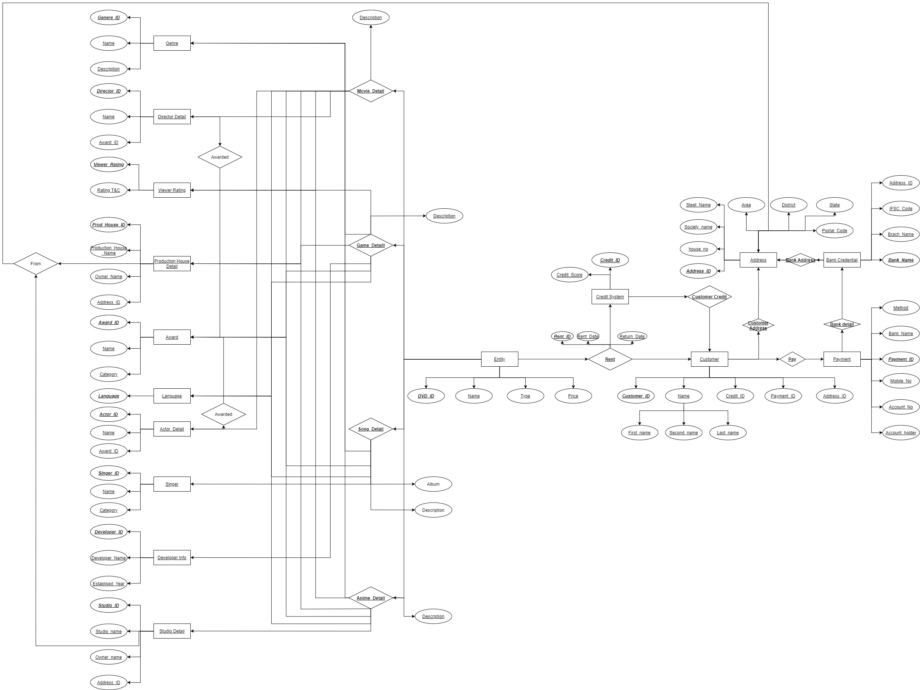
ER
Model
@30_assignment3_ERmodel

Slide 4
THANK YOU

