Slide 1
Installation Guide to MySQL
Nisarg Koradia : 19BCP088
Kumar Shashank: 19BCP120
Aditya Kishtawal: 19BCP147
Parth Raval: 19BCP090
Pathik Viramgama: 19BCP093

Slide 2
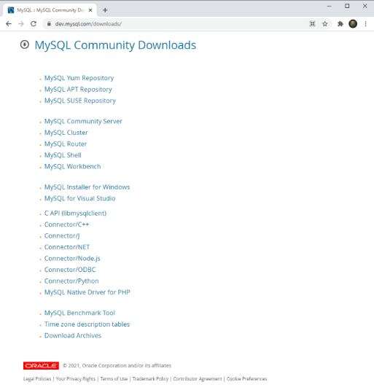
Downloading
Step 1: Go to website www.MySQL.com and download installer
Mac Users follow this link:(Community Server)
https://dev.mysql.com/downloads/mysql/
Windows Users follow this link:(Installer for Windows)
https://dev.mysql.com/downloads/installer/

Slide 3
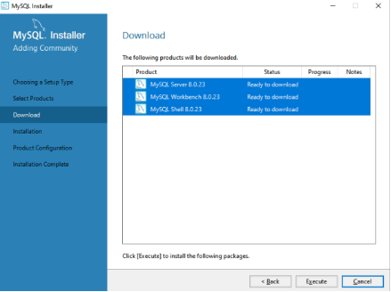
Installing
Step 2: Open the installer and select files you want to install and wait for it to download external files and install them.
Click on Finish at the end

Slide 4
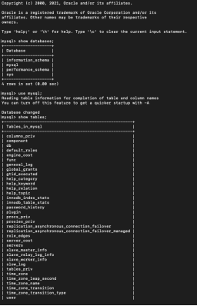
Running
Step 3: Go to Start Menu and search for MySQL Workbench and run the app
Search for MySQL Shell at same place and run the app

Slide 5
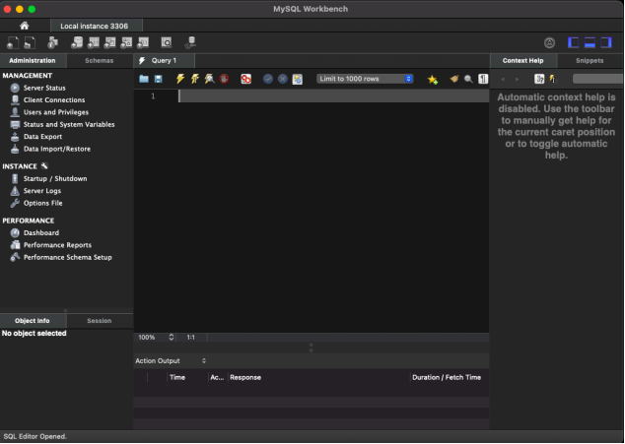
Working
Step 4: Do what you
do Best!

Slide 6
THANK YOU

