Slide 1
STAR ALIEN

Slide 2
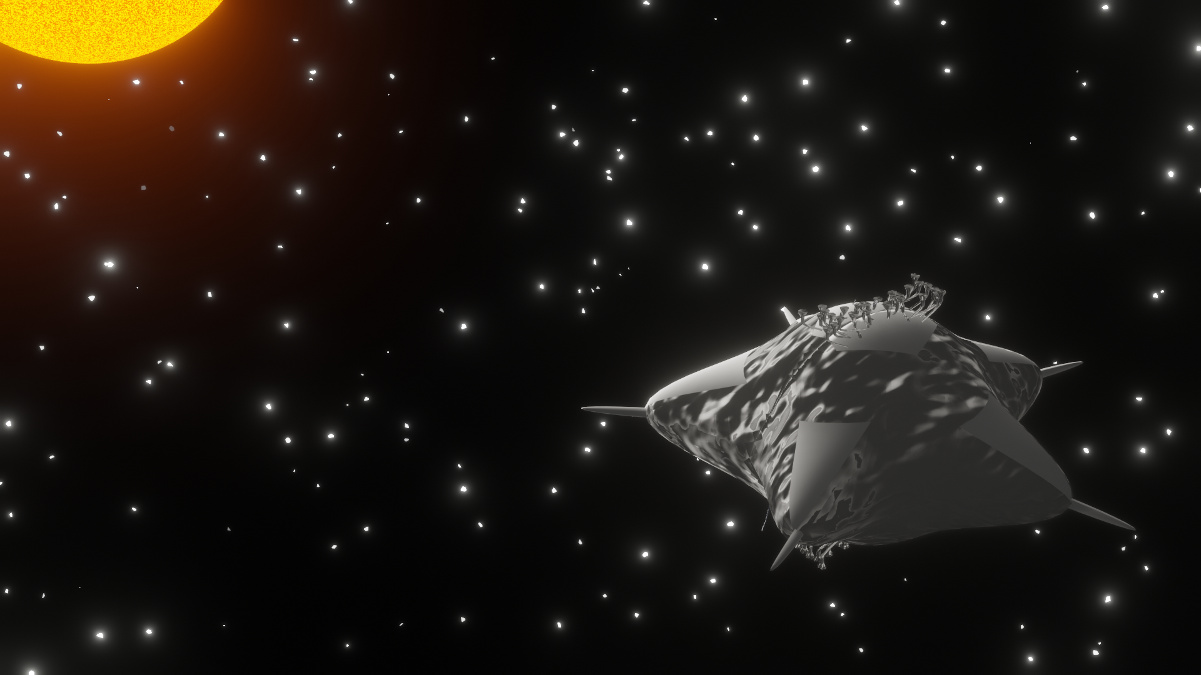
Our Space-Superhero
* Our Space Superhero is a starfish-tardigrade hybrid that has
very few movement funtions in order to survive.
* It has a liquid filtering organ, in order to prevent water loss.

Slide 3
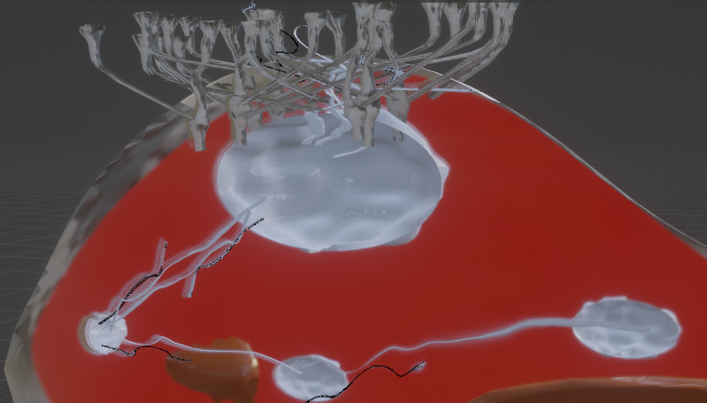
SYSTEMS:
The Water System:
* Our «Star» has 3 small and one huge water sack, in total 4 water sacks exist.
* Each sack has a flap like part in order to prevent
loss of all of water at once in case of an emergency.
* Water is taken in from the tentacle like parts.

Slide 4
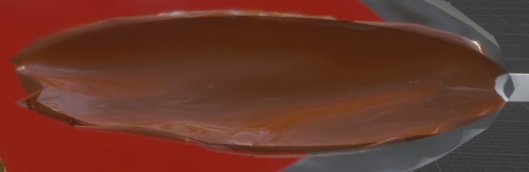
SYSTEMS:
Liver and Respiration:
Star has a liver like storage organ as well in order to have aerobic and unaerobic respiration in case of any need.
But aerobic respiration won’t be used in space so
the oxygen stay stored in muscles

Slide 5
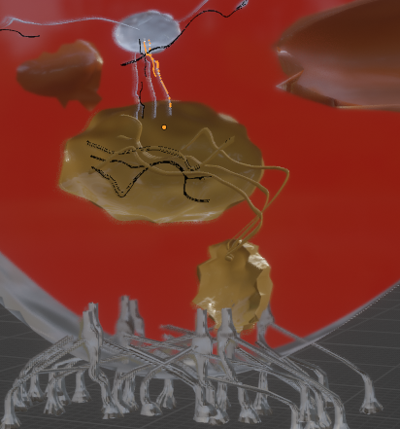
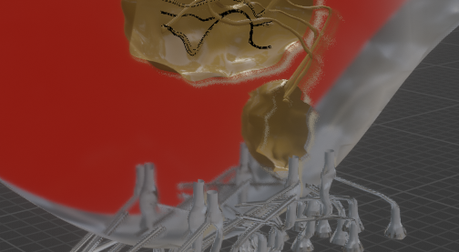
SYSTEMS:
Excretory System and Reproduction:
Star has single excratory system which can only be used in athmospheric conditions.
In two stages, water is filtered and resended to the sacks and the solid residue is passed to the other excratory sack so that it could be excreted from a seperate part.

Slide 6
THE RULES:
THE GAME
The characters are a human being, an ostrich, a tardigrad and the Star Alien (biological superhero)
Each character has its own status card that will state their abilities for each condition mentioned in the game.
When a player lands on a square and they don’t have the required statistics to live in that condition, the player’s statistics will be reset and they will be back to the ”Launch” square.
When the player lands on a “Booster Card Square” the player draws a single card. When a card is drawn, each character, except the Star Alien (biological superhero), gets the boosts written on the card.

Slide 7
Aim of The Game & Who It is For:
Our project aims to create an enjoyable and easily understandable platform for children to discover the risks and challenges associated with space missions.

