Slide 1
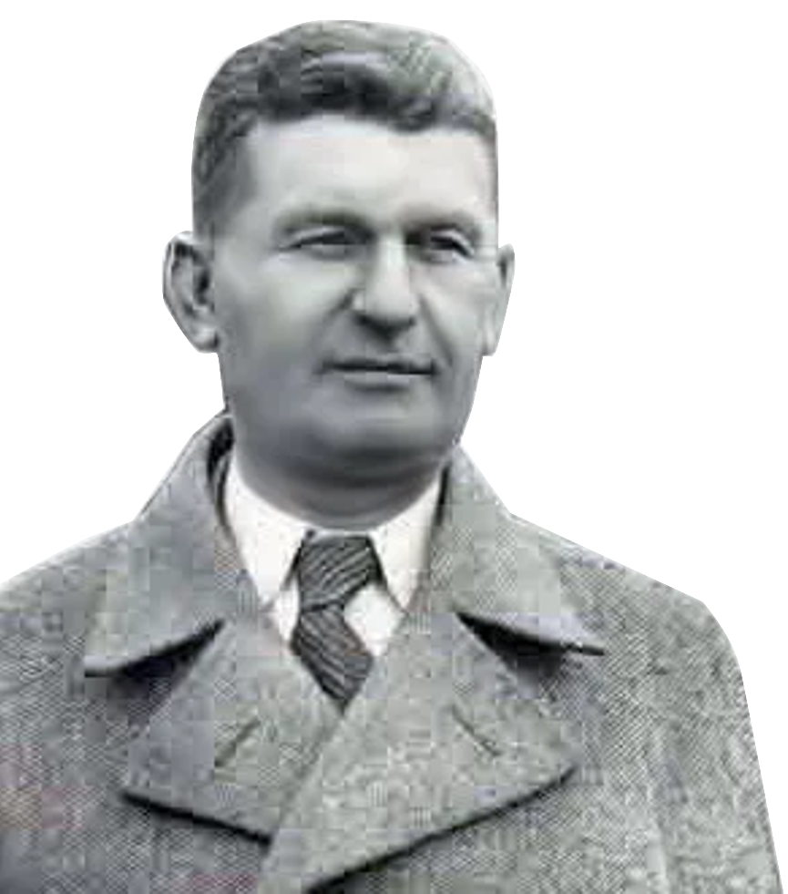

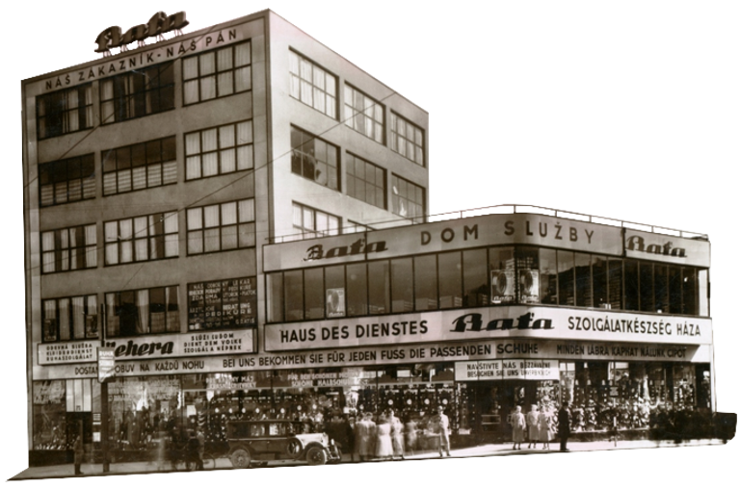
Marketing
M
A
R
K
E
Pavol Drozdík
Lukáš Kasper
Martin Paček
Juraj Mikulka
Katarína Čejková
T

Slide 2
Company history
1894
Founding
1897
“Baťovky”
1922
After WW1
1923
Autonomous departments
1932
Death of Tomáš Baťa

Slide 3

Marketing mix
Product
1.P
2.P
Price
Quality control, Customer cards
“Baťa Crushes High Prices”
Number 9

Slide 4
Marketing mix
3.P
Promotion
Honesty and customer engagement
Place
4.P
Retail outlets and factories

Slide 5
Social responsibility
1
Houses for employees
2
Cheaper goods
3
Fair Remuneration
4
Employee training
5
Customer-centric

Slide 6
Modern problems
Global competition
Rising production costs
E-commerce

Slide 7
Marketing approaches
Customer-centric
Employee education
Psychological pricing

Slide 8
Thank you

Slide 9
Sources
https://www.startitup.sk/zamestnancom-staval-domy-a-topankami-dobyl-svet-tomas-bata-bol-brilantny-obchodnik-toto-je-jeho-6-klucovych-zasad/
https://www.batovany.sk/reklama-firmy-bata-genialny-tah-krala-obuvi/
https://intuitivnimarketing.cz/podnikani/poucne-pribehy-tomas-bata-potreti/
https://www.startitup.sk/historia-spolocnosti-bata-pribeh-podnikatelskeho-fenomenu/
https://www.podnikajte.sk/marketing/marketing-reklama-bata
https://www.thebatacompany.com/about-us/history

