Slide 1

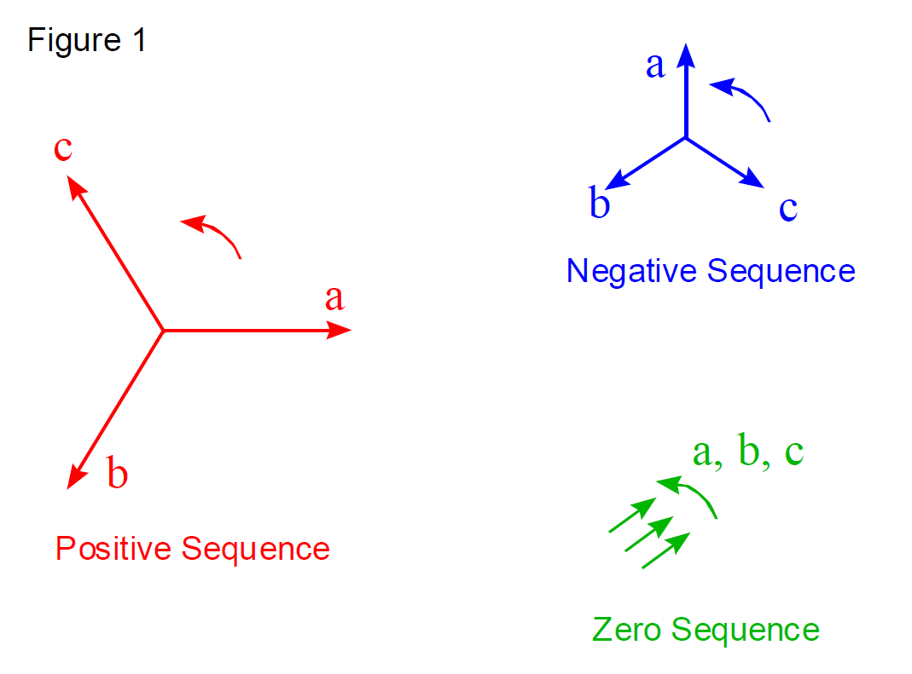

Slide 2
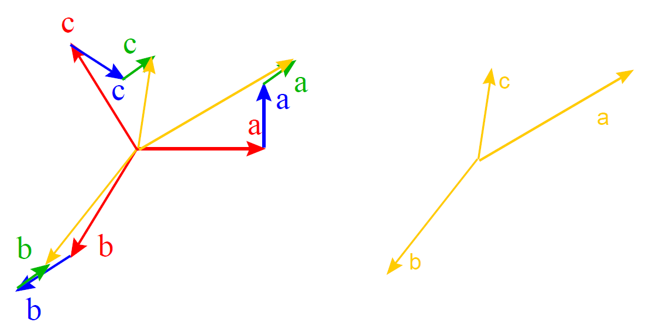

Slide 3
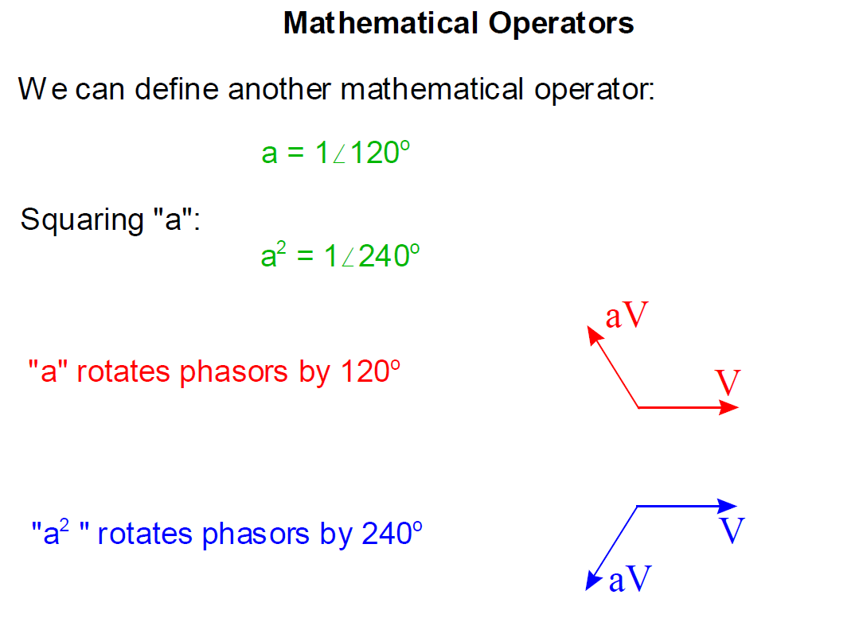

Slide 4
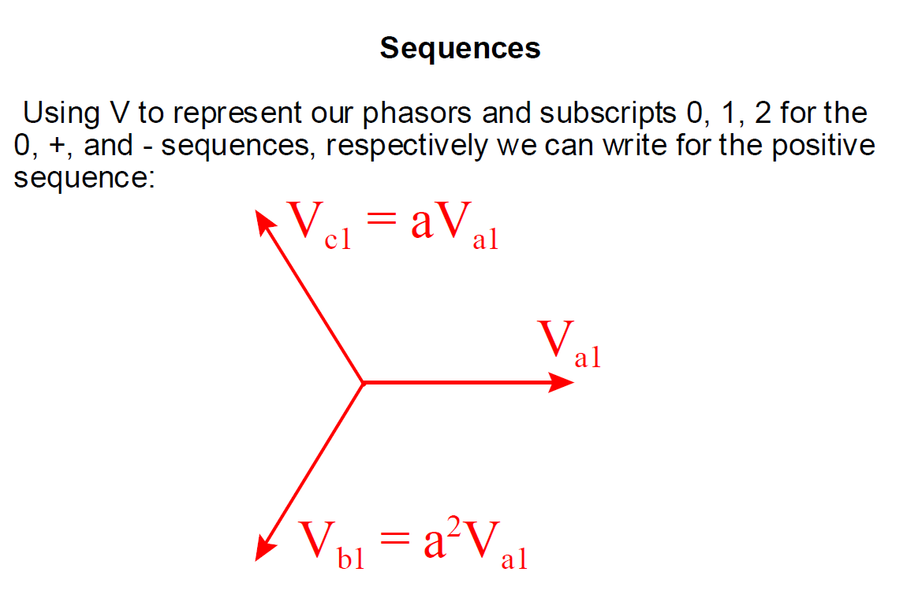

Slide 5
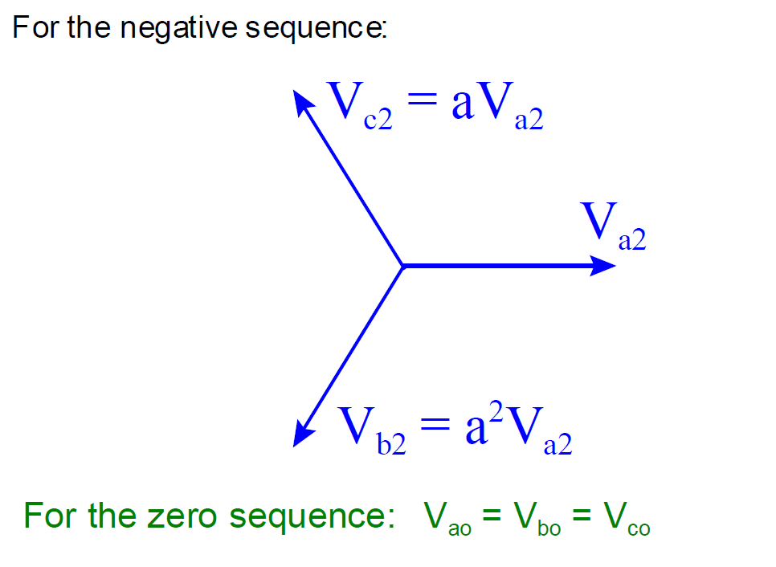

Slide 6
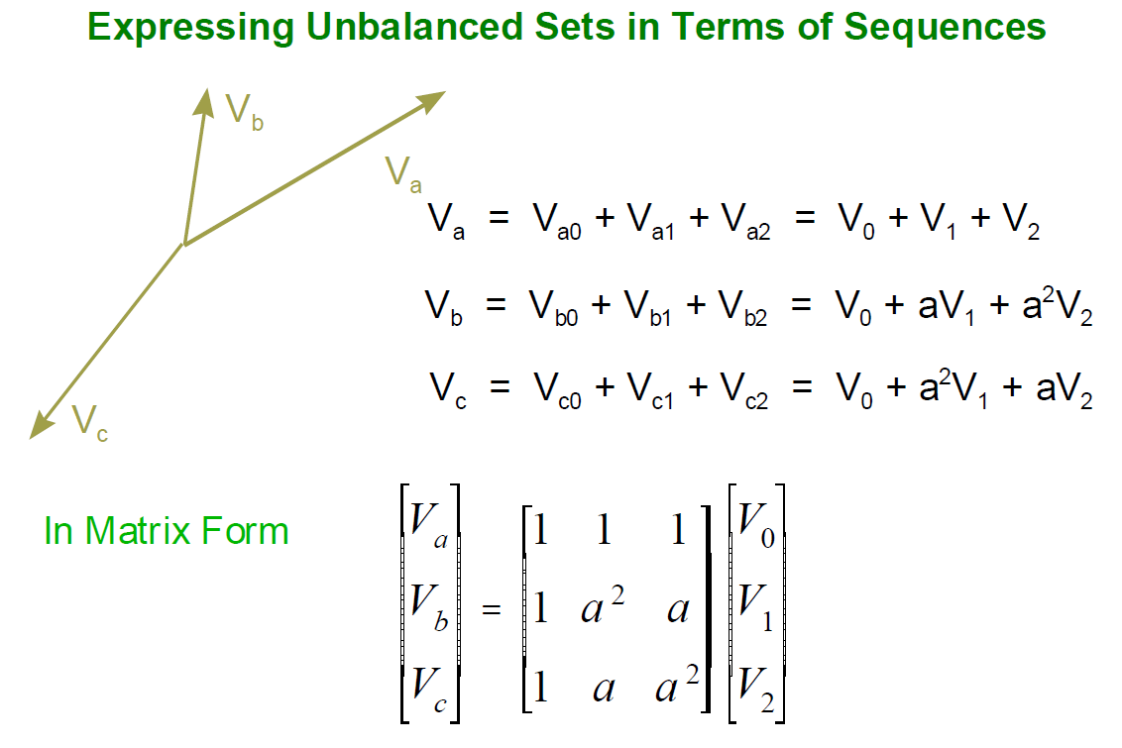
a=0.5+(sqrt(3)/2)*i

Slide 7
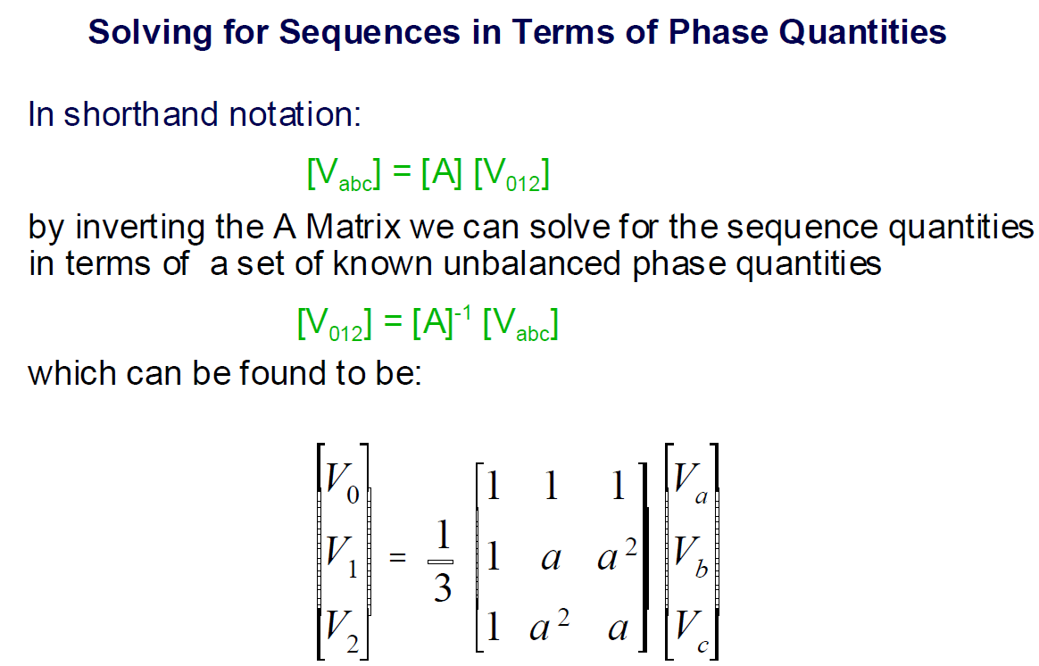

Slide 8
a=-0.5+(sqrt(3)/2)*i
m=[1 1 1;1 a^2 a;1 a a^2];
1.0000 + 0.0000i 1.0000 + 0.0000i 1.0000 + 0.0000i
1.0000 + 0.0000i -0.5000 - 0.8660i -0.5000 + 0.8660i
1.0000 + 0.0000i -0.5000 + 0.8660i -0.5000 - 0.8660i
inv(m)
0.3333 + 0.0000i 0.3333 + 0.0000i 0.3333 - 0.0000i
0.3333 + 0.0000i -0.1667 + 0.2887i -0.1667 - 0.2887i
0.3333 - 0.0000i -0.1667 - 0.2887i -0.1667 + 0.2887i
m2 1.0000 + 0.0000i 1.0000 + 0.0000i 1.0000 + 0.0000i
1.0000 + 0.0000i -0.5000 + 0.8660i -0.5000 - 0.8660i
1.0000 + 0.0000i -0.5000 - 0.8660i -0.5000 + 0.8660i
m2*1/3
0.3333 + 0.0000i 0.3333 + 0.0000i 0.3333 + 0.0000i
0.3333 + 0.0000i -0.1667 + 0.2887i -0.1667 - 0.2887i
0.3333 + 0.0000i -0.1667 - 0.2887i -0.1667 + 0.2887i

Slide 9
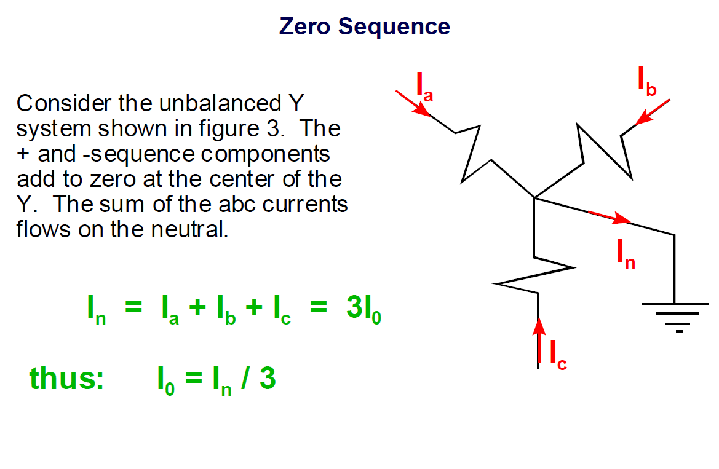

Slide 10
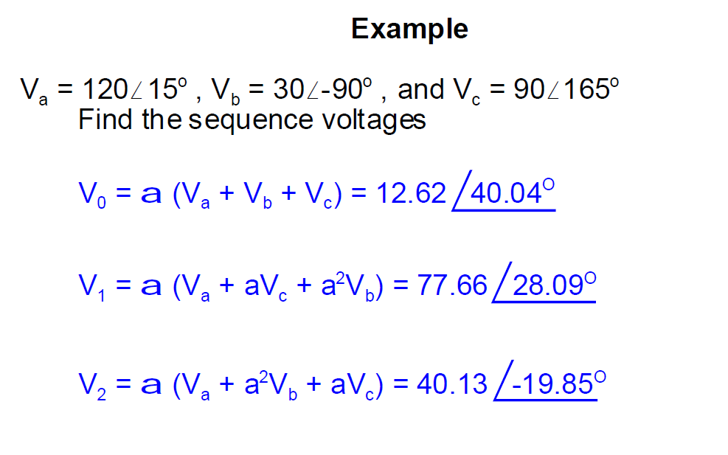

Slide 11
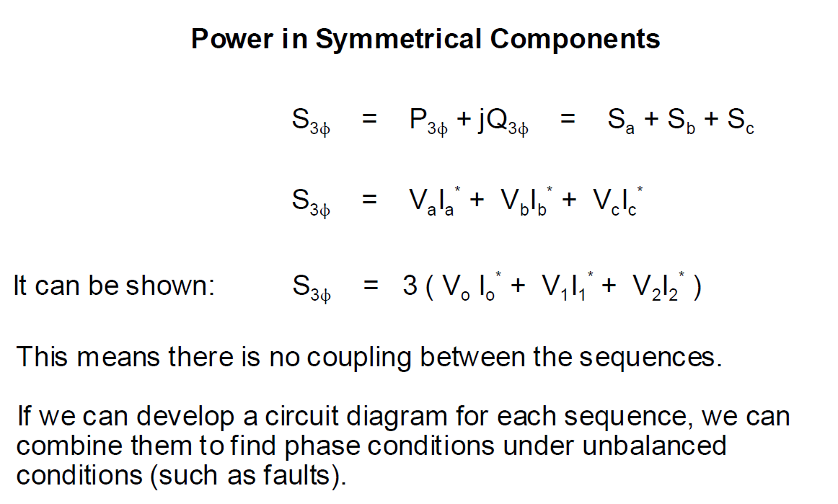

Slide 12
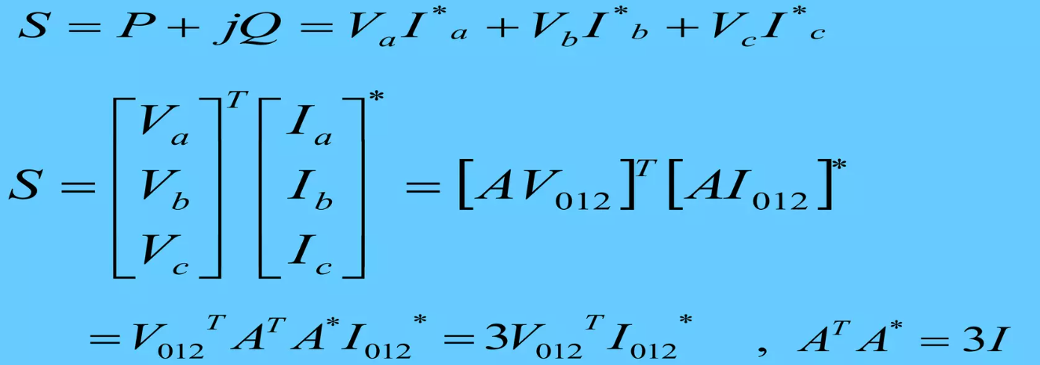
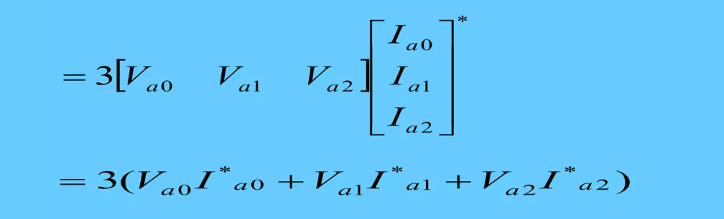

Slide 13
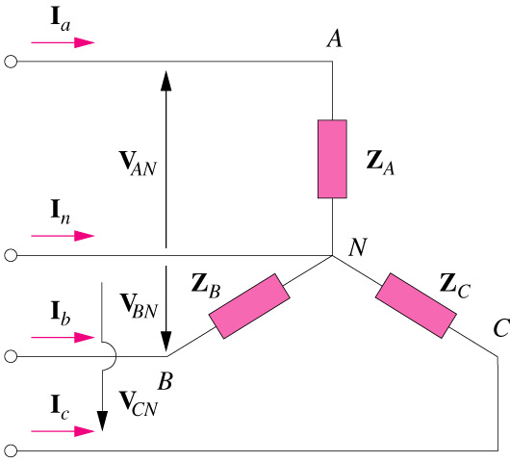

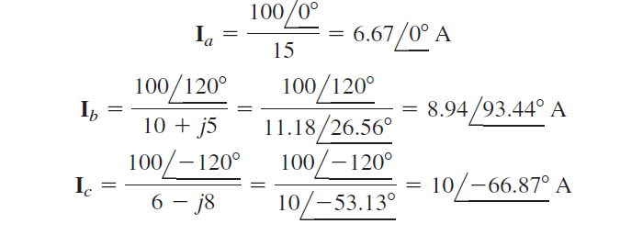

An unbalanced system is due to unbalanced voltage sources or an unbalanced load.
Balanced voltages of 100V ACB system

Slide 14
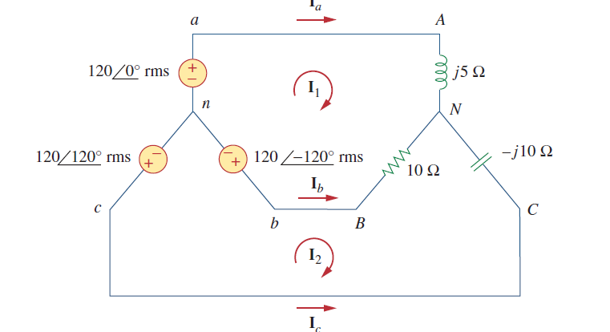


For the unbalanced circuit shown in figure, find (a) the line currents, (b) the total complex power absorbed by the load, and (c) the total complex power absorbed by the source

Slide 15
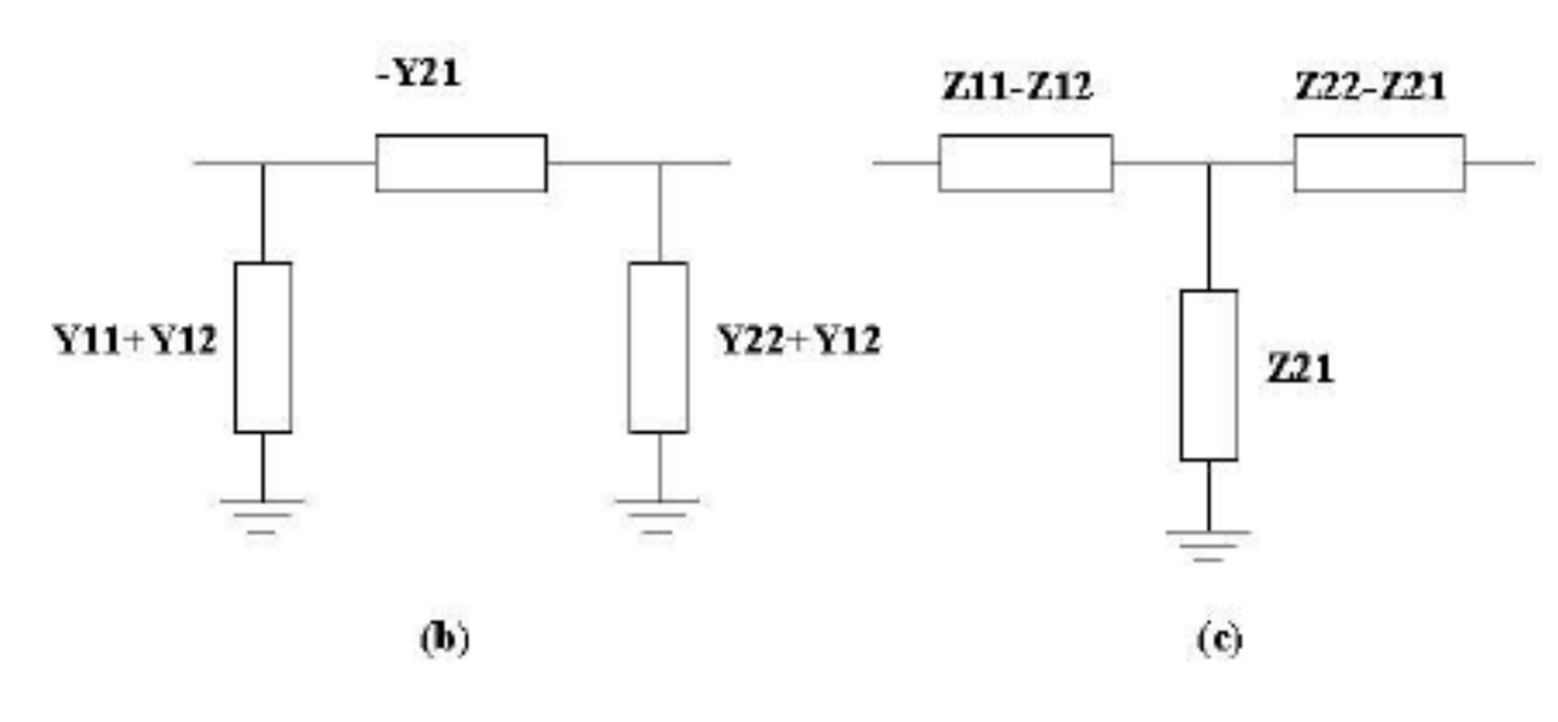
T and Pi equivalent circuits of a two-port network
For a reciprocal networks, z12=z21
For a symmetrical network z11= z22
Any reciprocal 2-port network can be represented by an equivalent Pi and T networks

