Slide 1

Foundations of math in Lean
Author: Davood Haji Taghi Tehrani, Supervisor: Prof. David Gross
Notes:
1

Slide 2
overview
Why?
What?
How?
2
Notes:
2

Slide 3
Why?
Manual calculation → numerical computation
Paper proof → computer-assisted proof
Working with infinities (e.g. Real Numbers)
Certificate for both humans and LLMs
Notes:
3

Slide 4
What was formalized?
Isomorphisms for tensor products
Restricted tensor products
Basic construction of ordered spaces
TBD: De Finetti’s theorem

Slide 5
PiTensorProduct Isomorphisms
Notes:
5

Slide 6
What is a pitensorproduct?
Its representatives are Lists*, with addition being concatenation as [a] + [b] = [a, b]
Tensor properties are enforced by Quotienting reps w.r.t appropriate equivalence
Multilinearmaps on the underlying families of representatives are compatible with the equivalence, so they can be lifted (universal property).

Slide 7
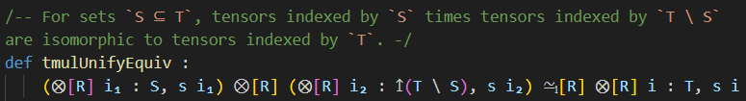

PiTensorProduct Isomorphisms

Slide 8
Restricted tensors

Slide 9
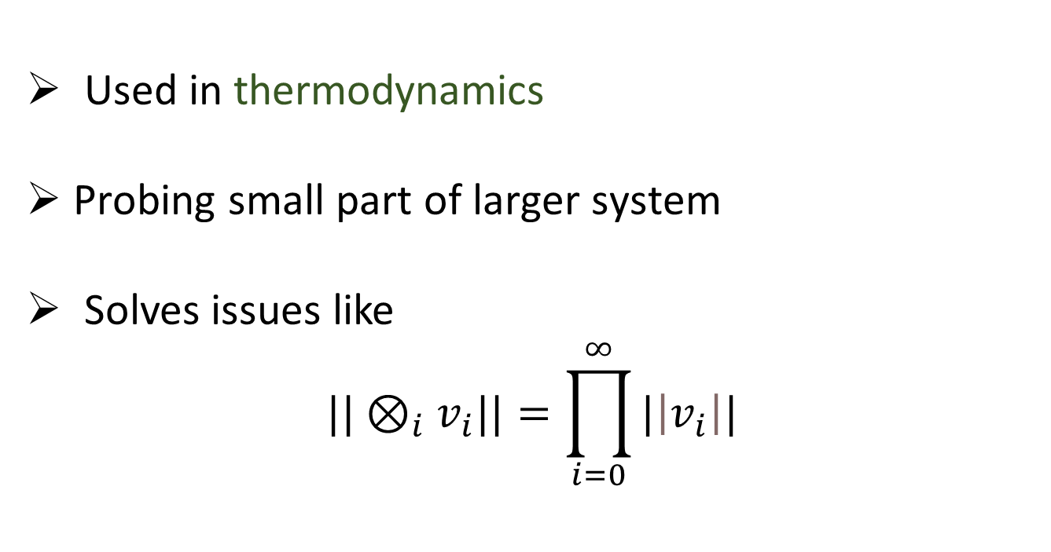
Why?
Used in thermodynamics
Probing small part of larger system
Solves issues like
$$||⊗_{i}v_{i}||=\prod_{i=0}^{∞}{|\left|v_{i}\right||}$$

Slide 10
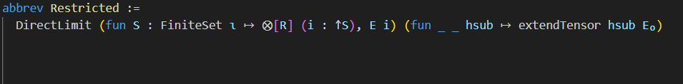
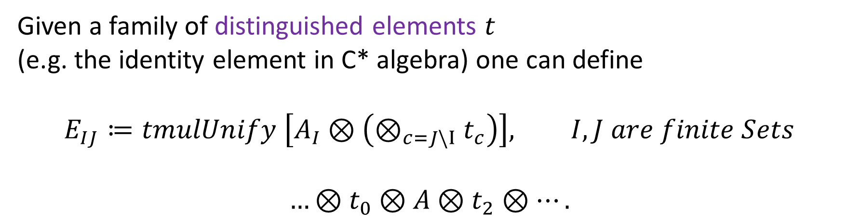
Padding
Given a family of distinguished elements $t$
(e.g. the identity element in C* algebra) one can define
$$E_{IJ}≔tmulUnify \left[A_{I}⊗\left(⊗_{c=J\backslash I}t_{c}\right)\right], I,J are finite Sets$$
$$…⊗t_{0}⊗A⊗t_{2}⊗….$$

Slide 11
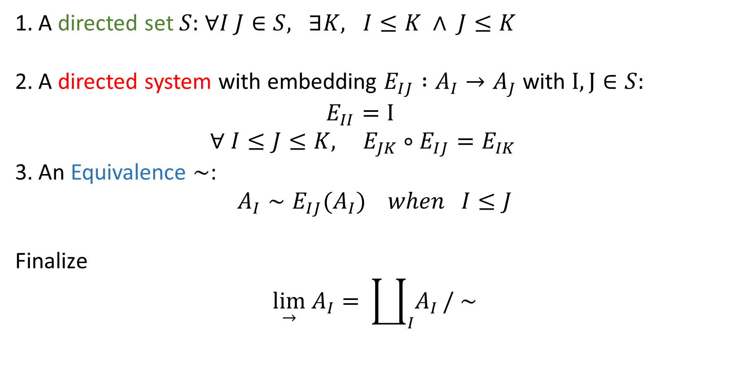
General Recipe
A directed set $S:$ $∀I J∈S, ∃K, I≤K ∧ J≤K$
A directed system with embedding $E_{IJ} :A_{I}→A_{J}$ with $I, J∈S:$
$E_{II}=Ι$
$∀ I≤J≤K, { E}_{JK} ∘E_{IJ}=E_{IK}$
An Equivalence $∼$:
$$A_{I}∼E_{IJ}{(A}_{I}) when I≤J$$
Finalize
$$\lim_{→} A_{I}=⁡\coprod_{I}{A_{I}}/ ∼$$

Slide 12
Ordered spaces
12
Notes:
12

Slide 13
Why?
Arises in probabilistic theories due to the positivity and convexity
Making generalization of certain theories possible (e.g. elementary quantum mechanics)
Minimalistic in the assumptions

Slide 14
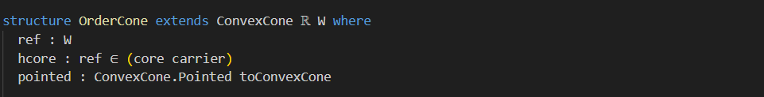
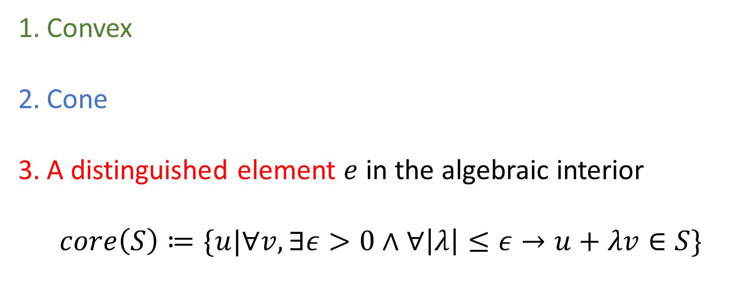
Order cones (Measurement devices)
Convex
Cone
A distinguished element $e$ in the algebraic interior
$$core\left(S\right)≔\{u|∀v, ∃ε>0∧∀\left|λ\right|≤ε→u+λv∈S\}$$

Slide 15

Positive dual space (States)
Set of dual vectors equipped with Weak* topology Defined as
$$S\left(O\right)≔\left\{d\right|d\left(e\right)=1∧∀v∈O, d\left(v\right)≥0\}$$
Compact, Convex, and assumed to be separating

Slide 16



maximal Minimal Sets
$$P_{F}(O) ≔\prod_{i∈F}{{S(O}_{i})}$$
$$Q_{Fmin}(O)≔\{t_{F}|t_{F}=\sum_{i}{t_{i}}∧∀j, {t_{F}}_{ij}∈O_{j})\}$$
$$Q_{Fmax}(O)≔\{t_{F}|∀x∈P_{F}\left(O\right),t_{F}\left(x\right)≥0\}$$
$$e_{F}≔⊗_{i∈F}e_{i}$$

Slide 17
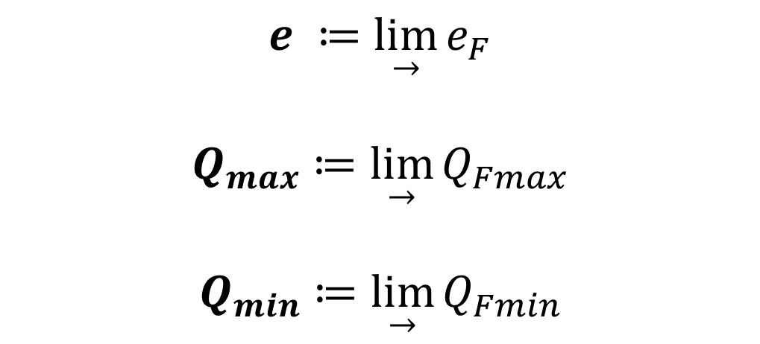
Putting everything together (Again)
$$e ≔\lim_{→}{e_{F}}$$
$$Q_{max}≔\lim_{→}{Q_{Fmax}}$$
$$Q_{min}≔\lim_{→}{Q_{Fmin}}$$

Slide 18
Thank you
To those who helped this project, and to those who took the time to attend this presentation

Slide 19
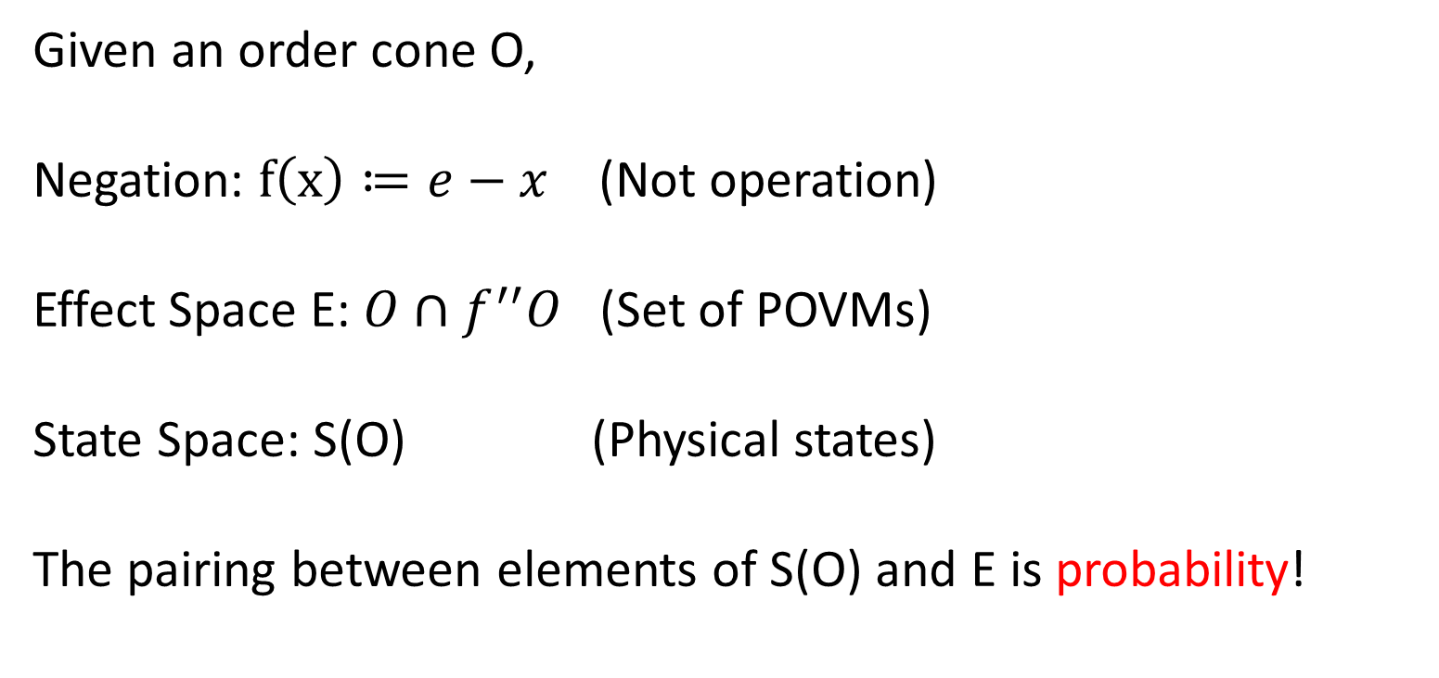
Application
Given an order cone O,
Negation: $f\left(x\right)≔e−x$ (Not operation)
Effect Space E: $O∩f^{′′}O$ (Set of POVMs)
State Space: S(O) (Physical states)
The pairing between elements of S(O) and E is probability!

